Slide 1
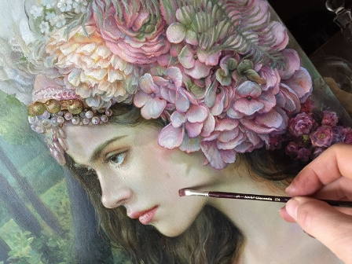
The Eyes Full of Delight
Art Gallery for 8-11 Formers
Автор:
Ольга Михайловна Степанова
учитель английского языка
МБОУ «Цивильская СОШ №1
имени Героя Советского Союза
М.В. Силантьева»
города Цивильск
Чувашской Республики
2017

Slide 2
Meet Maria Ilieva,
one of the brightest artists of Bulgaria !

Slide 3
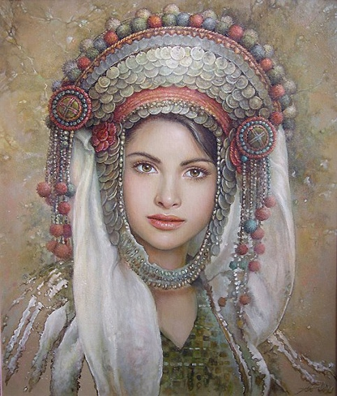
1973
Born in Sofia, Bulgaria

Slide 4
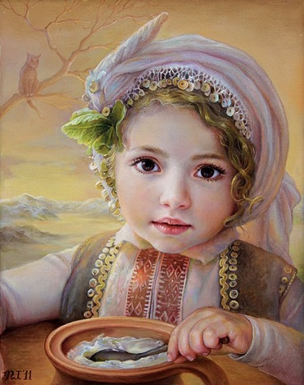
1991 Graduated the National High School of Fine Arts in Sofia, Bulgaria

Slide 5
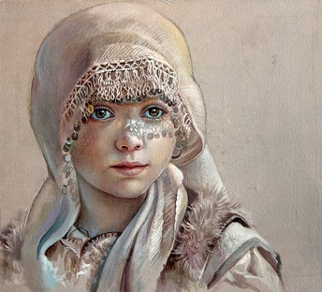
1997 Graduated the National Academy of Fine Arts in Sofia, Bulgaria, speciality Mural Painting

Slide 6
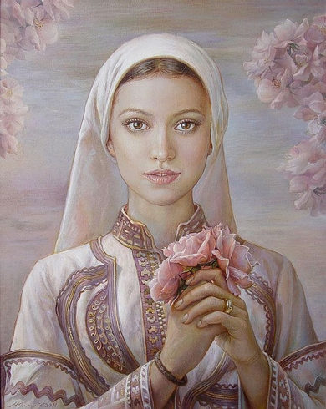
Since 1997 Member of the Association of Bulgarian Artists
She works in the field of the murals, portraits, still lifes, illustrations and fine arts painting.

Slide 7
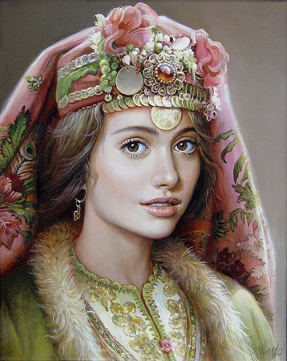
1992-1993 Illustrations for “Lakrima” Publishing house

Slide 8
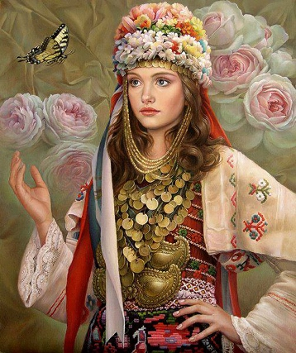
1994 Mural paintings in the Batak Church, Bulgaria

Slide 9
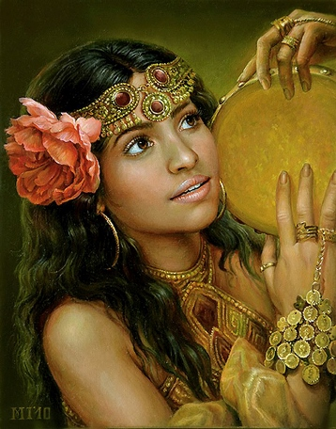
1995 Illustrations for “Snezana Ivanova” Publishing house

Slide 10
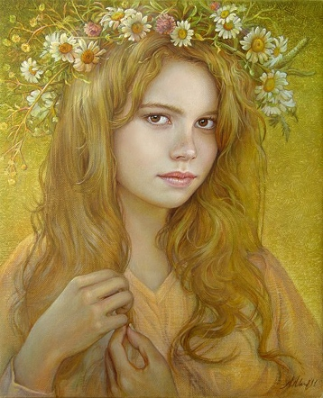
1996
Mural paintings in the Cript of the Russian Church, Sofia, Bulgaria

Slide 11
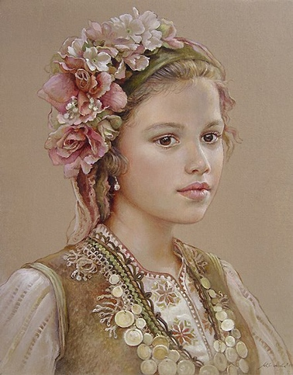
2000-2005 Illustrations for “Pan” Publishing house

Slide 12
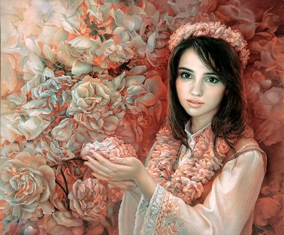
2000-2005 Mural paintings in the private apartments in Sofia and Veliko Tarnovo, Bulgaria

Slide 13
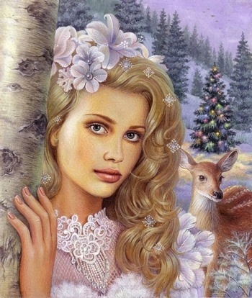
2001 Participation in the International exhibition Scenery Aquarelle, Rome, Italy

Slide 14
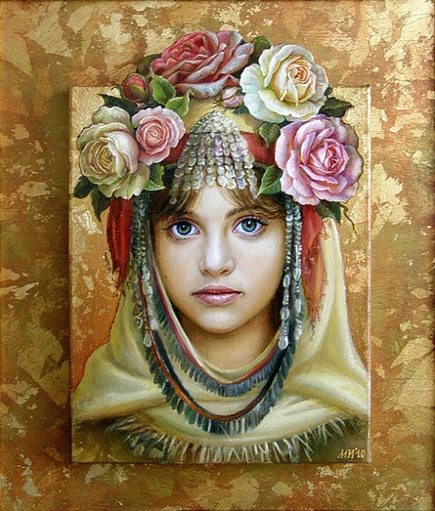
2004-2006 Participation in the National exhibition of Monumental Arts, Sofia, Bulgaria

Slide 15
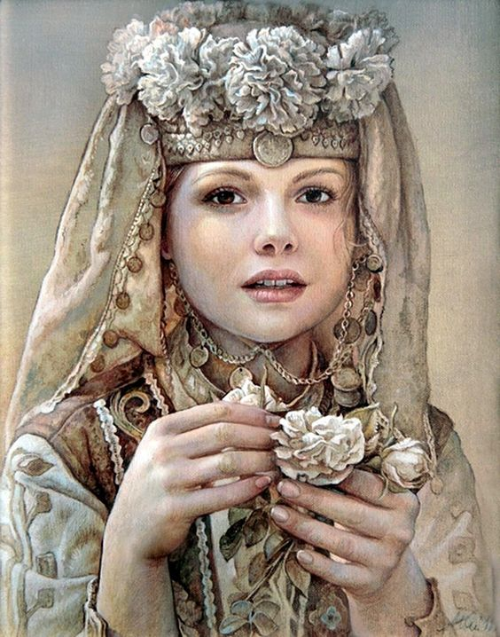
2008 Mural paintings in the private hotel in Pamporovo, Bulgaria

Slide 16
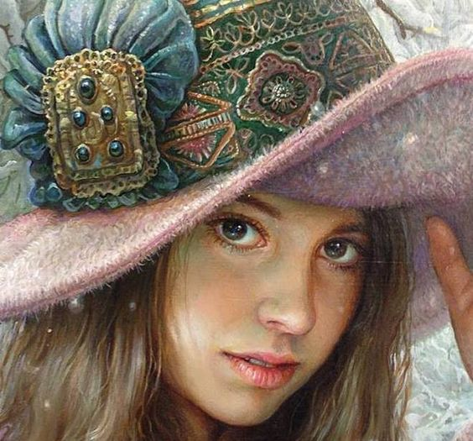
2006-2012 Participation in the all exhibitions for fondation "Stamen Grigorov", Sofia, Bulgaria

Slide 17
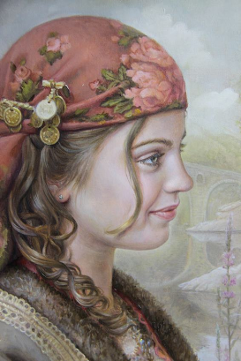
2012 Own family exhibition, Belgrade, Serbia

Slide 18
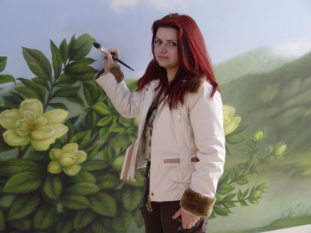
Her works are property of private collections in Germany, United Kingdom, France, Japan, Russia and USA.

Slide 19
Thank You for Visiting
the Maria Ilieva
Art Gallery!

Slide 20
Источник
Maria Ilieva http://mariailieva-art.com/index_1.php?m=6&img=0
Изображения взяты на сайте http://yandex.ru
Условия использования сайта https://yandex.ru/legal/fotki_termsofuse/

