Slide 1
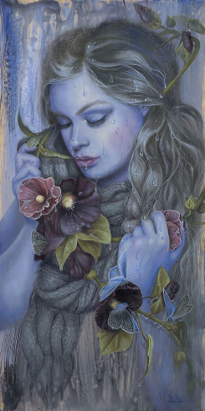
Alexander
Kari-Lise
A Story about the American Artist with her Picture Gallery for 7-11 Formers
Автор:
Ольга Михайловна Степанова
учитель английского языка
МБОУ «Цивильская СОШ №1
имени Героя Советского Союза М.В. Силантьева»
города Цивильск Чувашской Республики
2017

Slide 2
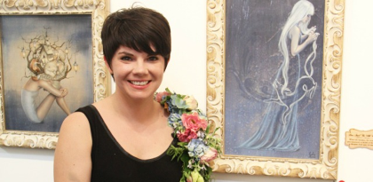
Meet Alexander Kari-Lise, Seattle, Los Angeles, USA
“I’ve always been inspired by Nordic fairy tales, folklore and legends. This particular focus on shape-shifting women in these legends really summed up what I had already been painting and I just expanded on it. Women that are secretive, vulnerable, mysterious and possibly not quite human. I think that it’s a very fascinating subject to explore and it was a natural evolution for me with my painting.”

Slide 3
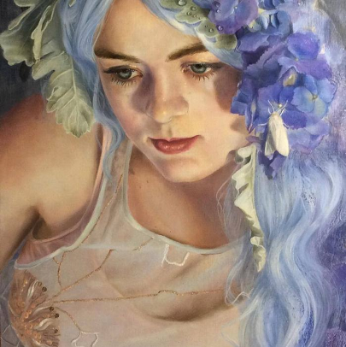
Kari-Lise Alexander’s work is rooted in the old folklore of her Scandinavian heritage as well as inspired by her home in the Pacific Northwest.

Slide 4
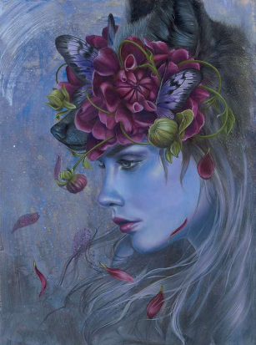
At a young age, Kari-Lise was always experimenting with paints, pencils, pastels and anything else she could get her hands on.

Slide 5
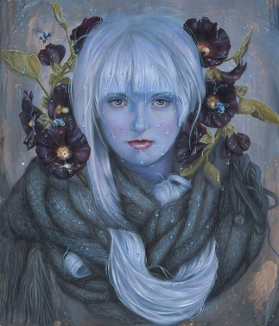
In 2000, she studied fine art for two semesters but left college to pursue other interests. It wasn’t until spring of 2009 that her heart led her back to painting and she hasn’t stopped since.

Slide 6
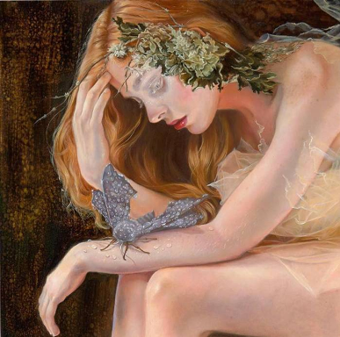
Her style captures the unique qualities of both her heritage and her home. Combining them she’s able to create surreal worlds and explore common themes between the two.

Slide 7
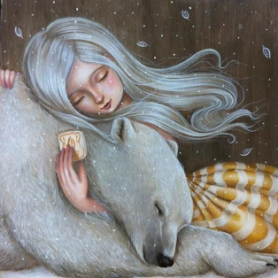
Kari-Lise’s work often reflects these worlds by the women, nature, and animals painted in them.

Slide 8
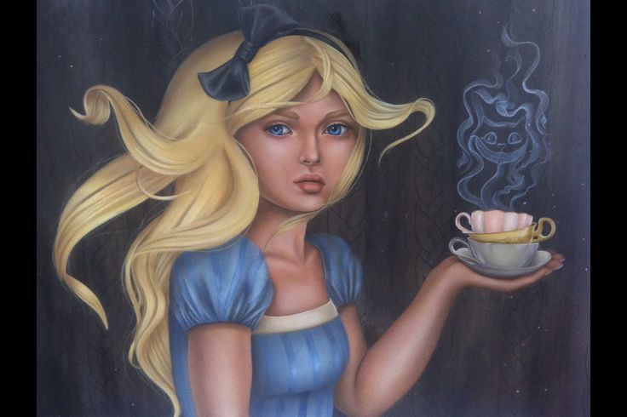
Her work tends to leave the viewer feeling as if they are experiencing the same private moment in time as the subjects.

Slide 9
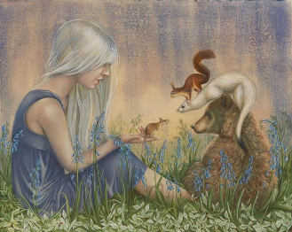
Kari-Lise works from her home studio in Seattle, WA where she lives
with her husband, two poodles,
and two rabbits.

Slide 10
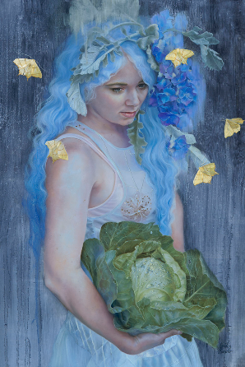
Her work often reflects the Norwegian folk art of rosemaling. This traditional art is given a contemporary feel in many of Kari-Lise’s paintings as it wraps and entwines itself within the composition, sometimes floating as a ghost as if it were an ancestral reminder.

Slide 11
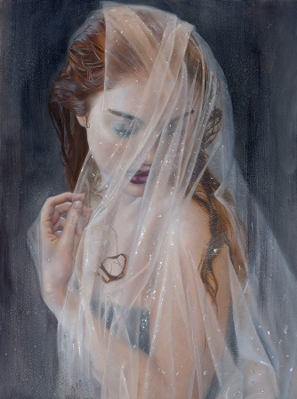
Working from her home studio
in Seattle,
Kari-Lise creates paintings that captivate
the viewer. She is currently working with local
as well as international
galleries.

Slide 12
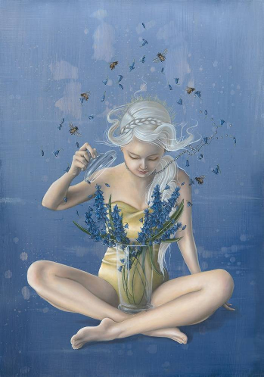
What’s your daily life like? What are some things you do when you’re not painting / making art?
KA: I usually get up get my coffee and then go out to take care of my 2 rabbits Horace and Willa. I might dabble in my garden for while too. After that I’m usually painting for 8 to 12 hours a day depending on what projects I have going on. When I’m not painting I love spending time out in the wilds of the Pacific Northwest with my husband Michael and our two dogs Tyrant and Sugar. We do lots of hiking and exploring. I’m always looking for new inspiration and adventures.

Slide 13
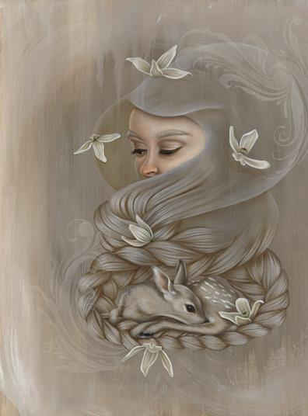
“Being creative is the most challenging part about being an artist. And what I mean by that is, coming up with new concepts that are inspiring and not the same old, same old. Which can be really challenging. Especially if you’re on social media, being bombarded with what’s going on in the art world on a daily basis. You think you have an original idea but you’ve subconsciously somehow picked it up from somewhere else…”

Slide 14
Thank you for Your Attention!

Slide 15
Source:
Alexander Kari-Lise biography and works http://thinkspacegallery.com/artists/kari-lise-alexander/
Изображения взяты на сайте http://yandex.ru
Условия использования сайта https://yandex.ru/legal/fotki_termsofuse/

