Slide 1
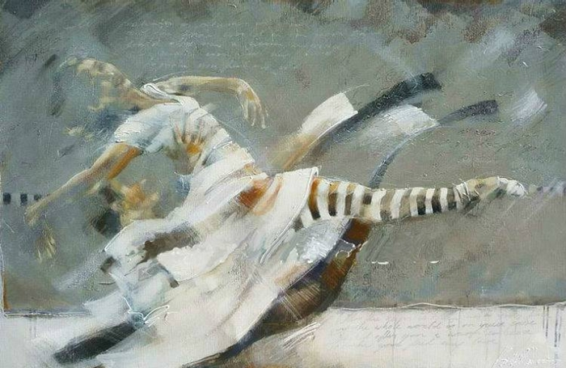
Dance Fusion
by Kitty Meijering
Экскурсия в картинную галерею с лекцией о творчестве голландской художницы Китти Мейджеринг для 7-11 классов
Автор:
Ольга Михайловна Степанова
учитель английского языка
МБОУ «Цивильская СОШ №1
имени Героя Советского Союза М.В. Силантьева»
города Цивильск Чувашской Республики
2017

Slide 2
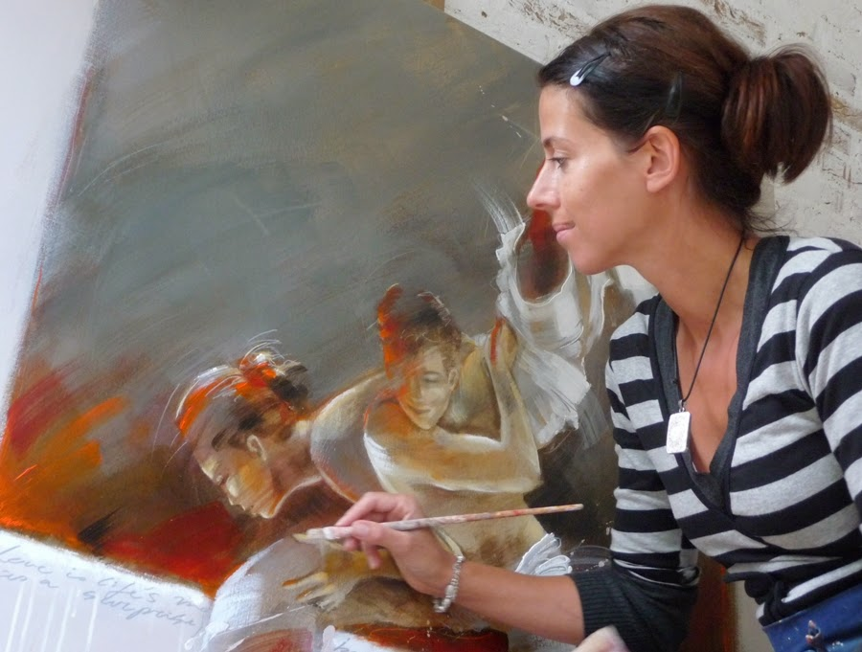
Kitty Meijering studied at the Amsterdam University. At this University she followed a visual arts education, which she completed in 1998.

Slide 3
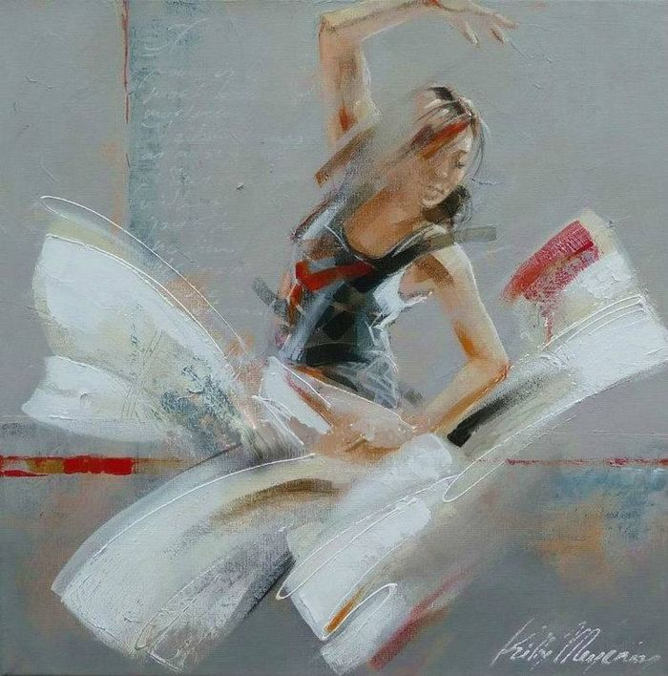
After completing her studies at the art university in Amsterdam, Kitty Meijering dedicated herself to paintings of dance.

Slide 4
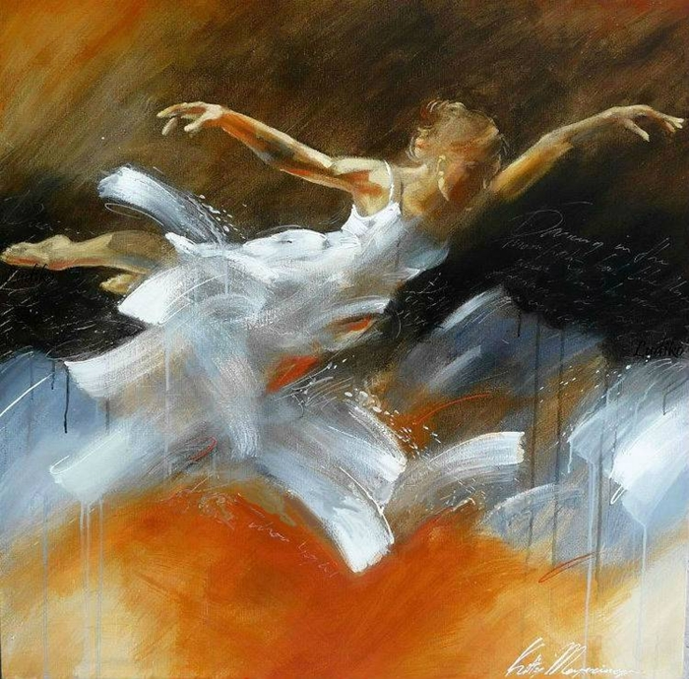
The figures she
paints seem entirely lost in motion.
The figures she paints seem entirely lost in motion…

Slide 5
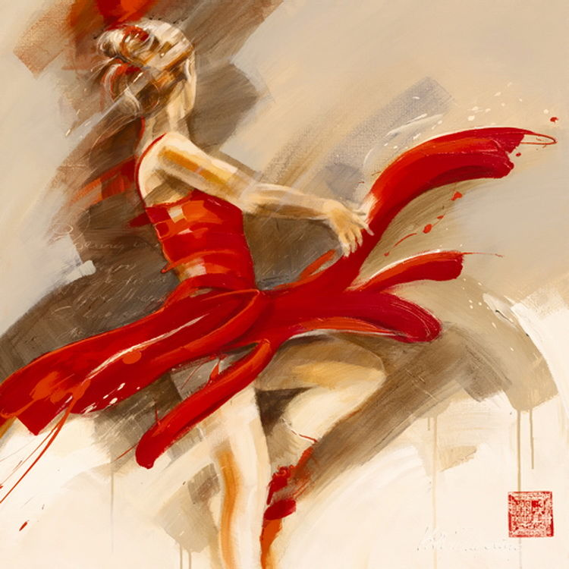
In dance, she has found a way of fusing abstract painting and figures. The transition between the various stages of movement is seamless.

Slide 6
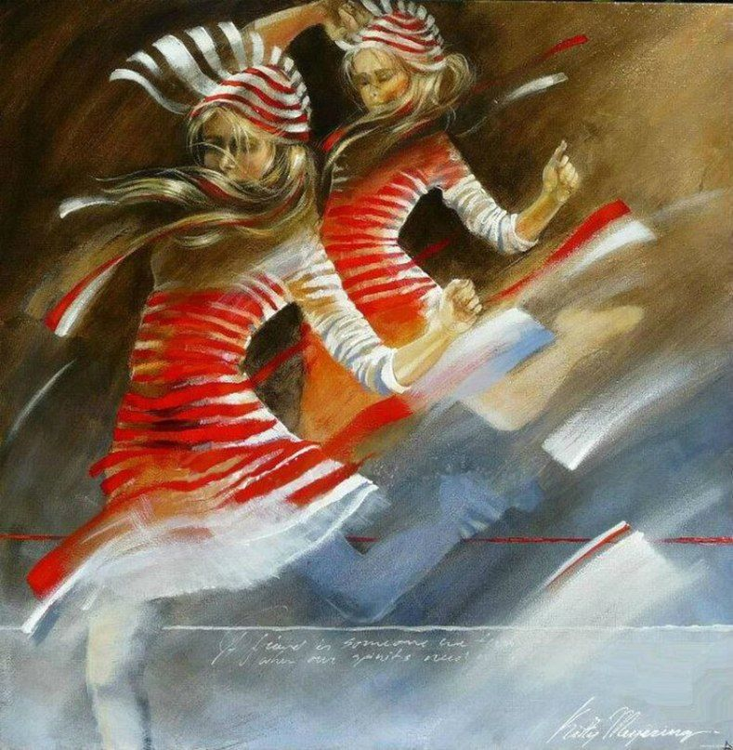
This grace is only possible by means of the artist's excellent attention to the most insignificant details.

Slide 7
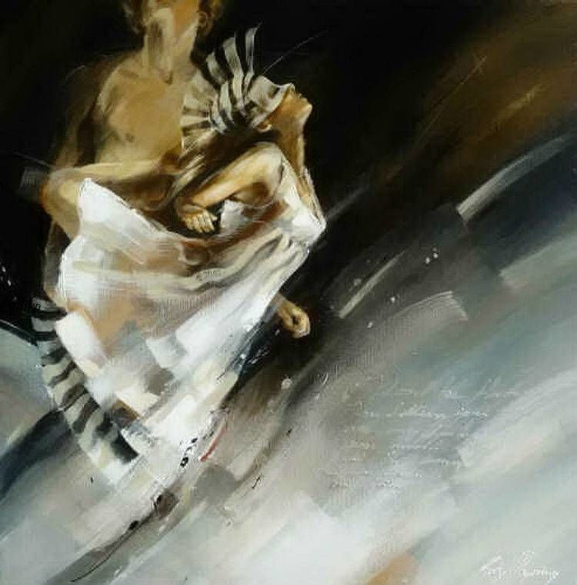
The elegance of the figures
she paints express her intuitive sense of harmony and shape.

Slide 8
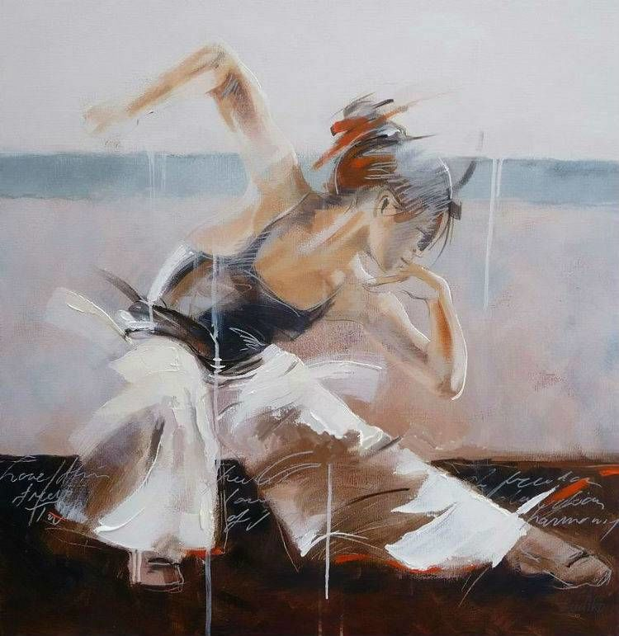
You can literally almost hear the music when you watch the dancers.

Slide 9
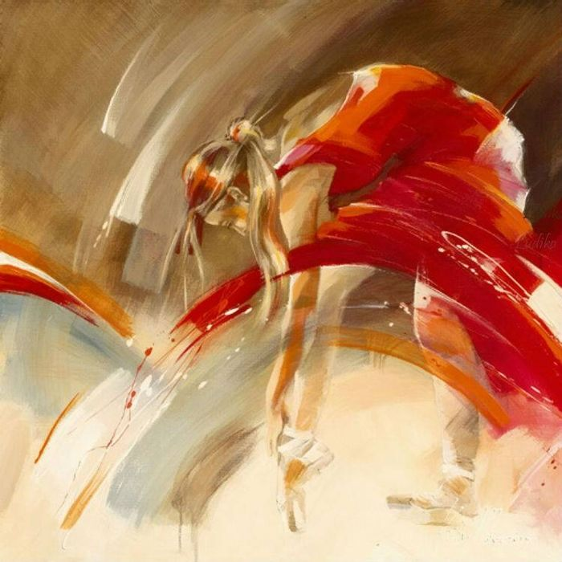
Another part of her work shows a more abstract style of painting.

Slide 10
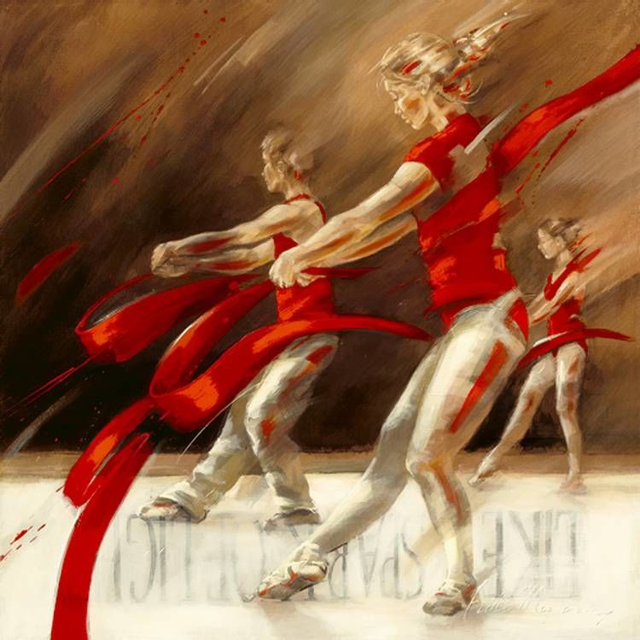
The paintings are abstract and variated with recognizable elements against a background which often reminds to old streets and weathered walls and houses.

Slide 11
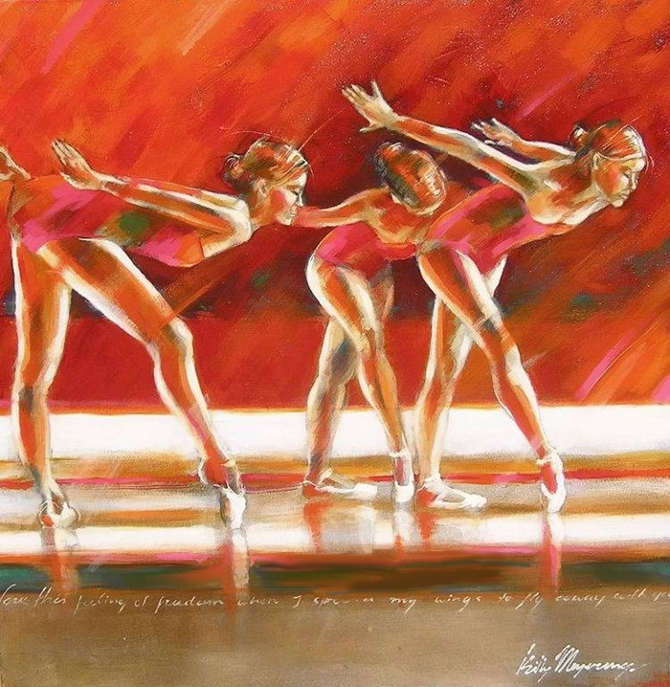
By travelling, Kitty has been inspired with ideas for her paintings.

Slide 12
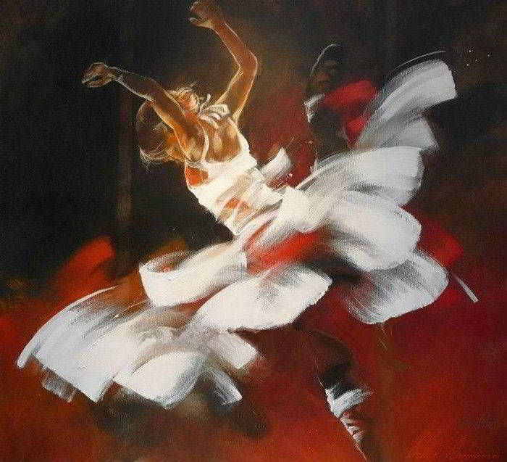
Her ability for creating a mysterious sphere into her work Kitty thanks to a large sense of colour, shapes and use of different kind of materials.

Slide 13
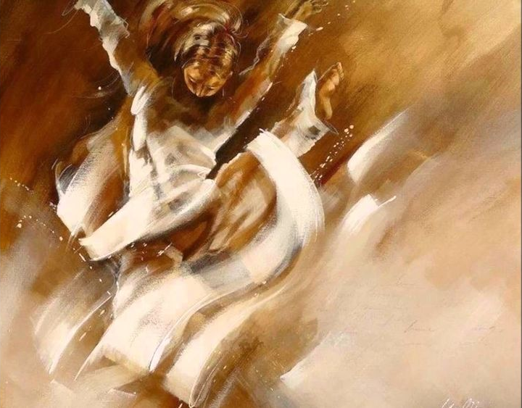
At this moment dance and specifically ballet is the main theme Kitty dedicates her time to.

Slide 14
The dancers defined in warm colours seems to dance right of the paintings!

Slide 15
Never miss
a Chance to Dance!

Slide 16
Source
Artist Kitty Meijering http://www.artbol.com/painting-artist/kitty-meijering
Все изображения взяты на сайте http://yandex.ru Условия использования сайта https://yandex.ru/legal/fotki_termsofuse/

