Slide 1
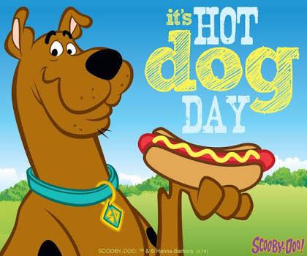
Story and Quiz
for 8-11 Formers
Автор:
Ольга Михайловна Степанова, учитель английского языка
МБОУ «Цивильская СОШ №1
имени Героя Советского Союза М.В. Силантьева» города Цивильск
Чувашской Республики, 2016

Slide 2
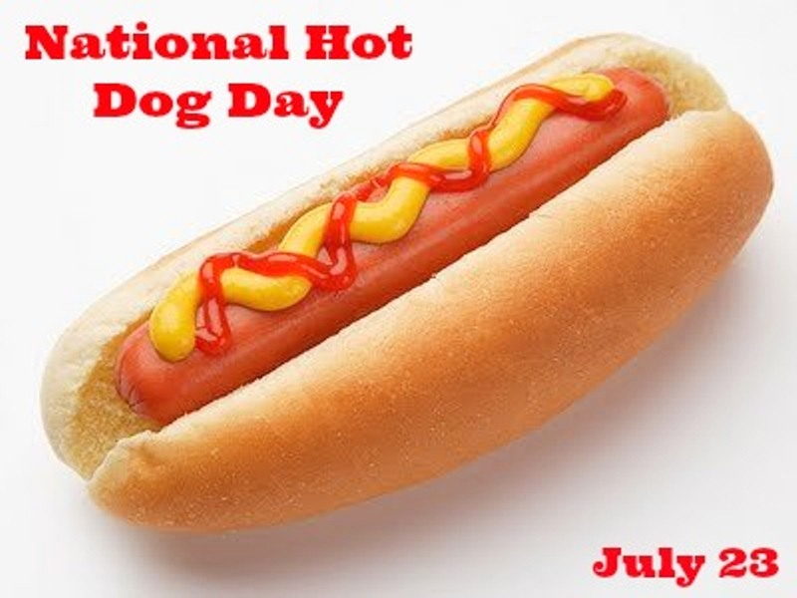

Slide 3
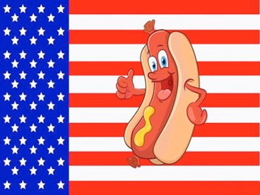
Hot Dog Days are informal events that are celebrated in communities throughout the hotdog-eating world, including the United States, Canada, Great Britain and Australia. Their origin is obscure.

Slide 4
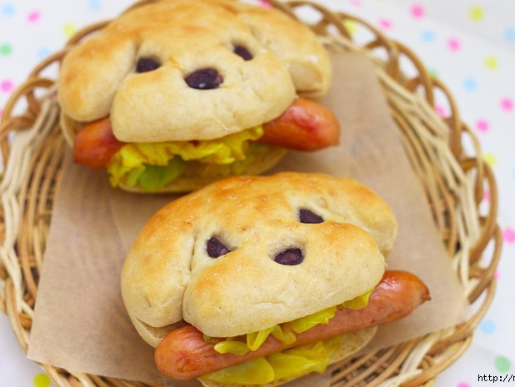
Often the proceeds from a hot dog day are given to charity.Industry groups, such as National Hot Dog and Sausage Council in the USA, encourage, sponsor, and support the events.

Slide 5
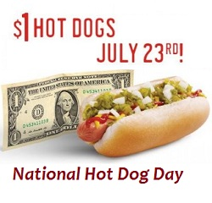
The Council designates July as National Hot Dog Month; National Hot Dog Day varies year to year – in 2017 it falls on July 23 – based on when the North American Meat Institute hosts its annual Hot Dog Lunch on Capitol Hill.

Slide 6
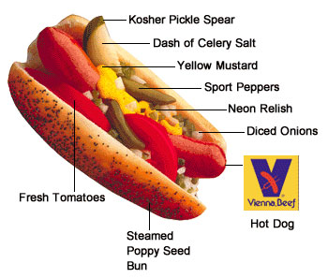
The council also gives advice on hot-dog eating etiquette, which aren't considered strict, as most Hot Dog Day style events do not adhere to them.

Slide 7
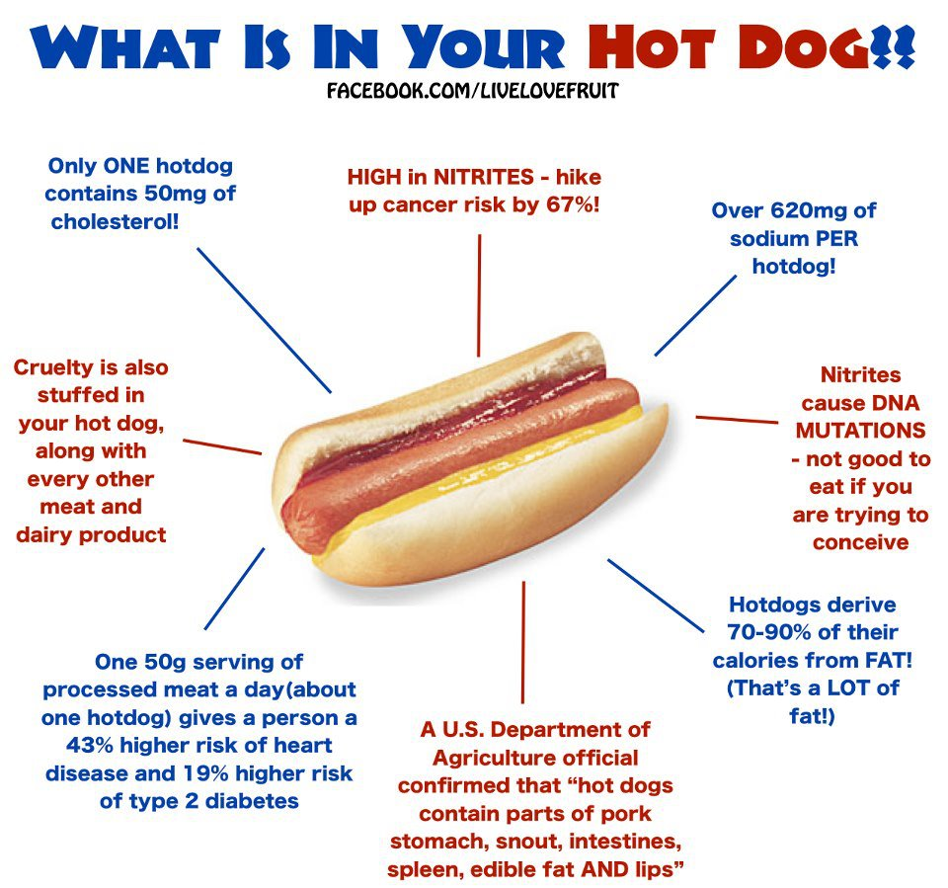

Slide 8
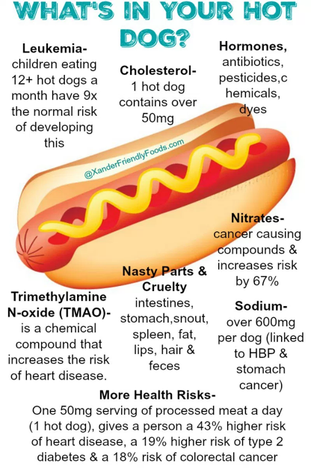
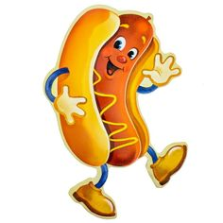

Slide 9
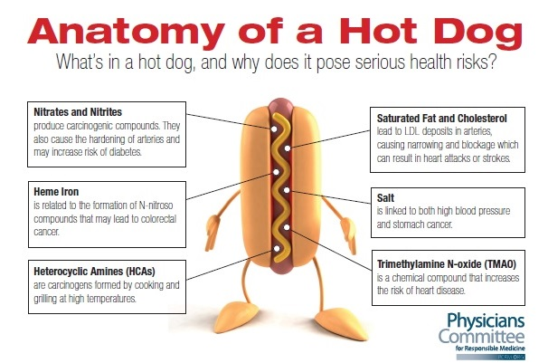

Slide 11
When Otto got a hot dog
he stared at it a while,
then dripped a drop of mustard on
and smiled a little ____________ .
smile
file
smile
style

Slide 12
He covered it with relish
which really made him grin,
then spread it thick with mayonnaise
and shoveled ___________ in.
onions
onions
berries
garlic

Slide 13
He splashed it with some ketchup,
as much as he could squeeze,
and tossed on chopped tomatoes
and some shredded cheddar _____________ .
cheese
cheese
bees
keys

Slide 14
He smothered it with sauerkraut,
and bacon bits and beans,
He even added twenty two
Norwegian canned ____________ .
sardines
beans
greens
sardines

Slide 15
He piled it high with pickles
and __________ by the pound.
He topped it off with chili
then he looked at it and frowned.
peppers
cucumber
peppers
salt

Slide 16
He shed a single tiny tear
and gave a little pout,
for Otto hated ________________
so he had to throw it out.
--Kenn Nesbitt
mustard
vinegar
mustard
cabbage

Slide 19
Source:
When Otto got a hot dog https://www.poetry4kids.com/poems/when-otto-got-a-hot-dog/
Изображения взяты на сайте http://yandex.ru
Условия использования сайта https://yandex.ru/legal/fotki_termsofuse/

