Slide 1
Waffle Day Story for 7 - 9 Formers
Автор:
Ольга Михайловна Степанова
учитель английского языка
МБОУ «Цивильская СОШ №1
имени Героя Советского Союза М.В. Силантьева»
города Цивильск Чувашской Республики
2017

Slide 2
August 24 is National Waffle Day, USA; a day to celebrate a breakfast staple that has been around
for hundreds of years.

Slide 3
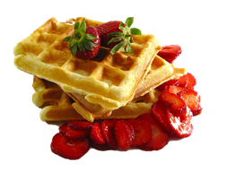
Enjoyed plain or stuffed with blueberries, strawberries, chocolate chips or any number of great things, waffles have long been a favorite at kitchen tables the world over.

Slide 4
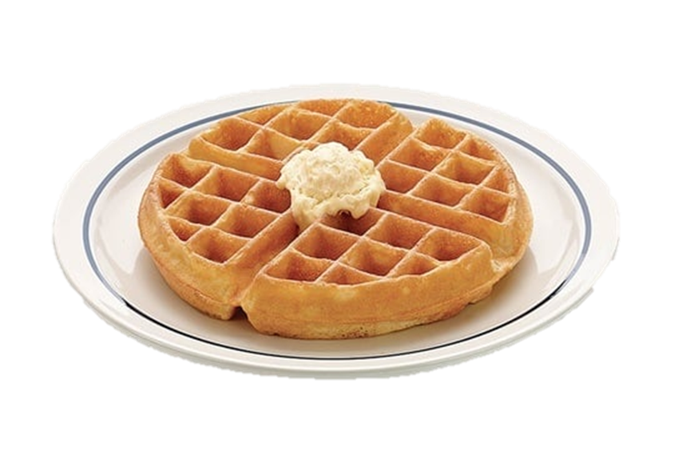
Here are 9 facts about waffles that you may not have known about :)

Slide 5
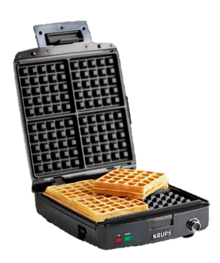
Fact №1
National Waffle Day is a celebration of when the first waffle iron was officially patented in 1869. The patent was submitted by Cornelius Swarthout.

Slide 6
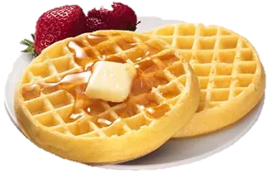
Fact #2
Waffles have been around since the middles ages, but the first written waffle recipe was discovered in the 14th century in an anonymous manuscript.

Slide 7
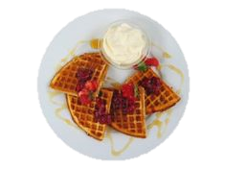
Fact #3
Belgian Waffles were first known as “Brussels” Waffles and was invented in 1839.

Slide 8
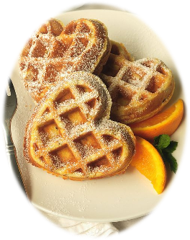
Fact #4
The Pilgrims brought the first waffles to America.

Slide 9
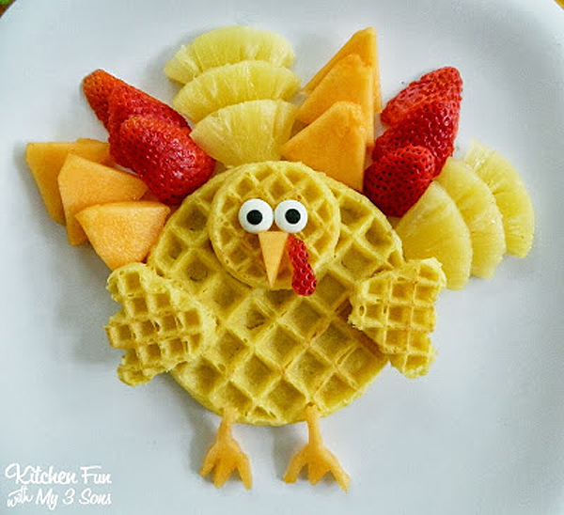
Fact #5
The World Record for the largest waffle was set at 110 pounds and had a diameter of 8 feet 1.24 inches. It was made in the Netherlands.

Slide 10
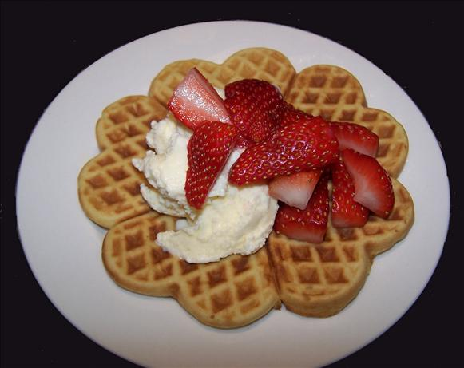
Fact #6
Eggo waffles were introduced to supermarkets in 1953.

Slide 11
Fact #7
Since its creation in 1955, the Waffle House restaurant has served just under 900 million waffles!

Slide 12
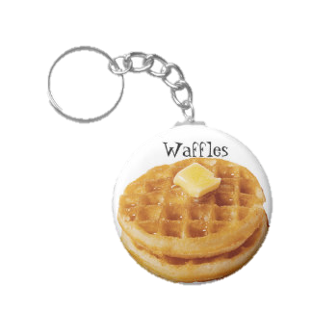
Fact #8
Waffles exist all over the world and incorporate what ingredients are available in their respective region. Some famous types are American, Belgian, Scandinavian and Hong Kong.

Slide 13
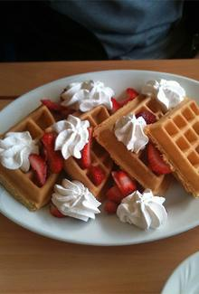
Fact #9
Patrick Bertoletti holds the world record for eating the most waffles in 10 minutes at 29.

Slide 14
How to Celebrate
National Waffle Day?

Slide 15
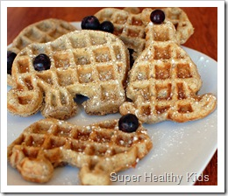
Eat Waffles
at Every Meal
Waffles aren’t just
breakfast items —
you can enjoy
them
throughout the day. Try planning your entire day around the waffle: waffles with syrup for breakfast, chicken and waffles for lunch, a Belgian waffle for your afternoon snack, and a Philly Cheesesteak wafflewich for dinner.

Slide 16
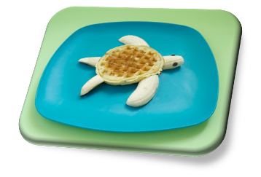
Finally Buy Yourself That Waffle Iron
We know—you don’t need that waffle iron. But today is an excuse to finally give in and buy yourself one. You know you’ve been looking at it for months, anyway :)

Slide 17
Host a Waffle Party
Now that you’re
in possession of
a shiny new waffle
iron, it’s time to
put it to good use.
Get out the butter
and syrup, invite your friends over, and fry up a heap of fresh waffles. Be sure to give your guests options—jam, chocolate syrup, powdered sugar, and peanut butter are musts.

Slide 18
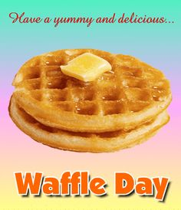
By the way, the verb waffle means to be indecisive and it comes from a Scottish term “waff” that means “to yelp like a puppy.” The noun waffle, meaning the
excellent gridded
breakfast food,
comes from the Old
German wefan,
which meant to
weave something
into the shape
of a honeycomb.
(Makes sense!)

Slide 21
THE END

Slide 22
Sources:
9 Facts About Waffles For National Waffle Day http://www.news9.com/story/29867813/9-facts-about-waffles-for-national-waffle-day
Изображения взяты на сайте http://yandex.ru
Условия использования сайта https://yandex.ru/legal/fotki_termsofuse/

