Slide 1
Интерактивная викторина для учащихся 6-7 классов
Автор:
Ольга Михайловна Степанова
учитель английского языка
МБОУ «Цивильская СОШ №1
имени Героя Советского Союза М.В. Силантьева»
города Цивильск Чувашской Республики
2017

Slide 2
September is here
And so is fall.
So welcome children
Welcome all.
I hope vacation
Was real fun.
And that you're glad
______________ has begun.
School

Slide 3
School bells are ringing, loud and clear;
Vacation's over, school is here.
We hunt our pencils and our books,
And say goodbye to fields and brooks,
To carefree days of sunny hours,
To birds and butterflies and flowers.
But we are glad school has begun.
For work is always mixed with fun.
When autumn comes and the ______________ is cool,
Nothing can take the place of school.
weather

Slide 4
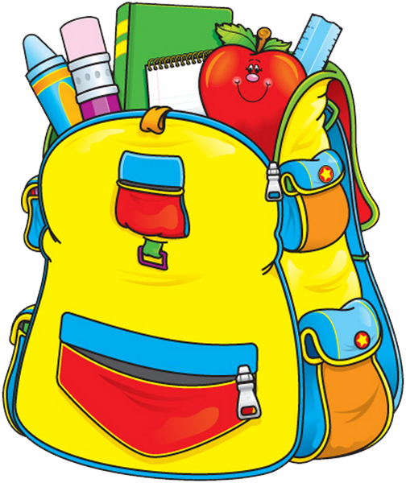
Crayons, ruler, scissors too,
And yes a little Elmer's glue
Paper, pencils, in my bag…
Wonder what made mom so sad?
Trapper keeper, nice and neat
Will it really stay this clean
On my back a pack I carry
In it, all my treasures!
Today I'll be
Just watch and see
One __________ higher!
class

Slide 5
Miss was at the blackboard writing with the chalk,
When suddenly she stopped in the middle of her talk.
She snapped her fingers – snap! snap! snap!
Pay attention
children and
I’ll teach
you how
To _________....
rap

Slide 6
Knowledge
School is something,
we must all embrace.
_______________ we need,
to seek out and chase.
Subjects and teaching styles,
are plentiful and vary.
Just like the backpacks,
we all need to carry.

Slide 7
Sports, clubs, and activities,
at every single turn.
So much to do,
study and learn.
To get the most from school,
we should consistently attend.
Around each corner,
there’s always a ________.
friend

Slide 8
teachers
Our favorite ______________ ,
are friendly and kind.
Their passion and job,
to expand every mind.
School is something,
we must all embrace.
Just remember to learn,
at your own pace.

Slide 9
Close the bar-b-que
Close the sun
Close the home-run-games we won
Close the picnic
Close the pool
Close the summer
Open ________
school

Slide 10
Today I hurry off to school,
To work and learn and play
I'm in a brand new grade this year.
What a happy ______ !!!
day

Slide 11
I'm finally going to school this year,
and now the big day's almost here.
I'll learn to write
and count and read -
Only two more days till _________ .
school

Slide 12
I got new pants and shirts and socks,
a brand-new red and blue lunch _______ ;
I'll paint and sing and dance and play--
Only one more day fill school.
box

Slide 13
My hair is washed, my sneakers squeak,
I'm so excited, I can hardly speak!
New things to do, new _________ to meet--
Hooray! It's the first day of school!
friends

Slide 14
What a lot of things to see,
On the way to school!
Chipmunks running up a tree,
On the way to school.
Sparrows busy building nests,
Robins smoothing down their vests,
What a lot of things
to see,
On the ______ to school!
way

Slide 15
What a lot of things to do,
On the way to school!
Act like monkies at the zoo,
On the way to school!
Jump in puddles, climb a tree,
Cross the __________ so carefully,
What a lot of things to do,
On the way to school!
street

Slide 18
Источник
Welcome back to school http://www.tooter4kids.com/classroom/back_to_school.htm
12 great poems for back to school http://teachingrocks.ca/the-tuesday-12-12-great-poems-for-back-school/
On the way to school http://www.dltk-teach.com/books/onthewaytoschool.html
Изображения взяты на сайте http://yandex.ru
Условия использования сайта https://yandex.ru/legal/fotki_termsofuse/

