Slide 1
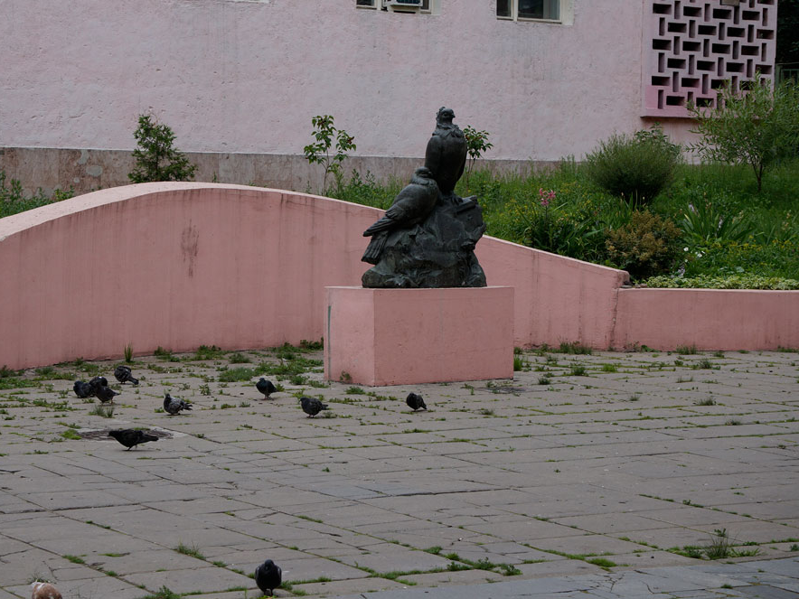
Those two stone pigeons…
Интерактивный рассказ для учащихся 7- 9 классов
Автор:
Ольга Михайловна Степанова
учитель английского языка
МБОУ «Цивильская СОШ №1
имени Героя Советского Союза М.В. Силантьева»
города Цивильск Чувашской Республики
2017

Slide 2
freedom
peace
happiness
Not long ago in Moscow was established a monument to the pigeons - symbol of _________ .
peace

Slide 3
stone
bridge
bricks
The monument shows us two pigeons which are sitting on the ________ .
stone

Slide 4
shoulder
cheeks
chest
The male pigeon is stretching in full growth and sticking out a ________.
chest

Slide 5
sleeping
hiding
eating
The female pigeon is pressing oneself to the stone and _________ behind the male pigeon.
hiding

Slide 6
marble
wood
concrete
The sculpture was placed on the simple pink pedestal which was made from the __________ .
concrete

Slide 7
2005
2010
2000
The monument was established
in ________ .
2005

Slide 8
Art
Military
Farm
The monument was established in the yard of the Central house of the _______ workers in year of the 75th anniversary of the house.
Art

Slide 9
square
street
boulevard
How to find the monument ?
Go to metro station Kuznetsky Most at exit to Rozhdestvenskaya ________ .
street

Slide 10
100
50
20
At the entrance to metro station turn left and go around ____ meters.
20

Slide 11
poisonous
dangerous
peaceful
There from the left side of you in the yard of the Central house of the Art workers you will find the monument to ____________ pigeons… _________.
peaceful

Slide 12
Thank you for visiting the monument to pigeons!
Thank you for taking part in the quiz!

Slide 13
Источник
Monument to pigeons http://progulyaemsya.ru/en/pamyatniki/monument_to_pigeons/
Изображение монумента http://progulyaemsya.ru/f_big/652_3968.jpg

