Slide 1
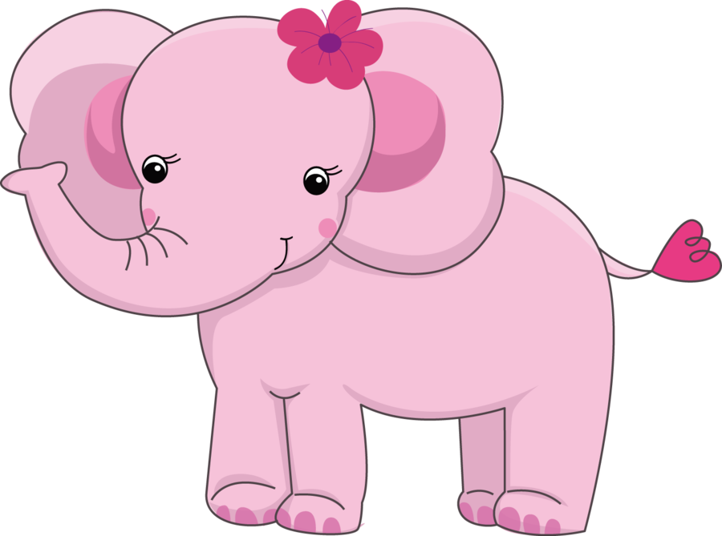
The Elephant,
the Nature’s Gift to Humans
Интерактивная викторина
для учащихся
6 - 9 классов
Автор:
Ольга Михайловна Степанова
учитель английского языка
МБОУ «Цивильская СОШ №1
имени Героя Советского Союза М.В. Силантьева»
города Цивильск Чувашской Республики
2017

Slide 2
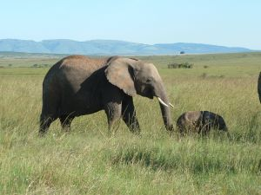
Elephants are warm blooded mammals that are some of the largest land animals in the world!
In fact, the African bush elephant is the largest land animal in the world.

Slide 3
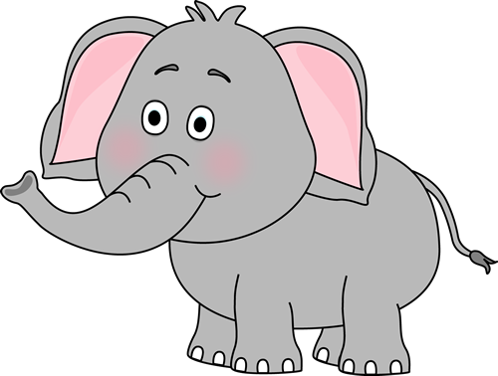
Question 1:
How long do elephants live?
Answer 1:
Elephants can live up to 70 years.

Slide 4
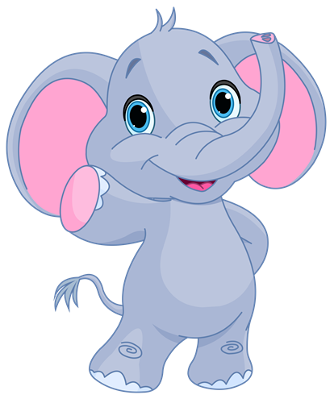
Question 2:
Are elephants smart?
Elephants are among the smartest animals in the world. They can work together and solve problems. Elephants have a largest brain of any animal.

Slide 5
Question 3:
What is a baby Elephant called?
A baby elephant is called a calf.

Slide 6
Question 4:
What is a male Elephant called?
A male Elephant is called a Bull.

Slide 7
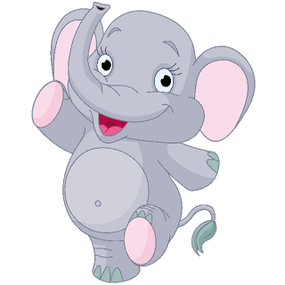
Question 5:
Have Elephants good hearing?
Elephants have excellent hearing. They have better hearing than us humans. Elephants can hear some sounds up to 1.5 km away

Slide 8
Question 6:
What is the largest land animal?
Elephants are the largest land animals. The African Elephant is the largest of the two types we have in the world. The Asian Elephant is the smaller of the two.

Slide 9
Question 7:
Can Elephants Jump?
Elephants cannot jump

Slide 10
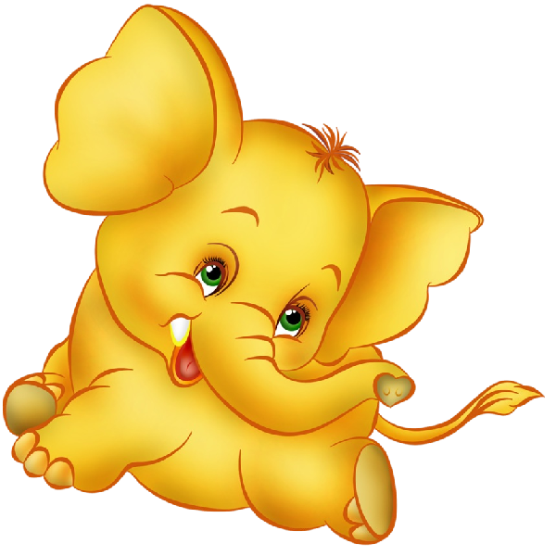
Question 8:
How thick is an Elephants skin?
An Elephants skin is an inch thick

Slide 11
Question 9:
Is it true that Elephants purr?
Yes Elephants do purr. They do this as a way of communicating to each other.

Slide 12
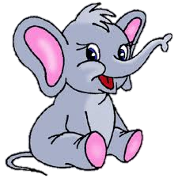
Question 10:
Why to Elephants have tusks?
An Elephant’s tusks are made of Ivory, they use the tusks for digging, lifting and when defending themselves.

Slide 13
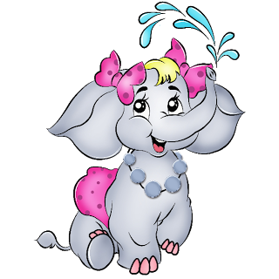
Question 11:
Do Elephants get emotional?
Yes, Elephants have emotions just like we do, they cry, laugh and have an absolutely fantastic memory.

Slide 14
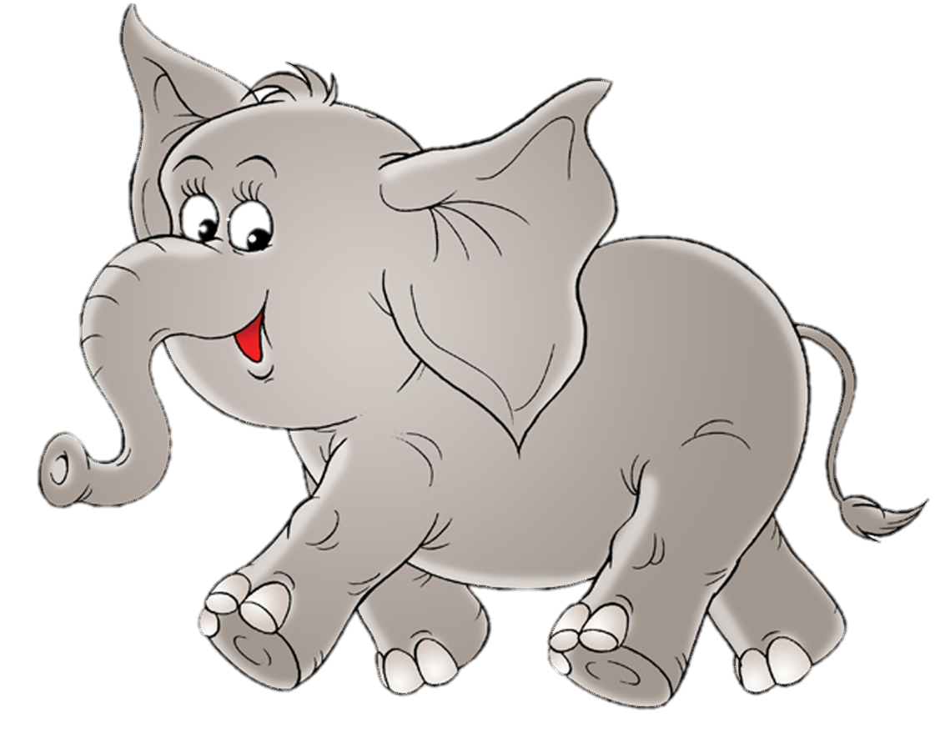
Question 12:
Can Elephants swim?
Yes, Elephants are good swimmers. They use all four legs to swim and they use their trunk to get air when in deep water.

Slide 15
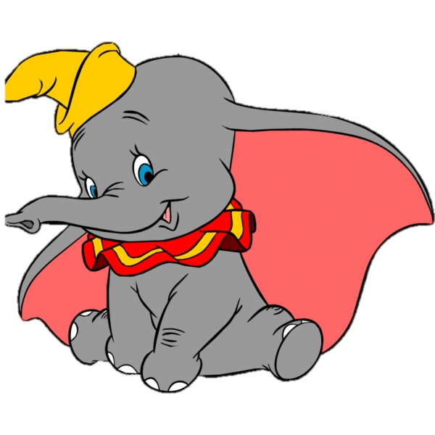
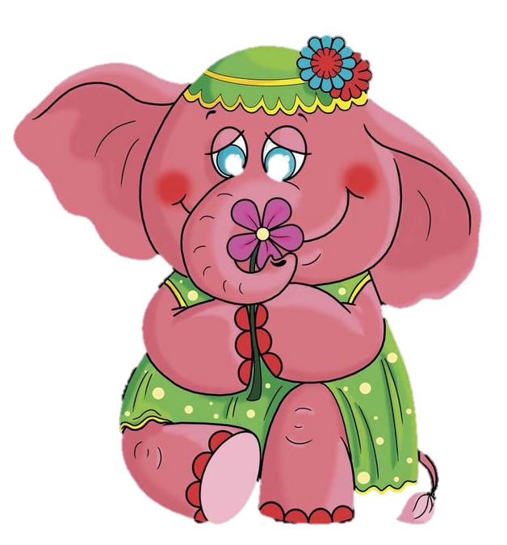
This is the End of the Quiz!
Thank You for Being with our Amazing Elephants!

Slide 16
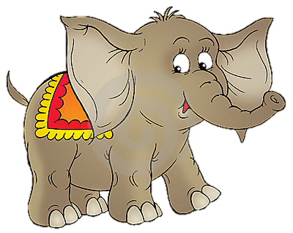
By the Way, World Elephant Day is an international annual event
on August 12th , dedicated to the preservation and protection of the world's elephants.

Slide 17
Источник:
Elephants – African and Asian http://easyscienceforkids.com/all-about-elephants/
Изображения взяты на сайте http://yandex.ru
Условия использования сайта https://yandex.ru/legal/fotki_termsofuse/

