Slide 1
Very … English!
Interactive Exercise
for 6-9 Formers
Автор:
Ольга Михайловна Степанова
учитель английского языка
МБОУ «Цивильская СОШ №1
имени Героя Советского Союза М.В. Силантьева»
города Цивильск Чувашской Республики
2018

Slide 2
Very noisy
Deafening

Slide 3
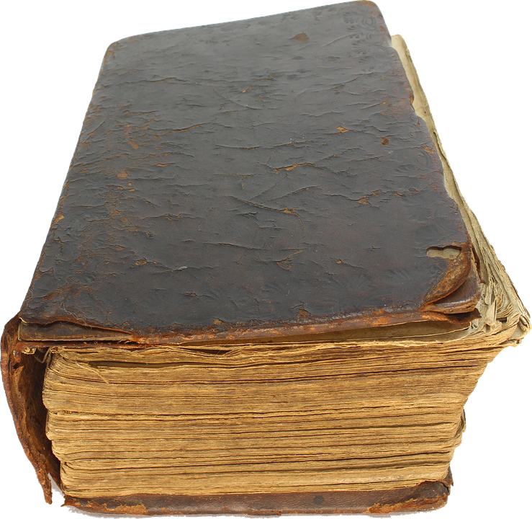
Very old
Ancient

Slide 4
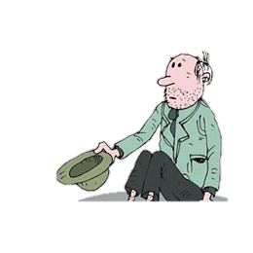
Very poor
Destitute

Slide 5
Very pale
Ashen

Slide 6
Very powerful
Compelling

Slide 7
Very pretty
Beautiful

Slide 8
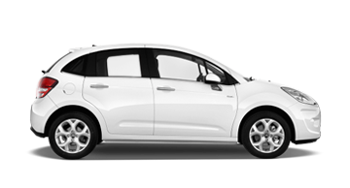
Very quick
Rapid

Slide 9
Very quiet
Hushed

Slide 10
Very rainy
Pouring

Slide 11
Very rich
Wealthy

Slide 12
Very sad
Sorrowful

Slide 13
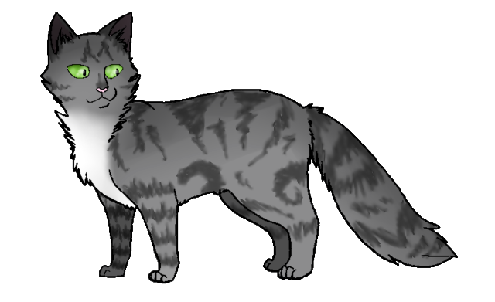
Very serious
Grave

Slide 14
Very short
Brief

Slide 15
Very shy
Timid

Slide 16
Very simple
Basic

Slide 17
Very open
Transparent

Slide 18
Very often
Frequently

Slide 19
Very angry
Furious

Slide 20
Very bad
Awful

Slide 21
Very lazy
Indolent

Slide 22
Be brilliant
in your English!

Slide 23
Источник:
147 Words to Use Instead of “Very” https://www.grammarcheck.net/very/
Изображения взяты на сайте http://yandex.ru
Условия использования сайта https://yandex.ru/legal/fotki_termsofuse/

