Slide 1
Happy 8th of March!
Interactive congratulations for 8-11 Formers
Автор:
Ольга Михайловна Степанова
учитель английского языка
МБОУ «Цивильская СОШ №1
имени Героя Советского Союза М.В. Силантьева»
города Цивильск Чувашской Республики
2018

Slide 2
All best wishes on the International women's day. Keep
shining and smiling always!
Shine and smile!

Slide 3
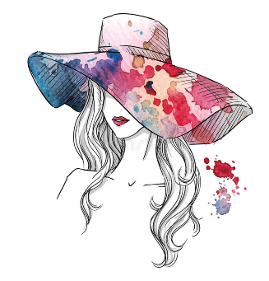
A charming woman doesn't follow the crowd. She is herself! Today is yours and so is every other day!
Always be charming!

Slide 4
Be beautiful if you can, be wise if you want to, but to be respected - that is essential! Wishing you a very happy Women's day!
Be respected!

Slide 5
Just wanted to thank you from bottom of my heart for all things you do! Wishing you a day filled with goodness and warmth.
Be always bright!

Slide 6
On the occasion of March 8,
I wish you happiness, health, success and prosperity in the years ahead.
Be successful!

Slide 7
You make life worth living. Happy Women's Day to all the lovely women!
Love and be loved!

Slide 8
Just be happy!
W-wonderful,
O-outstanding,
M-marvellous,
A-amazing,
N-nice!
Wishing you a day that's just like
you – really
special!

Slide 9
Don't follow the crowd, because you won't go further then crowd. Walk your way alone and you'll find yourself in places no one has ever been before!
Be unique!

Slide 10
A woman like you is precious and hard to find. Wishing you a day as beautiful as you are!
Be sweet!

Slide 11
Don't walk into a room full of people and wonder
if they like you.
Look around and wonder if YOU like them!
Be tender!

Slide 12
You are a special woman and I want you to know how very important you are. Have a wonderful day!
Be healthy and wealthy!

Slide 13
Despite failures - you stand up. Despite sorrow - you cheer up. Despite the pain - you keep fighting! Be happy!
Be nice!

Slide 14
Keep dreaming to fly higher reaching new heights. Congratulations on March 8!
Fly high!

Slide 15
Best wishes for your special day!
Live,
Laugh and
Love!
Be warm!

Slide 16
Happy women's day to you
You are special and know that it's true!
Be faithful!

Slide 17
It's Women's day! Feel special and unique on the top of the world!
Be careful!

Slide 18
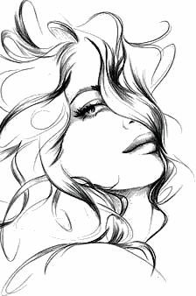
You just smile and the world changes. Let the harmony and colors of spring shine
in your life!
Live and love!

Slide 19
Источник:
Women’s day wishes https://congratulationsto.com/holidays_wishes/womens_day_wishes.php
Изображения взяты на сайте http://yandex.ru
Условия использования сайта https://yandex.ru/legal/fotki_termsofuse/

