Slide 1
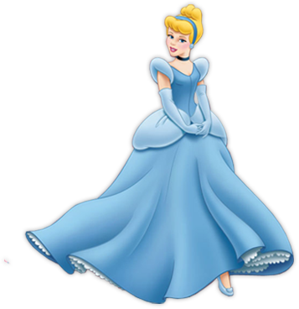
Just imagine
Interactive Reading
for 3-5 Formers
Автор:
Ольга Михайловна Степанова
учитель английского языка
МБОУ «Цивильская СОШ №1
имени Героя Советского Союза М.В. Силантьева»
города Цивильск Чувашской Республики
2018

Slide 2
The cat is 15 years old.
fifteen

Slide 3
The dog ran 37 kilometers.
Thirty seven

Slide 4
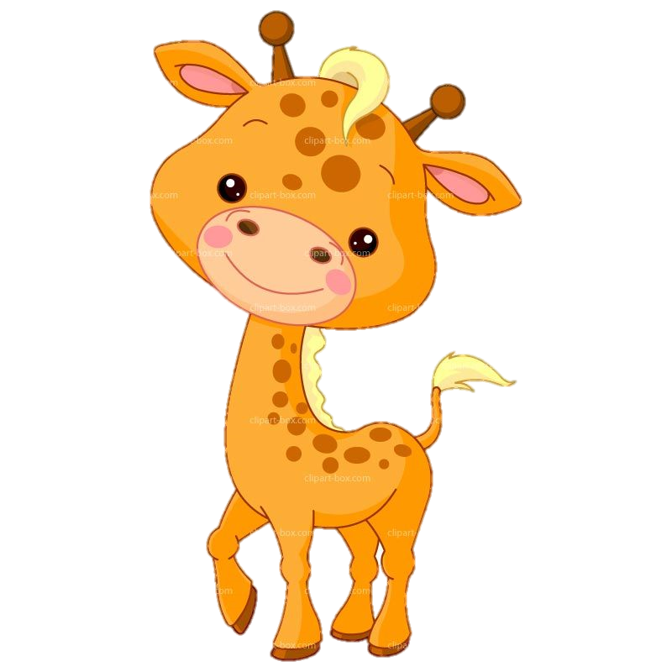
The giraffe has got 58 friends.
fifty-eight

Slide 5
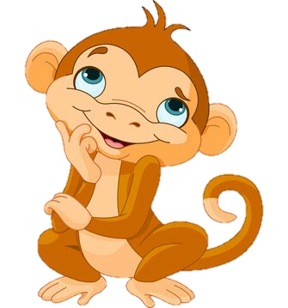
The monkey ate 89 bananas!
eighty-nine

Slide 6
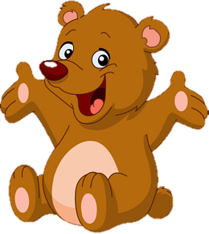
The bear has 33 friends.
Thirty-three

Slide 7
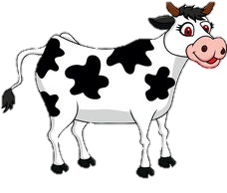
The cow gives us
18 liters milk per day.
eighteen

Slide 8
The chicken ate 45 seeds.
forty-five

Slide 9
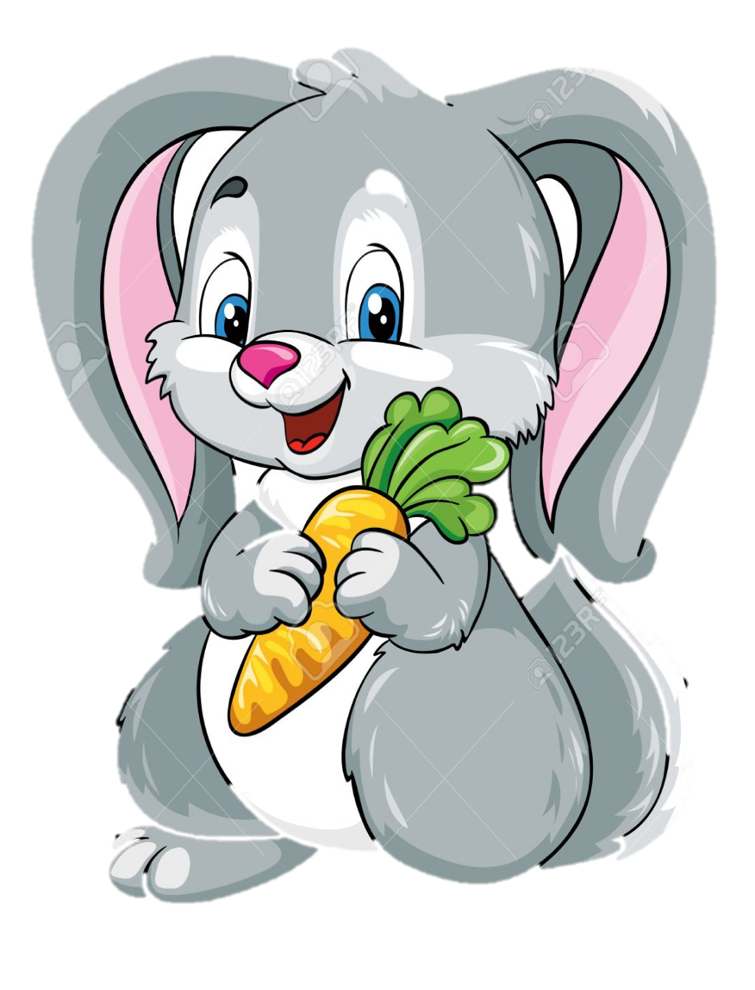
The rabbit ate 99 carrots.
ninety-nine

Slide 10
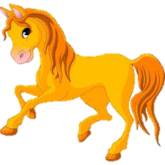
The Horse ran 62 kilometers
Sixty-two

Slide 11
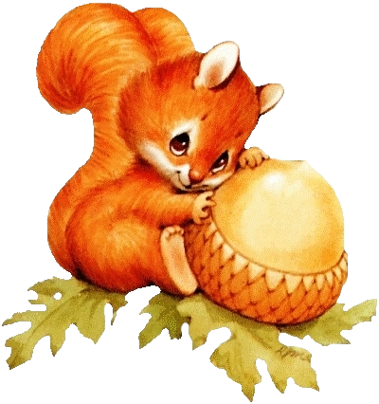
The squirrel has got 74 nuts.
seventy-four

Slide 12
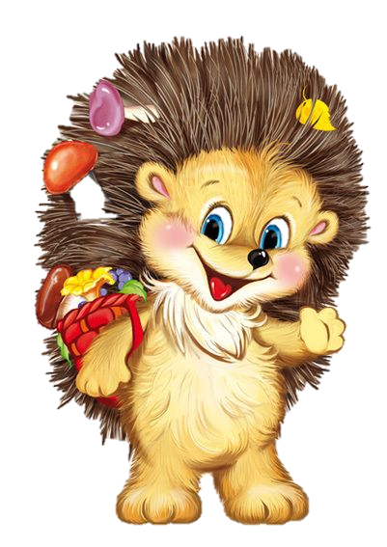
The hedgehog has got 28 mushrooms.
twenty-eight

Slide 13
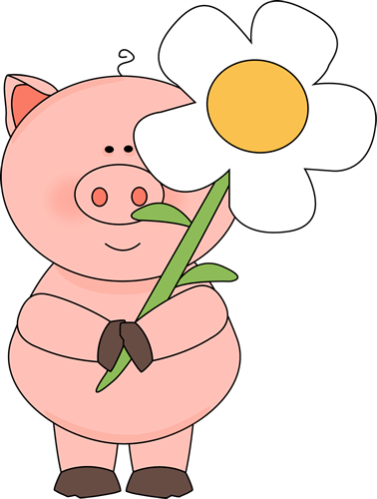
The pig has got 31 flowers.
thirty-one

Slide 14
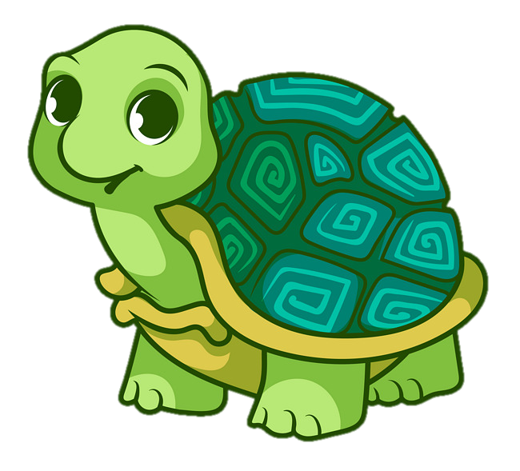
The tortoise is 87 years old.
eighty-seven

Slide 15
Источник:
Изображения взяты на сайте http://yandex.ru
Условия использования сайта https://yandex.ru/legal/fotki_termsofuse/

