Slide 1
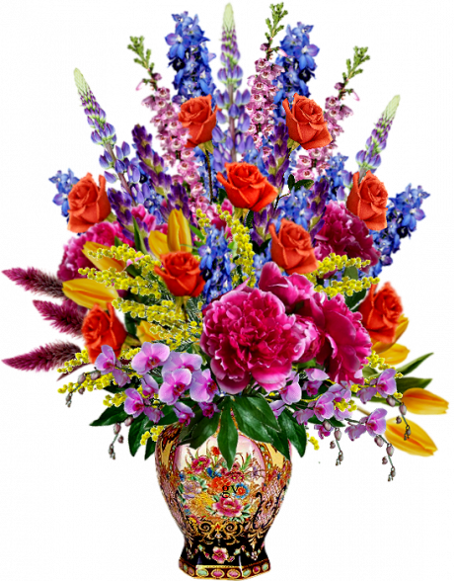
Floral Symbols
Интерактивная викторина
для учащихся 7-11 классов
Автор:
Ольга Михайловна Степанова
учитель английского языка
МБОУ «Цивильская СОШ №1
имени Героя Советского Союза
М.В. Силантьева»
города Цивильск Чувашской Республики
2018

Slide 2
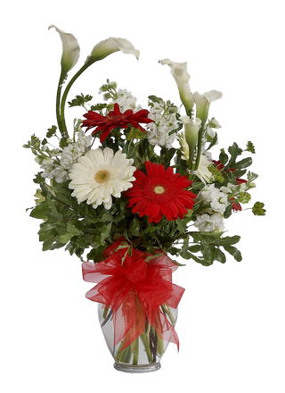
Правила интерактивной викторины
Щелчком мыши из трёх предложенных выбери правильный ответ на вопрос о цветочных символах некоторых стран. При неверном выборе прозвучит соответствующий звуковой сигнал, правильный ответ сопровождается текстом – дополнительной информацией того или иного цветка, изображением флага страны, о которой идёт речь.

Slide 3
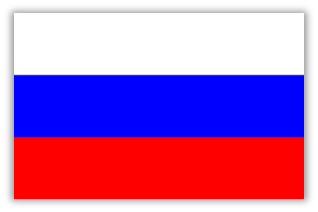
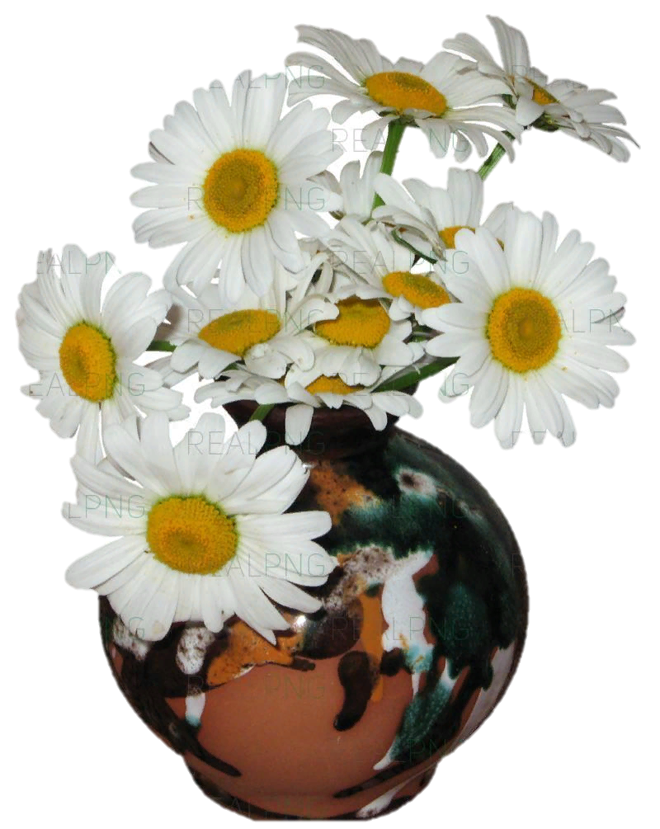
What country has got the camOMILE as a floral symbol?
KOREA
RUSSIA
SPAIN
Also known as the poet’s narcissus or the pheasant’s eye. The petals represent the parishes of the Principality, and the two coloured crown in the centre represents the two co-princes of Andorra.
RUSSIA

Slide 4
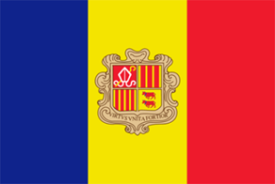
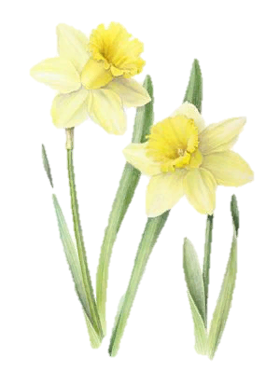
What country has got
the narcissus as a floral symbol?
ANGOLA
ANDORRA
ALBANIA
Also known as the poet’s narcissus or the pheasant’s eye. The petals represent the parishes of the Principality, and the two coloured crown in the centre represents the two co-princes of Andorra.
ANDORRA

Slide 5
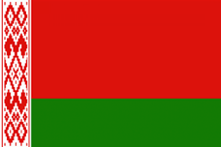
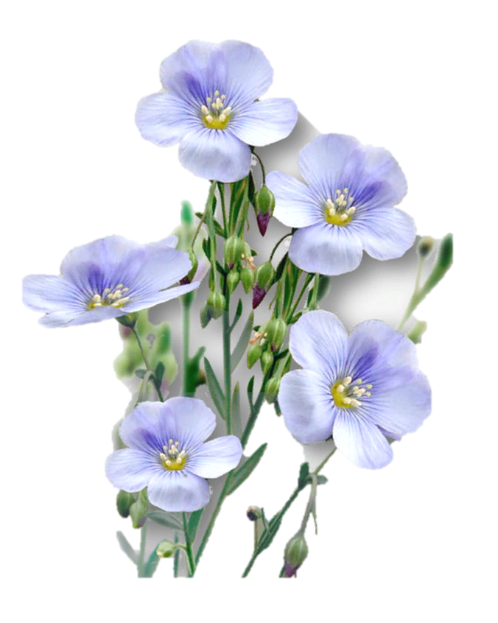
What country has got
the flax as a floral symbol?
BELARUS
BELARUS
Flax is known as common flax or linseed. It is a food and fiber crop cultivated in cooler regions of the world. The textiles made from flax are known in the Western countries as linen, and traditionally used for bed sheets, underclothes, and table linen. The oil is known as linseed oil. In addition to referring to the plant itself, the word "flax" may refer to the unspun fibers of the flax plant.
BULGARIA
BHUTAN

Slide 6
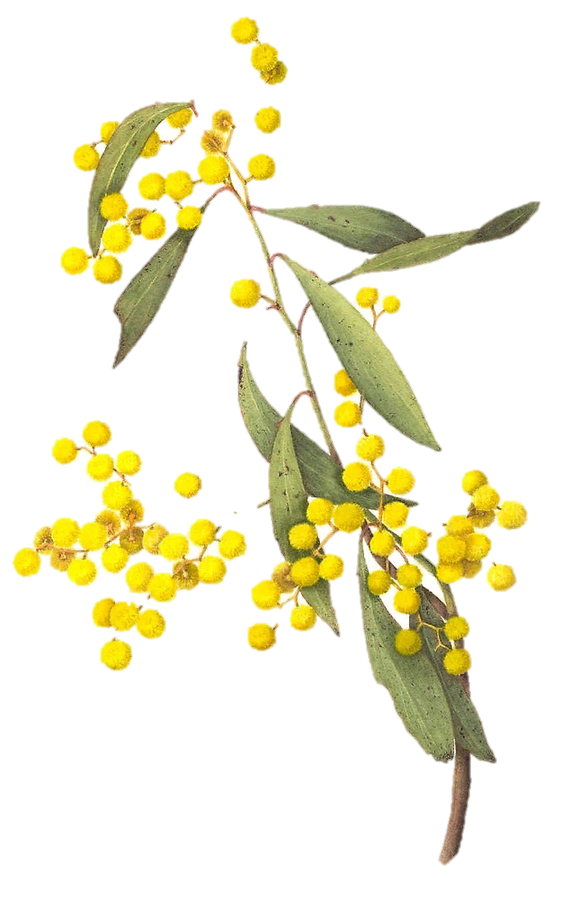
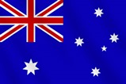
What country has got the Golden wattle as a floral symbol?
AUSTRALIA
AUSTRIA
ARGENTINA
The Golden Wattle blooms in spring, - beginning September - in Australia, with large fluffy, yellow, sweet smelling flower heads. Each Golden Wattle flower head is a bunch of many tiny flowers. Acacias are popularly called Wattle.
AUSTRALIA

Slide 7
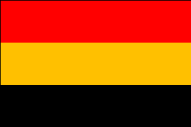
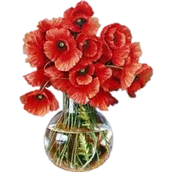
What country has got the red poppy as a floral symbol?
BELGIUM
BELGIUM
The center of the flower has a whorl of stamens surrounded by a cup of four petals. The pollen of the oriental poppy is dark blue. Poppy seeds are use in backing and cooking.. Poppies has long been used as a symbol of both sleep and death.
Sleep because of the opium extracted and death because of its
bloody color.
BERMUDA
BRAZIL

Slide 8
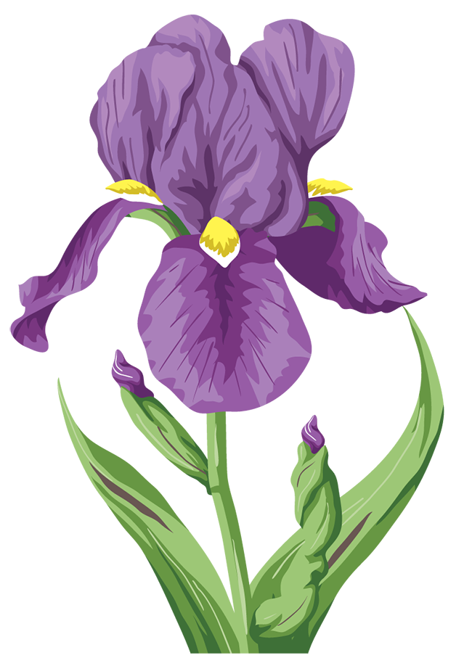
What country has got the iris as a floral symbol?
FRANCE
ETHIOPIA
FRANCE
The iris, or fleur-de-lis, has been used to represent French royalty since the 13th century and is said to signify perfection, light and life. In heraldic designs used by the French monarchy, the three petals also represented wisdom, faith and chivalry.
EGYPT

Slide 9
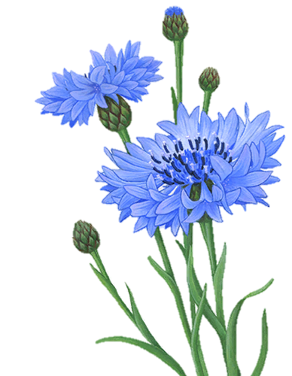
What country has got the corn flower as a floral symbol?
GERMANY
GREECE
The floral emblem of Germany is the beautiful cornflower with a refreshing blue color. In Japan, cornflowers are called Yagurumagiku ("Arrow-wheel Flower") because of their unique shape. It is said that the flower was found as a decoration on the Tomb of Tutankhamun in Egypt. The last Queen of France, Marie Antoinette, also particularly liked silverware with designs of the cornflower.
GERMANY
GREENLAND

Slide 10
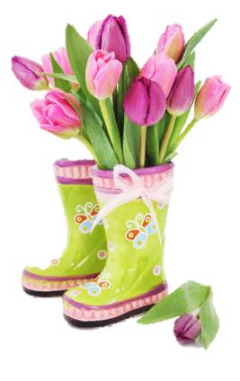
What country has got the tulip as a floral symbol?
HOLLAND
HOLLAND
The Tulip is a classic flower of love. The Turkish people who originally bred the flower considered it a symbol of paradise on earth, making it a part of many religious and secular poems and art pieces. While the Ottoman empire planted the bulbs to remind them of heaven and eternal life, the Dutch that popularized the flower considered it a reminder of how brief life can be instead.
ICELAND
IRAN

Slide 11
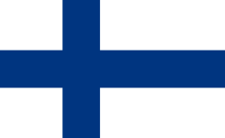
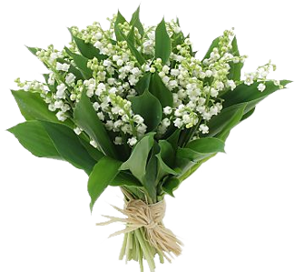
What country has got the Lily of the valley as a floral symbol?
FINLAND
POLAND
Lily of the Valley grows in the cool temperate Northern Hemisphere like Asia, Europe and the Southern Appalachian Mountains in the USA. The flowers look like little tiny white bells. They are very popular with weddings and can be quite expensive. The thing I did not realize was how toxic Lily of the Valley is. The entire plant and the red berries are very poisonous.
ITALY
FINLAND

Slide 12
Thank You for Taking part at my Quiz!

Slide 13
Источник:
National Flowers https://www.theflowerexpert.com/content/aboutflowers/national-flowers

