Slide 1
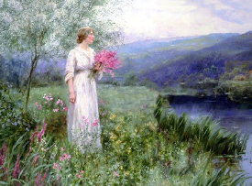
Katusha
Interactive quiz
for 8-11 Formers
Автор:
Ольга Михайловна Степанова
учитель английского языка
МБОУ «Цивильская СОШ №1
имени Героя Советского Союза
М.В. Силантьева»
города Цивильск Чувашской Республики
2018

Slide 2
Песня «Катюша»
переведена на многие языки, в том числе и на английский.
Угадайте, какие слова должны быть в строках знаменитой и
любимой всеми песни!
Перед началом Вы можете прослушать эту песню по ссылке https://youtu.be/WDyFJaPudoY

Slide 3
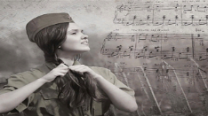
pear
Apple trees and _______ trees were a flower,
River mist was rising all around.

Slide 4
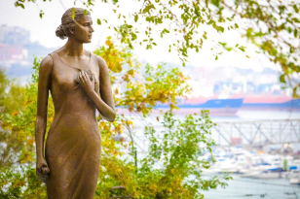
Young Katusha went strolling by the hour
On the steep _______,
O'er the rocky ground.
banks

Slide 5
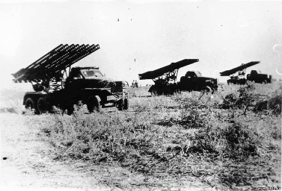
By the river's bank she sang
a love song
Of her ______ in a distant land.
hero

Slide 6
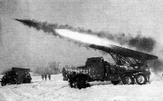
Of the one she'd dearly loved for so long,
Holding tight his letters
in her _______ .
hand

Slide 7
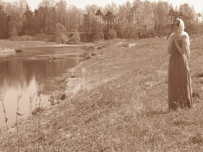
Oh, my song, song of a maiden's true love,
To my dear one travel with the _______ .
sun

Slide 8
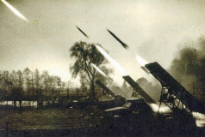
To the one with whom Katusha knew love,
Bring my __________ to him, one by one.
greetings

Slide 9
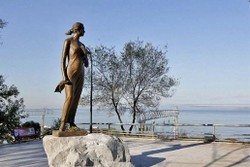
Let him know that I am true and faithful,
Let him hear the love ________ that I send.
song

Slide 10
Tell him as he defends our home that grateful,
True Katusha our _______will defend.
love

Slide 11
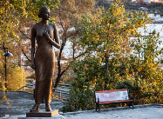
Apple trees and pear trees were a flower,
River ________ was rising all around.
mist

Slide 12
Young Katusha
went strolling
by the hour
On the steep banks,
O'er the rocky ________ .
ground

Slide 13
Apple trees and pear trees were a flower,
River mist was rising all around.
Young Katusha went strolling by the hour
On the steep banks,
O'er the rocky ground.
By the river's bank she sang a love song
Of her hero in a distant land.
Of the one she'd dearly loved for so long,
Holding tight his letters in her hand.
Oh, my song, song of a maiden's true love,
To my dear one travel with the sun.
To the one with whom Katusha knew love,
Bring my greetings to him, one by one.
Let him know that I am true and faithful,
Let him hear the love song that I send.
Tell him as he defends our home that grateful,
True Katusha our love will defend.
Let’s sing it along!

Slide 14
Источник:
Катюша (на английском) http://www.megalyrics.ru/lyric/eng/katiusha-na-anghliiskom.htm
Изображения взяты на сайте http://yandex.ru
Условия использования сайта https://yandex.ru/legal/fotki_termsofuse/

