Slide 1
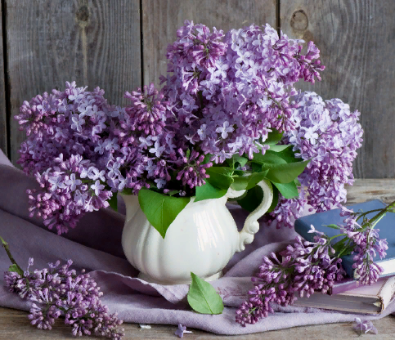
the Queen of Shrubs the lilac
Lilac facts collection for the 7-11 Formers
Автор:
Ольга Михайловна Степанова
учитель английского языка
МБОУ «Цивильская СОШ №1
имени Героя Советского Союза М.В. Силантьева»
города Цивильск Чувашской Республики
2018

Slide 2
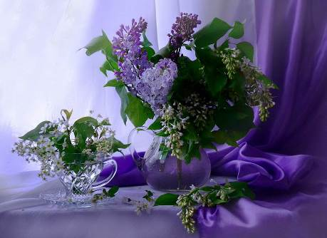
The lilac is known as the "Queen of Shrubs". Its beauty certainly warrants this title.

Slide 3
This story is from Greek mythology: It's about a beautiful nymph named Syringa (lilac's botanical name). "Pan", the god of the forests and fields, was captivated by Syringa's beauty. Pan chased Syringa through the forests. Syringa was frightened by Pan's affections. Syringa escaped Pan by turning herself into a lilac bush.

Slide 4
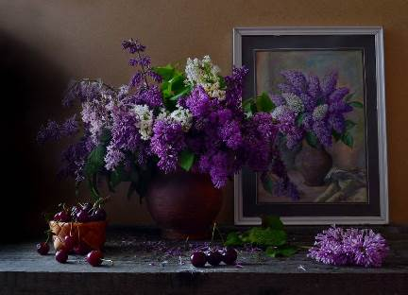
Lilacs belong to the same family as the olive (Oleaceae).

Slide 5
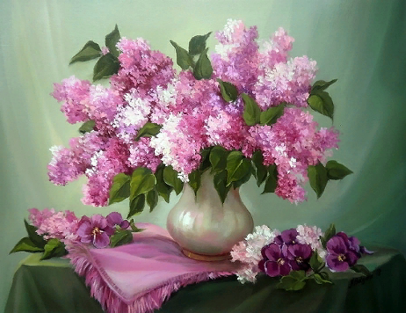
The purple lilacs have the strongest scent compared to other colours.

Slide 6
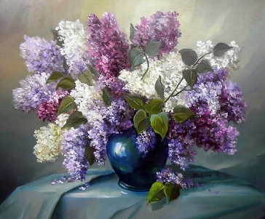
Lilacs are commonly used in soaps, perfumes and other cosmetics.

Slide 7
In the language of flowers, purple lilacs represent first love, while white lilacs symbolize youthful
innocence.

Slide 8
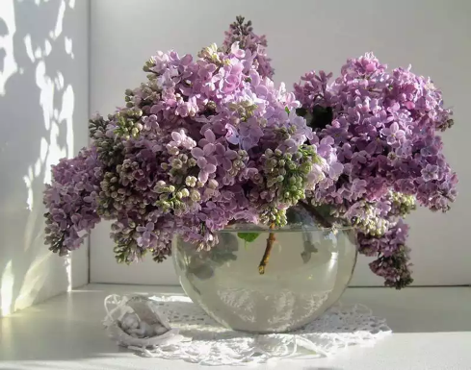
In Greece, Lebanon and Cyrus, the lilac is a symbol of Easter

Slide 9
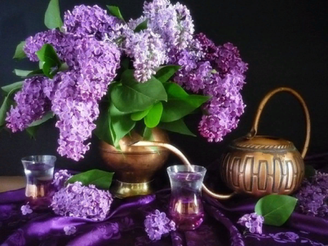
The lilac is the state flower of New Hampshire, USA

Slide 10
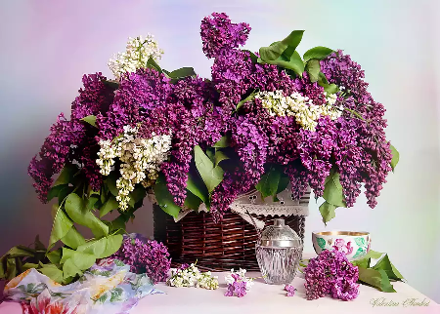
There are annual lilac festivals in North America cities.

Slide 11
Lilacs are native to Eastern Europe and Asia. The colonists brought them to America in the 17th century.

Slide 12
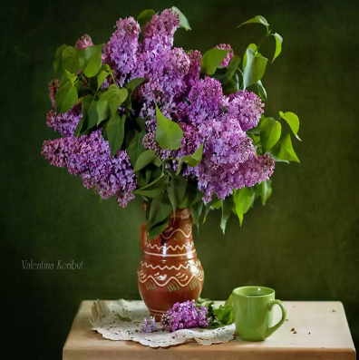
Thomas Jefferson loved lilacs and wrote about them in his gardening book.

Slide 13
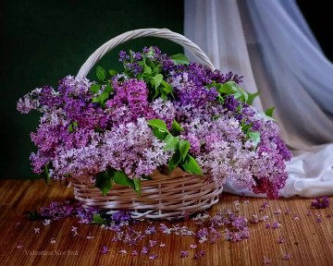
The name "Lilac: comes from from the Persian word "lilaq", which means flower.

Slide 14
There are over 1,000 varieties of lilacs. Lilacs bushes can live over 100 years!

Slide 15
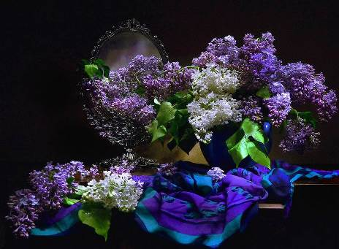
Wood from the lilac tree is amongst the densest and can be used to make musical instruments, knife handles and more!

Slide 16
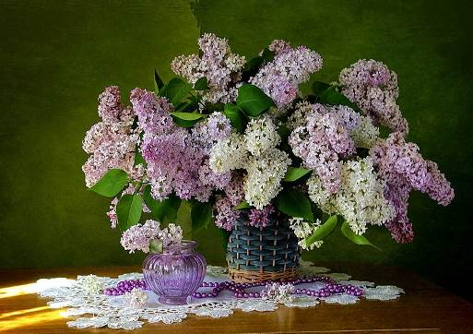
Lilacs are edible. Please pass the lilac salad :)

Slide 17
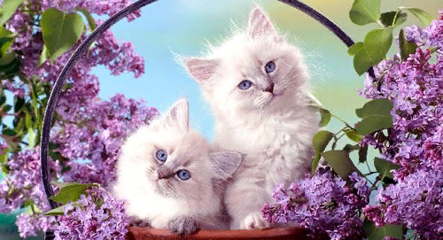
Spring is the very time to enjoy lilacs!

Slide 18
Источник:
Lilac trivia and facts http://gardenersnet.com/lilac/lilac-trivia.htm
Fun flower facts: lilacs https://funflowerfacts.com/2013/01/27/fun-flower-facts-lilac/
Изображения взяты на сайте http://yandex.ru
Условия использования сайта https://yandex.ru/legal/fotki_termsofuse/

