Slide 1
Children and their Planet
Приглашение в картинную галерею Сары Кей и в мир цитат выдающихся личностей для учащихся 9-11 классов
Автор:
Ольга Михайловна Степанова
учитель английского языка
МБОУ «Цивильская СОШ №1
имени Героя Советского Союза
М.В. Силантьева»
города Цивильск Чувашской Республики
2018

Slide 2
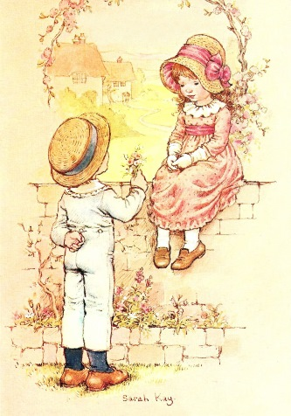
The most important thing a father can do for his children is to love their__________ .
Theodore Hesburgh
Mother

Slide 3
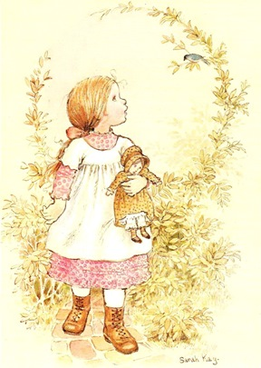
"Adults are just outdated ______________ .“
— Dr. Seuss
children

Slide 4
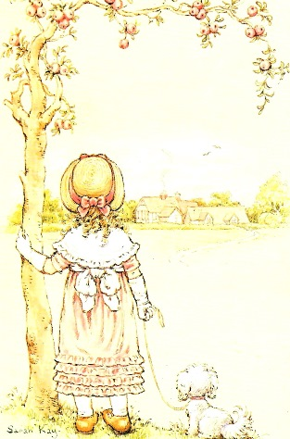
God
Mother is the name for ________ in the lips and hearts of little children.
William Makepeace Thackeray

Slide 5
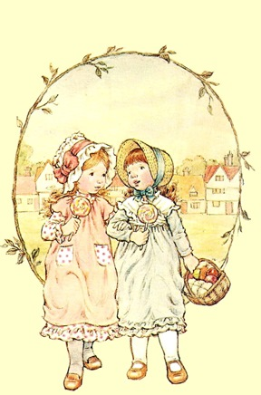
critics
"Children need models rather than ___________ .“
— Joseph Joubert, French moralist

Slide 6
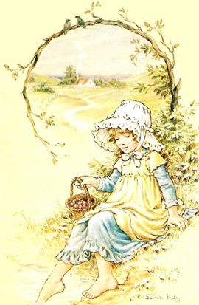
hands
"Children are the ____________ by which we take hold of heaven."
— Henry Ward Beecher, reverend and social activist

Slide 7
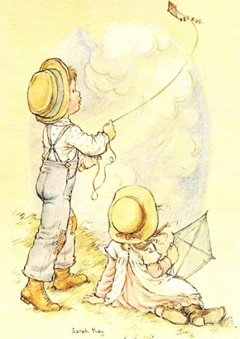
soul
"The ___________ is healed by being with children.“
— Fyodor Dostoyevsky, Russian novelist and philosopher

Slide 8
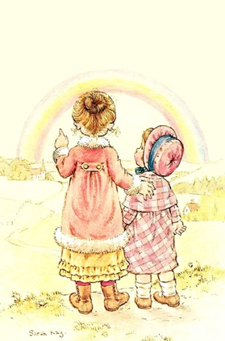
"You have to love your children unselfishly. That is hard. But it is the only _________ ."
— Barbara Bush, Former First Lady of the United States
way

Slide 9
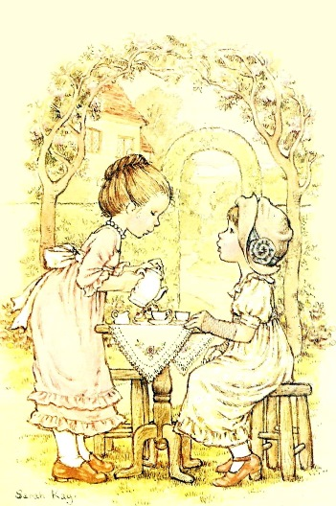
resource
"Children are our most valuable___________.“
— Herbert Hoover, 31st President of the United States

Slide 10
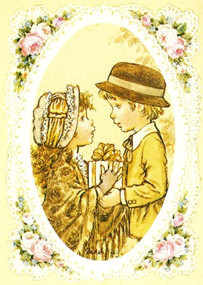
future
"Children are one third of our population and all of our ___________ .“
— Select Panel for the Promotion of Child Health, 1981

Slide 11
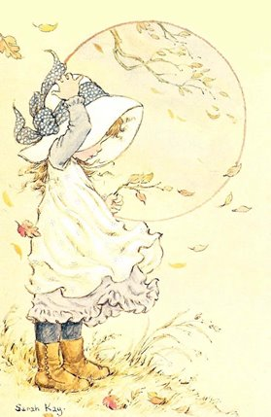
time
"Children are the living messages we send to a ________ we will not see.“
— John F. Kennedy, 35th President of the United States

Slide 12
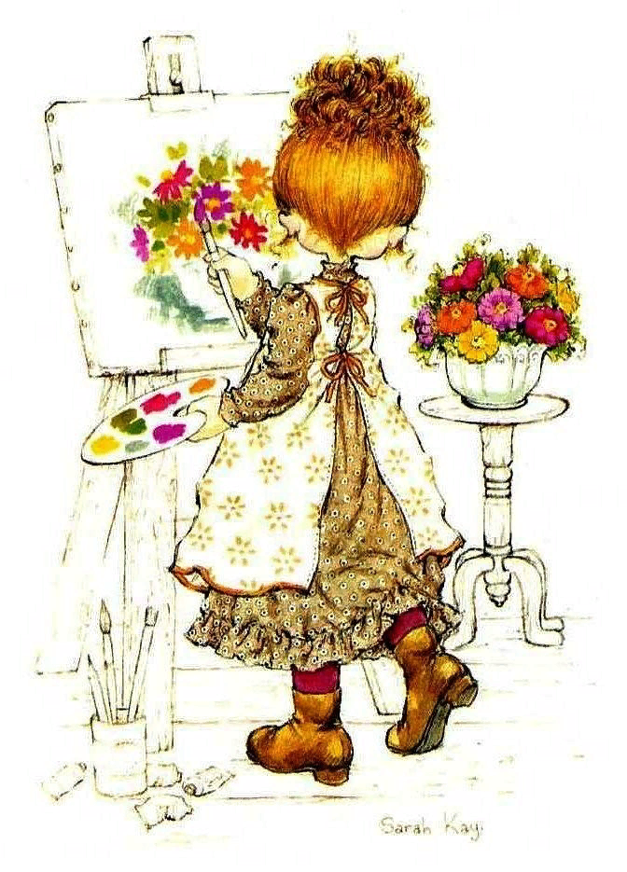
"Only where children gather is there any real chance of _______.“
— Mignon McLaughlin, journalist and author
fun

Slide 13
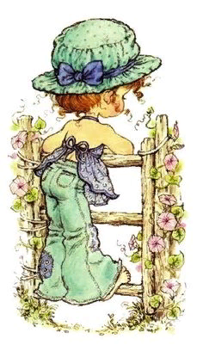
opinion
"A baby is God's ___________ that the world should go on.“
― Carl Sandburg, American poet

Slide 14
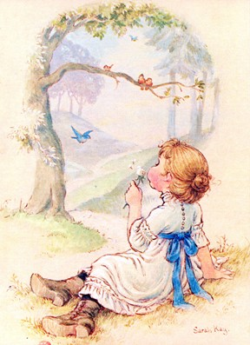
Hugs
“___________ can do great amounts of good, especially for children."
— Diana, Princess of Wales

Slide 15
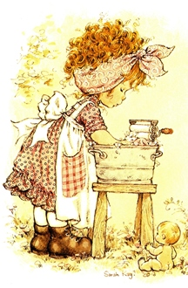
"Old men can make war, but it is children who will make_____________.“
— Ray Merritt, author
history

Slide 16
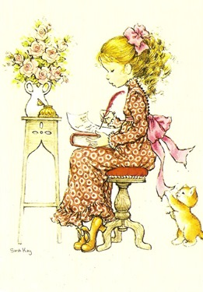
goodnight
"Always kiss your children ______________ , even if they're already asleep."
— H. Jackson Brown, Jr., author

Slide 17
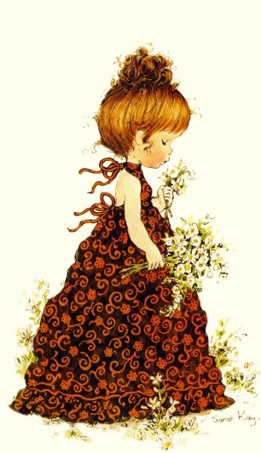
“If you want your children to be intelligent, read them fairy tales. If you want them to be more intelligent, read them more ______________ .”
― Albert Einstein
fairy tales

Slide 18
Вот и закончилась
наша викторина.
Спасибо за участие!

Slide 19
Источник:
Стихи о детях и детстве http://mamamozhetvse.ru/stixi-o-detyax-i-detstve.html
Красивые стихи о детстве http://t-loves.narod.ru/stihi-o-detstve.htm
Изображения взяты на сайте http://yandex.ru
Условия использования сайта https://yandex.ru/legal/fotki_termsofuse/

