Slide 1
fluffy lumps of the sun
the dandelions
Facts collection
for the 7th - 9th Formers
Автор:
Ольга Михайловна Степанова
учитель английского языка
МБОУ «Цивильская СОШ №1
имени Героя Советского Союза М.В. Силантьева»
города Цивильск Чувашской Республики
2018

Slide 2
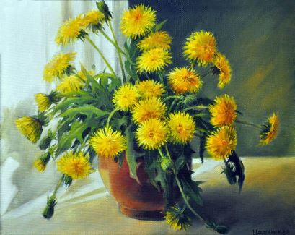
The name ‘dandelion’ originates from French words "dent de lion" which mean lion's tooth. This name is given because of deeply toothed leaves of a dandelion...

Slide 3
Dandelion resembles sun, moon and stars during the certain parts of its life cycle. Yellow flower looks like sun, spherical head with seeds looks like moon while dispersing seeds look like stars.

Slide 4
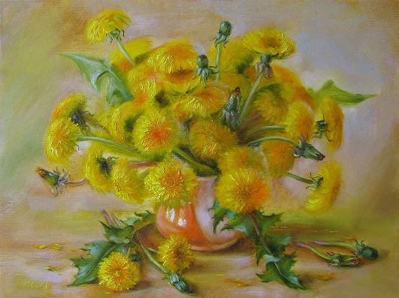
Dandelion is rich source of vitamins A, C and K. It also contains high level of iron, calcium and potassium. Dandelion is used mainly in Asian cuisine, often as an ingredient of salads and sandwiches.

Slide 5
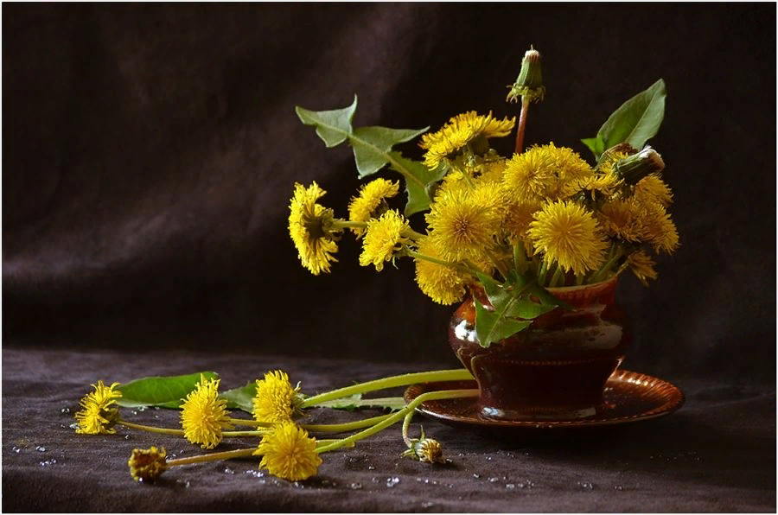
Every part of the dandelion is useful: root, leaves, flower. It can be used for food, medicine and dye for coloring.

Slide 6
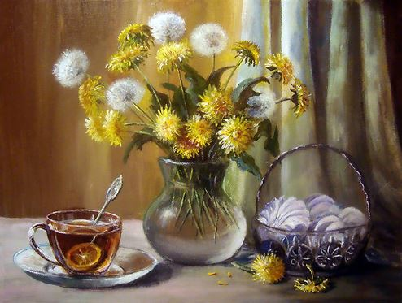
Animals such as birds, insects and butterflies consume nectar or seed of dandelion.

Slide 7
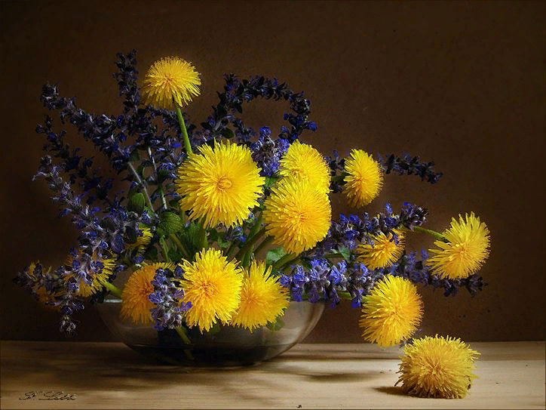
The dandelion flower opens to greet the morning and closes in the evening to go to sleep.

Slide 8
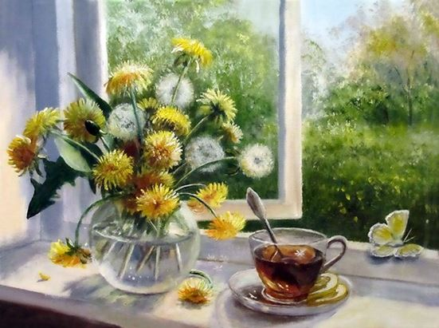
Pharmacists in 19th-century England made tea from roasted dandelion roots. The drink is still trendy today, thanks to a coffeelike taste and color without caffeine.

Slide 9
A cup of chopped raw dandelion greens provides 112 percent of the daily requirement for vitamin A (at only 25 calories).

Slide 10
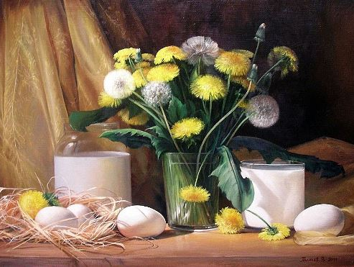
From blossom to root, 100 percent of this weed, which is also an herb, is edible for most people.

Slide 11
Dandelion leaves are rich in vitamins A, C, and K, and the minerals calcium, potassium, iron, and manganese.

Slide 12
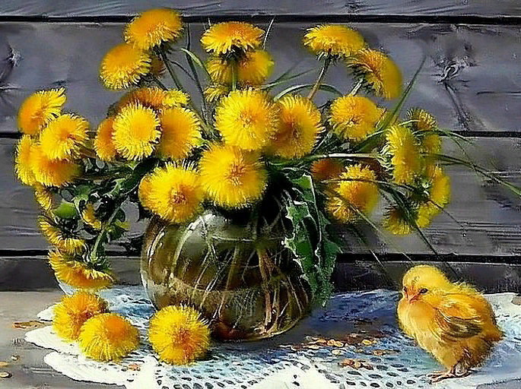
There are little things individuals can do. You can kill dandelions with hot water — just pour boiling water on them.

Slide 13
Did you know National Dandelion Day is April 5th? Did you know Vineland is the dandelion capital of the U.S.?

Slide 14
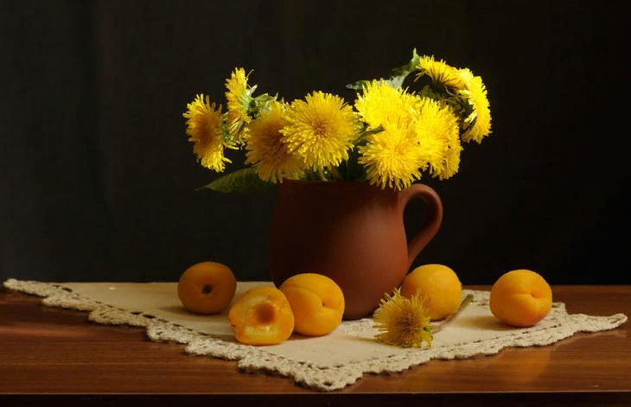
Who knew these plants were so versatile? Researchers were looking for an eco-friendly alternative to the rubber tree and stumbled upon dandelions. They use Russian dandelions which produces natural rubber.

Slide 15
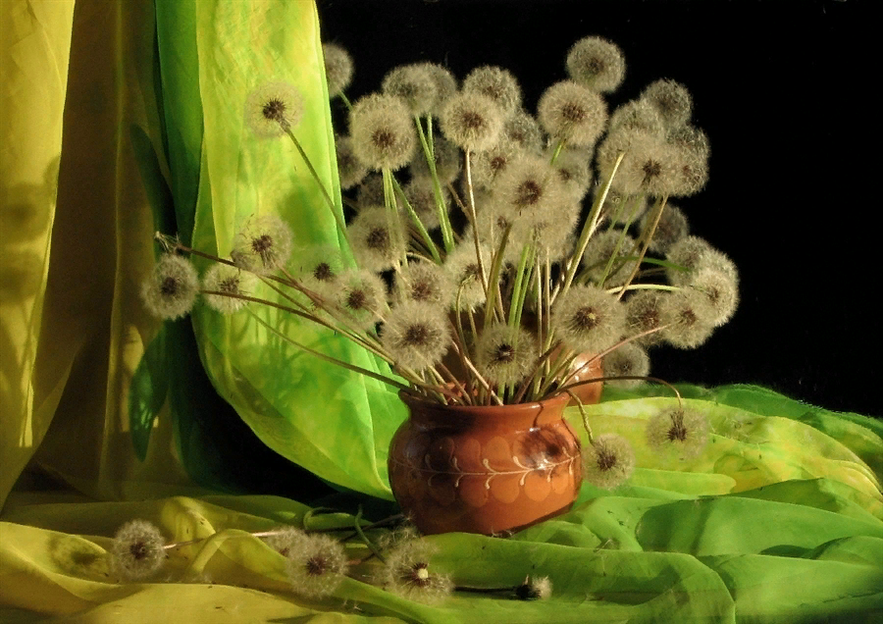
Since the Dandelion can thrive in difficult conditions, it is no wonder that people say the flower symbolizes the ability to rise above life’s challenges.

Slide 16
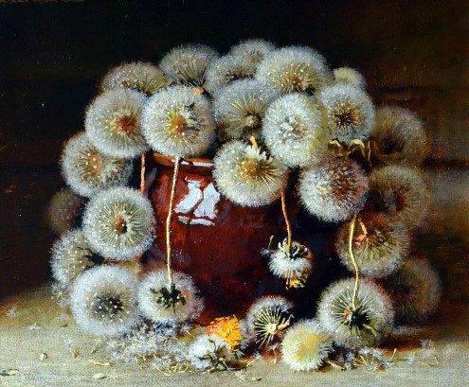
As a dandelion plant matures, their bright yellow flower turns into a white puff ball of seeds just waiting to be released. The dandelion relies on wind power to distribute its seeds (achnes).

Slide 17
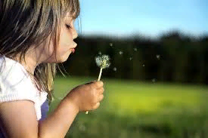
Make a wish and blow out the dandelion! Its parachutes will carry your dreams and wishes and make them come true, by the way!

Slide 18
Источник:
National dandelion day http://catcountry1073.com/national-dandelion-day/
Dandelion facts http://www.softschools.com/facts/plants/dandelion_facts/597/
7 surprising facts about dandelions http://www.birdsandblooms.com/gardening/7-surprising-facts-dandelions/
Изображения взяты на сайте http://yandex.ru
Условия использования сайта https://yandex.ru/legal/fotki_termsofuse/

