Slide 1
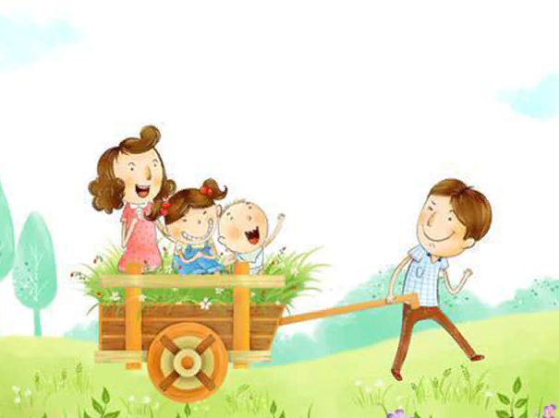
God’s gift the Parents
Quotes collection for the 7-11 Formers
Автор:
Ольга Михайловна
Степанова
учитель английского языка
МБОУ «Цивильская СОШ №1
имени Героя Советского Союза
М.В. Силантьева»
города Цивильск Чувашской Республики
2018

Slide 2
It’s a funny thing about mothers and fathers. Even when their own child is the most disgusting little blister you could ever imagine, they still think that he or she is wonderful.
-Roald
Dahl

Slide 3
No matter how far we come, our parents are always in us.
-Brad Meltzer

Slide 4
My heroes are and were my parents. I can’t see having anyone else as my heroes.
-Michael Jordan

Slide 5
The best part about being friends with your parents is that no matter what you do, they have to keep loving you.
-Natalie Portman

Slide 6
A father’s goodness is higher than the mountain, a mother’s goodness deeper than the sea.
-Japanese Proverb

Slide 7
You may believe or not, but it is true, in this world no one can give you truly love more than your parents.
-Unknown

Slide 8
Family is the first school for young children, and parents are powerful models.
-Alice Sterling Honig

Slide 9
It’s cool to have parents and family who will always tell me the truth no matter what. They’ll tell me if I’m doing something stupid!
-Jordin Sparks

Slide 10
Appreciate your parents. You never know what sacrifices they went through for you.
-Unknown

Slide 11
Treat your parents with loving care, you will only know their value when you see their empty chair...

Slide 12
Believe it or not, the worst thing to hear from your parents is ‘I’m Disappointed in you.’
-Unknown

Slide 13
Parents are the ultimate role models for children. Every word, movement and action has an effect. No other person or outside force has a greater influence on a child than the parent. - Bob Keeshan

Slide 14
One of the greatest titles in the world is parent, and one of the biggest blessings in the world is to have parents.
Love and
appreciate
them.

Slide 15
Don’t use the sharpness of your tongue on the mother who taught you to speak.
Ali Ibn Abi Talib

Slide 16
Nobody on earth can ever love you more than your parents.
Anonymous
Love your Parents and appreciate them!

Slide 17
Источник:
43 great quotes about parents http://www.curatedquotes.com/family-quotes/parents/
Изображения взяты на сайте http://yandex.ru
Условия использования сайта https://yandex.ru/legal/fotki_termsofuse/

