Slide 1
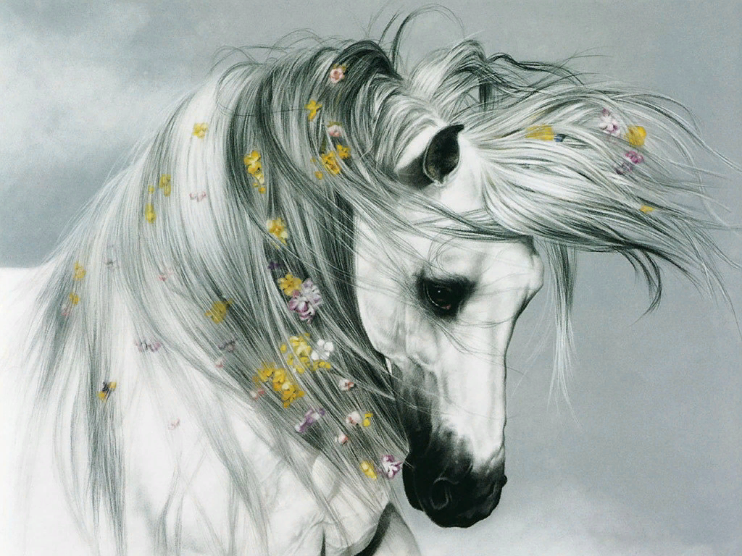
Paintings that touch
the hearts
Art Gallery for the 7th -11th Formers
Автор:
Ольга Михайловна
Степанова
учитель английского языка
МБОУ «Цивильская СОШ №1
имени Героя Советского Союза М.В. Силантьева»
города Цивильск Чувашской Республики
2018

Slide 2
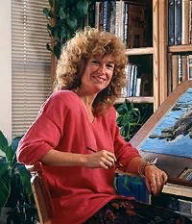
"Very few artists achieve the technical excellence found in the art of Lesley Harrison. Even fewer capture the spirit, the emotion and the life-like realism for which her work is known and collected.
Acknowledged as one of the finest pastel artists in America, her amazing equine and wildlife paintings have brought joy and happiness to animal lovers and art lovers throughout the world."
- The Monterey Herald

Slide 3
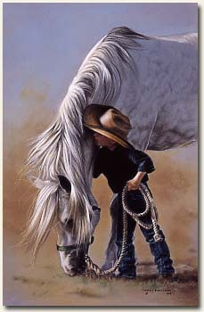
Lesley Harrison's Sacramento, California girlhood was shaped by animals and art. "I was born loving animals," she says. "It seems to be in my blood." She remembers an ongoing menagerie from cats to chickens.

Slide 4
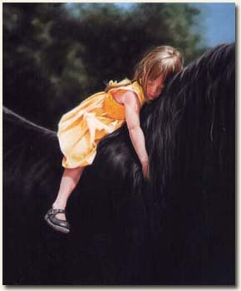
She started drawing animals in second grade. "I was taken down to the principal's office more than once, because I was drawing horses instead of paying attention to the teacher," she laughs.

Slide 5
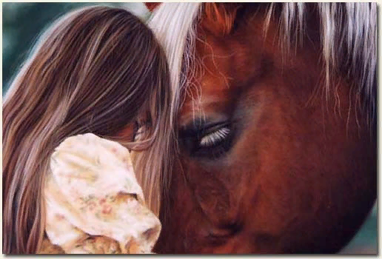
"In 1975, I picked up a stick of pastel and it was instant love. I had tried other mediums, but nothing had ever clicked." By 1983 she was selling enough paintings to quit her day job.

Slide 6
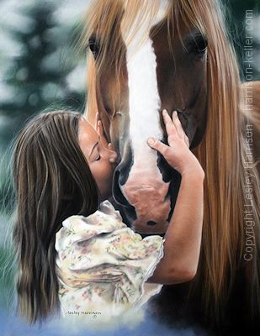
Lesley has now been painting professionally for 30 years. She has combined her love of animals with painting to produce in her career a continuing series of remarkable animal portraits.

Slide 7
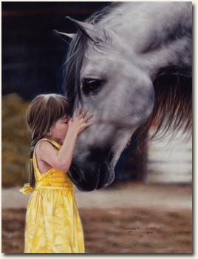
An affinity for the animals that she paints and a strong command of her medium allows her to capture the spirit of each animal and to convey to each viewer its individuality, grace and strength.

Slide 8
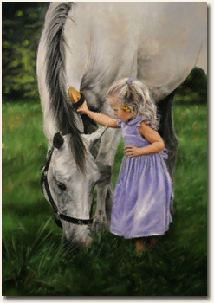
She sums up her experience: "I'm blessed, blessed that people want to buy what I love to paint. Sometimes people stand in front of my paintings and cry.

Slide 9
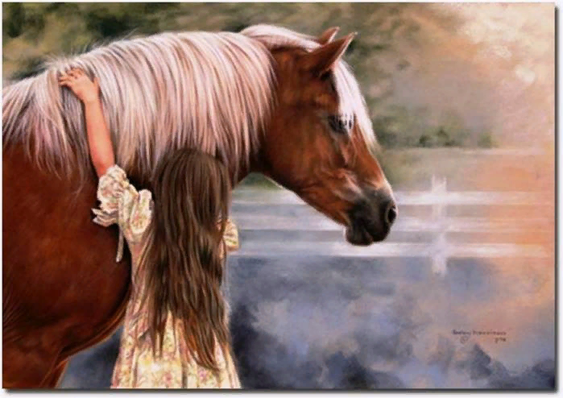
What better gift could any artist receive?

Slide 10
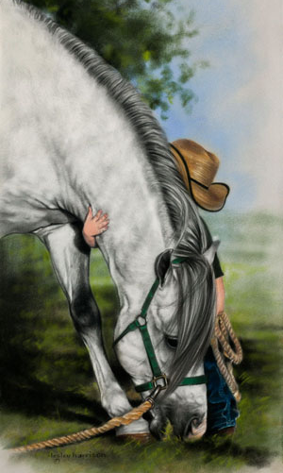
I'm convinced that paintings that come from the heart can touch the heart of others.

Slide 11
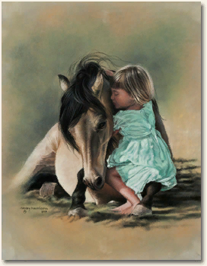
It's almost as though I become a source through which animals can be portrayed as an individual, each with a distinct personality.

Slide 12
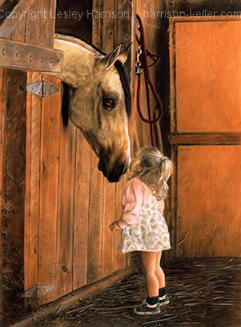
It doesn't matter if the animal is a cat, a wolf or a horse; I paint the ones that evoke an emotional response in me in the hope that I can pass that on to the viewer."

Slide 13
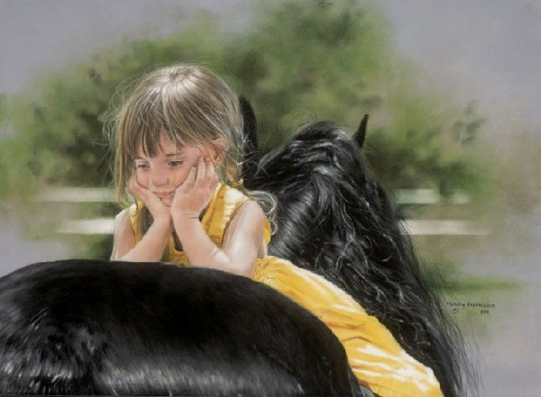
"I have always sought to form connections with animals, not merely study them. I'm not looking for a portrait. I'm looking for a connection."

Slide 14
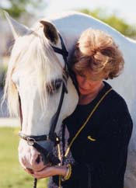
She and her sculptor husband, John Keller, live in Volcano, California, a town of about 100 people. They have a menagerie of eight cats, two horses, and a couple of goats.

Slide 15
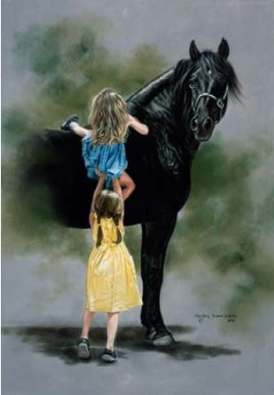
Her paintings are a gift that touches the hearts…

Slide 16
Thank You for visiting the Gallery!

Slide 17
Источник:
About Lesley Harrison http://www.harrison-keller.com/about-lesley-harrison.php
Изображения взяты на сайте http://yandex.ru
Условия использования сайта https://yandex.ru/legal/fotki_termsofuse/

