Slide 1
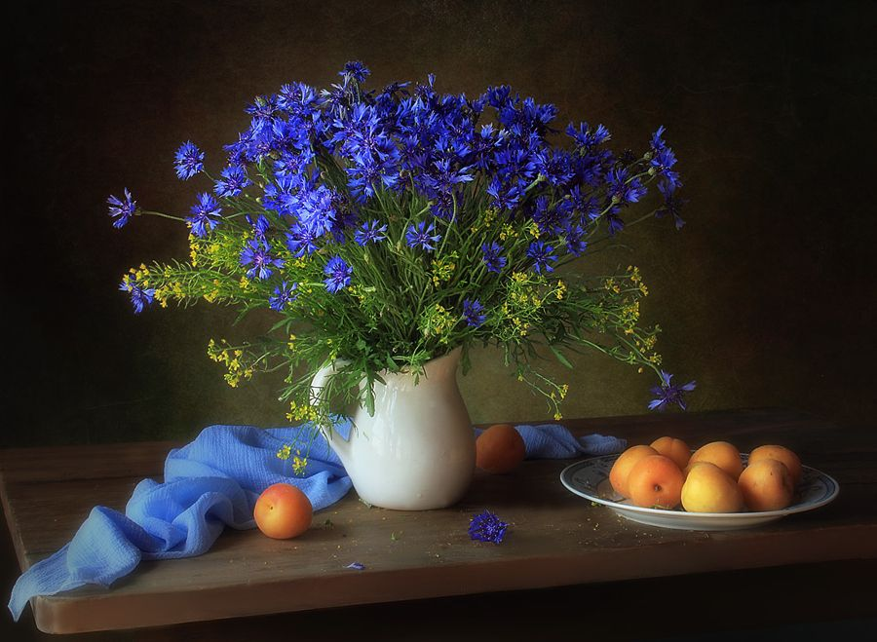
Cornflowers
Interactive Quiz for the 7th – 9th Formers
Автор:
Ольга Михайловна Степанова
учитель английского языка
МБОУ «Цивильская СОШ №1
имени Героя Советского Союза М.В. Силантьева»
города Цивильск Чувашской Республики
2018

Slide 2
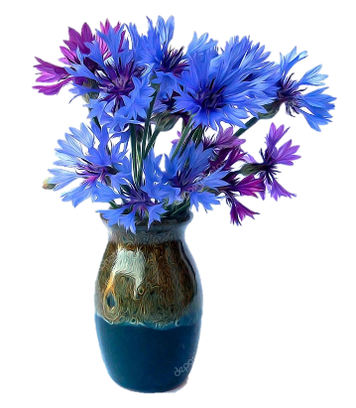
Cornflower is a member of daisy __________ renowned for its vibrant blue flowers.
family

Slide 3
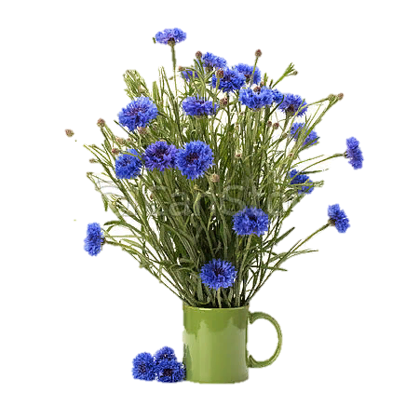
Button
Cornflower is also called Bachelors ________ , Blue Cap, Blue Bottle, Blue poppy, Blueblow, Bluebonnets, Boutonniere Flower…

Slide 4
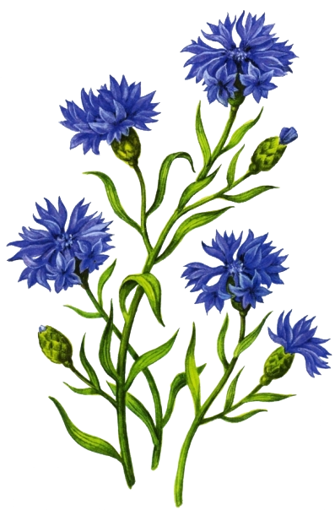
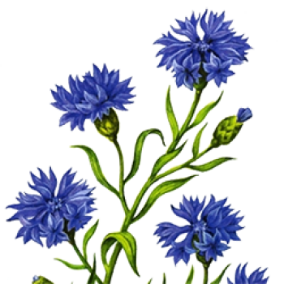
The cornflowers are edible and have a sweet, ___________-like taste.
cucumber

Slide 5
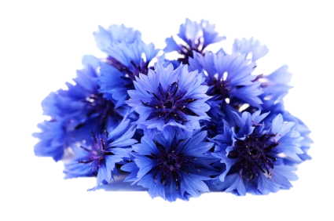
The name cornflower comes from the fact the flowers grow abundantly in corn fields in Europe and the U.S.
It can be used to make______ .
tea

Slide 6
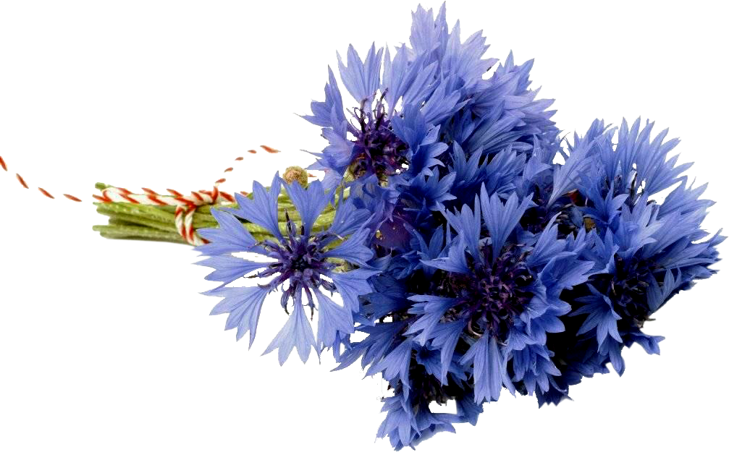
Cornflowers have been used in traditional herbal ____________ as an anti-inflammatory.
medicine

Slide 7
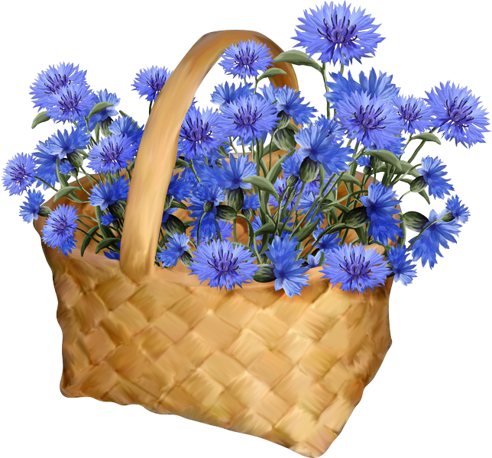
These colourful flowers tend to attract bees and butterflies because of their high _________ content.
nectar

Slide 8
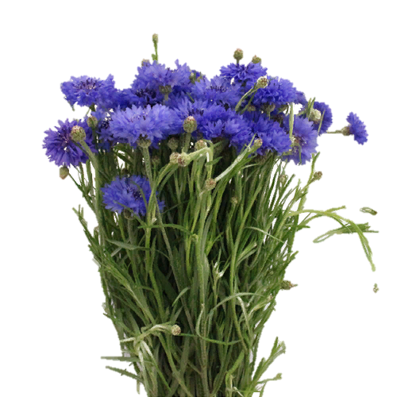
Cornflower
is
the national flower of ___________ .
Estonia

Slide 9
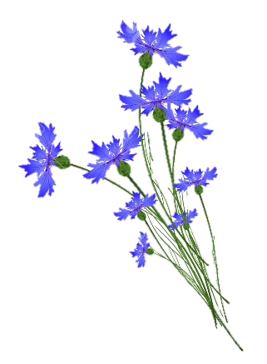
Flowers are found in various shades of blue, pink, white, purple, red and maroon ________.
color

Slide 10
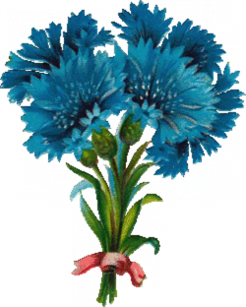
Flowers are consumed raw or cooked or added to ___________ and vegetables.
Young shoots are also consumed.
salads

Slide 11
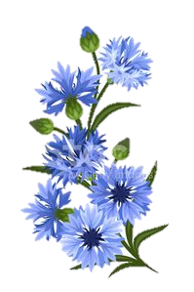
It is also used in desserts.
Petals are used in cornbread ___________ .
It is used as a garnish.
muffins

Slide 12
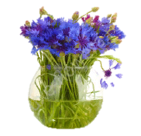
The eyewash prepared from cornflower blossoms for conjunctivitis, eye ailments and tired, strained or puffy ____________ .
eyes

Slide 13
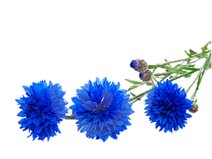
weeds
In fact, in some areas, they are considered __________ for their tendency to self-seed. Sow the seeds in the spring or the fall; the flowering period is from June to September.

Slide 14
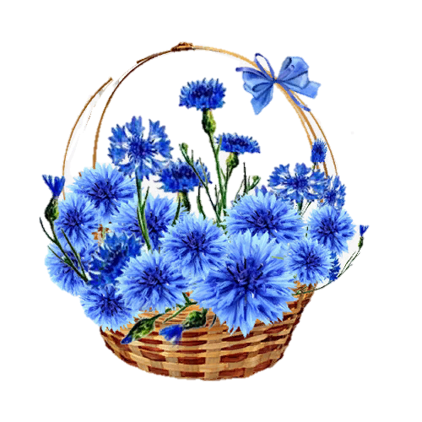
Scientifically known as Centaurea cyanus, is a robust and herbaceous annual plant growing to the ________ of 20 to 85 cm with greygreen, slender and distally branched stem.
height

Slide 15
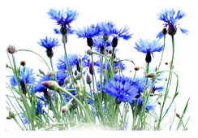
The infusion of flower heads (dried or fresh) is used as a wash on scalp to eliminate __________ .
dandruff

Slide 16
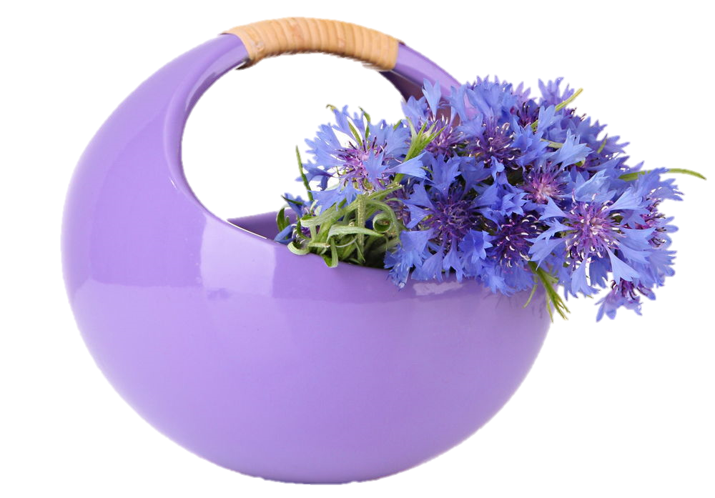
Enjoy cornflowers!
They are decorative and useful flowers!
Many Thanks for Your Attention!

Slide 17
Источник:
Fun Flower Facts: cornflowers https://funflowerfacts.com/2013/05/27/fun-flower-facts-cornflower-centaurea/
Know about the Cornflower https://www.healthbenefitstimes.com/cornflower/
Fun Facts about Cornflowers https://funflowerfacts.com/2013/05/27/fun-flower-facts-cornflower-centaurea/
Изображения взяты на сайте http://yandex.ru
Условия использования сайта https://yandex.ru/legal/fotki_termsofuse/

