Slide 1
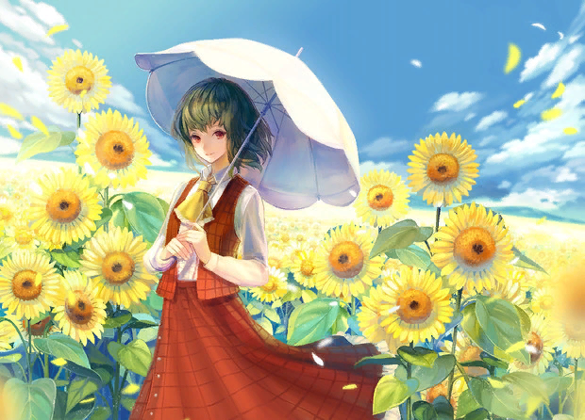
Sunflowers, Sunflowers…
Interactive Story-quiz for the 8th - 10th Formers
Автор:
Ольга Михайловна Степанова
учитель английского языка
МБОУ «Цивильская СОШ №1
имени Героя Советского Союза М.В. Силантьева»
города Цивильск Чувашской Республики
2018

Slide 2
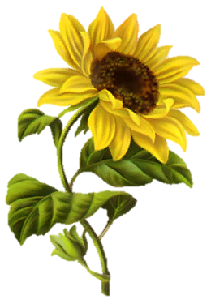
The scientific name for the common sunflower is Helianthus Annuus. Helianthus is made up from two Greek words. Helios means _______and Anthus means flower.
sun

Slide 3
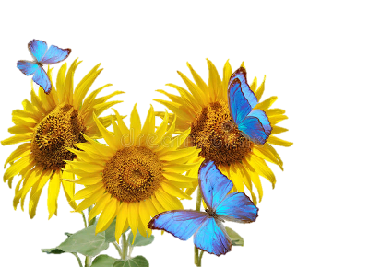
A sunflower is not just a single flower. The large dark middles of these flowers are actually made up from thousands of individual flowers. The dark brown and black centers are tiny flowers, no wonder they are such a haven for all the _______ collecting pollen.
bees

Slide 4
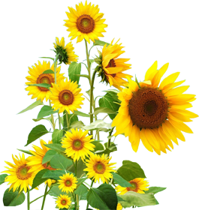
After pollination by bees and other insects, the flowers in the middle of each sunflower grow into edible _________.
seeds

Slide 5
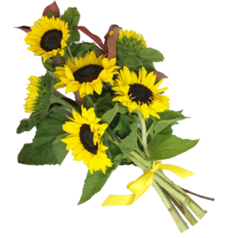
birds
Sunflower seeds are a treat for _________ to eat. We can also eat them. You can buy them ready to eat or harvest your own for snacking on.

Slide 6
The sunflower became the official state flower of Kansas in 1903. Kansas is also referred to as the Sunflower State for this __________.
reason

Slide 7
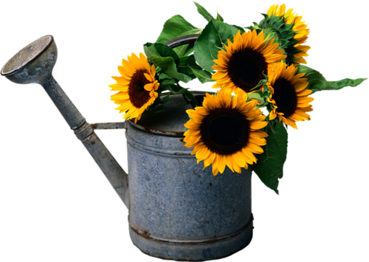
Sunflowers are the national flower of the Ukraine in Eastern Europe. The Ukraine is one of the world's biggest producers of sunflower seeds and also _________.
oil

Slide 8
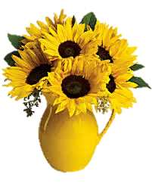
Sunflowers are a symbol of faith and loyalty, optimism and happiness, long life and good _________.
luck

Slide 9
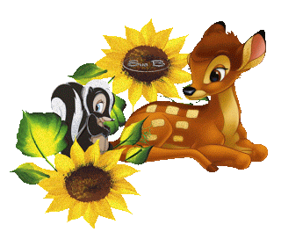
These flowers have many positive meanings but they are also truly positive with the fact that they are able to take up and absorb toxins and heavy
___________
from polluted ground.
metals

Slide 10
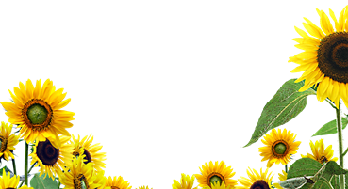
Sunflowers were actually used to help reduce the effects of pollution after nuclear ______________ like Chernobyl.
disasters

Slide 11
This flower has inspired great artists such as Vincent Van ___________ to produced famous and iconic paintings of this flower..
Gogh

Slide 12
It's not actually a fact but there is a folk legend that says if you sleep with a sunflower under your _________ , you will become truly wise.
pillow

Slide 13
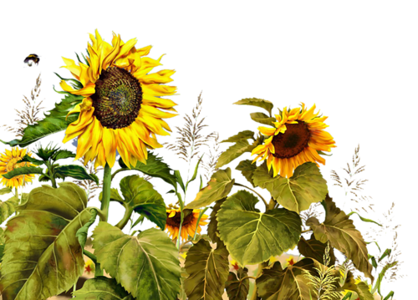
west
They follow the movement of the sun across the sky from east to ________, and this process is known as heliotropism.

Slide 14
Sunflower oil was able to soften leather, condition hair, wounds, and also used as cooking _________, medicine paint, animal feed and bio-diesel.
oil

Slide 15
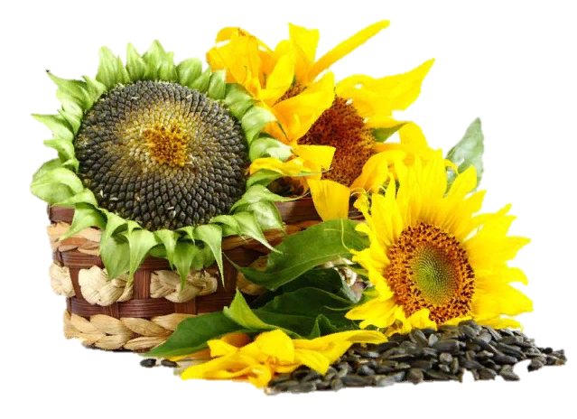
minerals
Oil of sunflower is rich in ___________ like calcium and iron and contains vitamin A and Vitamin D.

Slide 16
Planning to clip a few to display in a vase? If you wait until the afternoon, they may wilt. You should harvest sunflowers in the ___________ , not the afternoon.
morning

Slide 17
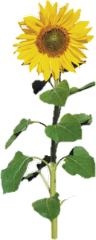
They're not just pretty faces; sunflowers are actually good at absorbing toxins, too. Millions were planted after the devastating tsunami destroyed reactors in the Fukushima nuclear power plant in ____________.
Japan

Slide 18
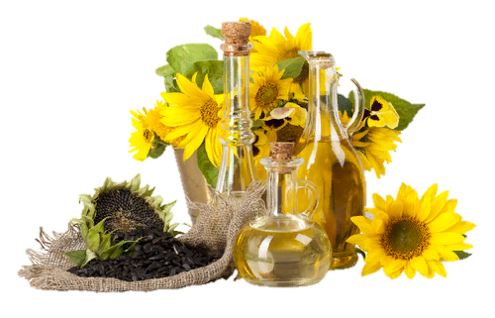
Cultivation of sunflowers started 2600 BC in Mesoamerica. These plants are very popular and widely cultivated today. Sunflowers are not only used as a ____________ of food, oils and pigments. People also cultivate sunflowers because of their ornamental morphology.
source

Slide 19
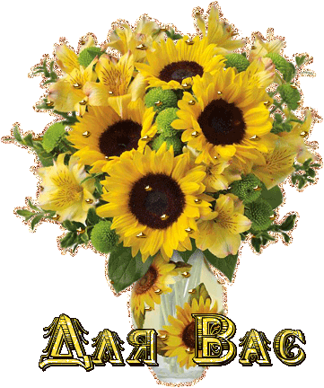
The End
Thank You for Your Attention!

Slide 20
Источник:
20 facts about sunflowers http://www.spinfold.com/20-facts-about-sunflowers/
Sunflower facts for kids and adults http://www.sunflowerjoy.com/2017/07/sunflower-facts.html
Изображения взяты на сайте http://yandex.ru
Условия использования сайта https://yandex.ru/legal/fotki_termsofuse/

