Slide 1
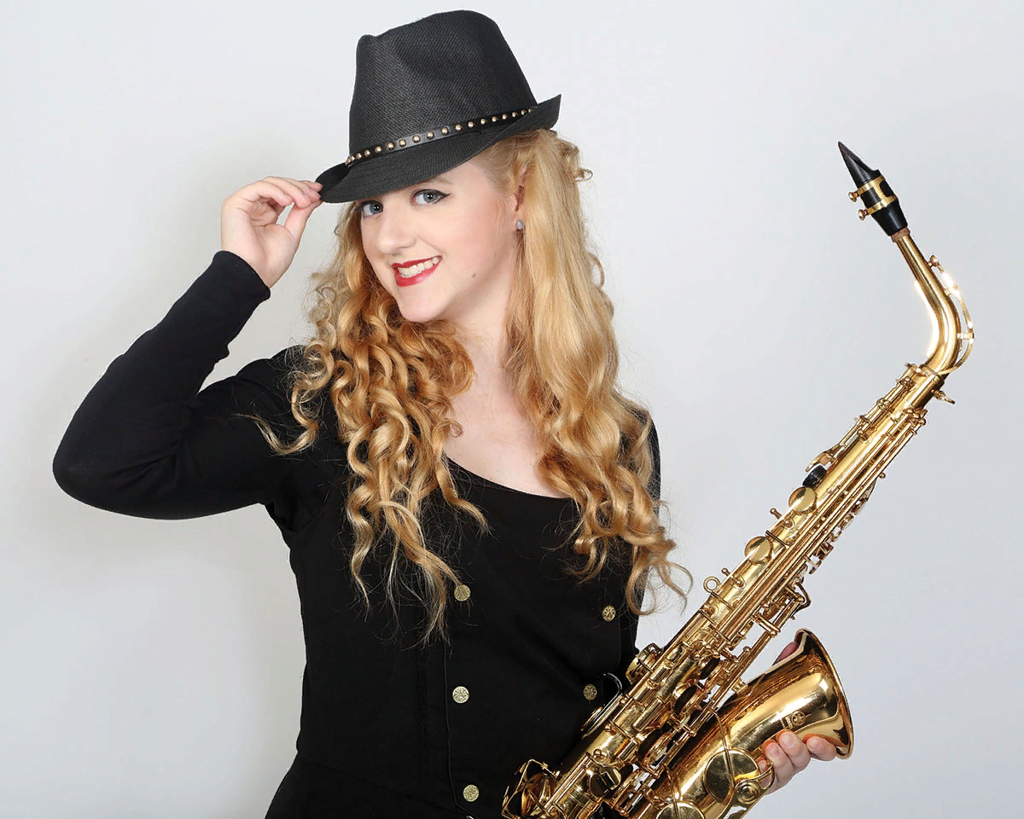
Those Enchanting Saxophone sounds
Интерактивная викторина
для учащихся 8-11 классов
Автор:
Ольга Михайловна Степанова
учитель английского языка
МБОУ «Цивильская СОШ №1
имени Героя Советского Союза
М.В. Силантьева»
города Цивильск
Чувашской Республики
2018

Slide 2
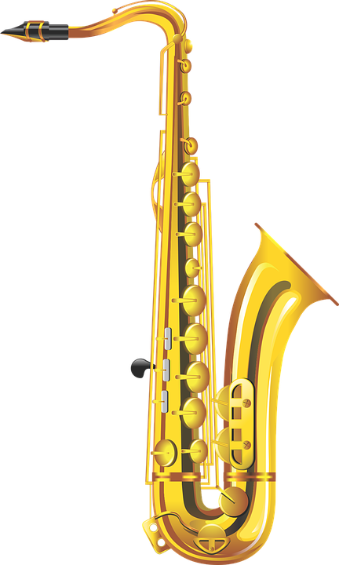
wooden
metal
leather
The saxophone has long been a star instrument in jazz, big bands, and solo performances. It has a ________ body and is played with a single beating reed, which the player controls through his or her mouth tightness.
metal

Slide 3
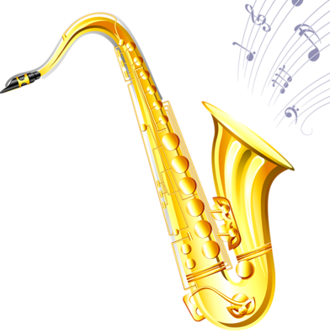
eight
There are ______ different sizes of saxophones in the sax family. The highest pitched ones are known as the Sopranino and Soprano sax. The more moderately middle toned saxes are the Alto and Tenor, while the lowest pitched saxs are Baritone Sax, Bass Sax, Contrabass Sax, and Sub-Contrabass Sax.
eight
seven
six

Slide 4
tune
melody
music
Although the saxophone is usually thought of as a jazz instrument, it has been used successfully with symphonic _______ such as Bizet, Massenet, and Berlioz.
Only four members of the sax family are commonly used today: the Soprano, Alto, Tenor, and Bass Saxophone. The most popular are the Alto and Tenor.
music

Slide 5
Although the saxophone is closely related to the ________ , the fingering of a saxophone is much easier. When the saxophone was first introduced to jazz, many musicians resisted the saxophone for a time.
flute
trombone
clarinet
clarinet

Slide 6
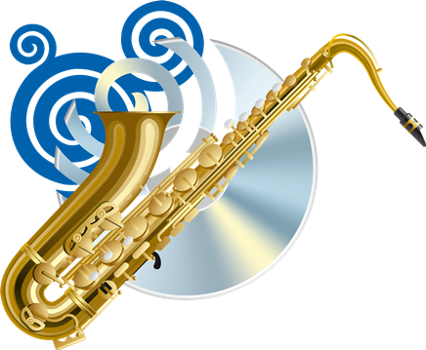
Claude Debussy talked about the saxophone as an “ __________ instrument”. He wrote Rhapsody for orchestra and Saxophone, commissioned by Elisa Hall, a wealthy woman from Boston who was told that playing the saxophone would improve her health.
aquatic
aquatic
air
fire

Slide 7
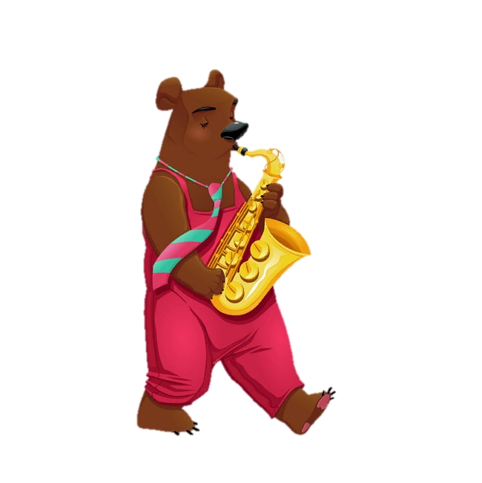
wind’s
human
nightingale’s
If you like an instrument that sings, play the saxophone. At its best it's like the ________ voice.
Stan Getz
human

Slide 8
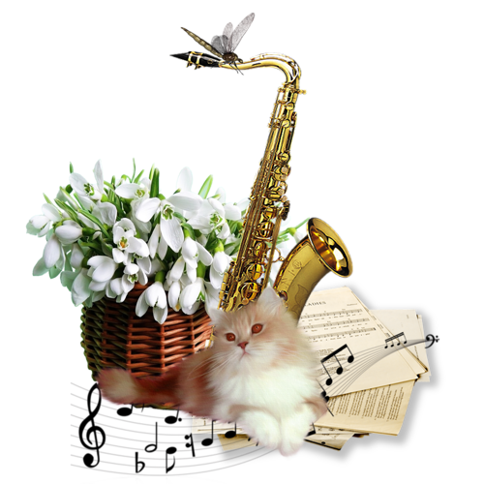
cohabit
cooperate
coexist
That's the beautiful thing about the saxophone. It can peacefully _________ with just about anything - whether it's hip-hop, rap, rock music, pop, R&B or jazz, there's a place for the saxophone in all of those styles.
Dave Koz
coexist

Slide 9
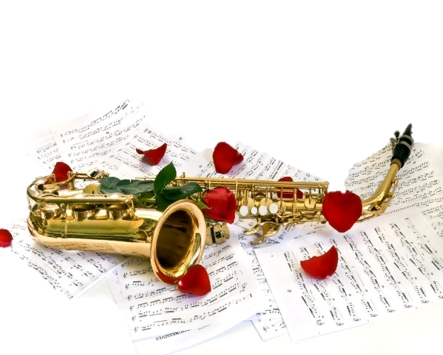
The saxophone is so human. Its tendency is to be rowdy, edgy, talk too loud, bump into people... but then, you take a breath all the way from the center of the earth and blow. All that heartache is forgiven. All that love we humans carry makes a sweet, deep sound and we ________ a little.
Joy Harjo
fly
fly
cry
dance

Slide 10
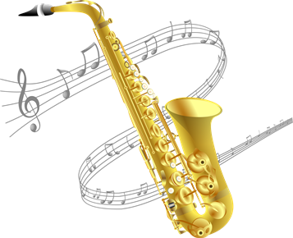
Ronald Reagan
George Bush
Bill Klinton
Former United States President __________
is an accomplished saxophone player.
Bill Klinton

Slide 11
If all else fails, I could go to a train station and open up my saxophone case and make some bucks. I can do "Mary Had A Little Lamb," I can do "Happy ____________ ."
Sean Price
Birthday
New Year
Journey
Birthday

Slide 12
Adolphe Sax ,
clarinetist, flautist and instrument maker from Belgium.
By the way, in 1840, Adolphe Sax created saxophone. He was a _________ instrument maker.
Belgian
British
Belgian
French

Slide 13
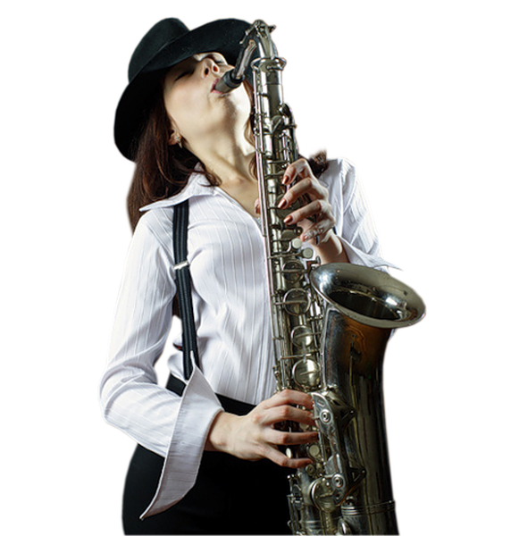
Enjoy playing the saxophone !
It is a really enchanting instrument that touches your heart!

Slide 14
Ресурсы:
Saxophone Facts http://www.softschools.com/facts/music/saxophone_facts/2763/
Saxophone Quotes https://www.azquotes.com/quotes/topics/saxophone.html
Изображения взяты на сайте http://yandex.ru
Условия использования сайта https://yandex.ru/legal/fotki_termsofuse

