Slide 1
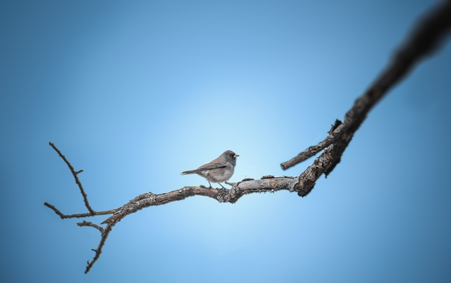
Birds. Arguments and Facts
Познавательная мини-игра
в стиле
«Кто хочет стать миллионером?»
для учащихся 8-11 классов
Автор:
Ольга Михайловна Степанова
учитель английского языка
МБОУ «Цивильская СОШ №1
имени Героя Советского Союза
М.В. Силантьева»
города Цивильск Чувашской Республики
2018

Slide 2
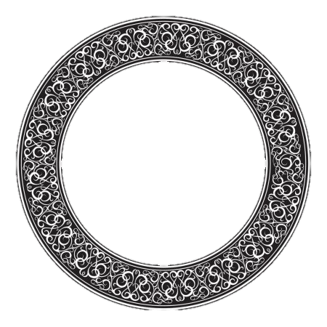

Slide 3
The Game
“Who wants to be a Millionaire?”
Contains Questions about Birds.
Your Task is to Choose the Right Answer.
Good Luck!

Slide 4
50/50
1 000 000
500 000
250 000
125 000
100 000
50 000
5 000
1000
500
100

Slide 5
50/50
1 000 000
500 000
250 000
It has the largest eye of any land animal, measuring almost 5 cm across, allowing predators such as lions to be seen at long distances. Flightless, it is the world’s largest bird. They have three stomachs. What is it?
125 000
100 000
25 000
5 000
А Ostrich
В Pelican
1000
500
Б Eagle
Г Peacock
100

Slide 6
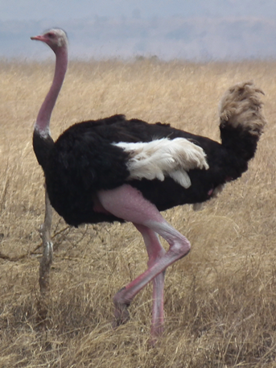
Congratulations!
You have got
100 points!

Slide 7
50/50
1 000 000
500 000
250 000
125 000
100 000
50 000
5 000
1000
500
100

Slide 8
50/50
1 000 000
500 000
Seed eating passerine bird,
Small, pink legged, conical bill
Grey brown, black throated males,
Grey brown with eye bordered females,
Black and tawny streaks on back,
Black winged feathers with white patches
Grayish white breasted birds. ..
What are they?
/
250 000
125 000
100 000
50 000
5 000
А Starling
В Skylark
1000
500
Б Stork
Г Sparrow
100

Slide 9
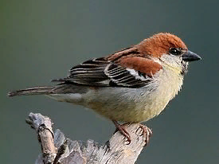
Congratulations!
You have got 500 points!

Slide 10
50/50
1 000 000
500 000
250 000
125 000
100 000
50 000
5 000
1000
500
100

Slide 11
50/50
1 000 000
500 000
They are a common type of bird in New Guinea, and they’re the only known type of poisonous birds in the world. They have poison in their skin and feathers. Researchers believe they don’t produce the poison themselves, it comes from a toxin-producing beetle in their diet. What is it?
250 000
125 000
100 000
50 000
5 000
1000
А Blackcock
В Oriole
500
Б Pitohui
Г Catbird
100

Slide 12
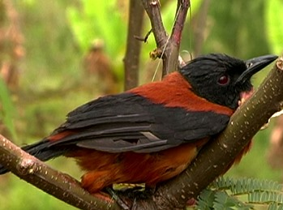
Congratulations!
You have got
1000 unburnable points!

Slide 13
50/50
1 000 000
500 000
250 000
125 000
100 000
50 000
5 000
1000
500
500
100
100

Slide 14
50/50
1 000 000
500 000
They are crested parrots that inhabit the Australian continent. Their crest rises when the birds are threatened, angry or excited. They are usually white, but there are also pink, yellow, orange, black or grey ones. They are social, friendly, loyal and loving animals, and therefore they make great pets.
250 000
125 000
100 000
50 000
5 000
А Cockatoos
В Cuckoo
1000
500
500
Б Dove
Г Pelican
100
100

Slide 15
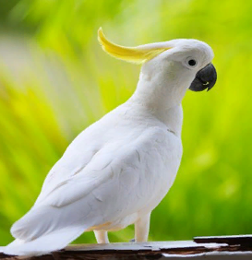
Congratulations
You are right!

Slide 16
50/50
1 000 000
500 000
250 000
125 000
100 000
50 000
5 000
1000
500
100

Slide 17
50/50
1 000 000
500 000
This is the only bird with nostrils at the end of its beak. This placement helps it sniff for food, such as worms and insects on the ground. It often snorts to clear its nostrils. Most of these birds are nocturnal ones, like many of New Zealand's native animals.
250 000
125 000
100 000
50 000
5 000
А Owl
В Kiwi
1000
500
Б Crow
Г Woodpecker
100

Slide 18
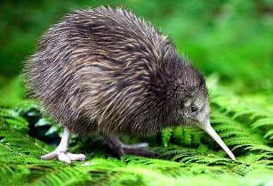
Congratulations
You have got 50 000 points!

Slide 19
50/50
1 000 000
500 000
250 000
125 000
100 000
50 000
5 000
1000
500
100

Slide 20
50/50
1 000 000
500 000
The name of this bird comes from the Spanish and Latin word which means fire, and refers to the bright color of the birds' feathers. They usually are pink because their food contains an organic chemical called beta carotene.
250 000
125 000
100 000
50 000
5 000
А Heron
В Crane
1000
500
Б Flamingo
Г Swan
100

Slide 21
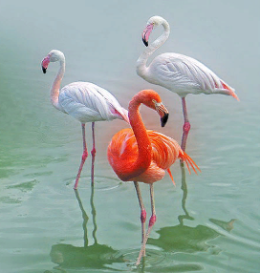
Congratulations!
You have got
100 000 unburnable points!

Slide 22
50/50
1 000 000
500 000
250 000
125 000
100 000
50 000
5 000
1000
500
100

Slide 23
50/50
1 000 000
500 000
They have been described as “the most legendary of all birds.” There is a myth that sailors do not shoot or eat them because they think it will bring bad luck, but in reality sailors regularly killed and ate them, as reported by James Cook in 1772. This is a (an) ………. .
250 000
125 000
100 000
50 000
5 000
А Ibis
В Seagull
1000
500
Б Puffin
Г Albatross
100

Slide 24
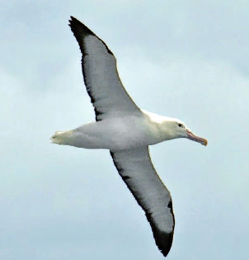
Congratulations!
You have got 125 000 points!

Slide 25
50/50
1 000 000
500 000
250 000
125 000
100 000
50 000
5 000
1000
500
100

Slide 26
50/50
1 000 000
500 000
It is is the national bird of Iran. These birds’ songs served as inspiration for many famous musicians (Beethoven and Tchaikovsky), writers (Homer, Sophocles, William Shakespeare and John Keats) and even philosophers (Aristotle).
250 000
125 000
100 000
50 000
5 000
А Robins
В Nightingales
1000
500
Б Swallows
Г Magpies
100

Slide 27
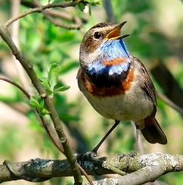
Congratulations!
250 000 points!
You are so near to be a Millionaire!

Slide 28
50/50
1 000 000
500 000
250 000
125 000
100 000
50 000
5 000
1000
500
100

Slide 29
50/50
1 000 000
500 000
250 000
They are the only birds that fly backward! Despite their small size, hummingbirds are one of the most aggressive bird species. They will regularly attack jays, crows and hawks that infringe on their territory.
125 000
100 000
50 000
5 000
A Tits
В Canaries
1000
500
Б Cardinals
Г Hummingbirds
100

Slide 30
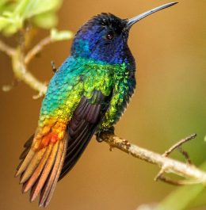
Congratulations!
500 000 points!
A real Chance to be the Winner!

Slide 31
50/50
1 000 000
500 000
250 000
125 000
100 000
50 000
5 000
1000
500
100

Slide 32
50/50
1 000 000
500 000
There are some states in USA which use this bird as the official state bird. They are Tennessee, Mississippi, Florida, Arkansas and Texas.
The unique feature that a mockingbird has is on the sound. It can imitate many sounds such as the barking dogs and sirens.
250 000
125 000
100 000
50 000
5 000
А Mockingbird
В Siskin
1000
500
Б Flycatcher
Г Cuckoo
100

Slide 33
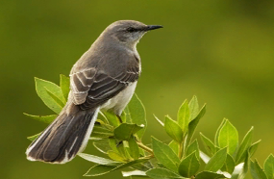
Congratulations!
You are a Millionaire!

Slide 34
The End
Hooray For the Winner!
See YOU!

Slide 35
Очень жаль!
Вы покидаете игру
без выигрыша.
Продолжить игру
Покинуть игру

Slide 36
Очень жаль!
Вы покидаете игру
без выигрыша.
Продолжить игру
Покинуть игру

Slide 37
Очень жаль!
Вы покидаете игру
без выигрыша.
Продолжить игру
Покинуть игру

Slide 38
Вы покидаете игру.
Ваш выигрыш составил
1 000 рублей.
Продолжить игру
Покинуть игру

Slide 39
Вы покидаете игру.
Ваш выигрыш составил
1 000 рублей.
Продолжить игру
Покинуть игру

Slide 40
Вы покидаете игру.
Ваш выигрыш составил
1 000 рублей.
Продолжить игру
Покинуть игру

Slide 41
Вы покидаете игру.
У Вас 100 000 рублей!
Продолжить игру
Покинуть игру

Slide 42
Вы покидаете игру.
У Вас 100 000 рублей!
Продолжить игру
Покинуть игру

Slide 43
Вы покидаете игру.
У Вас 100 000 рублей!
Продолжить игру
Покинуть игру

Slide 44
Вы покидаете игру.
У Вас 100 000 рублей!
Продолжить игру
Покинуть игру

Slide 45
See You!

Slide 46
Ресурсы интернета
Скочилова Н Шаблон игры «Кто хочет стать миллионером?» https://xn--j1ahfl.xn--p1ai/library/shablon_igri_kto_hochet_stat_millionerom_192031.html
Ostrich https://onekindplanet.org/animal/ostrich/
Sparrow poems http://natureforever.org/sparrow_supporters/sparrowpoems
Interesting facts about albatrosses http://justfunfacts.com/interesting-facts-about-albatrosses/
101 colouful facts about birds https://www.factretriever.com/bird-facts
Nightingale facts http://www.softschools.com/facts/animals/nightingale_facts/2710/
http://img842.imageshack.us/img842/1323/uq8sx.jpg - заставка игры
http://do.gendocs.ru/pars_docs/tw_refs/125/124165/124165_html_m1d622ee3.png - рисунок профессора
https://zvuk.top/tracks/кто-хочет-стать-миллионером
звуки к игре

