Slide 1
Keep Your Heart Healthy!
Интерактивная лекция-викторина
для учащихся 8-11 классов
Автор:
Ольга Михайловна Степанова
учитель английского языка
МБОУ «Цивильская СОШ №1
имени Героя Советского Союза М.В. Силантьева»
города Цивильск Чувашской Республики
2017

Slide 2
Make time to play! Ride bikes, take a walk, go swimming or play ___________ outside. It is the best way to keep your heart healthy!
games
Keep moving!

Slide 3
All kinds of exercises are important, from strength training and aerobics, to flexibility and stretching exercises.
Aim for a 10-minute morning walk, workout with hand weights at lunch, and some digging in the garden before dinner, and you’ve met your _________.
goals
Move, move and keep moving!

Slide 4
role
Believe it or not but our emotions play a crucial _________ in our well-being. A positive mindset can work wonders in helping you deal with various ailments. A recent study has found that people with heart disease may benefit from maintaining positive emotions.
Be positive!

Slide 5
Stress is a significant villain of heart health and really any health issue. It can wreak havoc.
Avoid stressful situations and try to be calm. By the way, it’s widely believed that dog owners are less prone to _____________than the dog-les.
depression
Keep calm and have healthy heart!

Slide 6
Excessive screen time leads to a sedentary lifestyle and constant snacking, which increases the risk for obesity and cardiovascular disease. Limit TV, computer and phone time to two _________ each day.
hours
Limit screen time !

Slide 7
Your kitchen should be 100 percent full of whole wheat or grains, low-fat dairy products, poultry, fish and nuts.
Well, drink __________ instead of sugary drinks. And … cut the salt!
water
Keep healthy options on hand!

Slide 8
Eat lots of fiber. We know from the scrolls we found in the Grains section that whole wheat foods like brown rice, whole wheat pasta and whole grains bread are great __________ of fiber. We also know that fresh fruits and vegetables give us lots of fiber. Don’t forget tasty beans!
Eat healthy fats
sources
Add the 'Food Rules' to Your Memory!

Slide 9
Eat healthy fats, NOT trans fat
which is known to increase your risk of developing heart disease or having a stroke over a lifetime. They are industry-produced fats often used in packaged baked goods, snack foods, margarines and fried fast ________to add flavor and texture. So, avoid trans-fat!
foods
Keep track of what you eat!

Slide 10
Dental health is a good indication of overall health, including your heart, because those who have periodontal disease often have the same risk factors for heart disease. Studies have shown that bacteria in the mouth may increase your ________ of heart disease and stroke.
risk
Practice good dental hygiene!

Slide 11
Gaining weight is a constant threat for most people in the world of cheap, convenient, and decadent foods. And extra pounds -- especially if you tip into obesity -- raise the risk of a heart attack, stroke, and high blood _________ .
pressure
Work Toward a Healthy Body Weight!

Slide 12
Sleep is an essential part of keeping your heart healthy. If you don’t sleep enough, you may be at a higher risk for cardiovascular disease no matter your age or other health habits. Get 7 to 8 hours of sleep most nights. If you have sleep apnea, you should be treated as this condition is linked to heart __________ and arrhythmias.
disease
Make sleep
a priority!

Slide 13
Using ANY tobacco product damages nearly EVERY organ in your ________ and can cause heart disease and cancer. Using smokeless tobacco is NOT a safe alternative to smoking!
body
Don’t even think about smoking!

Slide 14
Dogs don’t just fill your heart; they actually make it stronger. Studies show that having a canine companion is linked to lower blood pressure, reduced cholesterol, and decreased triglyceride levels, which contribute to better overall cardiovascular health and fewer heart __________ .
attacks
Your Dog improves your heart health!

Slide 15
Keeping your heart healthy is simple when you look at the big picture:
Get exercise. Eat right. Stress less. Watch your weight. Don’t smoke. Get a four-legged friend – a dog!

Slide 16
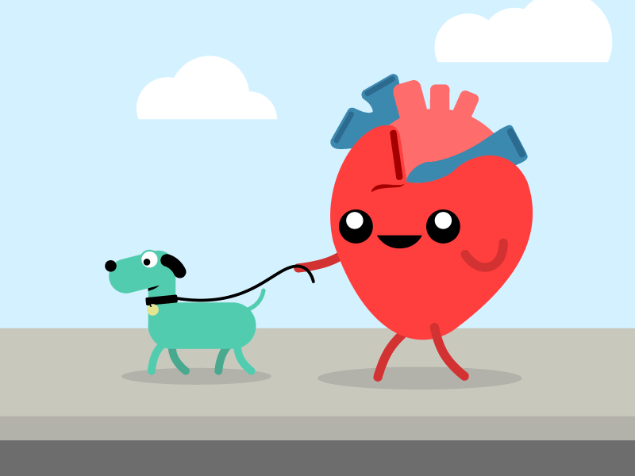
Keep Your Heart Healthy!

Slide 17
Источник:
6 Simple Steps to Keep Your Heart Healthy https://www.webmd.com/diet/features/6-simple-steps-to-keep-your-heart-healthy#1
5 Things to Do Daily to Keep Your Heart Healthy https://health.clevelandclinic.org/5-things-to-do-daily-to-keep-your-heart-healthy/
Hey Kids, Eat a Heart-Healthy Diet http://www.heart.org/HEARTORG/HealthyLiving/HealthyKids/LifesSimple7forKids/Hey-Kids-Eat-a-Heart-Healthy-Diet_UCM_466602_Article.jsp
Изображения взяты на сайте http://yandex.ru
Условия использования сайта https://yandex.ru/legal/fotki_termsofuse/

