Slide 1
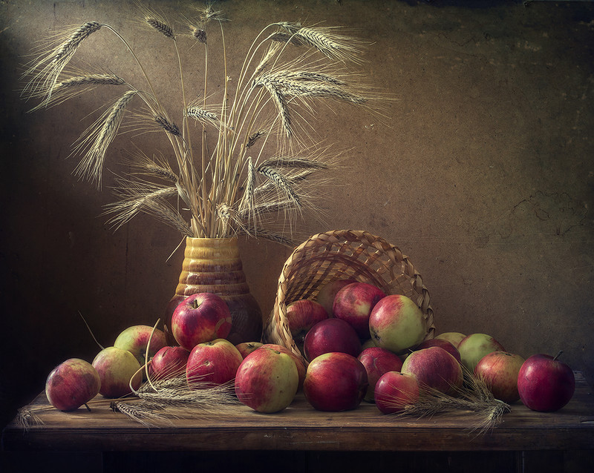
Apple Still life
Интерактивная викторина для учащихся 4-6 классов
Автор:
Ольга Михайловна Степанова
учитель английского языка
МБОУ «Цивильская СОШ №1
имени Героя Советского Союза М.В. Силантьева»
города Цивильск
Чувашской Республики
2018

Slide 2
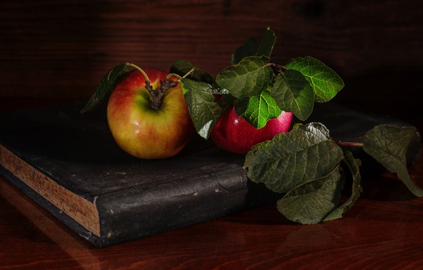
Are the apples on the book or under the book?
On the book!

Slide 3
How many apples are there in the basket?
Three!

Slide 4
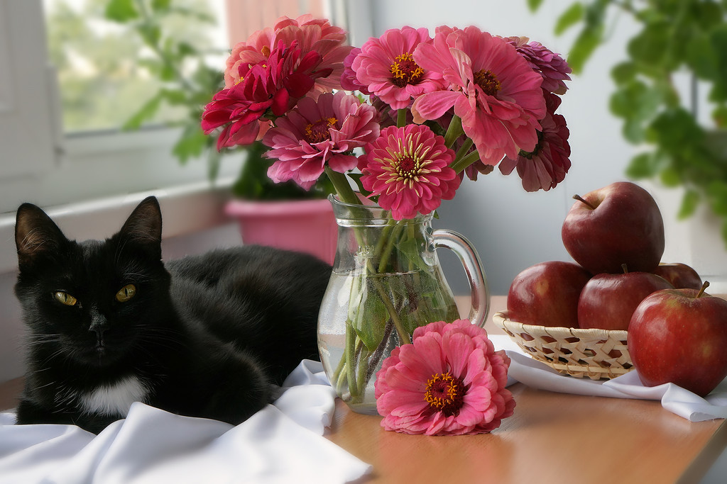
Are the apples on the left or on the right ?
On the right!

Slide 5
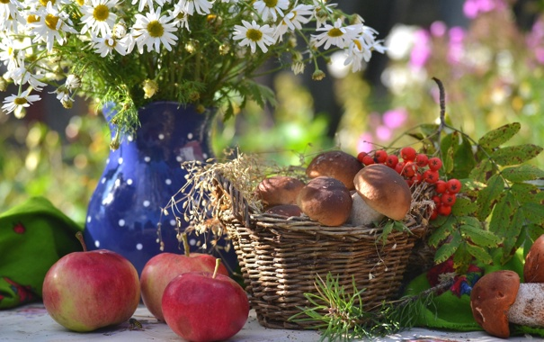
Are there mushrooms or apples in the basket?
Mushrooms!

Slide 6
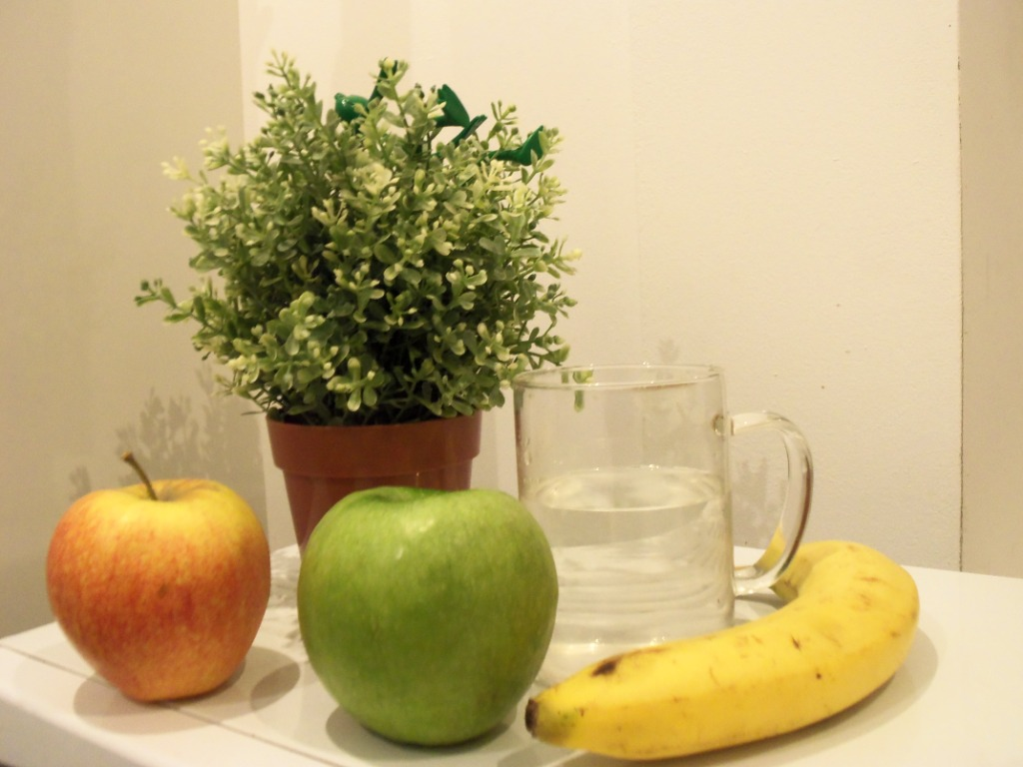
Is the glass of water behind the green apple or
behind
the red apple?
Behind
the green apple!

Slide 7
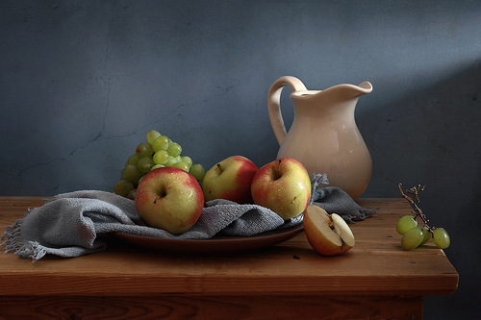
grapes
There are two kinds of fruits on the table – apples and __________.

Slide 8
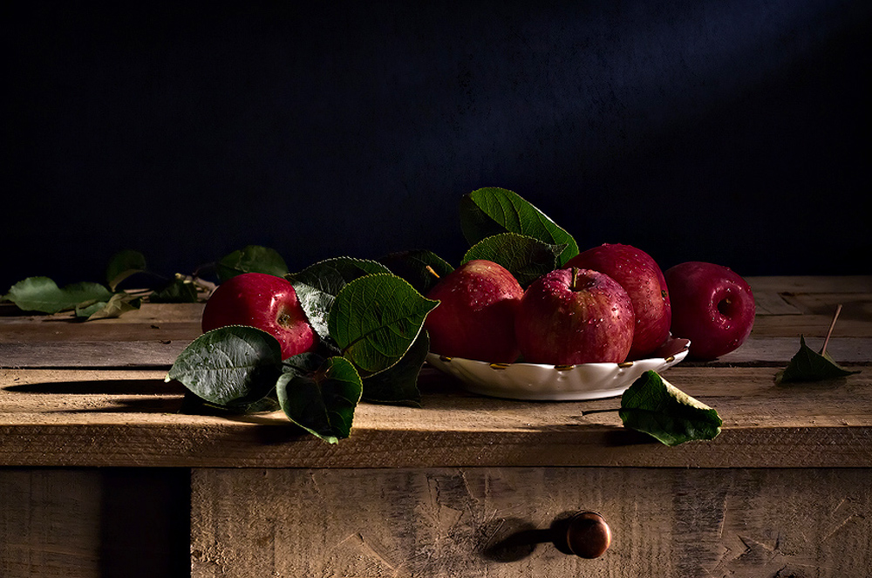
How many apples are there on the table?
Five!

Slide 9
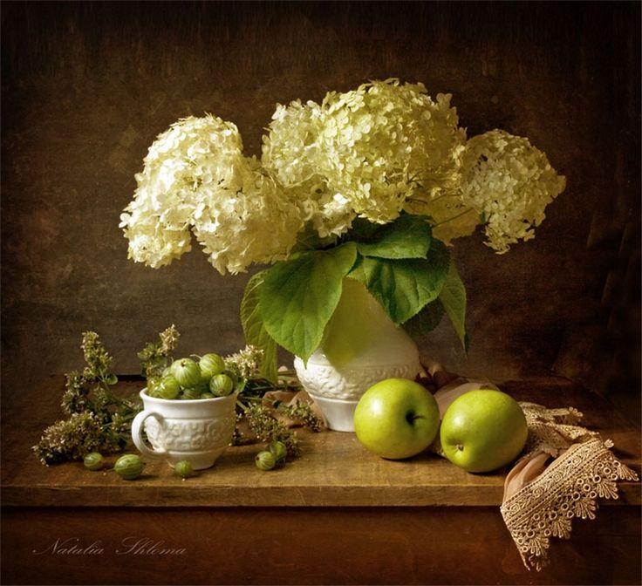
Are there gooseberries or strawberries
next
to the
apples?
Gooseberries !

Slide 10
Are there any flowers on the table with apples?
No, there aren’t!

Slide 11
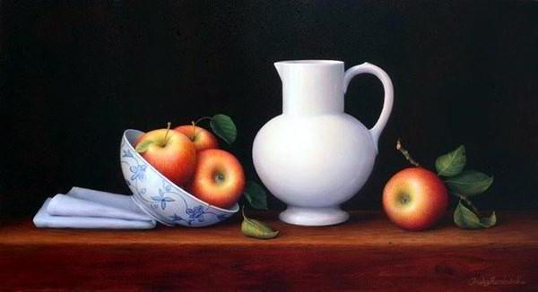
The jug is between the apples, isn’t it?
Yes, it is!

Slide 12
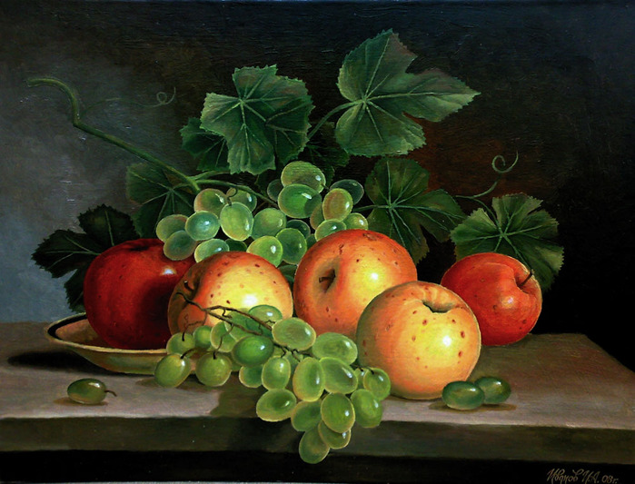
Are the apples green?
No, they aren’t. They are red!

Slide 13
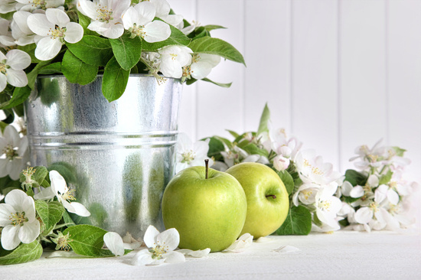
Is there a pail or a jug next to the apples?
A pail!

Slide 14
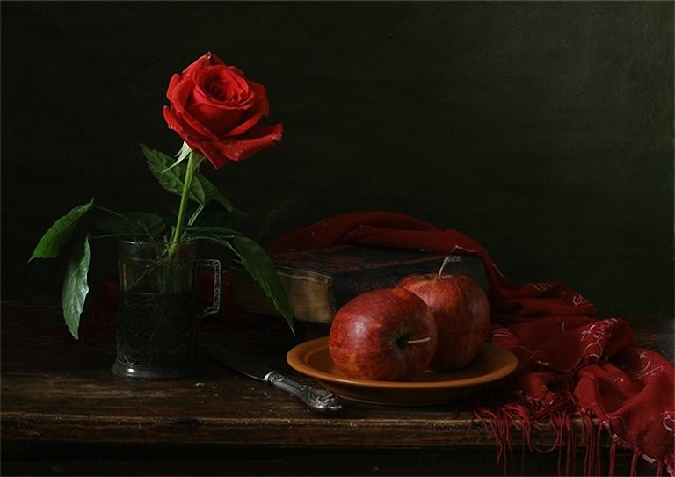
There are two apples, one book, one glass, one knife and one _______ on the table.
rose

Slide 15
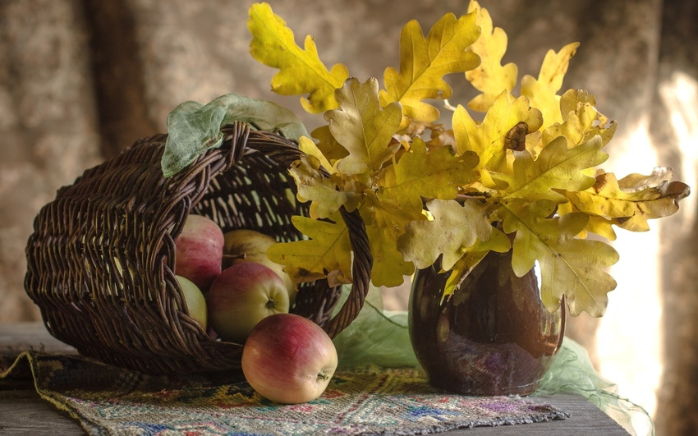
Is it an oak or a maple that gave its leaves for the bouque?
An oak!

Slide 16
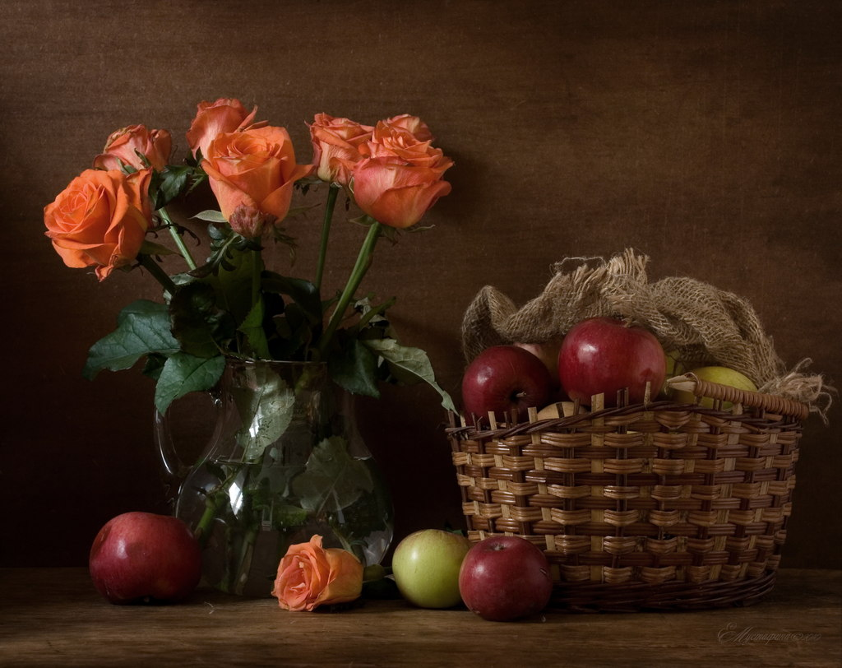
What flowers decorate the table with apples?
Roses!

Slide 17
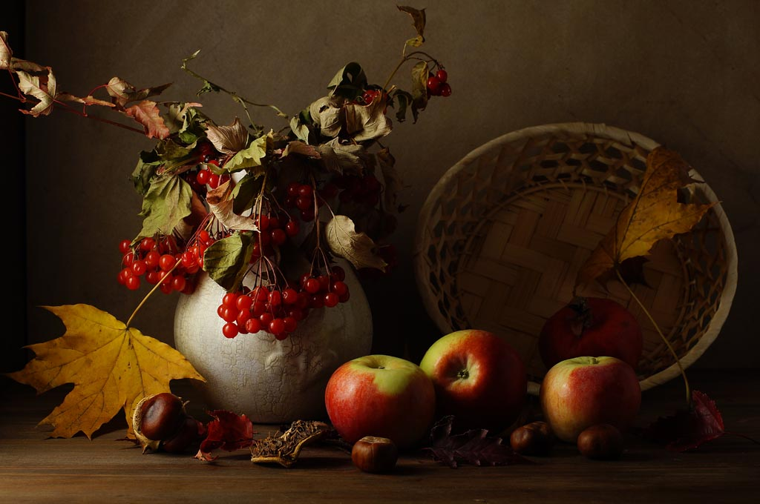
There are seven apples on the table, aren’t there?
No, there aren’t. There are four!

Slide 18
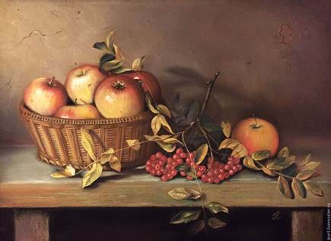
The basket of apples is on the wooden table, isn’t it?
Yes, it is!

Slide 19
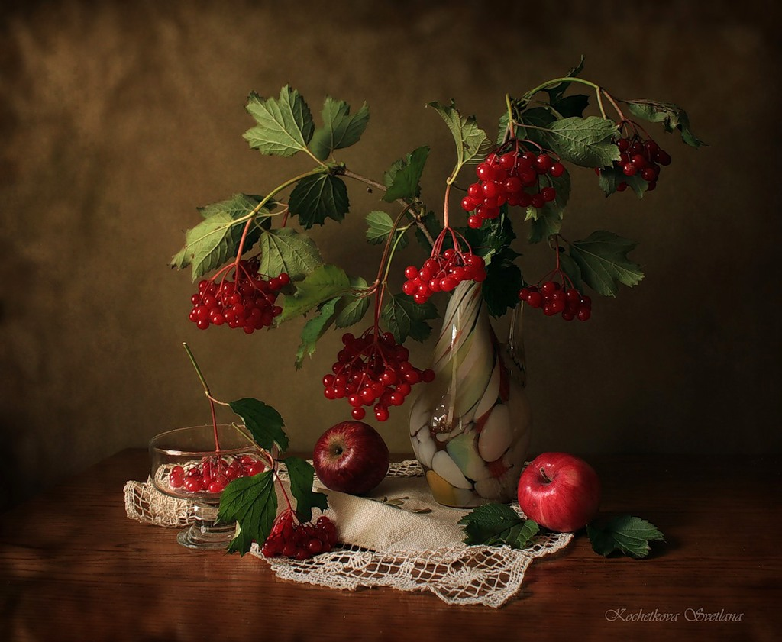
The viburnum and the apples are red. What is viburnum for Russian?
Калина!

Slide 20
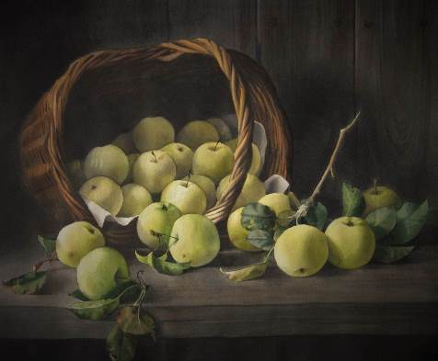
How many apples were fallen out of the basket?
Nine!

Slide 21
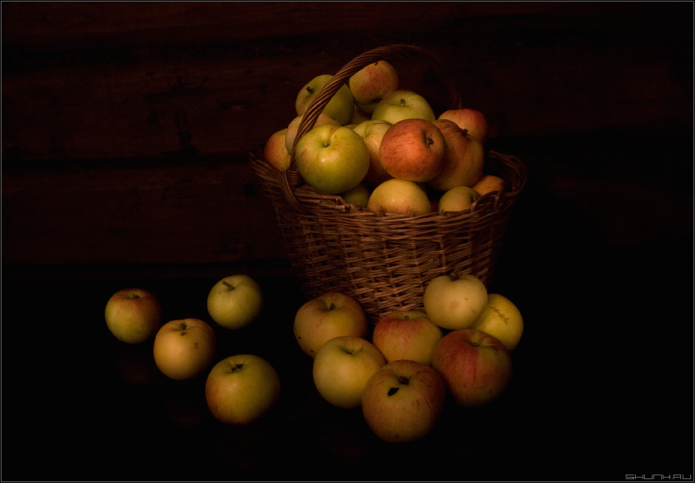
Is the basket full of apples?
Yes, it is!

Slide 22
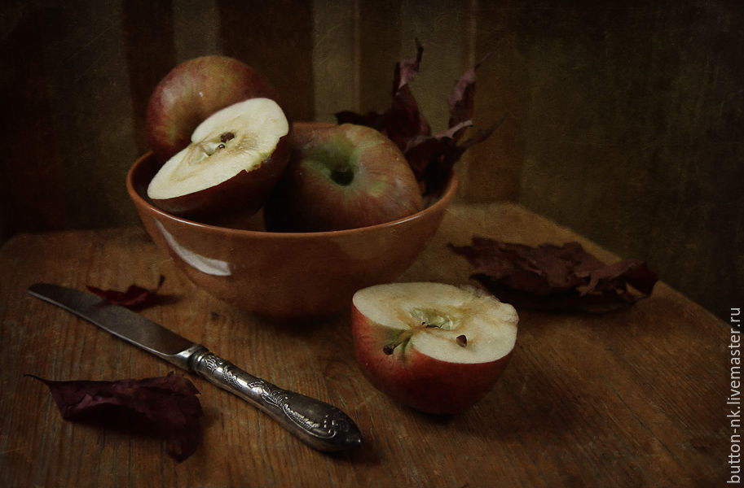
Is there a knife or a spoon on the table?
A knife!

Slide 23
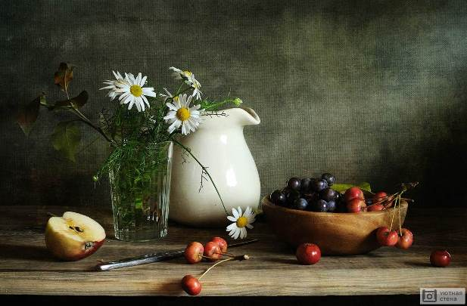
What an apple is there on the table?
Half an apple!

Slide 24
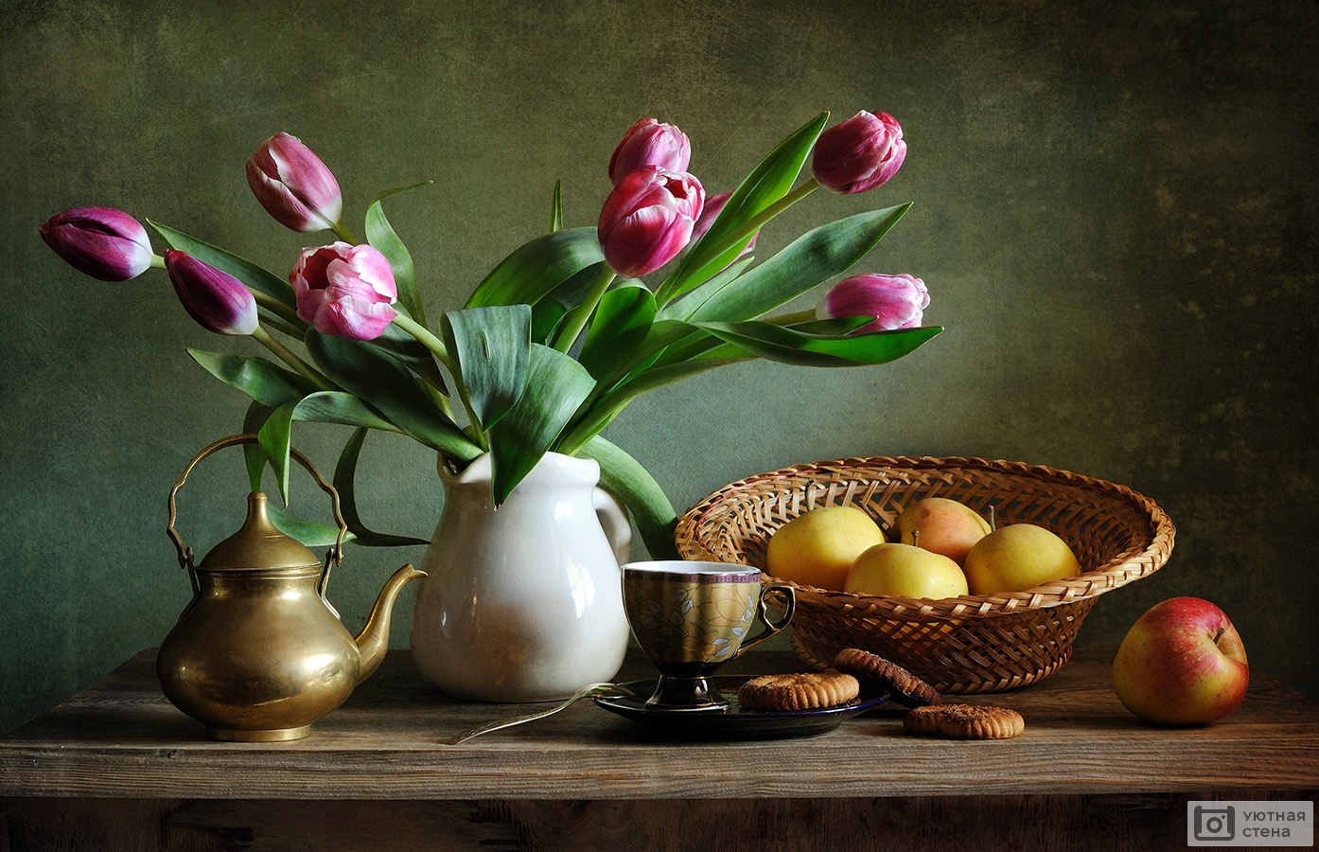
What kind of flowers are there in the vase next to the apples?
Tulips!

Slide 25
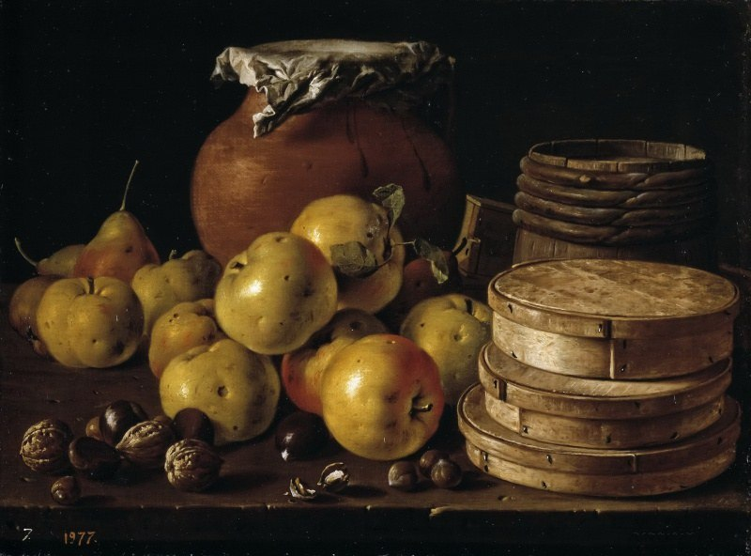
What fruit is there behind the apples?
Pears!

Slide 26
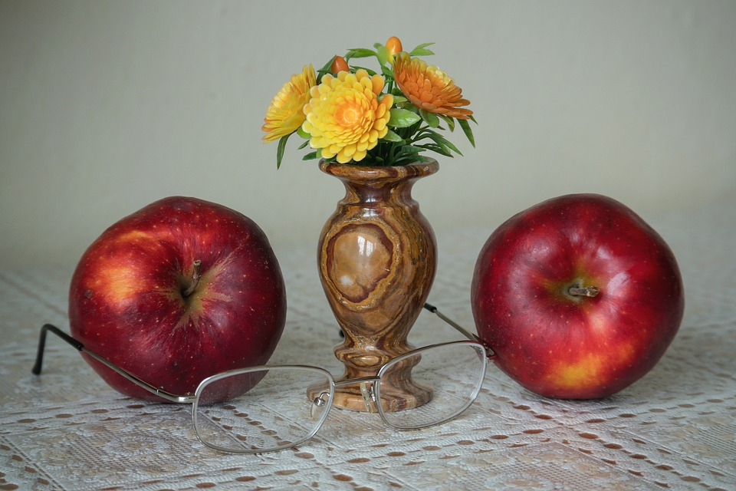
Between the apples!
Is the vase between the apples or behind the apples?

Slide 27
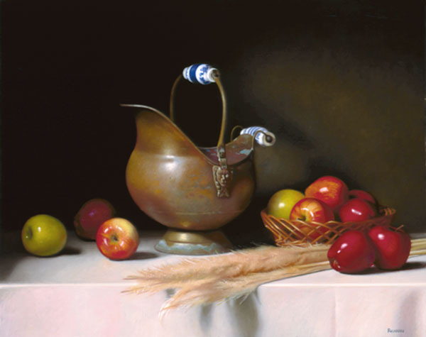
How many green apples can you see?
Two!

Slide 28
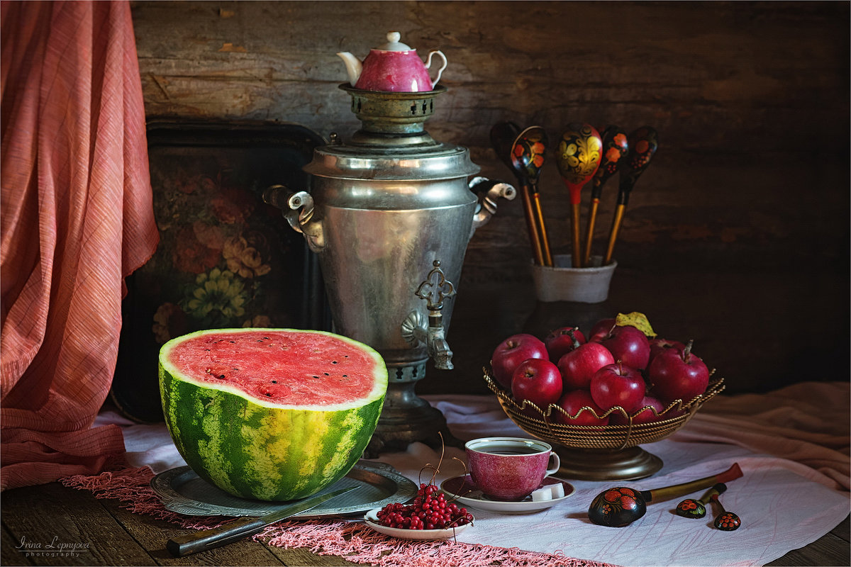
How many spoons can you see?
Eight!

Slide 29
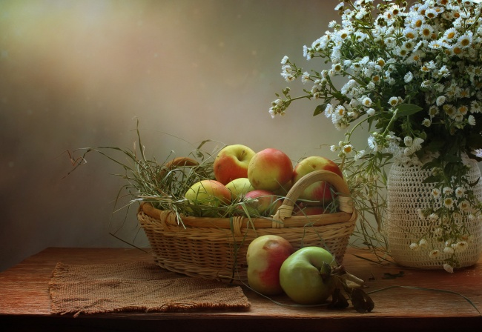
Are the apples in a pail or in a basket?
In a basket!

Slide 30
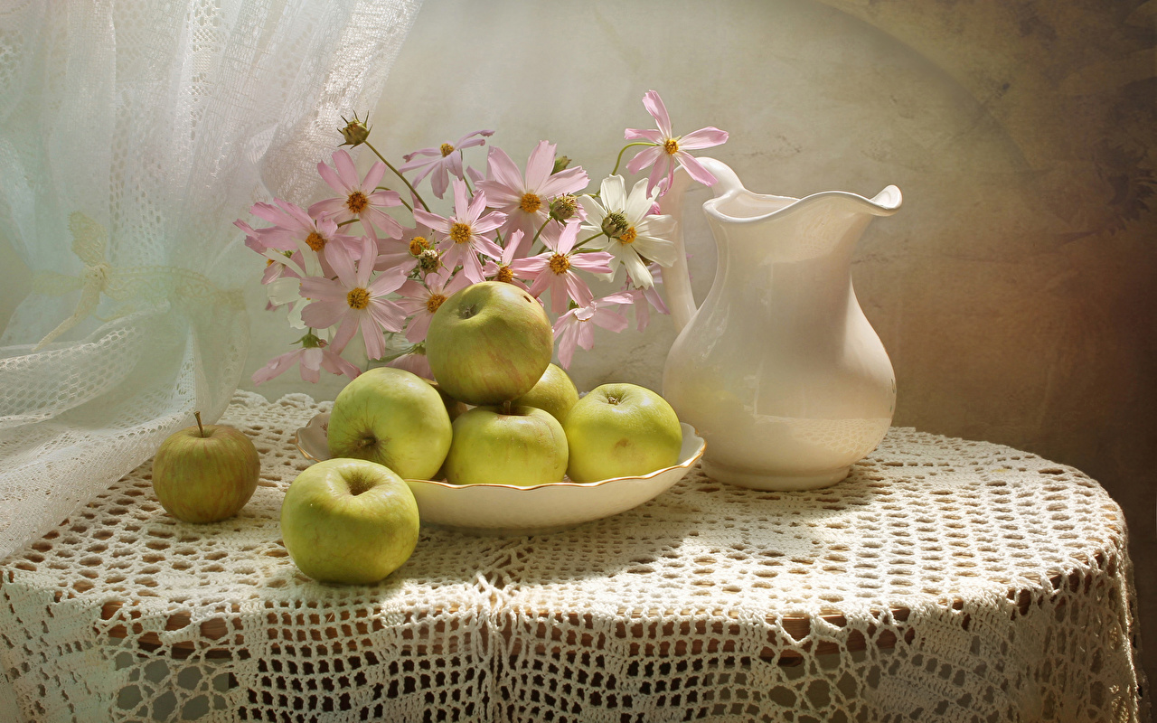
Are the apples behind the flowers or in front of the flowers?
In front of the flowers!

Slide 31
The End
Congratulations
to the winners!

Slide 32
Источник: Все изображения для презентации взяты на сайте http://yandex.ru
Условия использования сайта https://yandex.ru/legal/fotki_termsofuse/

