Slide 1
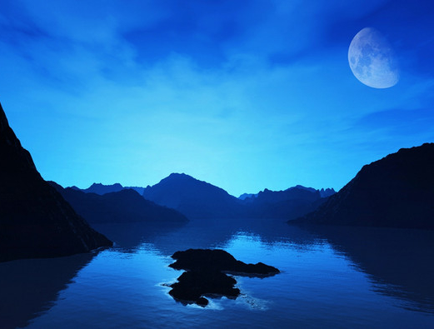
The Color Blue
That Rules!
Interactive Facts Story
for 8th -10th Formers
Автор:
Ольга Михайловна Степанова
учитель английского языка
МБОУ «Цивильская СОШ №1
имени Героя Советского Союза М.В. Силантьева»
города Цивильск Чувашской Республики
2018

Slide 2
Blue is a cool colour, it’s the colour of the sky
and sea.
It symbolises stability, loyalty,
confidence, intelligence and peace. Here are some facts!

Slide 3
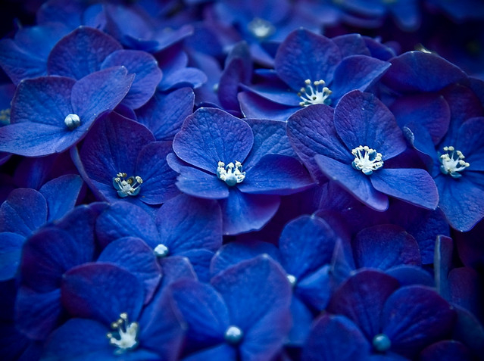
Blue is associated with air ________ and the navy.
mail

Slide 4
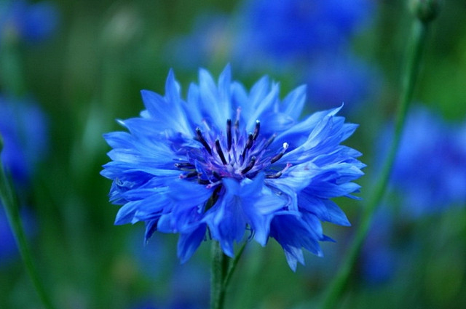
In ancient Rome, blue was worn by the public servants, which marked the
beginning of the idea for today’s police
___________ .
uniforms

Slide 5
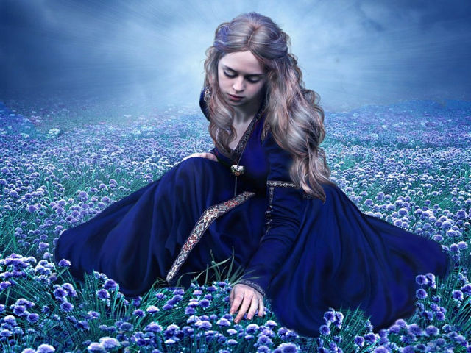
The colour blue has a Biblical meaning symbolizing heavenly grace. The Virgin
Mary is often depicted wearing blue __________ .
clothing

Slide 6
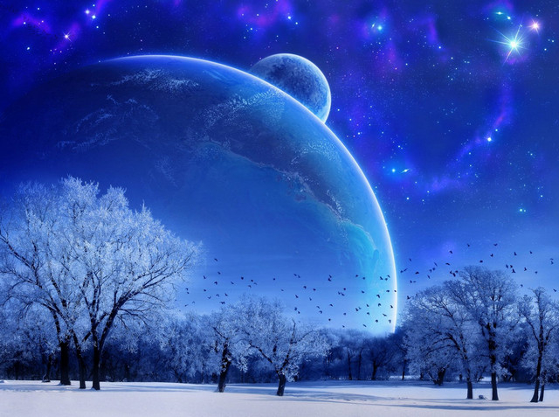
luck
In India, blue is thought to bring bad _________ and is associated with mourning.

Slide 7
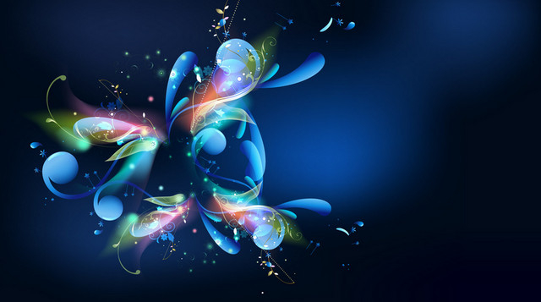
Blue was traditionally associated with pain in __________ .
China

Slide 8
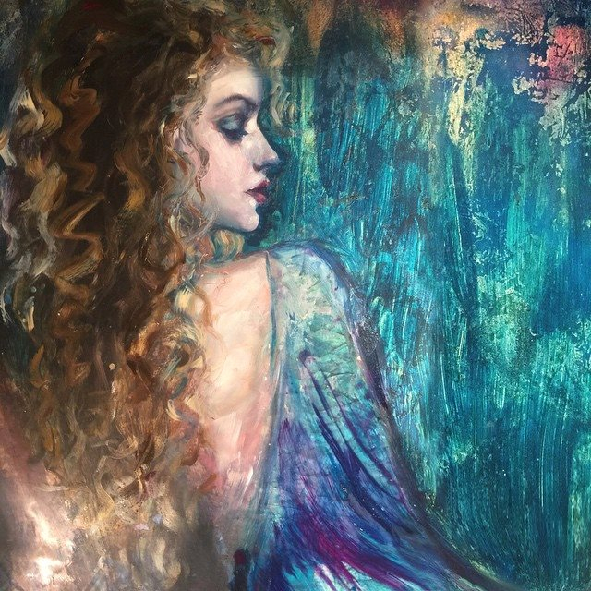
8% of the world’s population have blue ________ .
eyes

Slide 9
symbol
In the UK, a blue ribbon can be the __________ of testicular cancer awareness.

Slide 10
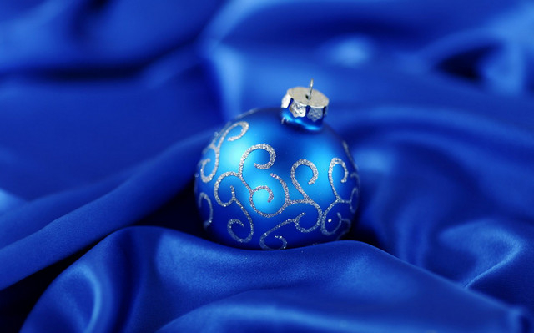
Blue is the favoured colour choice for tooth___________.
brushes

Slide 11
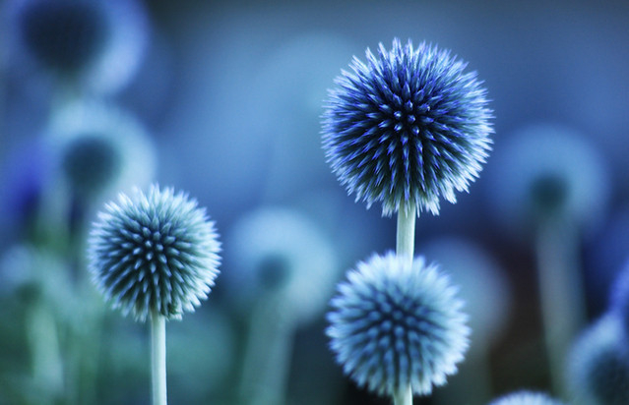
The colour blue is the least common colour in the _________ we eat.
foods

Slide 12
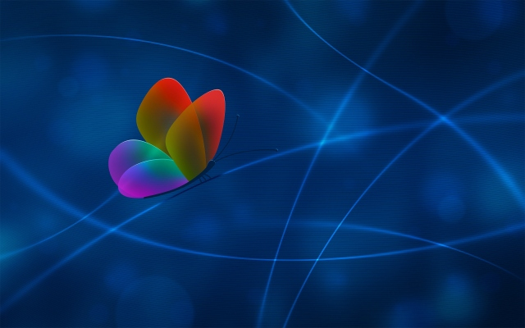
Mosquitoes
______________ are attracted to the colour blue twice as much as to any other colour.

Slide 13
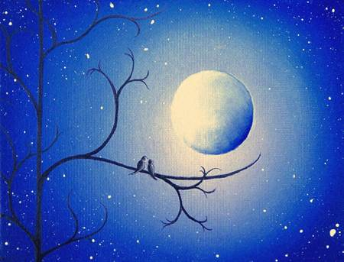
Owls
___________are the only birds who can see the colour blue!

Slide 14
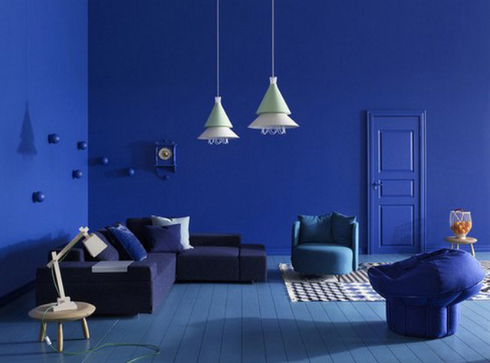
Blue is often used to decorate offices because research has shown that people are
more productive in blue___________ .
rooms

Slide 15
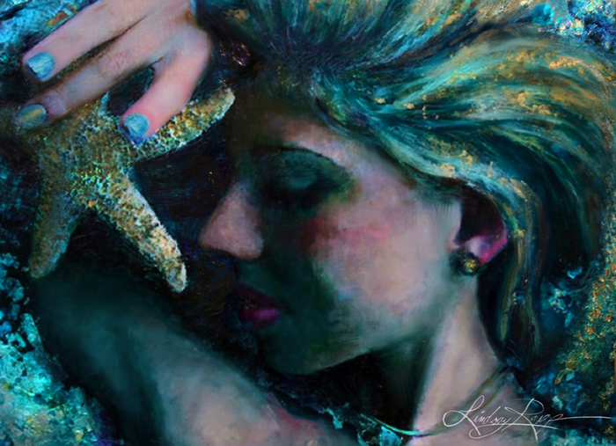
The phrase ‘Feeling blue’ means to feel _______ or unhappy.
sad

Slide 16
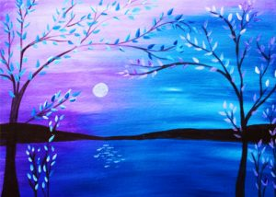
moon
The phrase ‘once in a blue_______ ’ means an event that occurs infrequently.

Slide 17
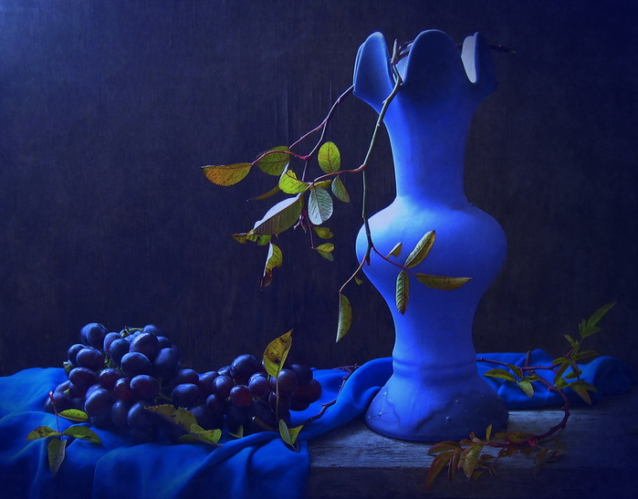
Studies show weight-lifters are able to
handle heavier weights in blue ________ .
gyms

Slide 18
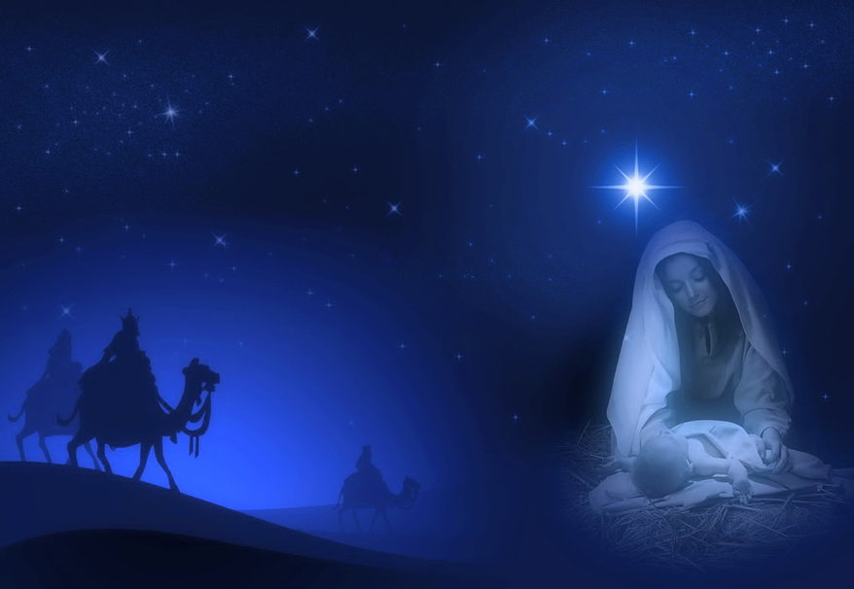
color
More than half of American adults today say blue is their favorite ___________ . Pastoreau suggests that this statistic be taken with a grain of salt, even as he cites it as evidence of just how far blue has come since antiquity.

Slide 19
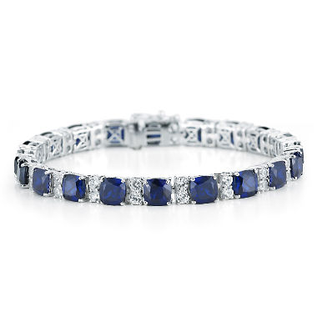
In Greece, the color blue is believed to ward off “the evil eye.” Those who believe in this Greek superstition often wear a blue charm necklace or blue ___________ for protection.
bracelet

Slide 20
Blue is considered as one of the primary colors in the traditional color theory and painting. The other primary colors include yellow and red. You can get green by mixing yellow and blue. If you want to form violet, you can mix blue and ________ .
red

Slide 21
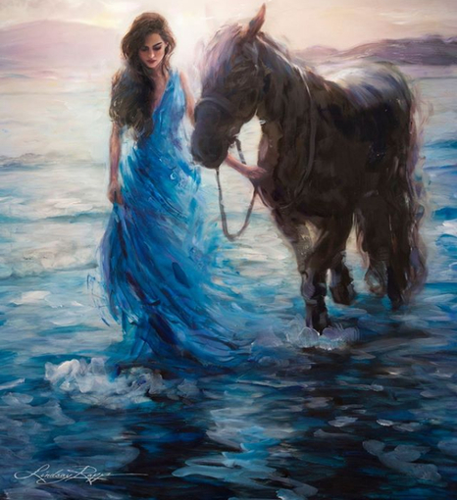
Blue is for a baby girl; pink for a baby boy in _________.
Belgium

Slide 22
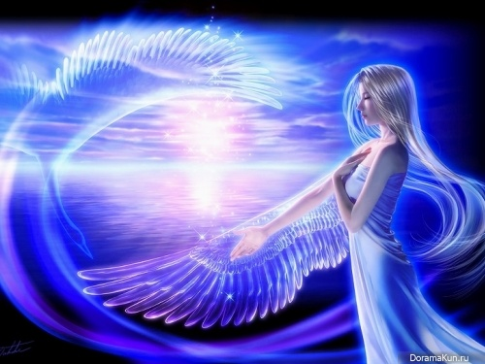
Blue is the #1 favorite color of all people.
And…
53% of the _________ in the world contain blue.
flags

Slide 23
Keep Calm and
Love Blue:)

Slide 24
Источник:
Interesting facts about the colour blue https://dykthings.com/interesting-facts-colour-blue/
Изображения взяты на сайте http://yandex.ru
Условия использования сайта https://yandex.ru/legal/fotki_termsofuse/

