Slide 1
Potato planet
Интерактивная викторина для учащихся
7-10 классов
Автор:
Ольга Михайловна Степанова, учитель английского языка
МБОУ «Цивильская СОШ №1
имени Героя Советского Союза М.В. Силантьева»
города Цивильск Чувашской Республики
2018

Slide 2
Where and when did our ancestors start growing potatoes?
Scientists think the first potatoes were cultivated about 8 000 years ago by communities of hunters and gatherers near Lake Titicaca - high in the Andes mountains, on the border between Peru and Bolivia.

Slide 3
When was the potato introduced to the rest of the world?
In 1532 the Spaniards invaded Peru in search of gold. But the real treasure they took back to Europe was the potato.

Slide 4
Where are potatoes grown today?
All around the world!
Potato farming has spread from the Andes to more than 100 countries. You will find potatoes being grown on China's Yunnan plateau, the subtropical lowlands of India, the steppes of Ukraine, in the highlands of Rwanda, and as far north as Finland.

Slide 5
Are potatoes an important food crop?
Yes! Potato is the world's No. 4 food crop, after maize, wheat and rice.

Slide 6
Why are potatoes such a popular food?
Because potatoes are rich in carbohydrates, which makes them a good source of energy. They are have high content of vitamin C and potassium, and protein that is well matched to human needs.

Slide 7
Is it easy or difficult to grow potatoes?
Potatoes are easy to grow even in harsh environments. They also produce a lot of food very quickly from a small area of land. Because they grow under the ground, potatoes are also less prone to damage than other crops.

Slide 8
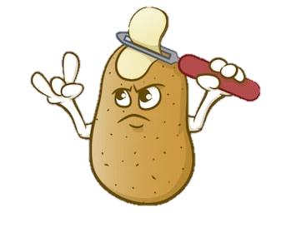
How much potato do people eat each year?
That depends on the region. In Europe, people eat 88 kg of potatoes, per person, in a year. In the developing regions, such as Africa, Asia and Latin America, people eat a lot less - but their potato intake is increasing all the time.

Slide 9
Where Are The Most Potatoes Grown?
Top Potato Growing Countries (per year):
1 China, 88.99 million metric tons of potatoes
2 India, 45.34 million metric tons of potatoes
3 Russian Federation, 30.20 million metric tons of potatoes
4 The United States, 19.84 metric tons

Slide 10
How do farmers grow their potatoes?
Usually, farmers plant a small potato (known as "seed potato") where one to two sprouts (or "eyes") have formed. The new potatoes are ready to harvest when the leaves of the plant start to turn yellow and die.

Slide 11
How long does it take to grow a potato crop?
It depends on the local climate. In the tropics farmers can harvest potatoes within 90 days of planting. In colder places, such as Argentina, Canada and northern Europe, it takes up to 150 days.

Slide 12
Is it true that the potato can be poisonous?.
Green parts of the skin and the leaves of the plant contain a toxic compound. (But poisoning from potatoes is very rare.)
Cutting away green areas and peeling potatoes before cooking ensures healthy eating.

Slide 13
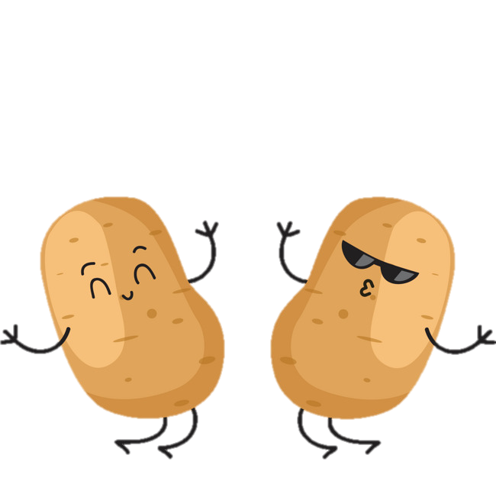
Now, Mini-Quiz!!!
Potatoes are a rich source
of _____________
Carbohydrates

Slide 14
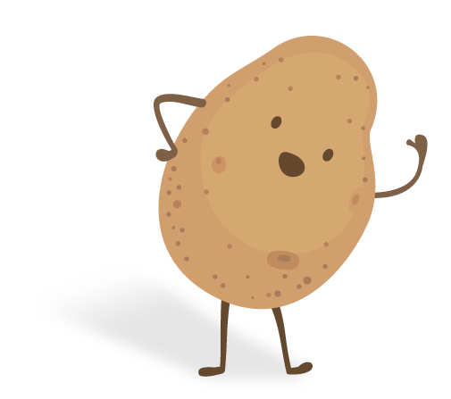
The first potatoes were grown near a lake in which country?
Peru !

Slide 15
Which country grows the most potatoes?
China !

Slide 16
In the tropics, how many days does it take to grow a potato?
90 days !

Slide 17
How much potato do people in Europe eat each year per person ?
88 kg !

Slide 18
Is potato the world's No. 1 food crop?
No. 4 !

Slide 19
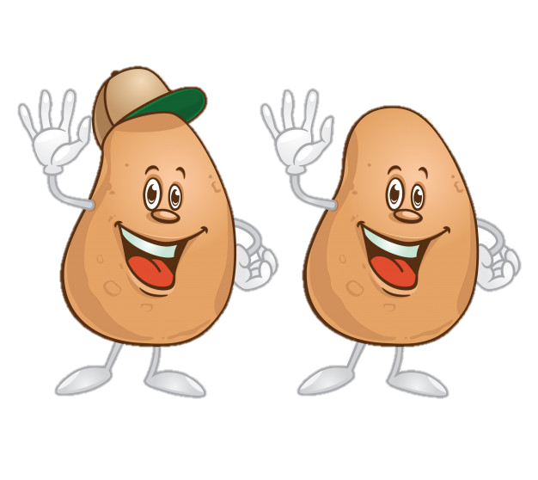
Where are potatoes grown today?
All around the World !

Slide 20
Let Potatoes Inspire You!
To be continued…

Slide 21
Источник:
Potato facts http://www.fao.org/potato-2008/en/kids/index.html
Where Are The Most Potatoes Grown? https://www.worldatlas.com/articles/countries-with-the-highest-potato-production.html
Изображения взяты на сайте http://yandex.ru
Условия использования сайта https://yandex.ru/legal/fotki_termsofuse/

