Slide 1
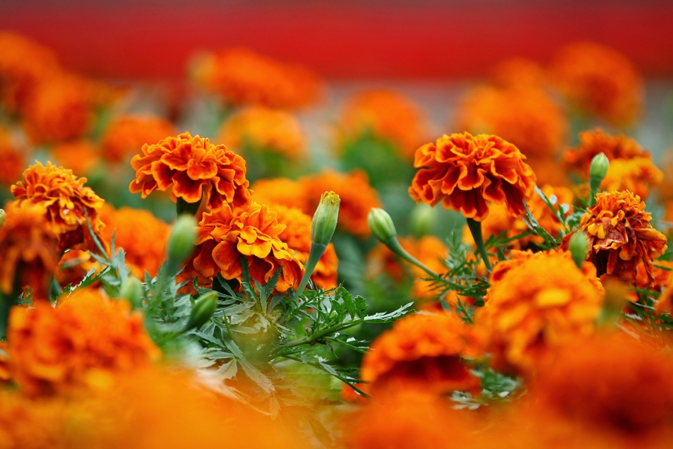
Charming Marigold
Interactive Quiz for the Students of the 7th – 11th Grades
Автор:
Ольга Михайловна Степанова, учитель английского языка
МБОУ «Цивильская СОШ №1
имени Героя Советского Союза М.В. Силантьева»
города Цивильск Чувашской Республики
2018

Slide 2
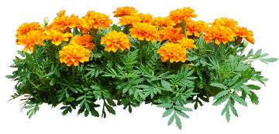
There's a special flower for every month in a year. If you are ruled by Venus and October born smart person, Marigold is the _________ flower for you..
birthday

Slide 3
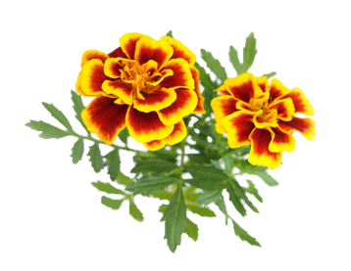
Worldwide known as a Marigold, October's birth flower, the very charming and vibrant Marigold is a Mediterranean native ________ .
plant

Slide 4
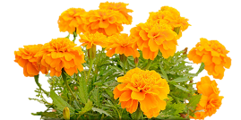
Aztec was the civilization that cultivated this exotic flower for the first time and the people of Aztec civilization believed that this flower has a huge amount of magical ____________.
properties

Slide 5
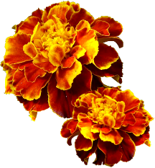
Conquistadors from Spain took these flowers back to their country and there Marigolds were grown in ________________.
monasteries

Slide 6
Marigolds have been around for a long time and throughout the span of their existence, they have developed many connotations and uses which can be seen in various ________________ .
cultures

Slide 7
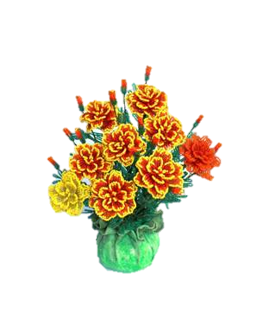
According to the people of Wales, this flower has been seen as the symbol of cheerful communication. If a couple struggles to communicate, it is advised to them to keep a pot of Marigolds in their home to keep the __________ .
peace

Slide 8
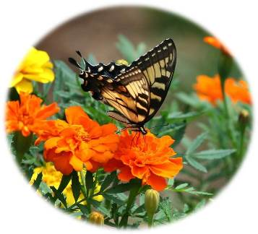
According to the local Mexican folklore, Marigold flowers represent sorrow and the feeling of unrest and that's the reason why these particular flowers are used in the days of dead ritual on every second day of the ______________ month of each year.
November

Slide 9
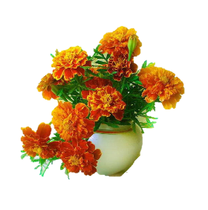
In different cultures, Marigolds hold different meanings, both positive and negative, such as: - Promoting cheer and joy.
- Winning over someone's heart with honest and hard work.
- Promotes success and ___________ .
- Grief and despair.
- Remembering the people who passed away.
happiness

Slide 10
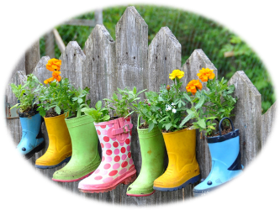
Throughout the history, Marigold flowers have been used as dyes and culinary ingredients. It has been used as a medical cure for a lot of __________ problems also.
health

Slide 11
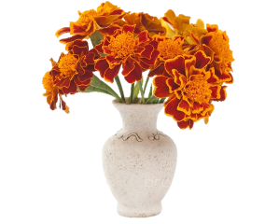
Marigold is an edible flower. You can simply use this flower in your ________ items. Instead of using highly-priced saffron spice, you can use Marigolds as the substitute.
salad

Slide 12
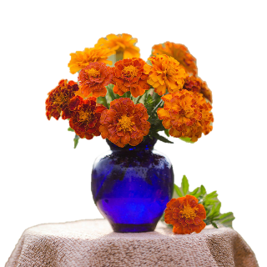
There's an antioxidant called carotenoids which leads to the vibrant color of this Marigold flowers, has several health benefits for humans. It helps to lower the chance of heart _____________ .
diseases

Slide 13
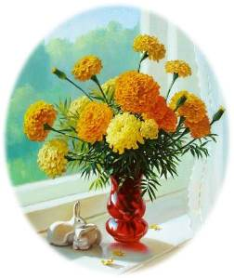
Another excellent use of Marigold is that it works as a natural ____________repellent.
insect

Slide 14
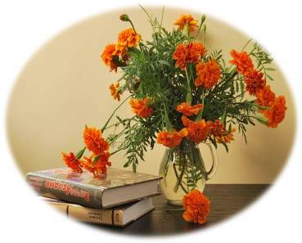
The strong smell of this flowers keep mosquitoes and aphids away from the vegetable gardens and you can actually keep your home protected from mosquitoes by keeping a pot of Marigold flowers in your ________ .
home

Slide 15
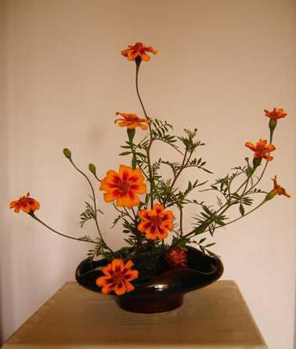
Some gardeners also plant marigolds in vegetable gardens because they believe the flower can protect ________ from insect pests, although research studies have not supported these claims.
plants

Slide 16
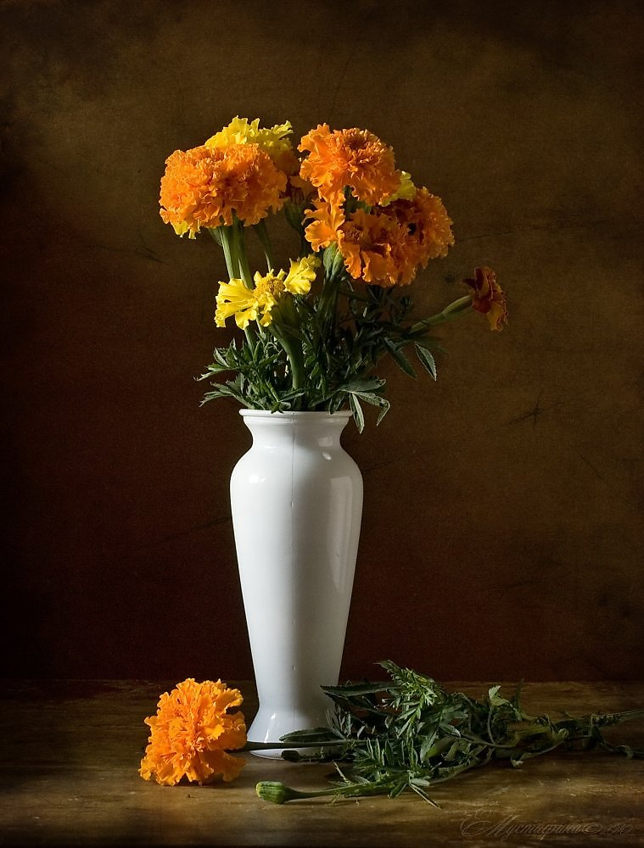
While some marigolds are effective at keeping away some nematodes, there is no marigold that keeps away all _____________.
nematodes

Slide 17
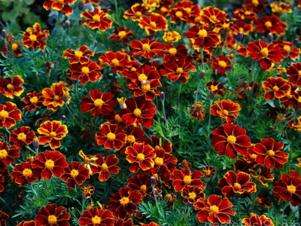
conditions
It doesn't require special ____________ for successful cultivation, which makes it very popular among the gardeners worldwide.

Slide 18
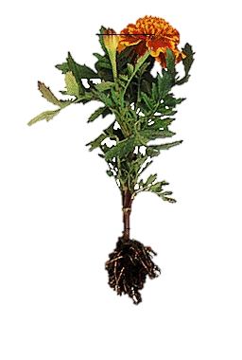
Native to South America, Mexico and the southwestern United States, marigolds (Tagetes) have been found in gardens worldwide for hundreds of _________ .
years

Slide 19
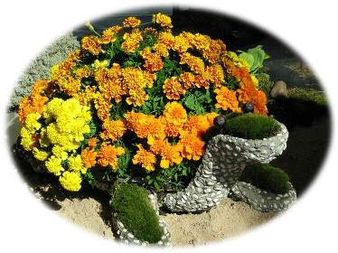
The edible types of marigold are the pot marigold florets. The bright color will increase the ___________of the people. That is why the floret is often spotted in the dishes or salads as a garnish.
appetite

Slide 20
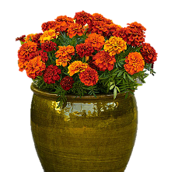
Because of their cheerful bright orange and yellow blooms, ease of care and few problems with insects and disease, marigolds continue to be a popular bedding _________ all over the world.
plant

Slide 21
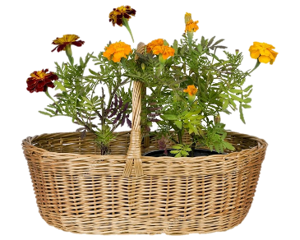
The meaning of Marigolds in the language of flowers is sorrow and grief but these flowers primarily convey the message “I will comfort your grieving _________ ”.
heart

Slide 22
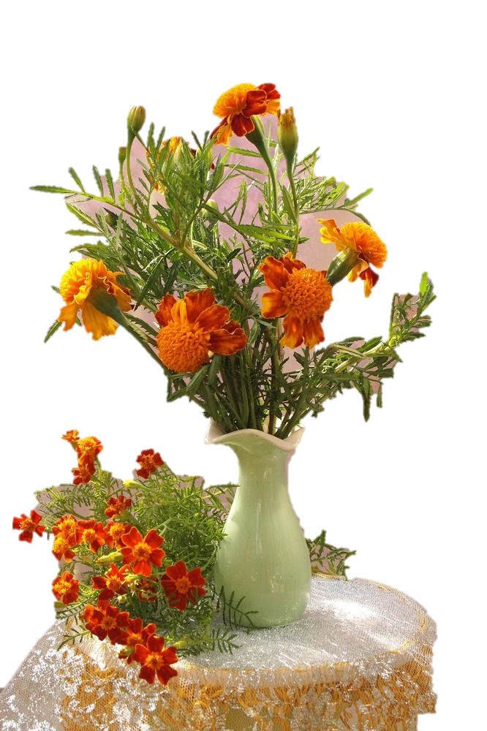
Ancient Christians used to place this flower on Mother Mary’s altar as offering, instead of coins, and that is where Marigold (Flower being Mary’s Gold, depicting coins) derives its _________ from.
name

Slide 23
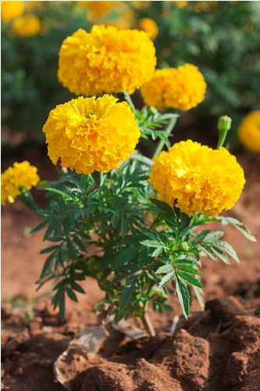
Since these flowers are associated with Mother Mary, the English consider them as protection from evil and also as a symbol for good _______ .
luck

Slide 24
The end
To be continued…

Slide 25
Источник:
Charming Marigold-Staple Flower Of October https://www.floweraura.com/blog/charming-marigold-staple-flower-october
Изображения взяты на сайте http://yandex.ru
Условия использования сайта https://yandex.ru/legal/fotki_termsofuse/

