Slide 1
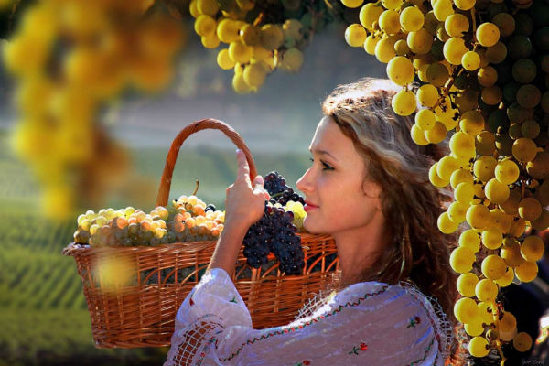
Anti-aging Agent’s
photo gallery
Interactive Quiz Story for 7-11 Grades
Автор:
Ольга Михайловна Степанова, учитель английского языка МБОУ «Цивильская СОШ №1
имени Героя Советского Союза М.В. Силантьева»
города Цивильск Чувашской Республики
2018

Slide 2
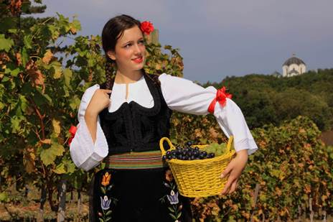
While they are botanically classified as berries, grapes still are considered a _______ and they appear in many colors - white, red, black, blue, green, purple and golden.
fruit

Slide 3
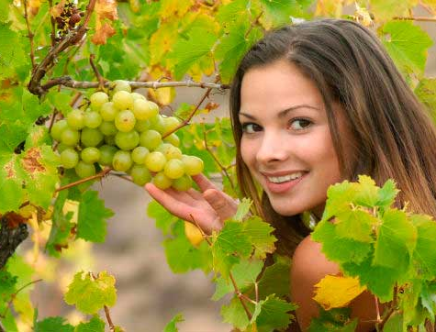
One cup of grapes, with about 100 calories, provides more than a quarter of the daily recommended values of vitamins K and ______ .
C

Slide 4
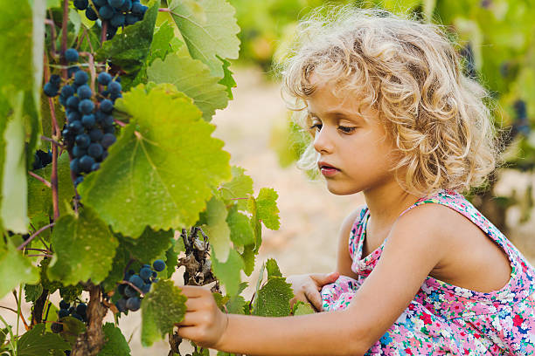
Grapes are used to help cure asthma indigestion, migraine, kidnеy disease and _________ .
fatigue

Slide 5
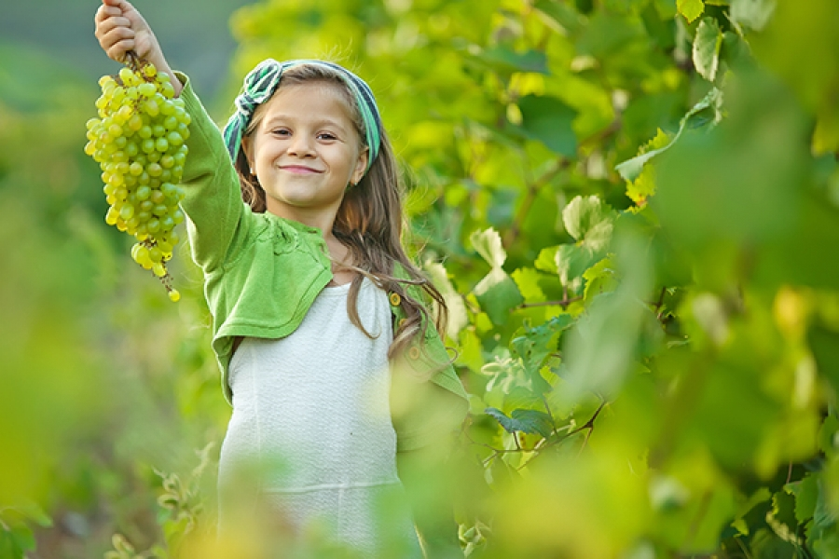
heart
Grapes help minimize the risk of _________ attacks because they increase the levels of nitric acid in the blood.

Slide 6
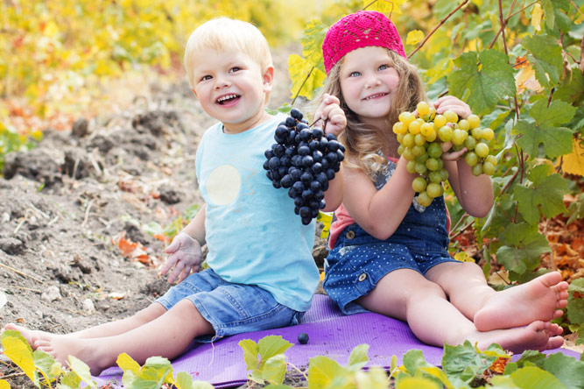
Raisins are dried, sweet grapes. The drying happens naturally when the grapes are left in ___________ .
sunlight

Slide 7
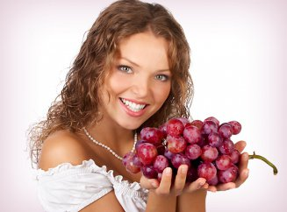
The sweet and sour taste of grapes enlightens your ________ and makes you stress and depression free.
mood

Slide 8
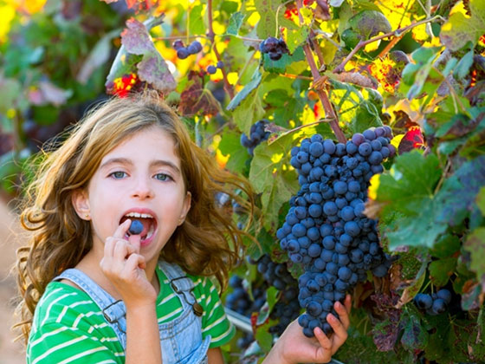
seeds
Grape ________ , which are edible, are chock-full of antioxidants.

Slide 9
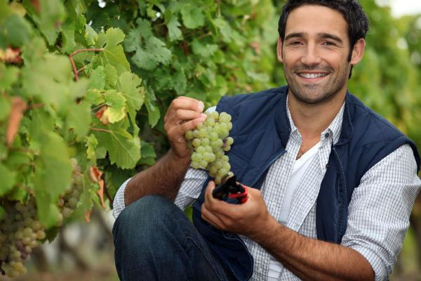
Grape seeds are very healthy when eaten. They are capable of reducing fat and have anti-_________ properties and also fight against inflammatory acne, asthma, and arthritis.
cancer

Slide 10
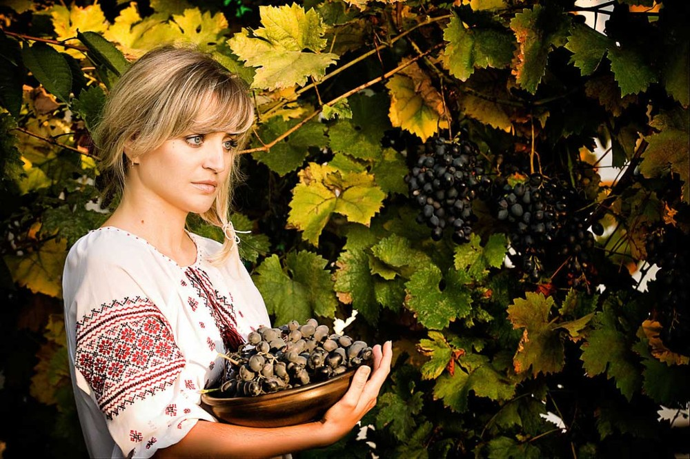
Grape seeds also contain oils which are used in the cosmetic industry for the manufacture of skin-care ____________.
products

Slide 11
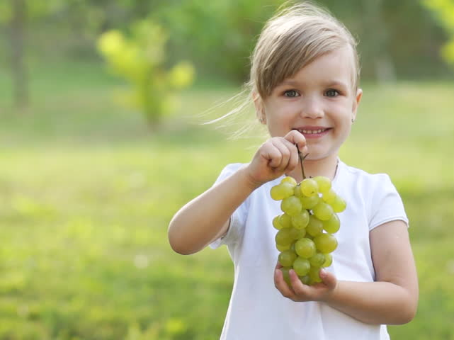
China
_________ is the greatest producer of grapes on the planet with 9,600,000 tons in 2016.

Slide 12
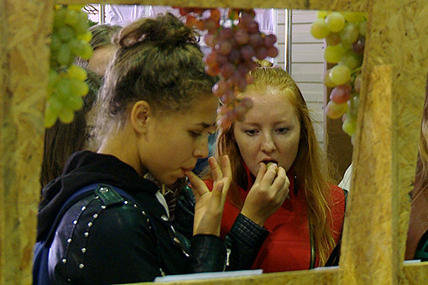
It’s very common for people in __________ to peel grapes before eating them, due to a perception that the skins are dirty and/or bitter.
Japan

Slide 13
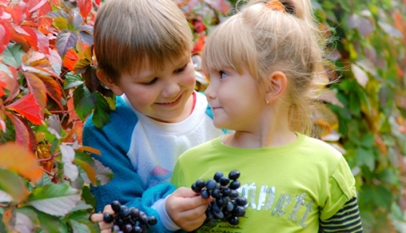
Spanish
The ___________ have a tradition consisting of eating a grape with each bell strike at midnight of December 31.

Slide 14
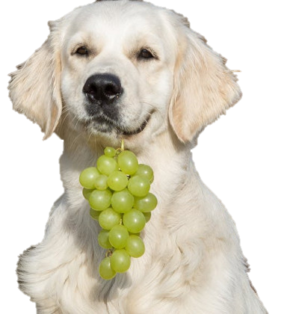
Grapes and raisins are severely toxic to dogs and can cause an acute __________ failure.
kidney

Slide 15
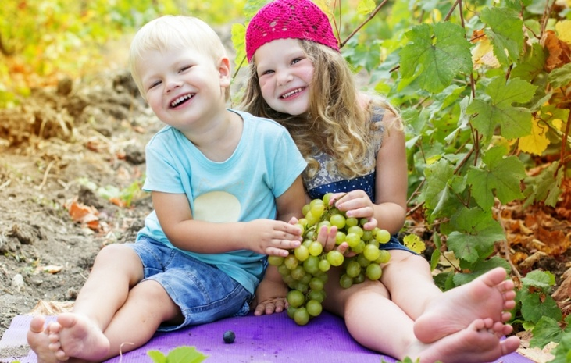
Grapes grow on beautiful, vining plants. The plants need trellises or fences to support their heavy __________ .
vines

Slide 16
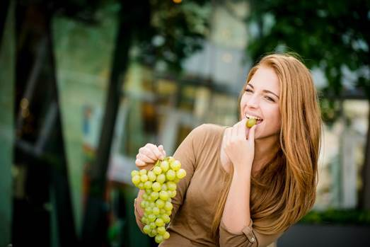
A phytonutrient called resveratrol found moderately in grapes contributes a lot towards long life and taking off wrinkles from your ________ .
face

Slide 17
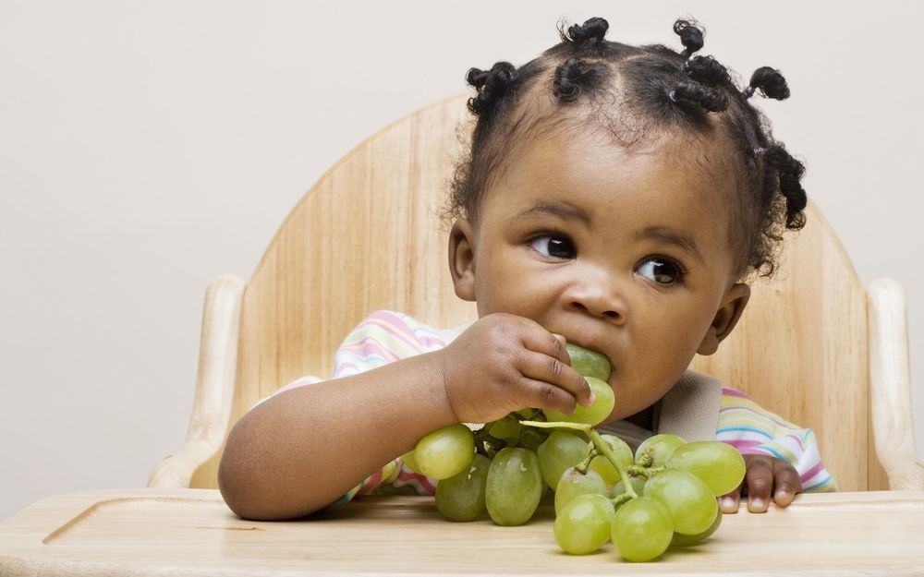
By the way, grapes were significant to both the Greeks and Romans, and their god of agriculture, Dionysus, was linked to grapes, being frequently portrayed with grape leaves on his _________ .
head

Slide 18
In one study, scientists identified resveratrol that is in grapes as a nutrient that activated the human ________ for survival and longevity.
gene

Slide 19
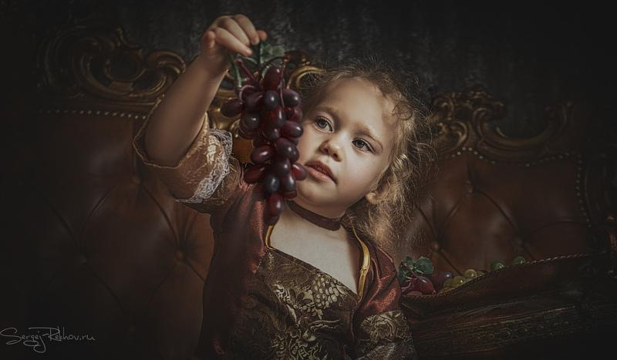
Thanks to their benefits and healthy nutrients; grapes are often referred to as the ___________ of fruits.
Queen

Slide 20
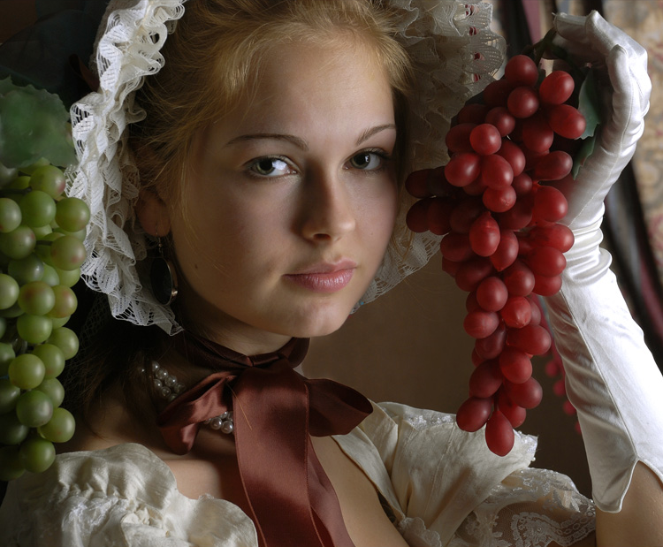
Next time you pop one in your mouth, remember the exciting history and wonderful health __________ of these tasty little berries.
benefits

Slide 21
The end
To be continued…

Slide 22
Источник:
Interesting And Fascinating Facts About Grapes http://tonsoffacts.com/28-interesting-fascinating-facts-grapes/
Grapes https://easyscienceforkids.com/grapes/
10 Miracle Healing Powers of Grapes https://www.care2.com/greenliving/10-miracle-healing-powers-of-grapes.html
Изображения взяты на сайте http://yandex.ru
Условия использования сайта https://yandex.ru/legal/fotki_termsofuse/

