Slide 1
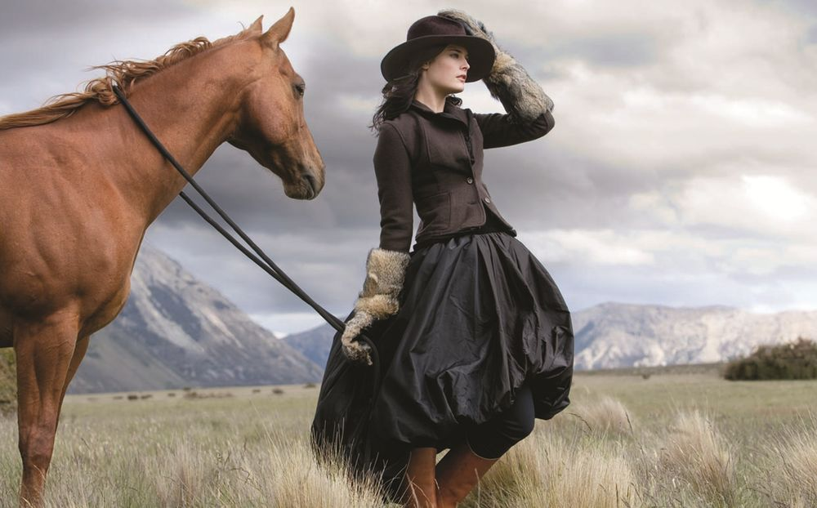
Horses the poetry of motion
Interactive Quiz for the Students of 8th-11th Grades
Автор:
Ольга Михайловна Степанова, учитель английского языка
МБОУ «Цивильская СОШ №1
имени Героя Советского Союза М.В. Силантьева»
города Цивильск Чувашской Республики
2018

Slide 2
Господь, сотворив лошадь, сказал ей: «С тобой не сравнится ни одно животное; все земные сокровища лежат между твоими глазами. Ты будешь топтать моих врагов и возить моих друзей. С твоей спины будут произносить мне молитвы. Ты будешь счастлива на всей земле и тебя будут ценить дороже всех существ, потому что тебе будет принадлежать любовь властелина земли. Ты будешь летать без крыльев и разить без мяча…».
Арабская легенда

Slide 3
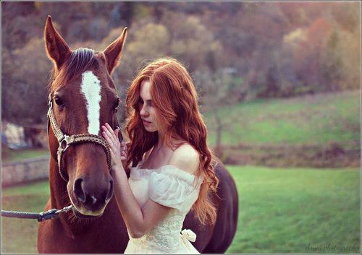
All horses deserve, at least once in their lives, to be loved by a little ________ .
Lendon Gray
girl

Slide 4
God
Of all creatures _____ made at the Creation, there is none more
excellent, or so much to be respected as a horse.
– Bedouin Legend

Slide 5
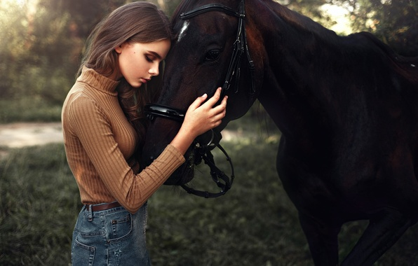
You cannot train a horse with shouts and expect it to obey a _________.
– Dagobert D. Runes
whisper

Slide 6
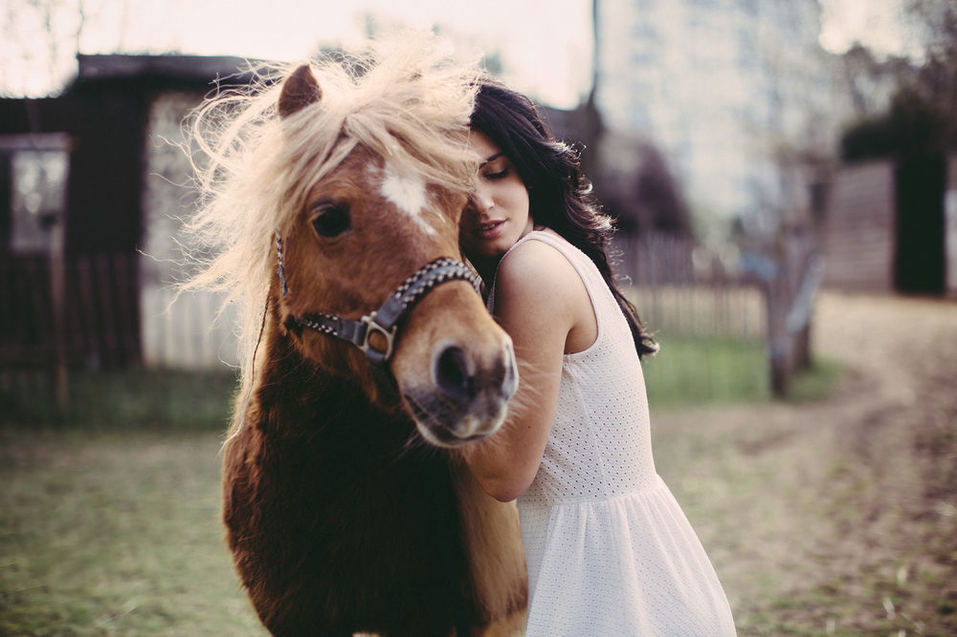
Care
________ , and not fine stables, makes a good horse.
– Danish Proverb

Slide 7
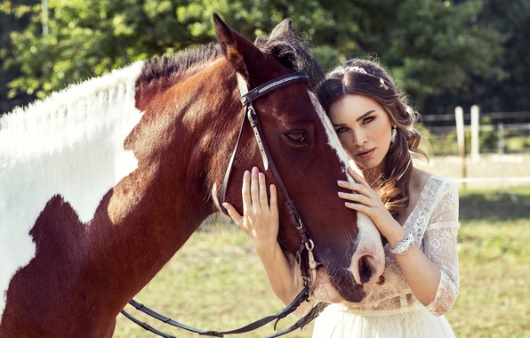
reason
One _________ why birds and horses are happy is because they are not trying to impress other birds and horses.
– Dale Carnegie

Slide 8
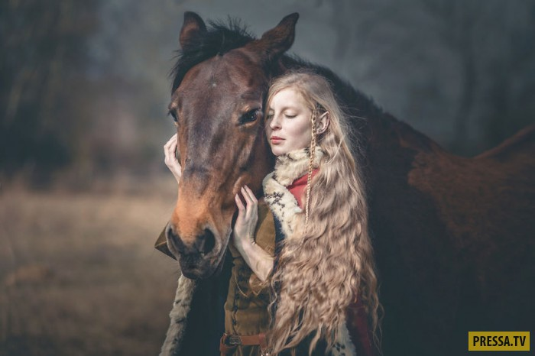
joy
"The essential _______ of being with horses is that it brings us in contact
with the rare elements of grace, beauty, spirit and freedom."
~ Sharon Ralls Lemon

Slide 9
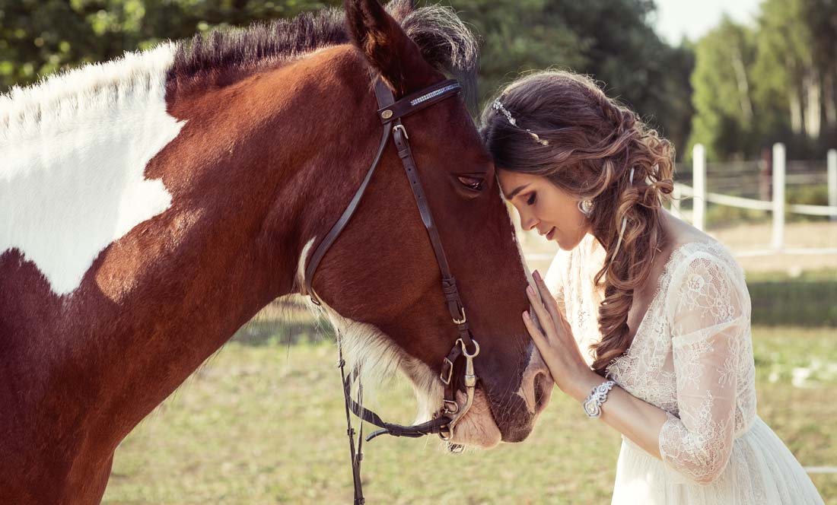
"To see the wind's power, the rain's cleansing and the sun's radiant _______ , one need only to look at the horse."
~ Author Unknown
life

Slide 10
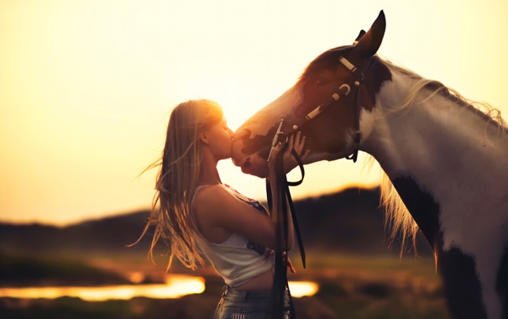
hope
"To many, the words love, ______ and dreams are synonymous with horses."
~ Author Unknown

Slide 11
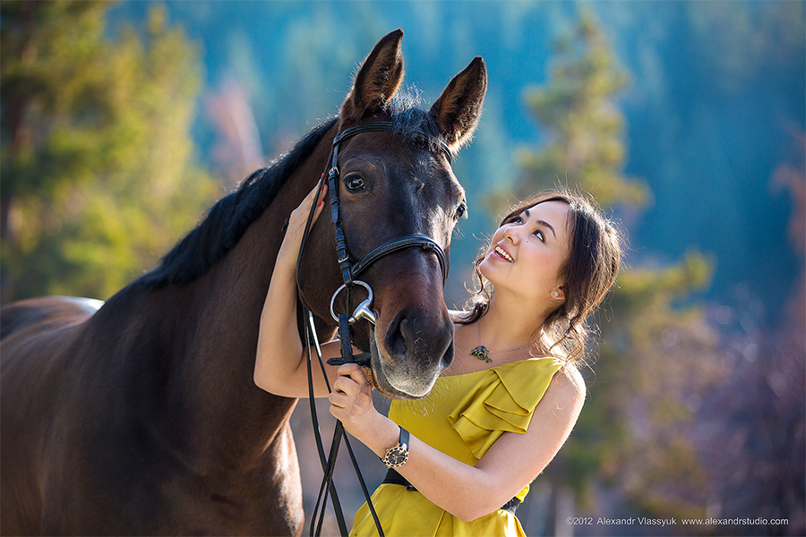
"Horses change lives. They give our young people confidence and self-esteem.
They provide _______ and tranquility to troubled souls. They give us hope!"
~ Toni Robinson
peace

Slide 12
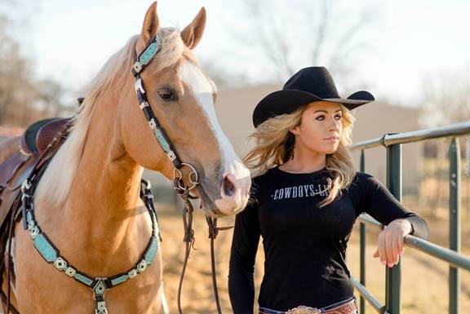
"On the back of a horse you will find _________."
~ Stella A. Walker
Paradise

Slide 13
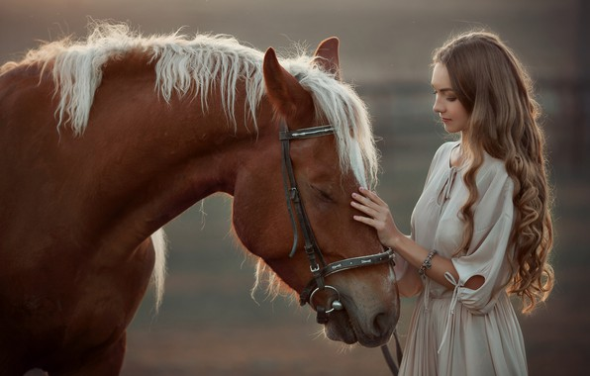
motion
"Ask me to show you poetry in _______ and I will show you a horse."
~ Author Unknown

Slide 14
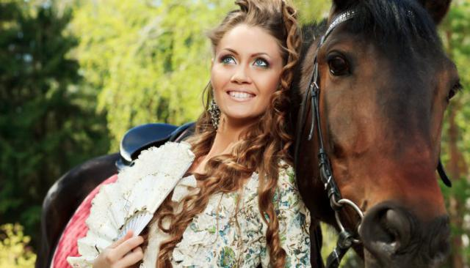
"In riding a horse, we borrow _________."
~ Helen Thompson
freedom

Slide 15
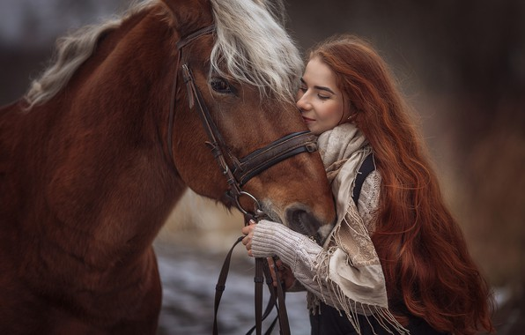
head
"When your horse follows you without being asked, when he rubs his _______on yours,
and when you look at him and feel a tingle down your spine...you know you are loved."
~ John Lyons

Slide 16
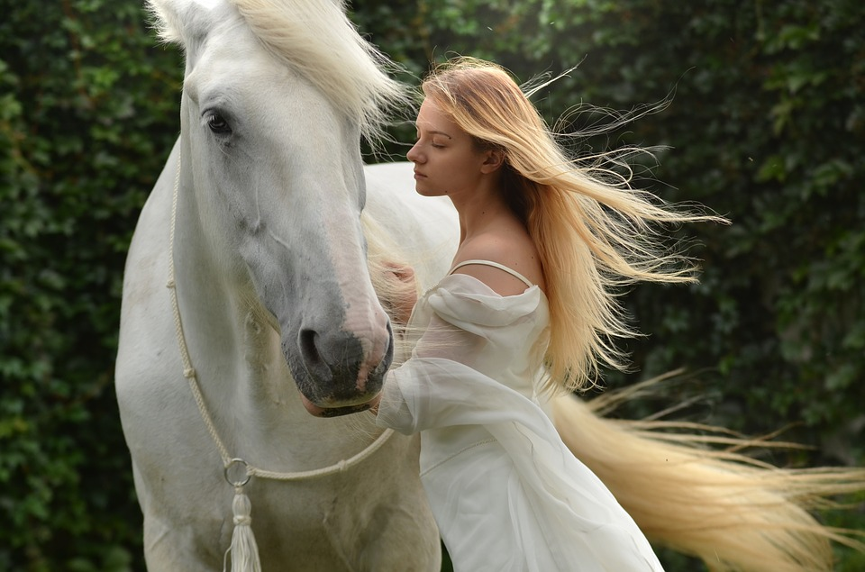
"Bread may feed my body, but my horse feeds my ________ ."
~ Author Unknown
soul

Slide 17
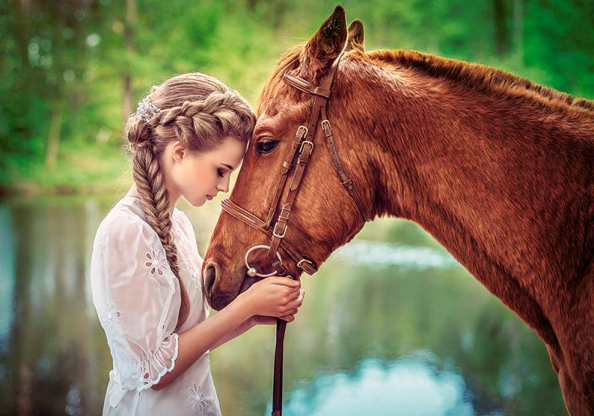
"To see a horse is to see an angel on________."
~ Author Unknown
earth

Slide 18
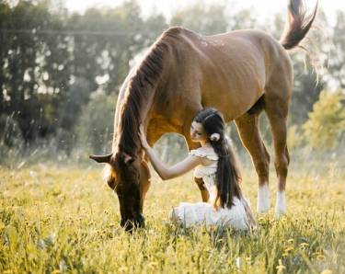
heart
"Let a horse whisper in your ear and breathe on your ________. You will never regret it."
~ Author Unknown

Slide 19
The end
To be continued…

Slide 20
Источник:
Horse quotes http://horsefund.org/horse-quotes.php
Изображения взяты на сайте http://yandex.ru
Условия использования сайта https://yandex.ru/legal/fotki_termsofuse/

