Slide 1
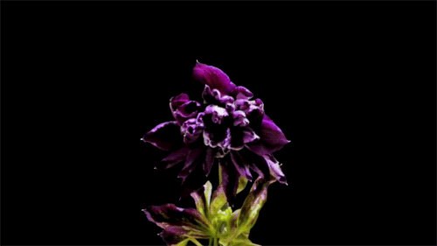
Purple, violet, lilac…
Интерактивный рассказ- викторина для учащихся
7-11 классов
Автор:
Ольга Михайловна Степанова, учитель английского языка
МБОУ «Цивильская СОШ №1
имени Героя Советского Союза М.В. Силантьева»
города Цивильск Чувашской Республики
2018

Slide 2
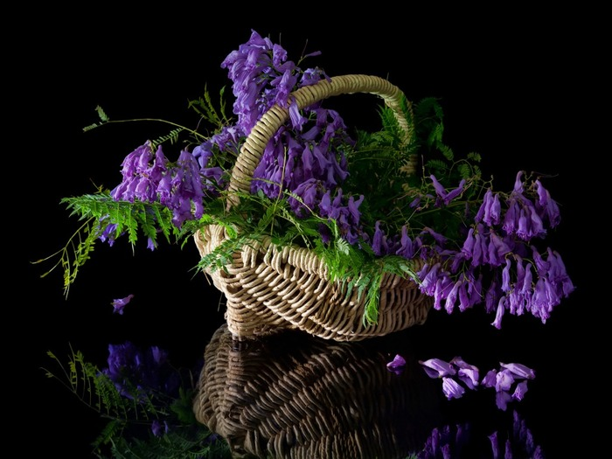
Shades of purple and violet can relax and stimulate us at the same _______ .
time

Slide 3
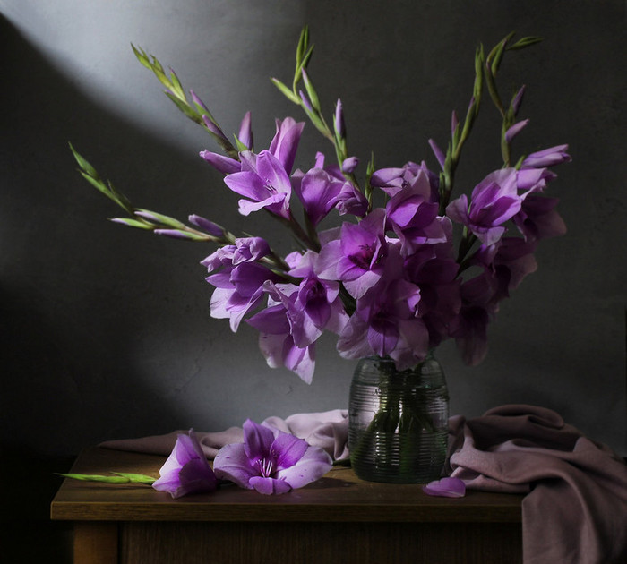
Violet often represents relaxation, making it a good choice for use in a ___________ setting.
bedroom

Slide 4
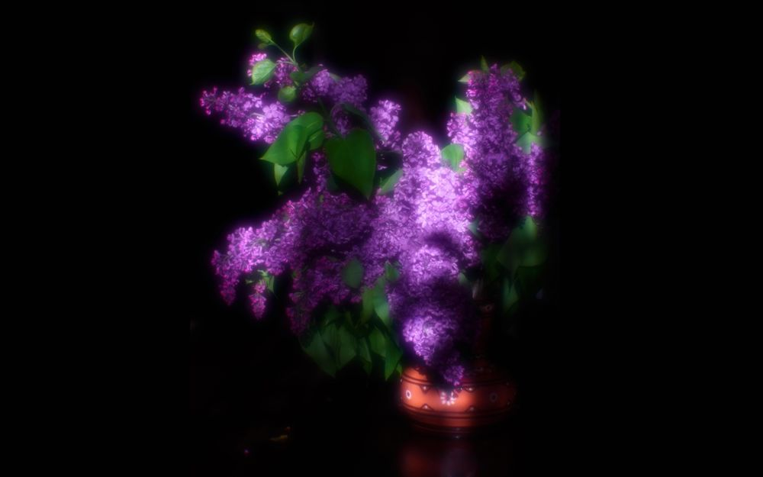
Purple is often favoured by artists, designers and musicians because it stimulates ____________.
creativity

Slide 5
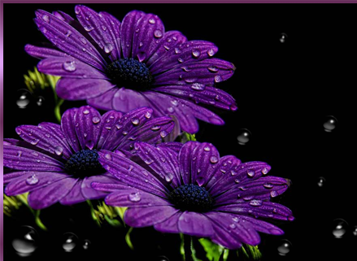
Physically, purple can have calming effects over the mind and ________ .
nerves

Slide 6
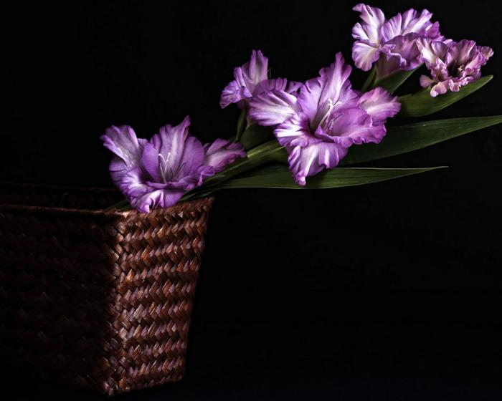
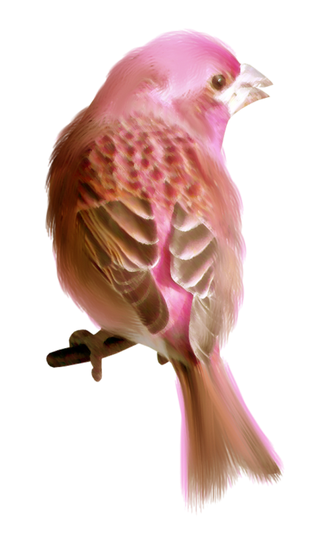
The purple finch is the state ________ of New Hampshire, USA
bird

Slide 7
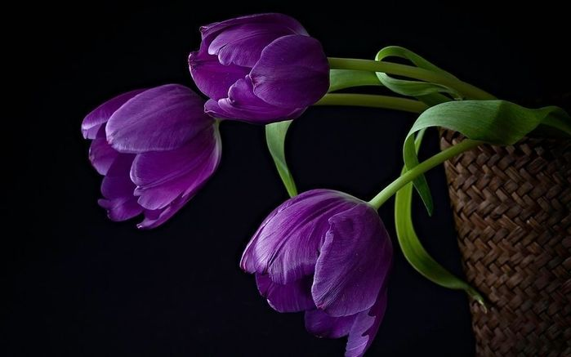
Originally, the color purple came from a dye made from the muscus glands of a tropical sea ________ known as the murex.
snail

Slide 8
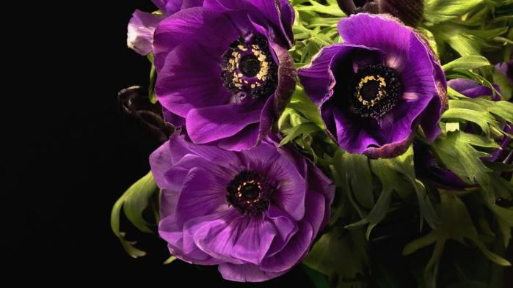
name
The murex's Latin ______ is purpura which is where we get the word purple from.

Slide 9
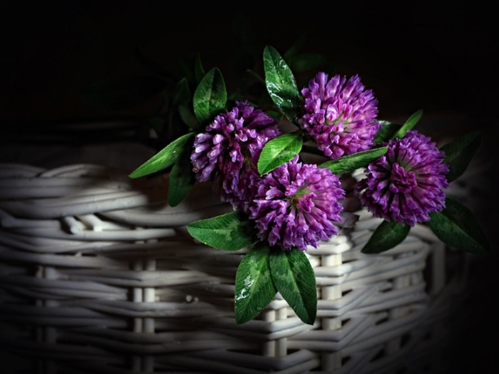
Japan
In ________ the color purple signifies wealth and position.

Slide 10
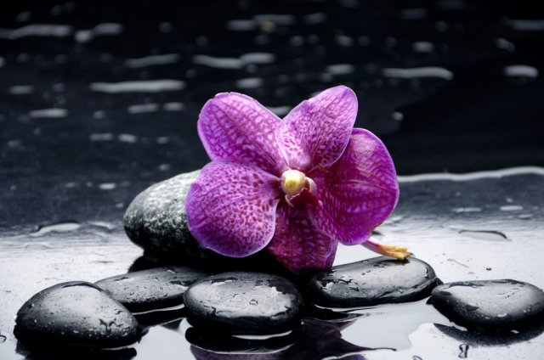
There is only one nation with purple in its flag It is ___________.
Dominica

Slide 11
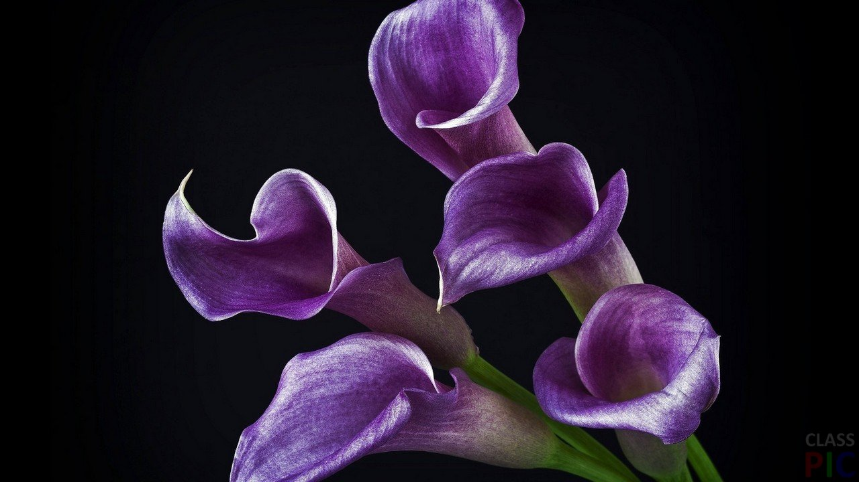
eyes
Violet, or purple, ________ are extremely rare. Only (some) people with Albinism or Alexandria's Genesis may have that color eyes.

Slide 12
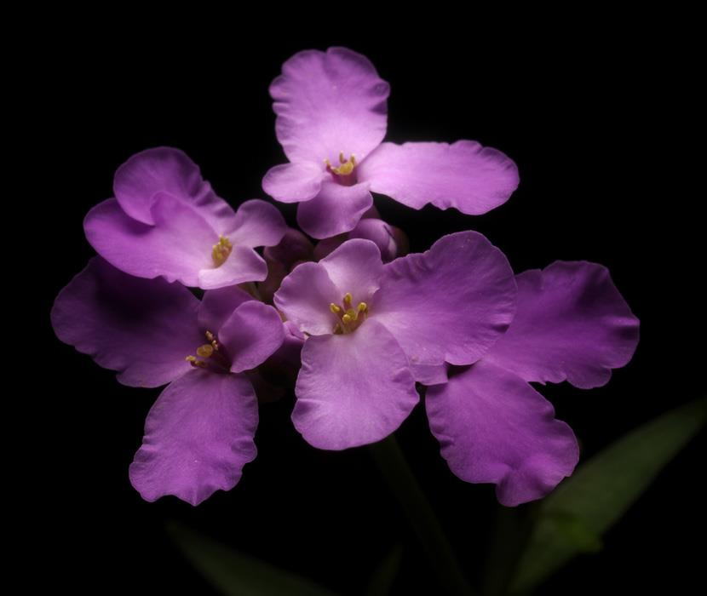
Purple Day was founded in 2008, by Cassidy Megan, aged nine, of Nova Scotia,
________ .
Canada

Slide 13
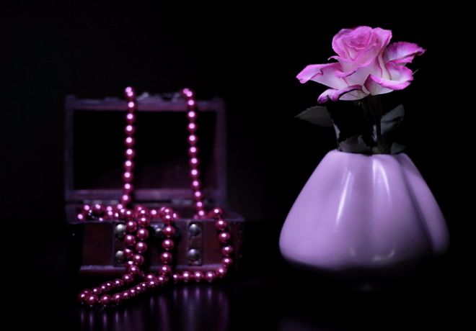
Purple Day is celebrated on March 26 and was created to raise awareness for
_________.
epilepsy

Slide 14
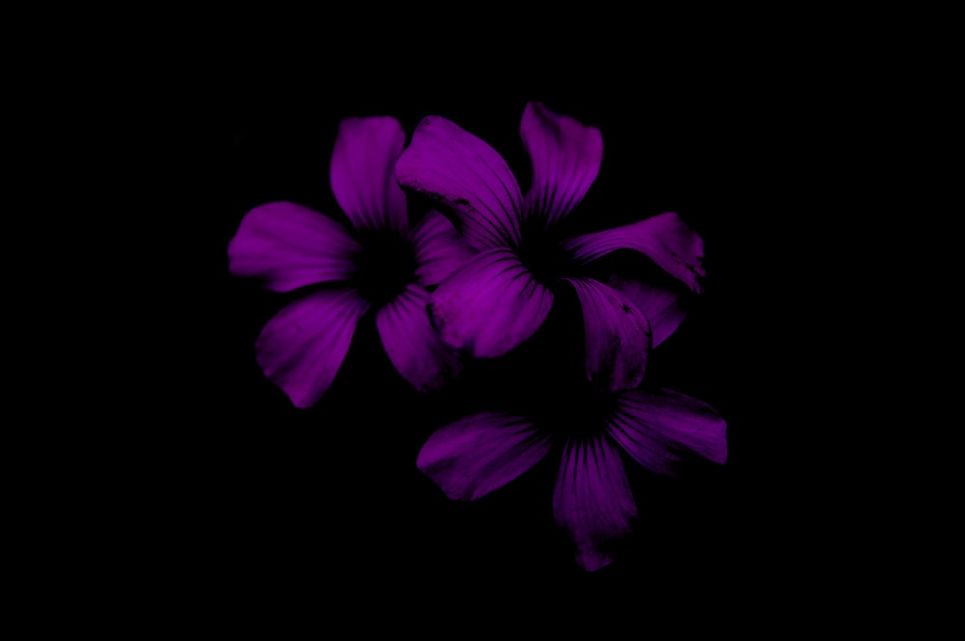
fear
Porphyrophobia is _______of the color purple.

Slide 15
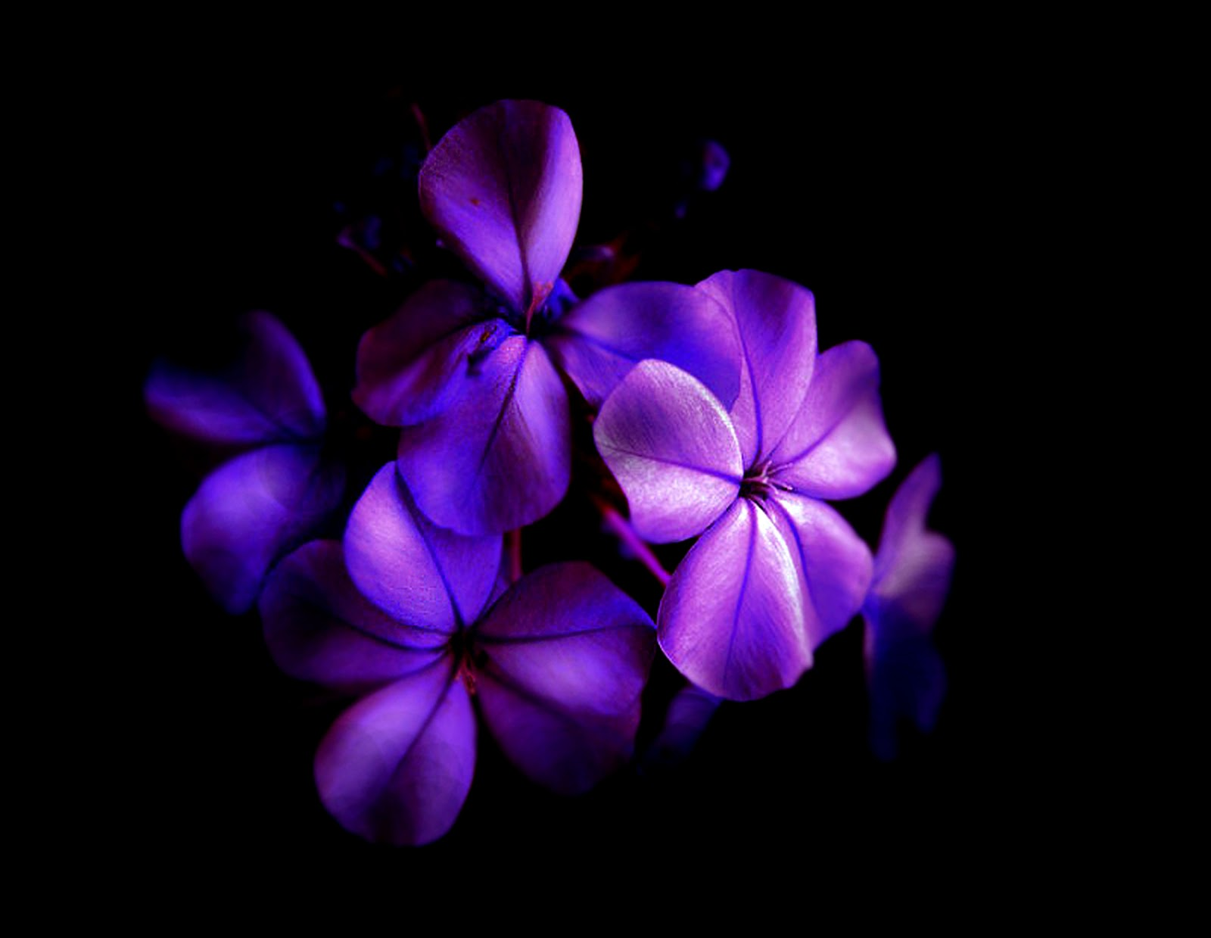
bridge
The 'purple people __________ ' is a purple pedestrian bridge that connects Cincinnati, Ohio with Newport, Kentucky.

Slide 16
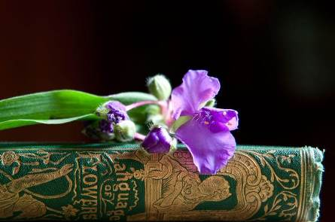
All in all, purple conveys wealth and extravagance. Associated with wisdom, dignity, independence, creativity, mystery, and _______.
magic

Slide 17
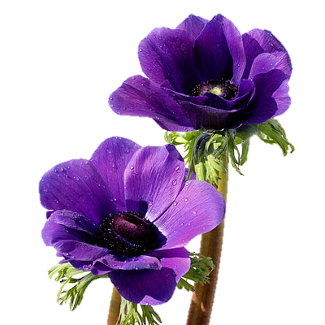
It is a beautiful color, selected by both women and men. Since it is a chromatic mixture between the fiery red and profound calm, purple is considered to be the _________
between these two primary colors.
balance

Slide 18
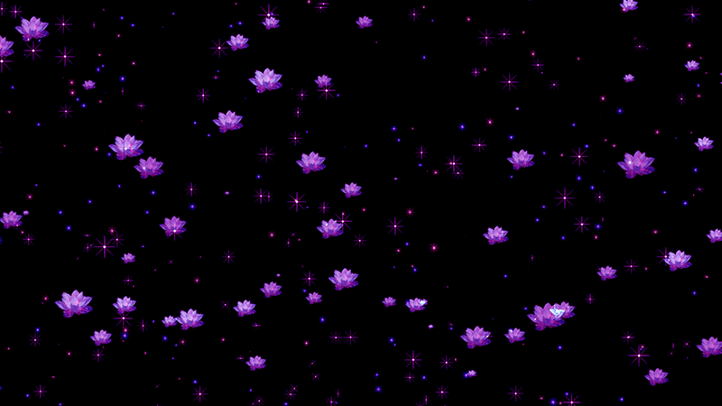
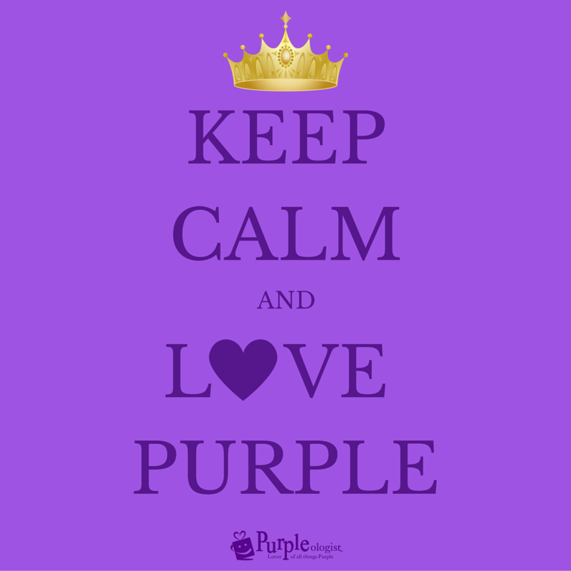

Slide 19
Источник:
Purple Color Psychology and Meaning https://www.colorpsychology.org/purple/
7 unique facts about purple http://www.purpleologist.com/blog/7-unique-facts-about-purple/
20 facts about the color purple https://www.thefactsite.com/2014/11/colour-purple-facts.html
Изображения взяты на сайте http://yandex.ru
Условия использования сайта https://yandex.ru/legal/fotki_termsofuse/

