Slide 1
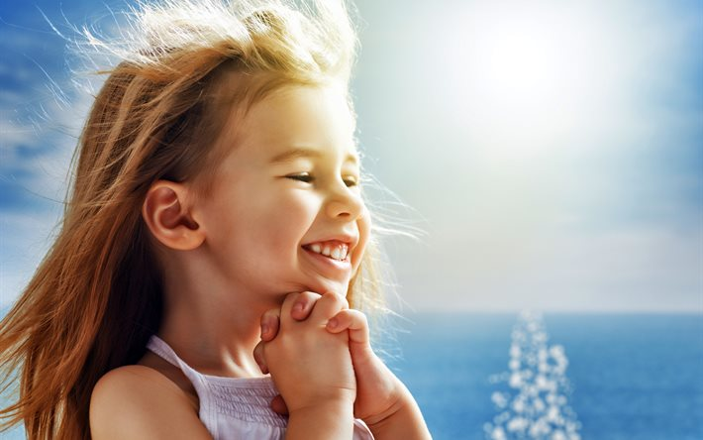
Being a Girl is…
Interactive Quiz
for the 7th – 11th Grades
Автор:
Ольга Михайловна Степанова
учитель английского языка
МБОУ «Цивильская СОШ №1
имени Героя Советского Союза М.В. Силантьева»
города Цивильск Чувашской Республики
2018

Slide 2
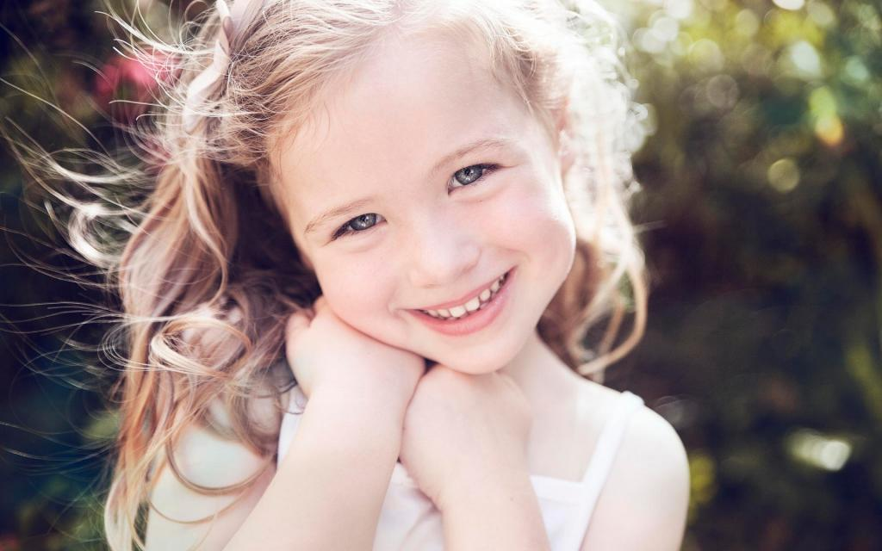
Courage, sacrifice, determination, commitment, toughness, heart, ________ , guts. That's what little girls are made of. Bethany Hamilton
talent

Slide 3
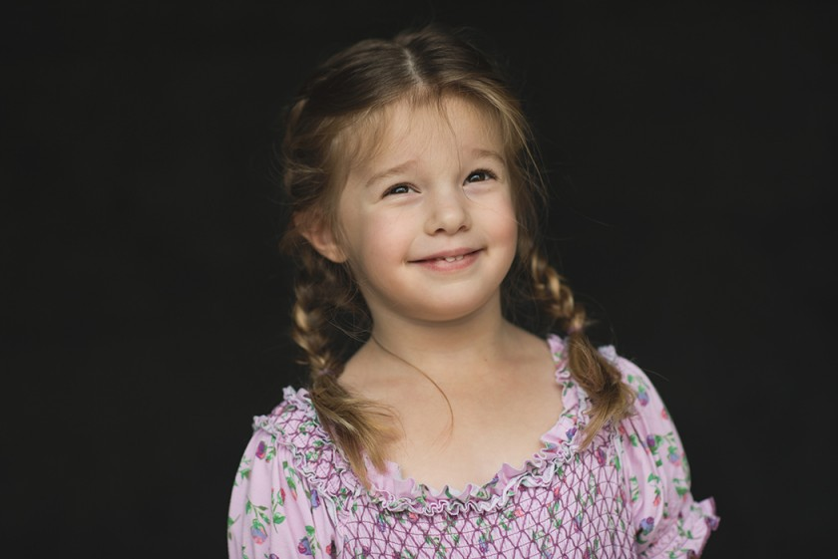
Give a girl the right shoes, and she can conquer the __________.
Marilyn Monroe
world

Slide 4
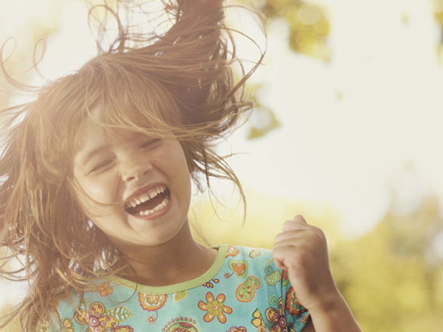
Some girls are just born with _________ in their veins. Paris Hilton
glitter

Slide 5
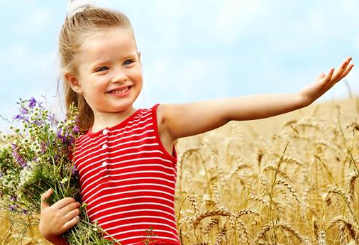
In my dreams, I could be a Princess, and that's what I was. Like most little girls, I believed nothing less than a Prince could make my ____________ come true.
Loretta
Young
dreams

Slide 6
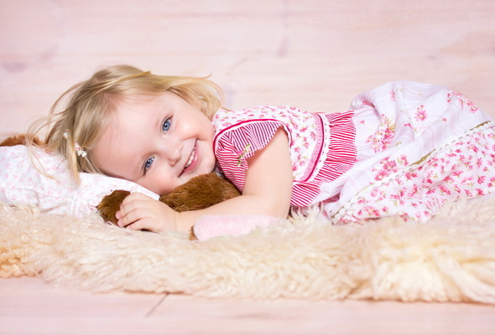
There's no better feeling than making your little girls ________. Jerry O'Connell
laugh

Slide 7
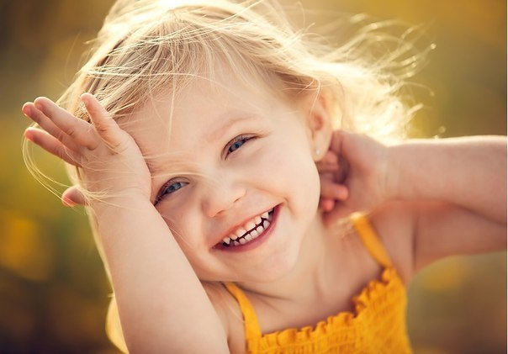
I think my mom put it best. She said, 'Little girls soften their daddy's ________.' Paul Walker
hearts

Slide 8
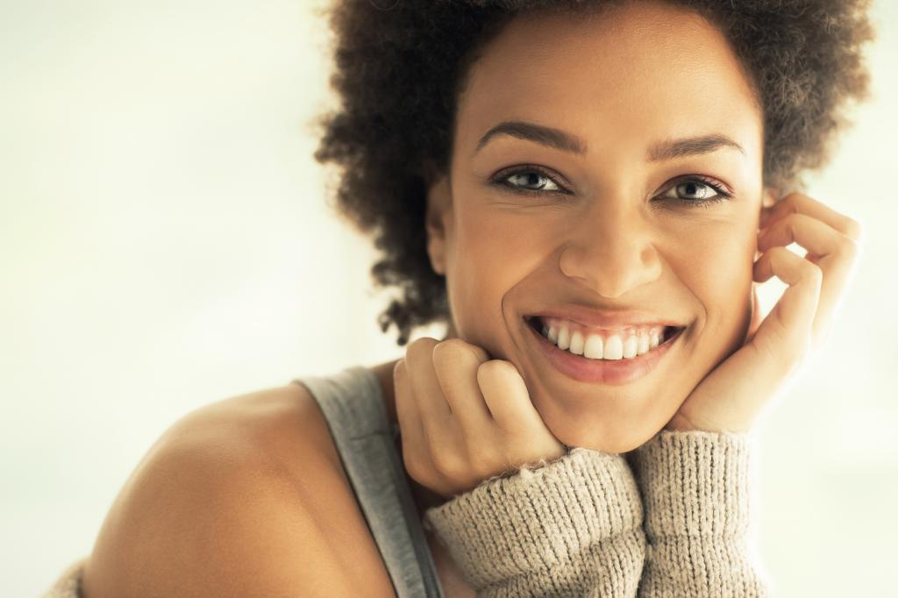
I was the original Cinderella girl, looking for the happy ending in the fairy story. But my fantasy _________ never came.
Evelyn Keyes
prince

Slide 9
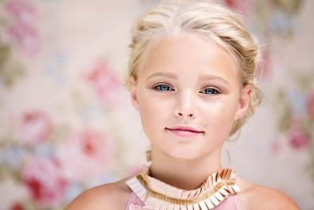
I like Cinderella, I really do. She has a good work ethic. I appreciate a good, hard-working gal. And she likes shoes. The fairy tale is all about the shoe at the end, and I'm a big ________ girl.
Amy Adams
shoe

Slide 10
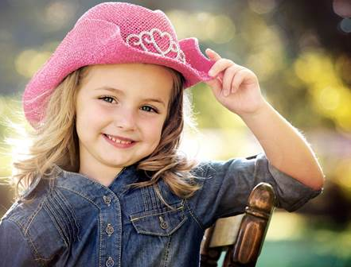
Every girl creates a dream in her mind; everyone needs an _______ . Roberto Cavalli
idol

Slide 11
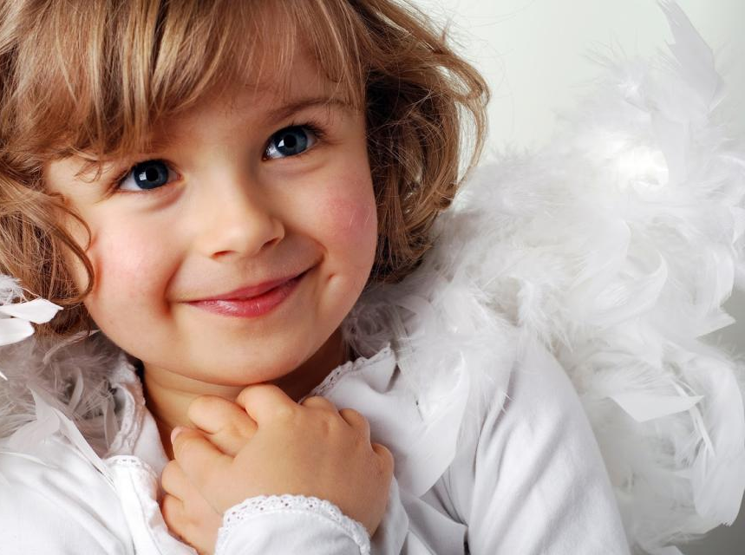
princess
Every young girl wants to be a _________. Then, when you find a real-life one, it's very easy to imagine yourself in that role. Lauren Willig

Slide 12
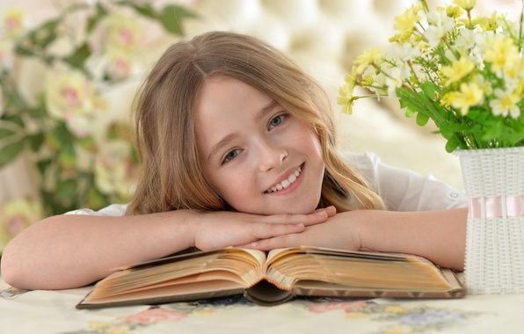
I don't want to be stinky poo poo girl, I want to be happy flower ________ . Drew Barrymore
child

Slide 13
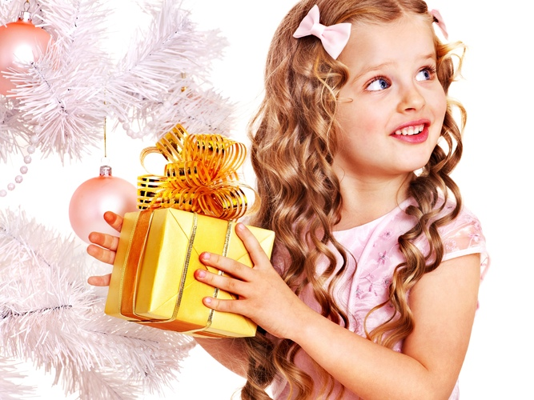
I love accessories. I'm a girl. I love shoes. I love _____________. Petra Stunt
handbags

Slide 14
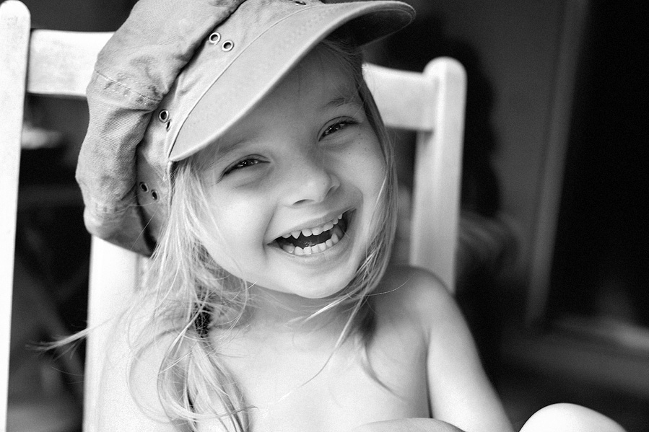
I always tell young girls, surround yourself with goodness. I learned early on how to get the haters out of my _______ . Michelle Obama
life

Slide 15
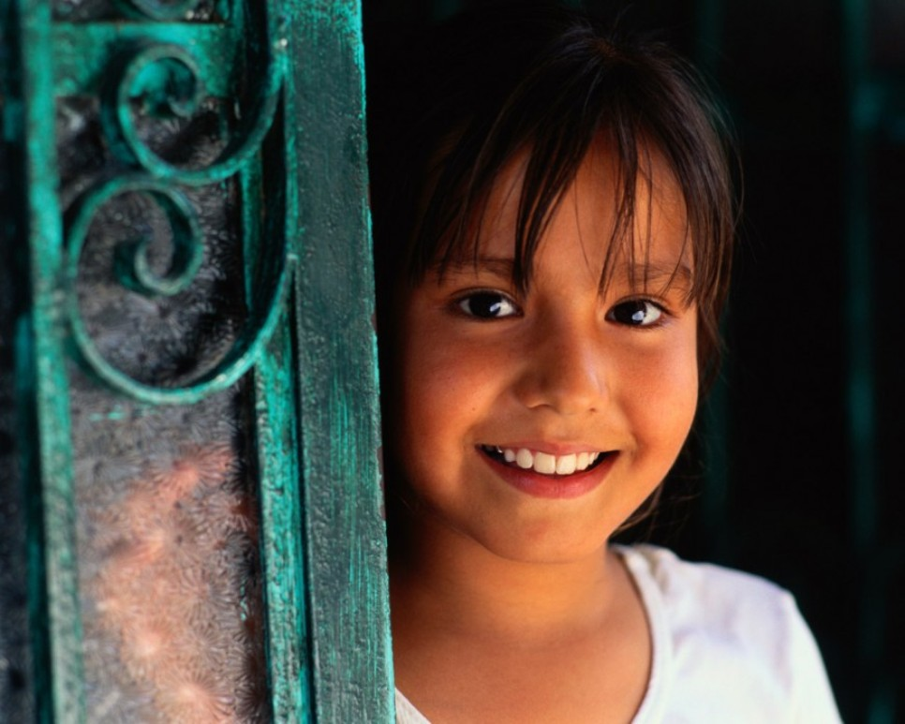
I was a very earthly, matronly, plus-size little girl with a pure ________. Paula Pell
heart

Slide 16
The ideal girl is driven, working on something other than modeling or being a _______. Drake
singer

Slide 17
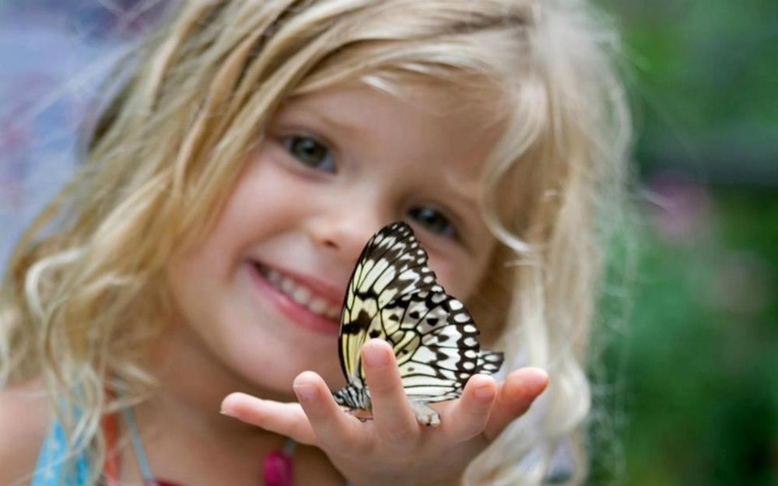
Barbie has always been an inspiration. Dressing her was part of ever girl's ________. Reem Acra
dream

Slide 18
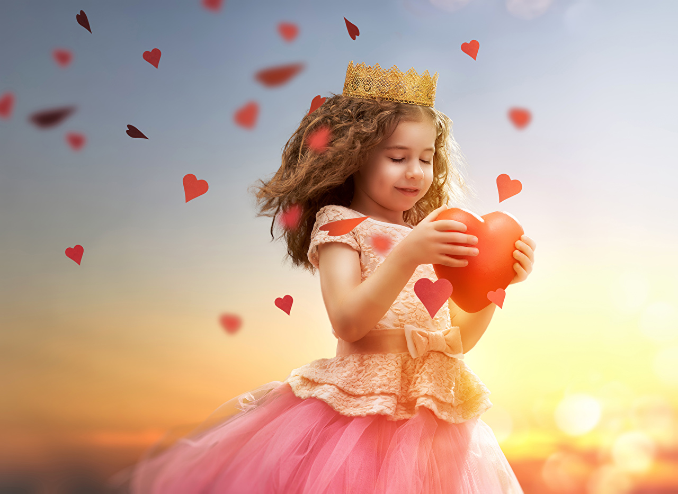
I think the biggest part of being a girl boss in the office, at home, or anywhere you go is just knowing your ________.
Meghan
Markle
value

Slide 19
Источник:
Girl Quotes https://www.brainyquote.com/topics/girl
Изображения взяты на сайте http://yandex.ru
Условия использования сайта https://yandex.ru/legal/fotki_termsofuse/

