Slide 1
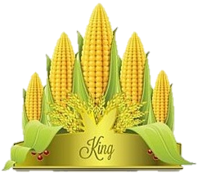
Corn Not just for health and beauty
Interactive Quiz for the 7-11 Grades
Автор:
Ольга Михайловна Степанова, учитель английского языка
МБОУ «Цивильская СОШ №1
имени Героя Советского Союза М.В. Силантьева»
города Цивильск Чувашской Республики
2018

Slide 2
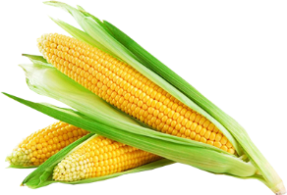
Corn, which is also known as maize, is a cereal grain first domesticated by indigenous peoples in southern ______ about 10,000 years ago.
Mexico

Slide 3
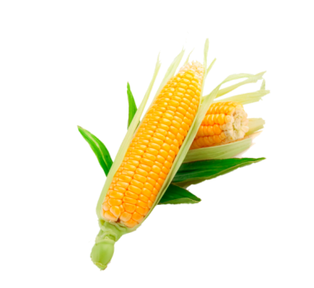
Corn has become a staple food in many parts of the world, with total production surpassing that of wheat or ______.
rice

Slide 4
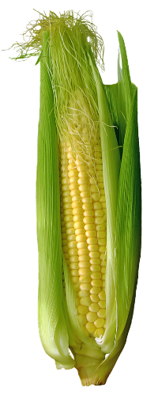
Corn is a cereal crop that is part of the grass ________.
There are over 3,500 different uses for corn products.
family

Slide 5
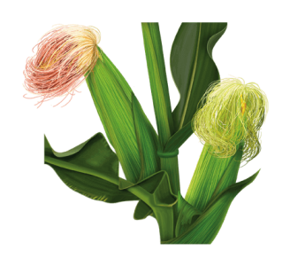
Corn is produced on every continent of the world except _______________.
Antarctica

Slide 6
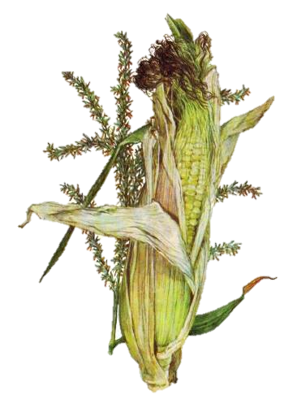
The word “corn” is an English word used to describe any type of grain. “Maize” is an indigenous Taino word meaning “sacred _________,” or “giver of life.”
mother

Slide 7
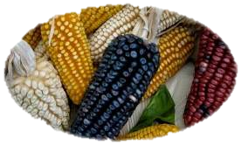
Color of the kernels depends on the variety of corn. They can be yellow, green, red, blue or black. Corn is made up of about 62% starch, 3.8% oil, 15% moisture, and 19.2% _________ and fiber.
protein

Slide 8
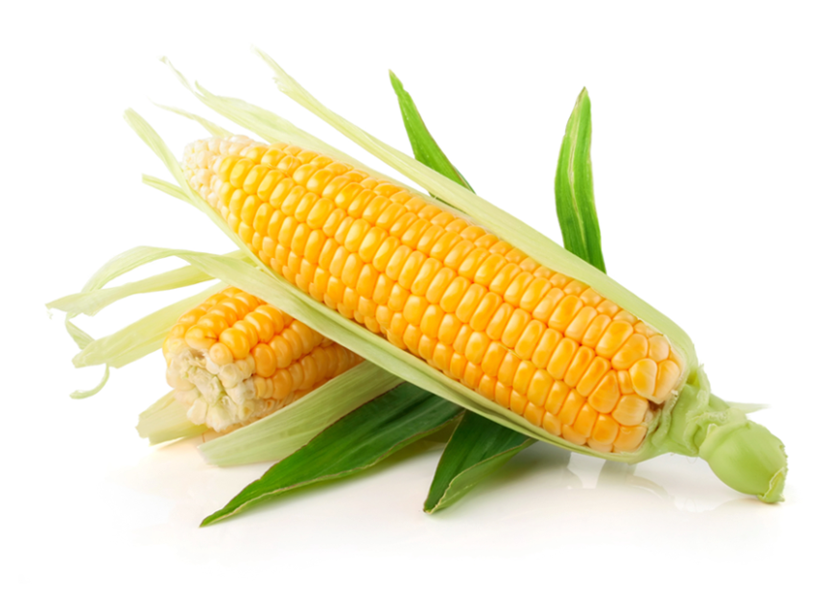
There are more than 3,500 different uses for corn, and its found in all sorts of products from peanut butter to batteries. The starch in corn can be made into plastics, fabrics, adhesives and many other chemical ___________.
products

Slide 9
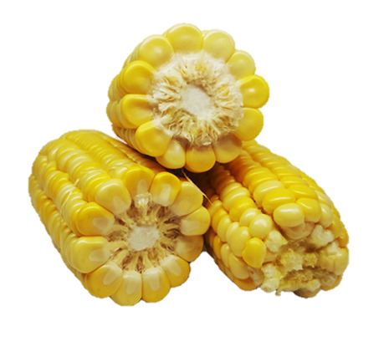
Besides selective breeding, new varieties of corn are produced through genetic engineering. Scientists can alter color and the size of kernels, improve nutritional ________ and develop varieties that are resistant to pests, herbicides and drought.
value

Slide 10
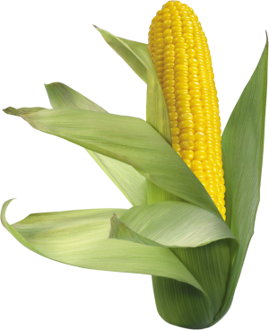
One acre of corn eliminates 8 tons of carbon dioxide from the air. Because of that, corn is one of the most important plants when it comes to the cleaning of the _________.
air

Slide 11
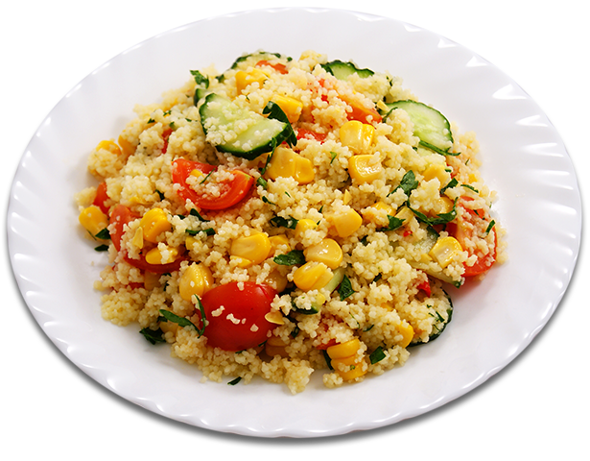
As well as being eaten by the cob, corn is also processed and used as a major component in many food items like cereals, peanut butter, potato chips, soups, marshmallows, ice cream, baby food, cooking oil, margarine, mayonnaise, salad dressing, and chewing ________.
gum

Slide 12
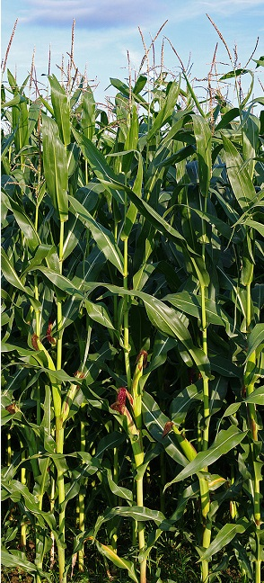
Corn and its by products are also found in many non-food items such as fireworks, rust preventatives, glue, paint, dyes, laundry detergent, soap, aspirin, antibiotics, paint, shoe polish, ink, cosmetics, the manufacturing of photographic film, and in the ____________of plastics.
production

Slide 13
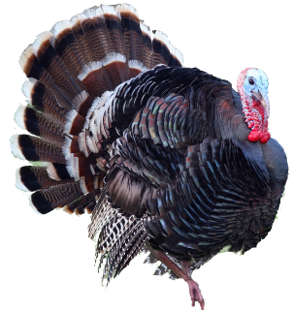
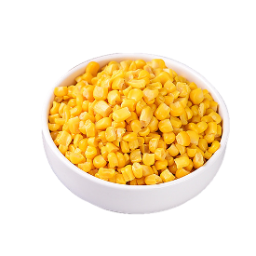
Corn is also used as feeding fodder for livestock and poultry and found in domestic pet _______.
food

Slide 14
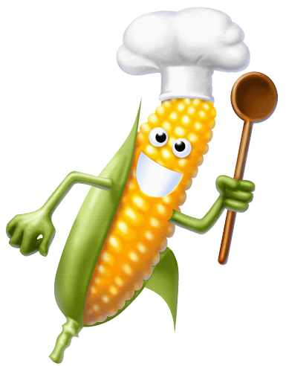
Corn not only provides the necessary calories for healthy, daily metabolism, but is also a rich __________of vitamin A, vitamin B, vitamin E and many minerals and some antioxidants. It is also high in fiber content.
source

Slide 15
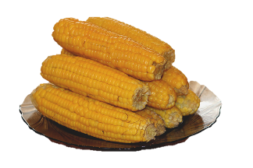
Health
___________ benefits of corn include controlling diabetes, prevention of heart ailments, lowering hypertension and prevention of neural-tube defects at birth.

Slide 16
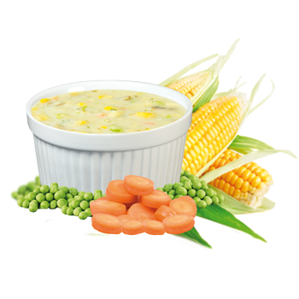
The antioxidants present in corn also act as anti-carcinogenic agents and prevent Alzheimer’s _________.
disease

Slide 17
Popcorn consists of kernels of certain varieties that explode when heated, forming fluffy pieces that are eaten as a __________.
snack

Slide 18
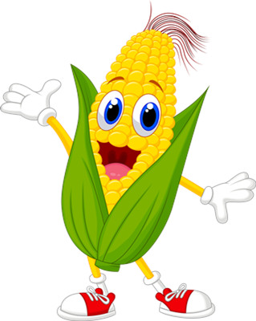
Corn is central to Mexican food. Virtually every dish in Mexican cuisine uses maize. In the form of grain or cornmeal, maize is the main ___________of tortillas, tamales, and all the dishes based on them, like tacos, quesadillas, enchiladas, tostadas and many more.
ingredient

Slide 19
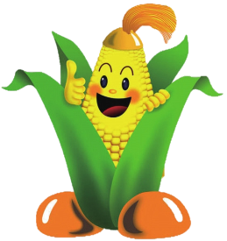
cultures
Cornmeal is made into a thick porridge in many ___________: from the polenta of Italy, the angu of Brazil, the mămăligă of Romania, the kačamak of Serbia, to cornmeal mush in the US (and hominy grits in the South).

Slide 20
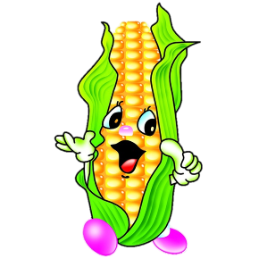
voyages
There was no corn in Europe prior to Christopher Columbus _________to the new world. While in the West Indies, Columbus traded with the natives and brought corn back to Europe.

Slide 21
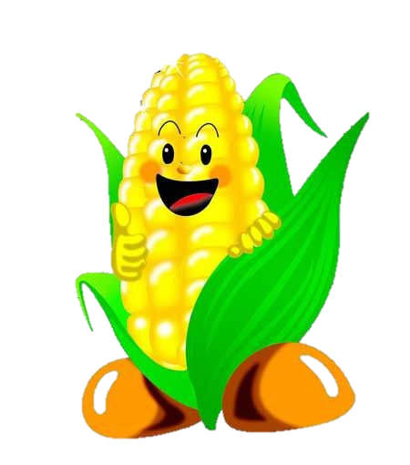
Native Americans in North America introduced corn to early settlers, and saved them from starvation by trading with them, and taught them how to plant, and cultivate corn using _________ for fertilizer.
fish

Slide 22
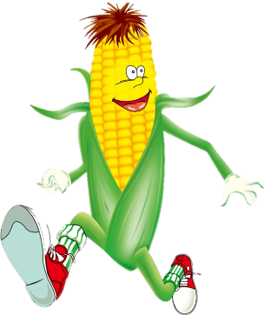
Indians taught the early settlers how to make various corn dishes including corn bread, corn pudding, corn soup, and fried corn cakes.
The pilgrims ate corn at the first _______________
Thanksgiving

Slide 23
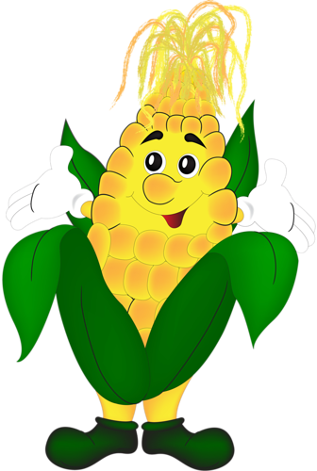
Corn flakes are a common breakfast cereal in North America and the United Kingdom, and found in many other _________ all over the world.
countries

Slide 24
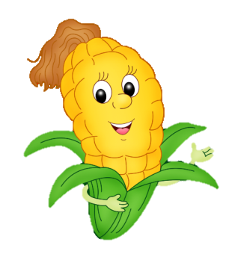
Corn is also used to produce ethanol, a first-generation liquid ________.
biofuel

Slide 25
century
Before the 20th ___________, all corn harvesting was by manual labour.
The first mechanical corn harvester was developed in 1930 by Gleaner Harvester Combine Corporation of Independence, Missouri.

Slide 26
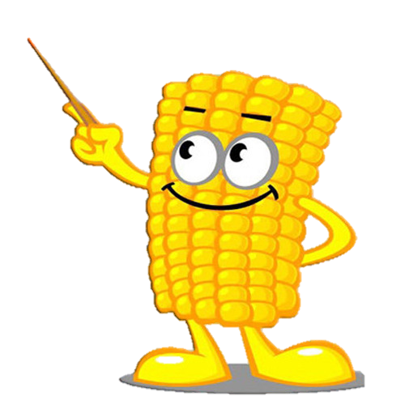
In the United States, corn ears along with tobacco leaves are carved into the capitals of columns in the United States Capitol ___________.
building

Slide 27
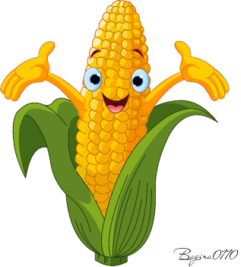
I’m a stalk of corn growing high
Here are my husks oh so dry!
When you pull them back
You will find
Juicy kernels sweet as _______.
pie

Slide 28
Источник:
Corn facts for kids http://www.sciencekids.co.nz/sciencefacts/food/corn.html
Interesting facts about corn http://justfunfacts.com/interesting-facts-about-corn/
28 Awesome And Interesting Facts About Corn http://tonsoffacts.com/28-awesome-and-interesting-facts-about-corn/
Изображения взяты на сайте http://yandex.ru
Условия использования сайта https://yandex.ru/legal/fotki_termsofuse/

