Slide 1
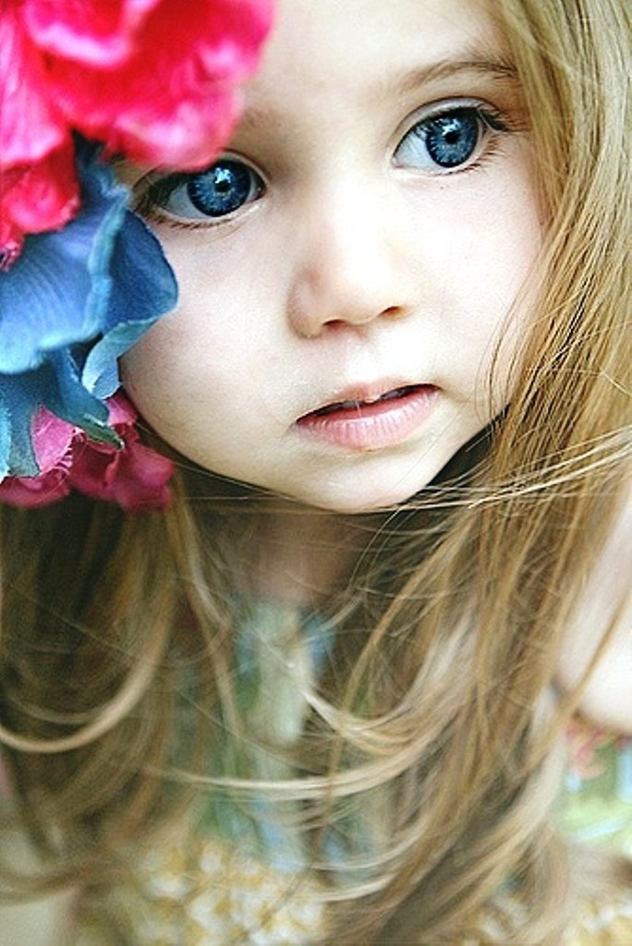
The fairy-tale
about
the girl and
animals
Хабарова Любовь Викторовна, учитель английского языка МБОУ «Белослудская школа» Красноборский район Архангельская область,
высшая квалификационная категория

Slide 2
This is a girl.
She meets animals.

Slide 3
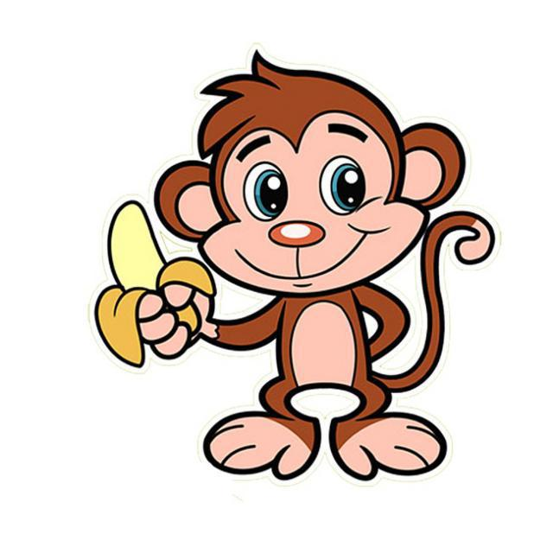
Hello!
I am a little girl.
Hi! Are you a little girl?
No. You are not a little girl.
I am a little monkey.
You are a big girl.

Slide 4
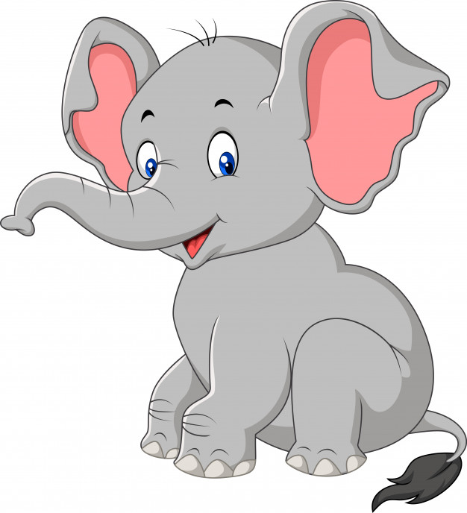
Hello! I am a big girl.
Hi! Are you a big girl?
No. You are not a big girl.
I am a big elephant.
You are a small girl.

Slide 5
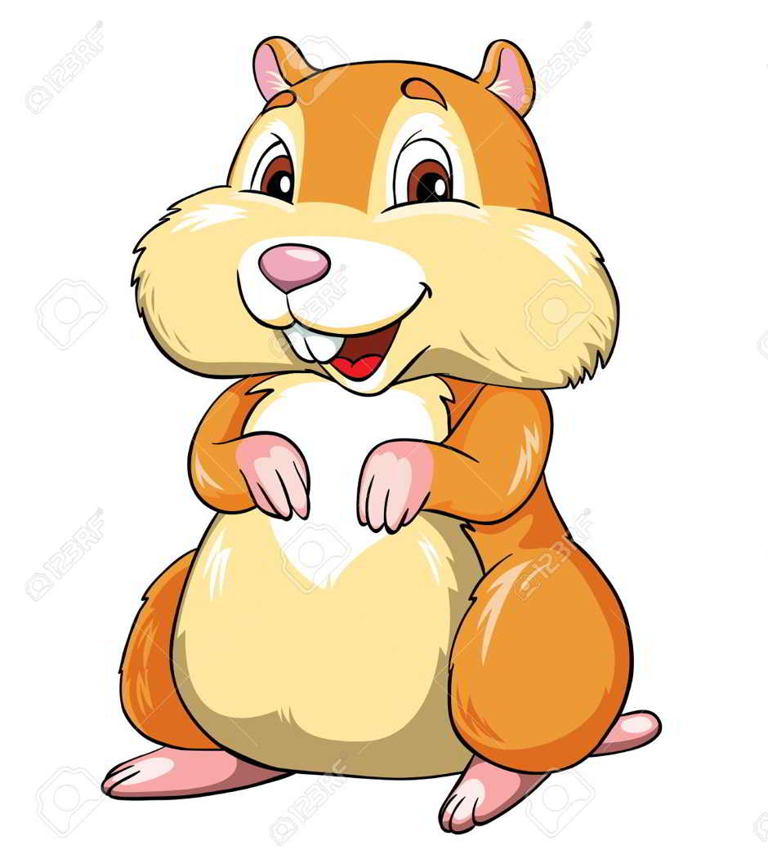
Hello! I am a small girl.
Hi! Are you a small girl?
No. You are not a small girl.
I am a small hamster.
You are a tall girl.

Slide 6
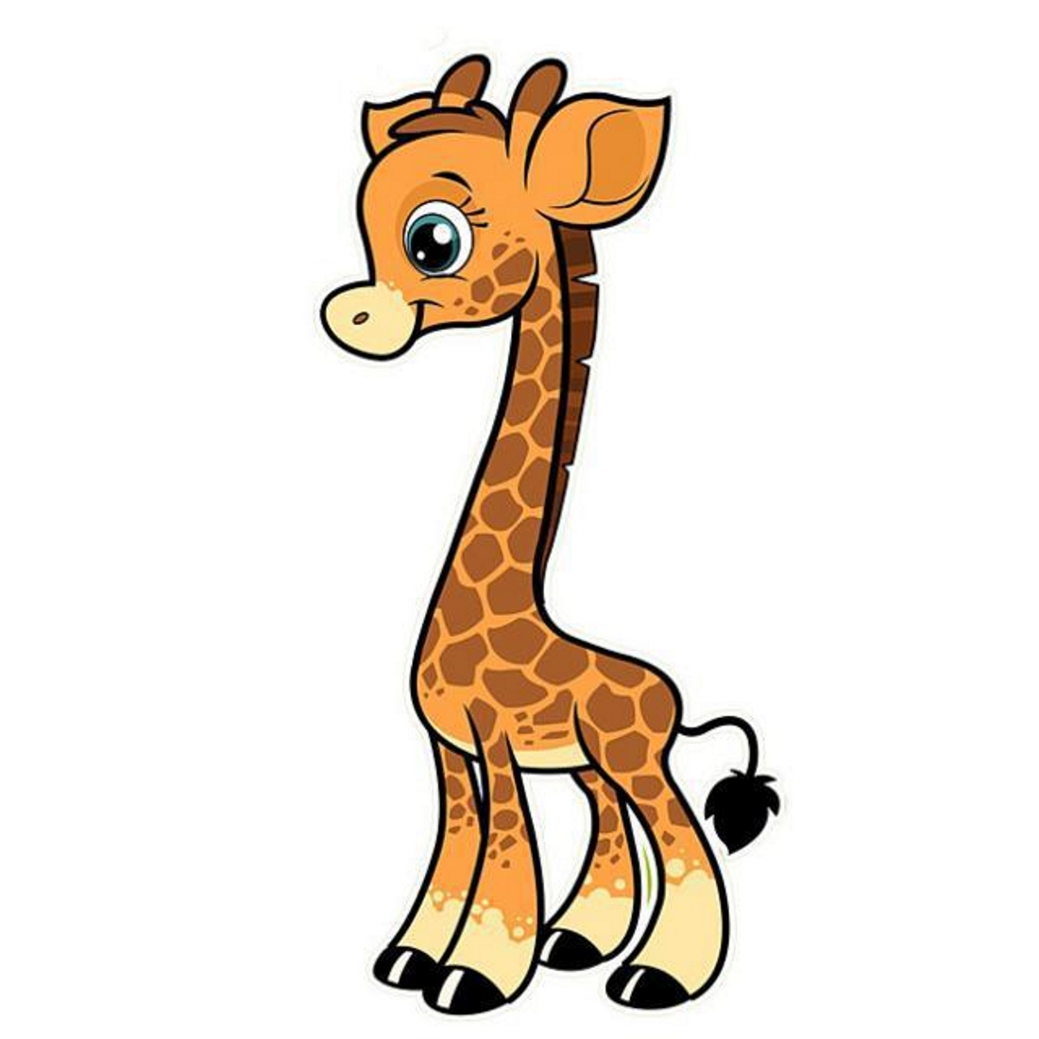
Hello! I am a tall girl.
Hi! Are you a tall girl?
No. You are not a tall girl.
I am a tall giraffe.
You are a short girl.

Slide 7
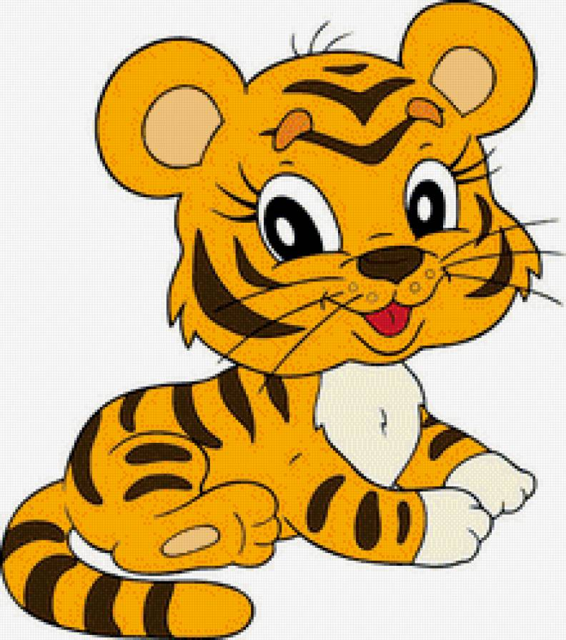
Hello! I am a short girl.
Hi! Are you a short girl?
No. You are not a short girl.
I am a short tiger.
You are a fat girl.

Slide 8
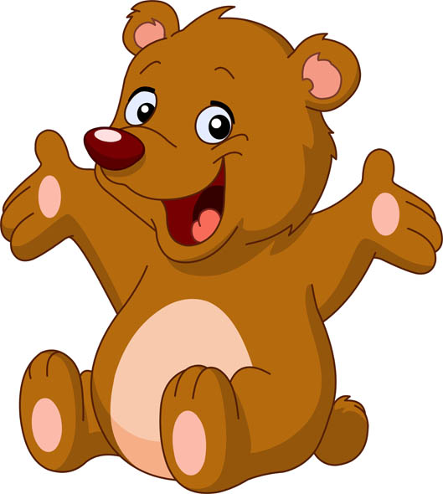
Hello! I am a fat girl.
Hi! Are you a fat girl?
No. You are not a fat girl.
I am a fat bear.
You are a thin girl.

Slide 9
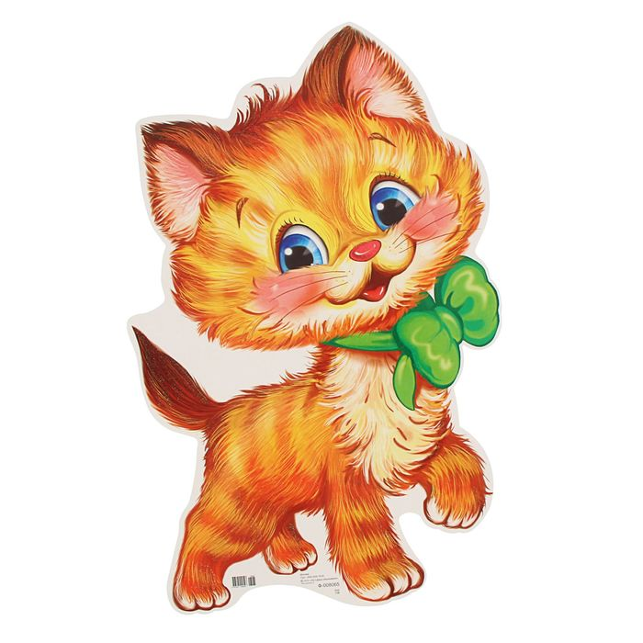
Hello! I am a thin girl.
Hi! Are you a thin girl?
No. You are not a thin girl.
I am a thin kitten.
You are a fast girl.

Slide 10
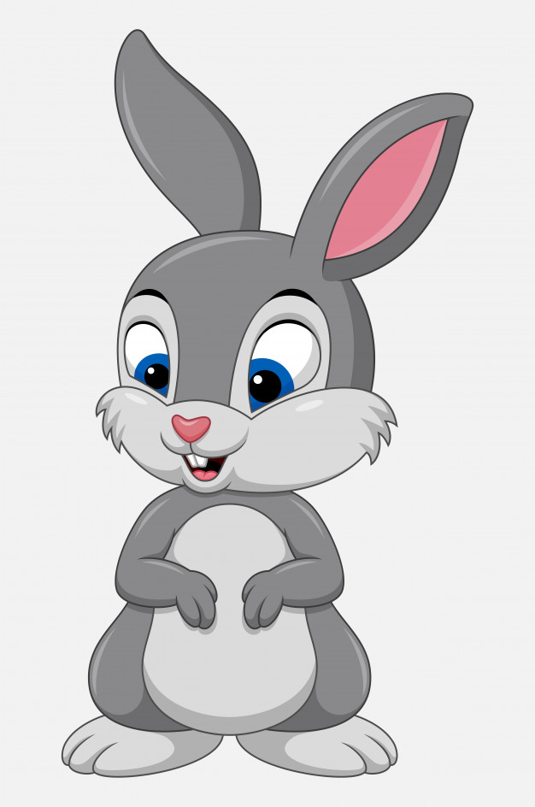
Hello! I am a fast girl.
Hi! Are you a fast girl?
No. You are not a fast girl.
I am a fast rabbit.
You are a slow girl.

Slide 11
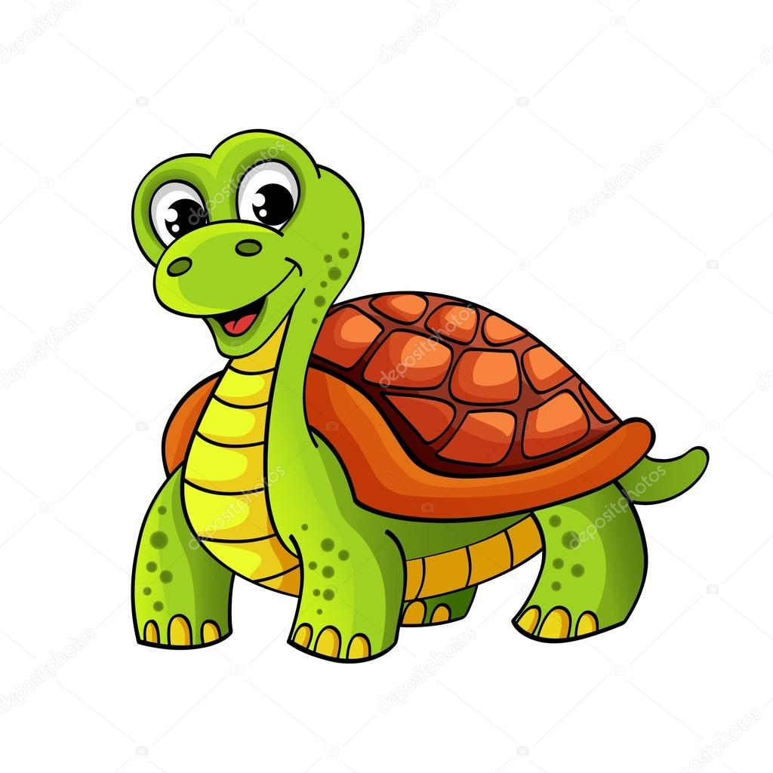
Hello! I am a slow girl.
Hi! Are you a slow girl?
No. You are not a slow girl.
I am a slow tortoise.
You are a sad girl.

Slide 12
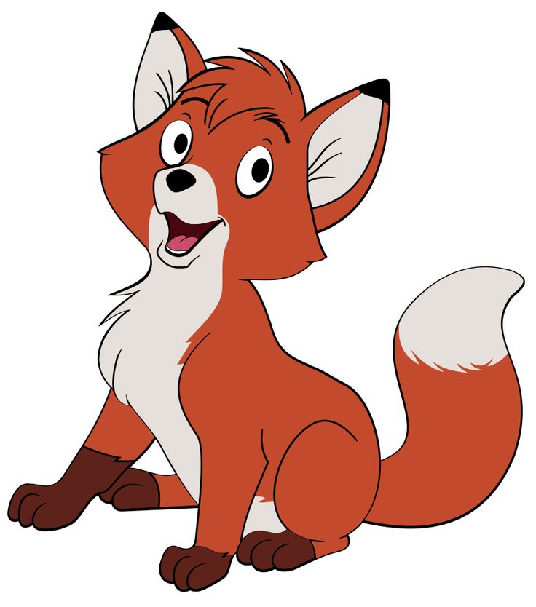
Hello! I am a sad girl.
Hi! Are you a sad girl?
No. You are not a sad girl.
I am a sad fox.
You are a happy girl.

Slide 13
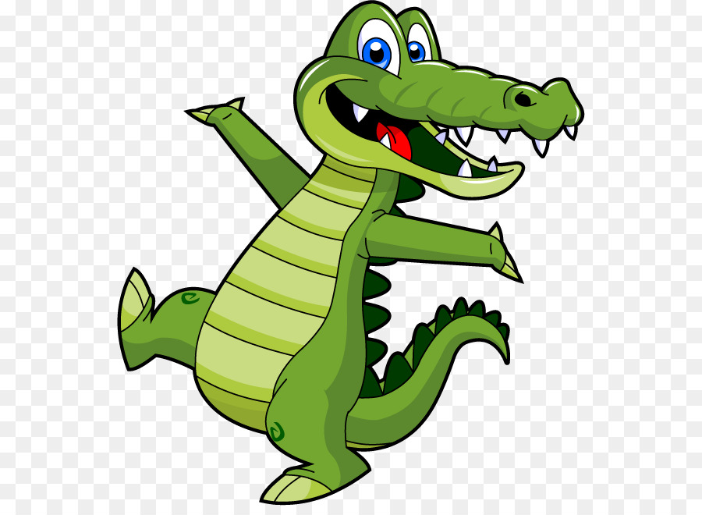
Hello! I am a happy girl.
Hi! Are you a happy girl?
No. You are not a happy girl.
I am a happy crocodile.
You are a pretty girl.

Slide 14
Hello, dear children!
I’m a little, big, small, tall, short, fat, thin, fast, slow, sad, happy, pretty girl.
And you?

Slide 15
Источник:
Изображения взяты на сайте http://yandex.ru
Условия использования сайта https://yandex.ru/legal/fotki_termsofuse/

