Slide 1
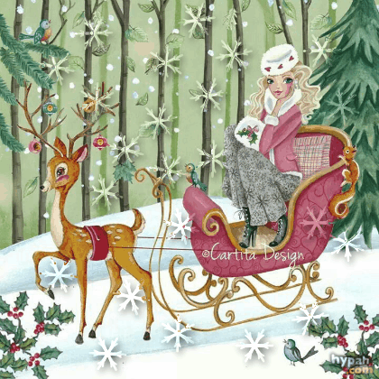
Meet Caroline Bonne-Müller!
Art Gallery for 5th-9th Grades
Автор:
Ольга Михайловна Степанова, учитель английского языка
МБОУ «Цивильская СОШ №1
имени Героя Советского Союза М.В. Силантьева»
города Цивильск Чувашской Республики
2018

Slide 2
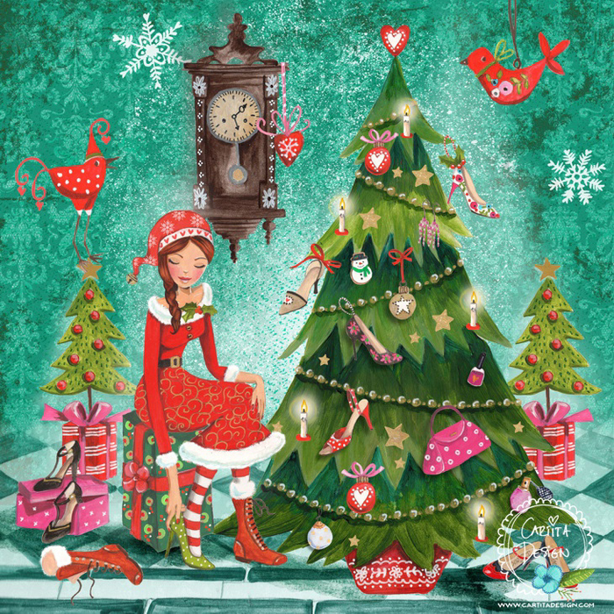
My name is Caroline Bonne-Müller, I am a Dutch artist living in Switzerland.

Slide 3
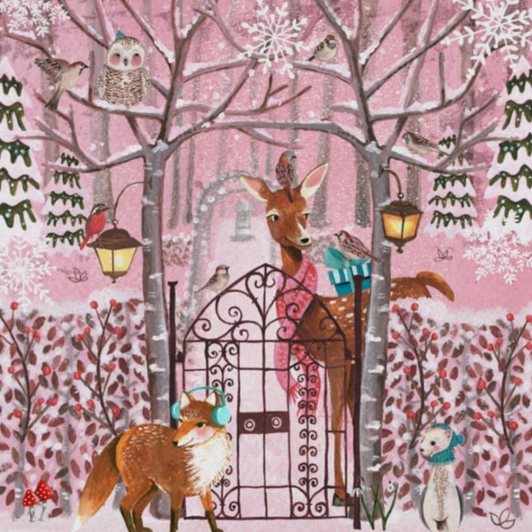
I studied fashion in Amsterdam

Slide 4
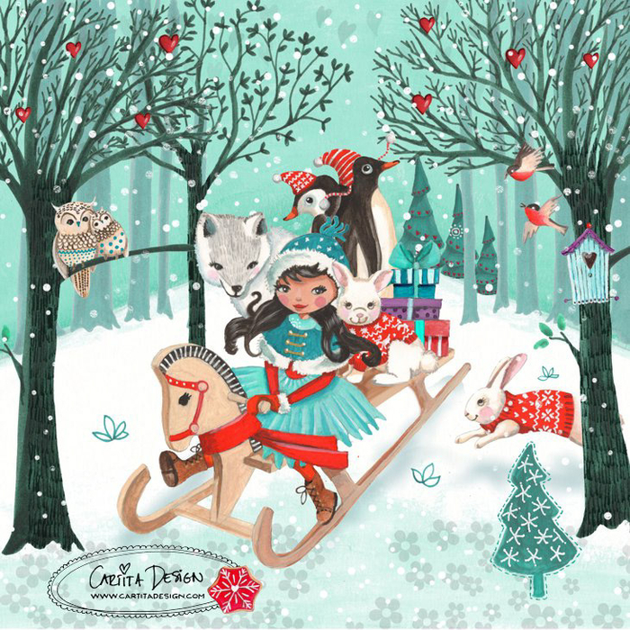
In Amsterdam I worked for 14 years as a fashion designer for kids collections.

Slide 5
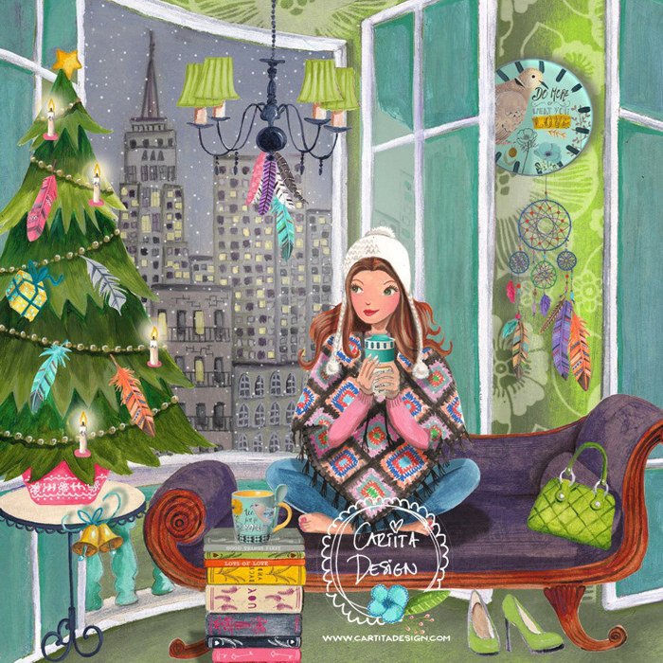
In 2000 I moved to Barcelona.

Slide 6
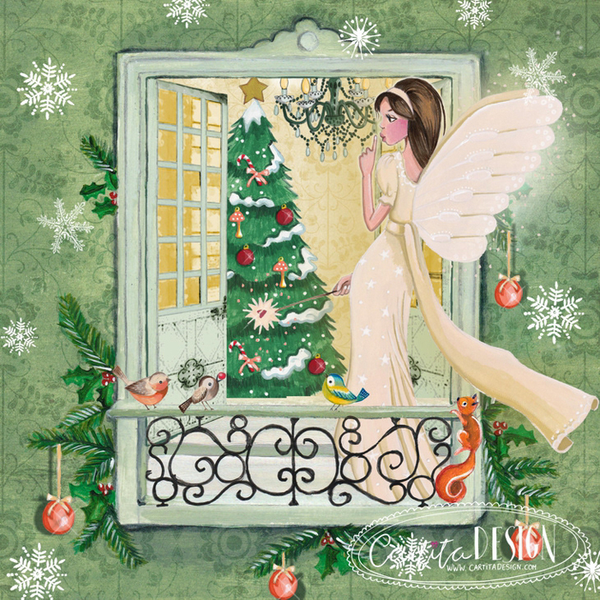
In Barcelona my three kids are born.

Slide 7
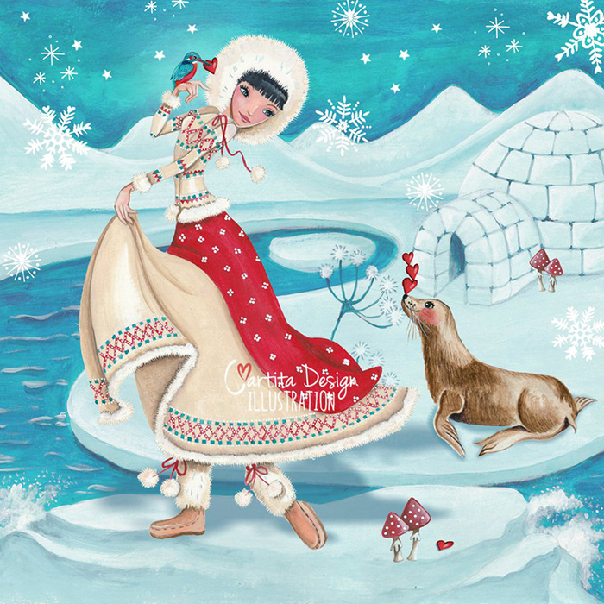
I started to illustrate greeting cards.

Slide 8
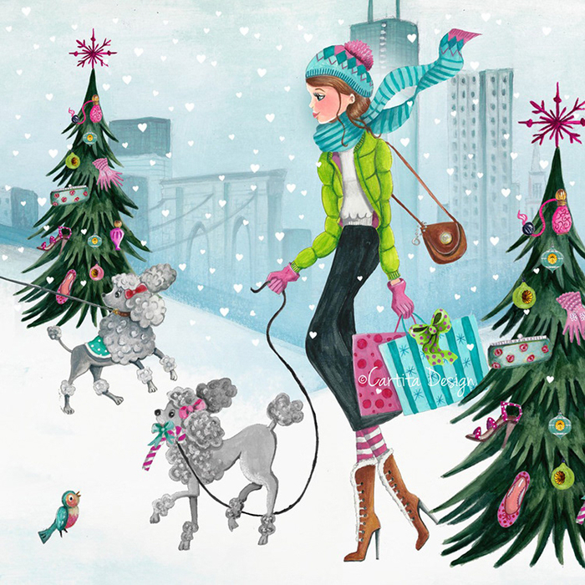
Mostly painted with acrylics and digital manipulation.

Slide 9
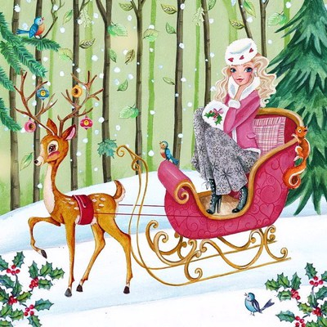
From 2013 - till 2017 I moved to Asia.

Slide 10
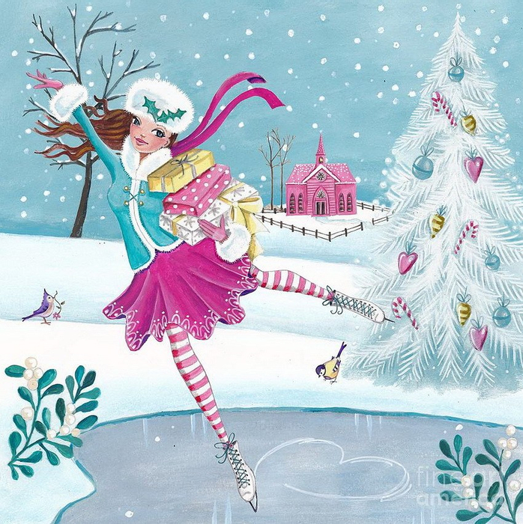
In Asia I was working as an illustrator.

Slide 11
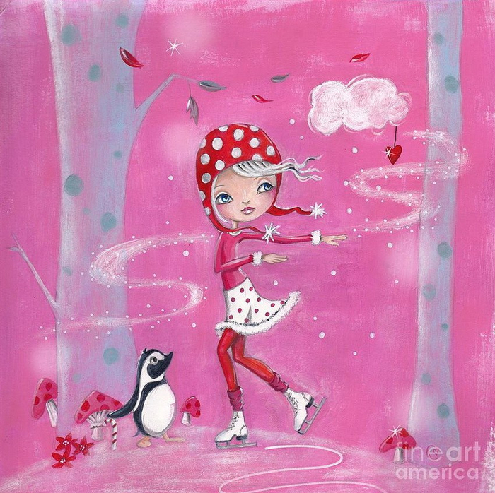
I enjoyed the life in the tropics in Asia so much!

Slide 12
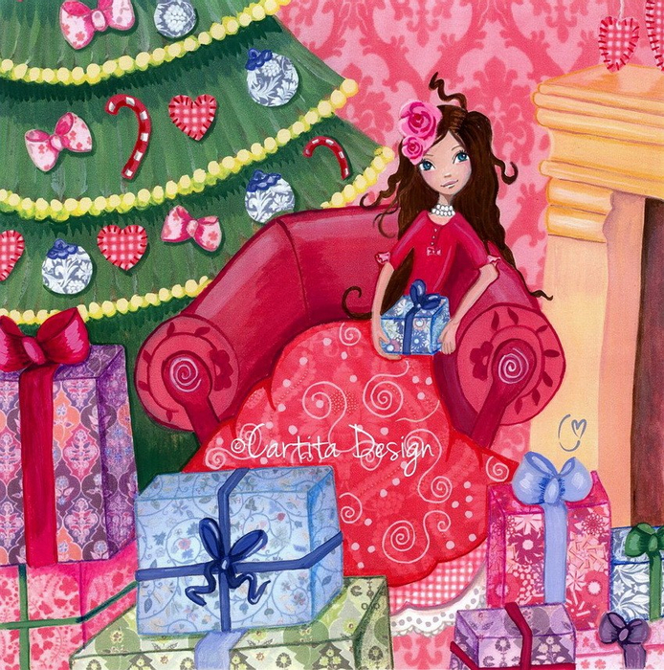
Now I am working and living with my husband and my three kids!

Slide 13
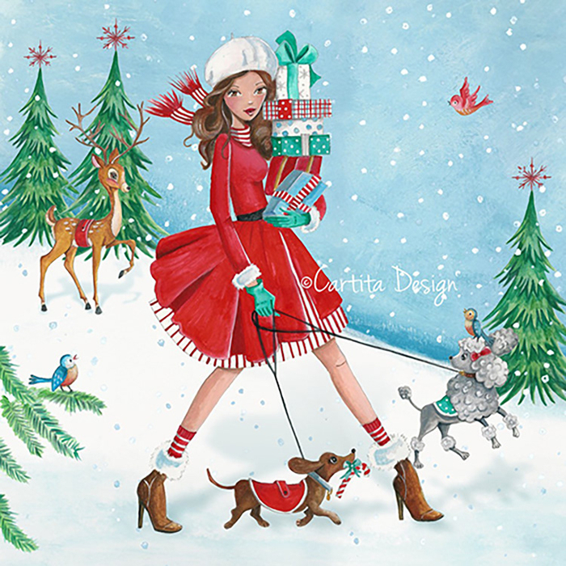
I have four stray cats from Malaysia in Switzerland!

Slide 14
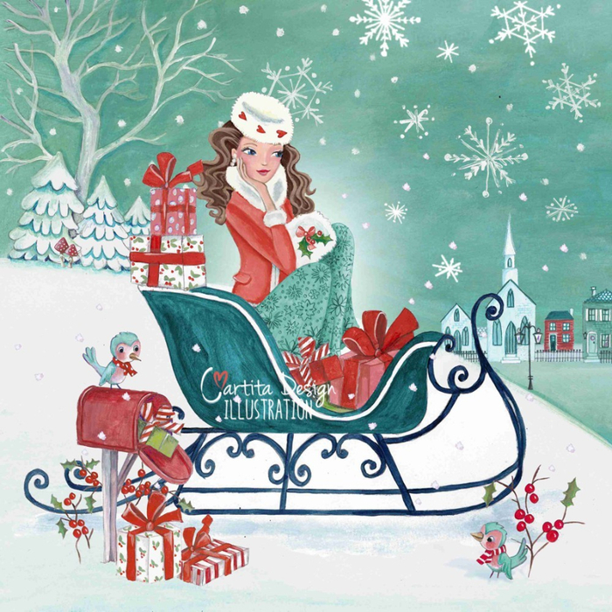
It was me — C.B.M.
Yours,
Caroline Bonne-Müller

Slide 15
Have a great festive season!

Slide 16
Источник:
Caroline Bonne-Muller https://www.carolinebonnemuller.com/testimonials-1/
Изображения взяты на сайте http://yandex.ru
Условия использования сайта https://yandex.ru/legal/fotki_termsofuse/

