Slide 1
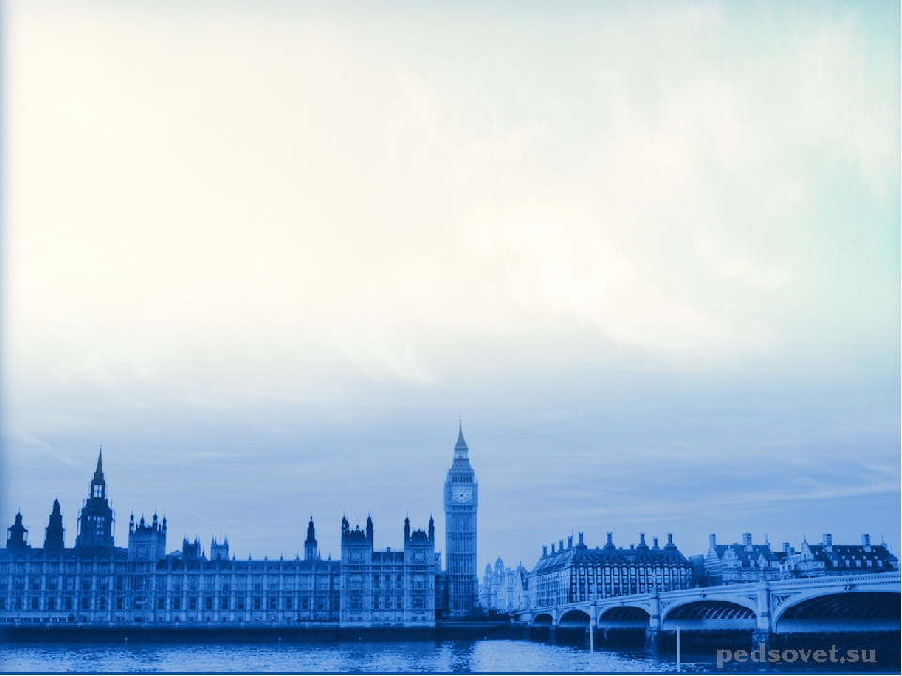
Let’s find and correct the mistakes!
Хабарова Любовь Викторовна, учитель английского языка, высшая квалификационная категория,
МБОУ «Белослудская школа» Красноборский район Архангельская область
Form 4

Slide 2
1. Kate making a cake now.

Slide 3
2. Give me a sugar, please.

Slide 4
3. He like ice-cream.

Slide 5
4. I doesn’t eat bread.

Slide 6
5. You can play volleyball?

Slide 7
6. Tom have got a hamster.

Slide 8
7. What it is?

Slide 9
8. What colour the pencils are?

Slide 10
9. There aren’t some milk in the fridge.

Slide 11
10. Mary and John is friends.

Slide 12
11. We has got a lot of different school subjects.

Slide 13
12. She go to school with her friend.

Slide 14
13. She is not a tall.

Slide 15
14. You happy are?

Slide 16
15. She don’t like her journey to school.

Slide 17
16. He is teacher.

Slide 18
17. There aren’t bus where I live and I walk to school.

Slide 19
18. It is in the car?

Slide 20
19. The skirt is a brown.

Slide 21
20. What her name is?

Slide 22
21. Does you live in London?

Slide 23
22. Do you dance and sing.

Slide 24
23. When your birthday is?

Slide 25
24. My home two kilometers from school.

Slide 26
25. My granny make cakes.

Slide 27
26. Children plays now.

Slide 28
27. I am liking my dog.

Slide 29
28. She is going to school every day.

Slide 30
29. Tom watches TV now.

Slide 31
30. There are a lot of picture in a book.

Slide 32
31. They are sleep now.

Slide 33
32. I am not sleep now.

Slide 34
33. She eats an apple at this moment.

Slide 35
34. She doesn’t writes letters very often.

Slide 36
35. He go to school every day.

Slide 37
Источники: УМК Английский язык ФГОС Начальная инновационная школа Ю.А. Комарова, И.В. Ларионова, Ж. Перретт Учебник для общеобразовательных учреждений. Изображения взяты на сайте http://yandex.ru Условия использования сайта https://yandex.ru/legal/fotki_termsofuse/

