Slide 1
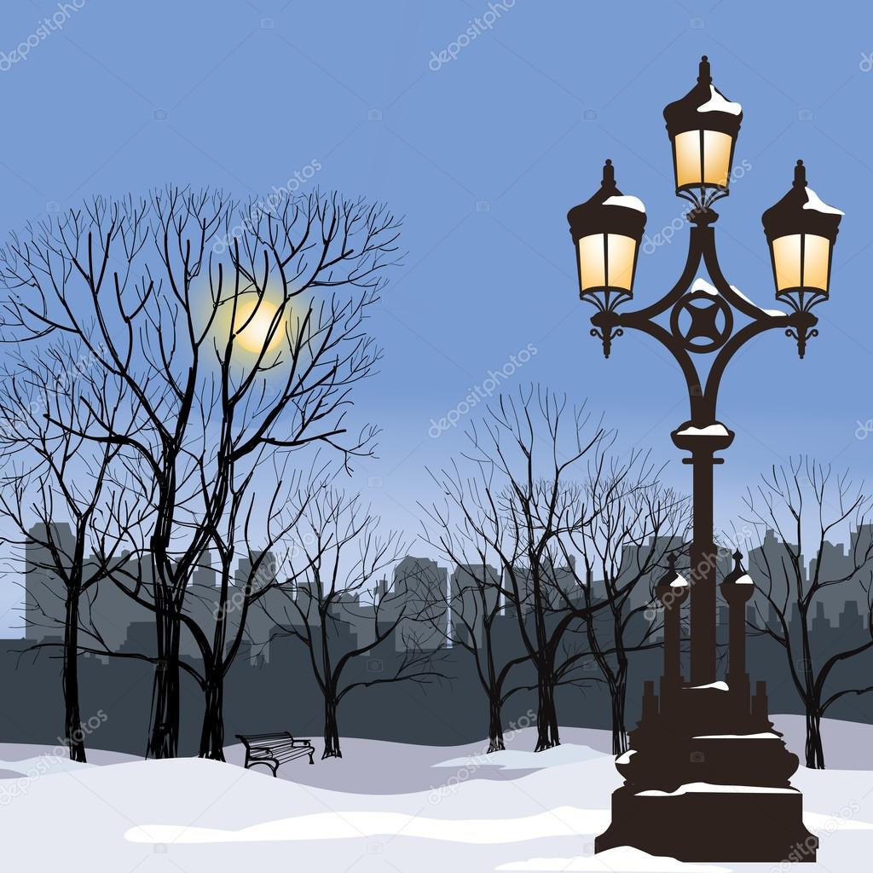
Хабарова Любовь Викторовна, учитель английского языка, высшая квалификационная категория,
МБОУ «Белослудская школа» Красноборский район Архангельская область
Form 7
The History of London Double-Decker Bus

Slide 2
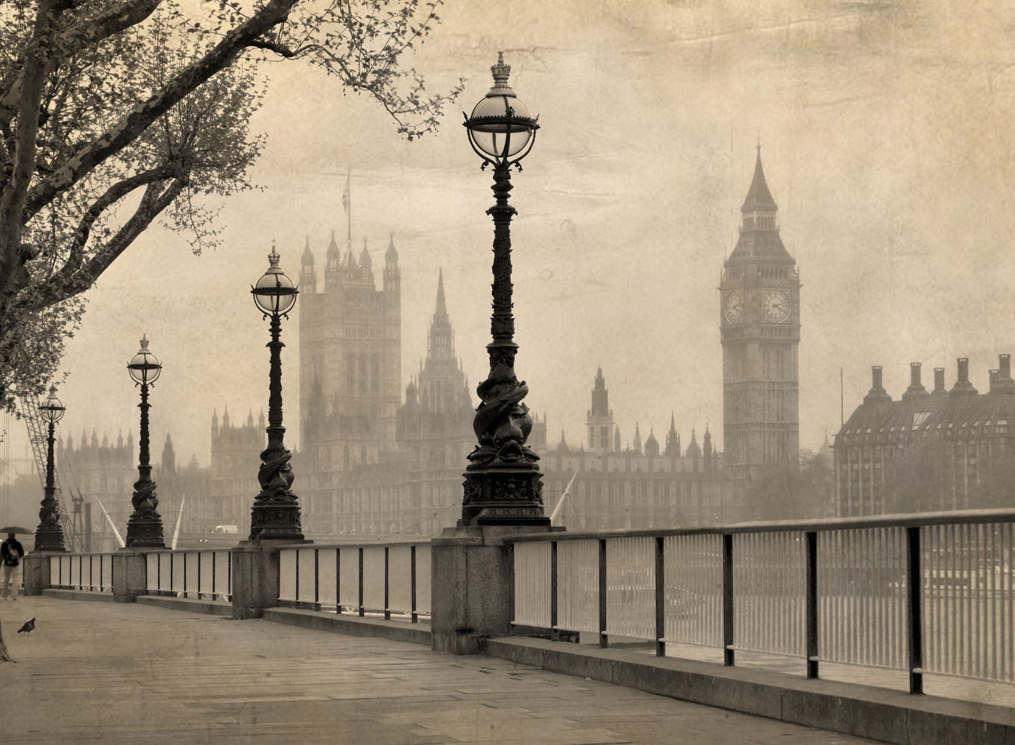
You know that British people take much part of attention for symbolic things of their country.

Slide 3
British people adore and idolize the Royal Family;
the Union Jack is the icon of style; and, by the way, as a cup of tea. Owing their attitude to these things, British weather also has the world fame!

Slide 4
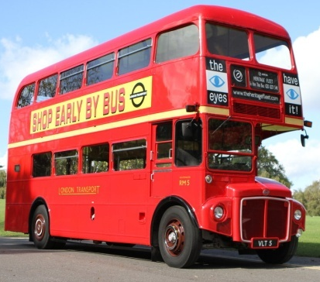
Many countries use double-deckers, but a red colored bus becomes one of the well-known sight of the capital of __________. And now we know how this story has been started…
Great Britain

Slide 5
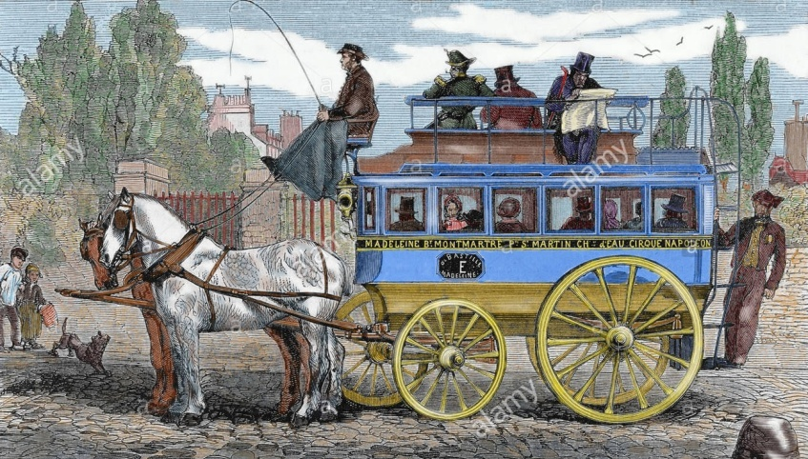
But ________buses in London were not red at all!
the first

Slide 6
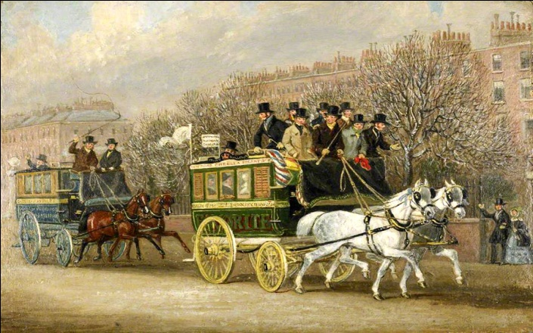
The first double-deckers appeared in the streets of ________ in 1829. They was harnessed with horses and named “omnibuses”.
London

Slide 7
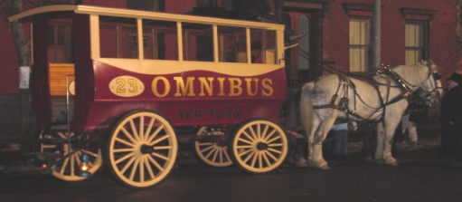
For up their effectiveness (to transport more number of people in narrow London streets) omnibuses started to offer two levels of service: the first deck is comfortable deck for rich people and the second level is an opened deck for ________ people.
poor

Slide 8
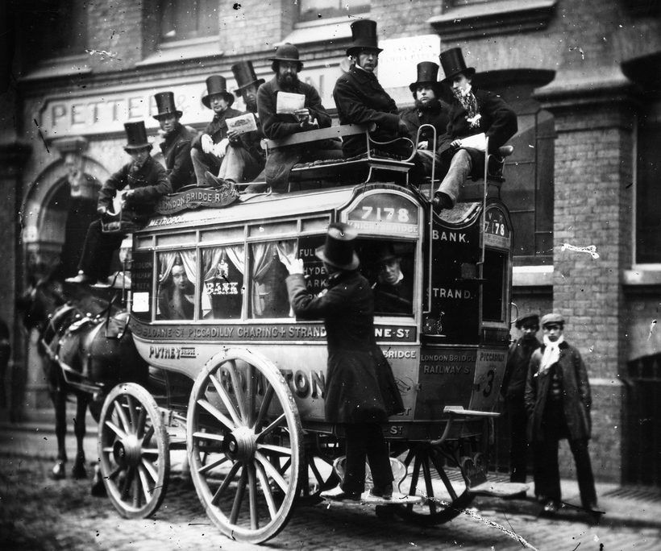
It was the first prototype for a ________double-decker.
modern

Slide 9
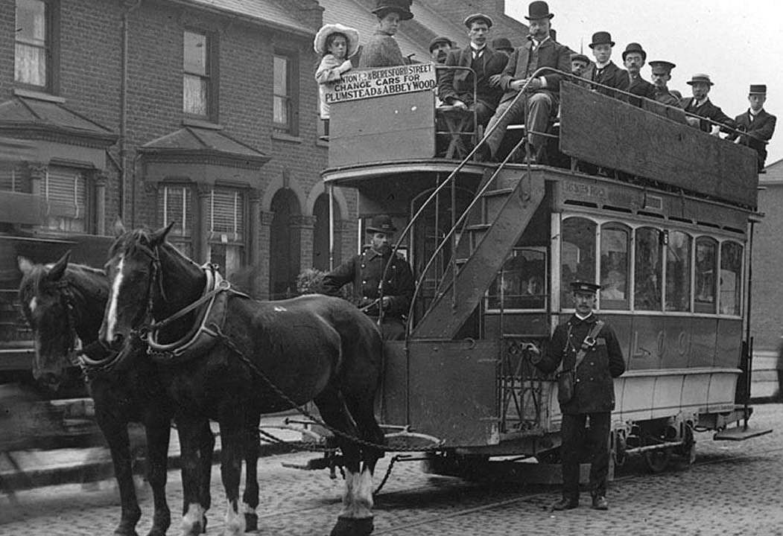
Little by little omnibuses were changed. Citizens laid rails for omnibuses. Thanks to electricity necessity in horses disappeared – trams went in the London _________(also double-deckers).
streets

Slide 10
Then they were changed with trolleybuses, because they had more mobility. Together them motorbuses were developed, then they were renamed “autobuses”.

Slide 11
The most well-known double-decker is Routemaster (you can translate it as “a host of roads”). It was existed in 1954 and appeared in the streets of the capital on February 1956. Routemaster immediately became the ultrapopular symbol of ___________.
London

Slide 12
There was some reasons of its popularity, but the main reason was the unique design: Routemaster hadn’t ________, and enter-entrance was on the opened back deck.
doors

Slide 13
So people could go out not only_________, but in the crossroads, traffic lights and traffic jams.
bus stops

Slide 14
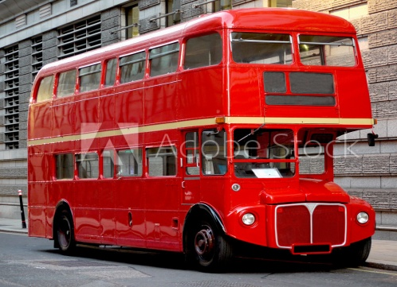
Some years ago they said that double-deckers would disappear in London. But it was not true. Simply citizens took away ________ Routemaster. The main reason was Health and Safety regulations.
old

Slide 15
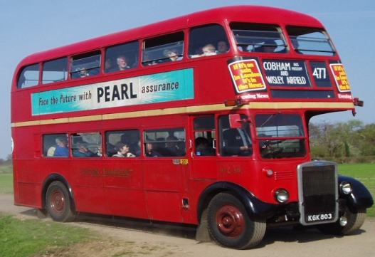
Today you can see old buses on two “historical routes” - 9 и 15 - and you can go by them with a usual ticket. “Historical routes” are named so, because they go near many important __________and sights of London – from Tower to Kensingtons Gardens.
monuments

Slide 16
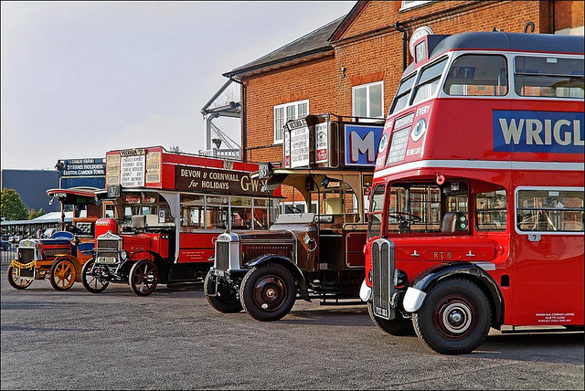
After charge-off “Routemasters” weren’t scraped, but were exposed on selling. There everybody could buy a drop of London history for some thousands pounds. So buses were taken by owners.

Slide 17
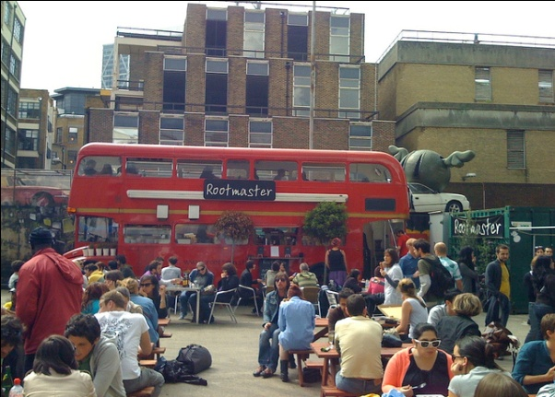
Some of double-deckers were removed Canada, China, Japan and so on, but another stayed in museums and own touristic companies. Some of them had more interesting fortune: one, for example, was made a popular vegetarian restaurant of East-End in London.

Slide 18
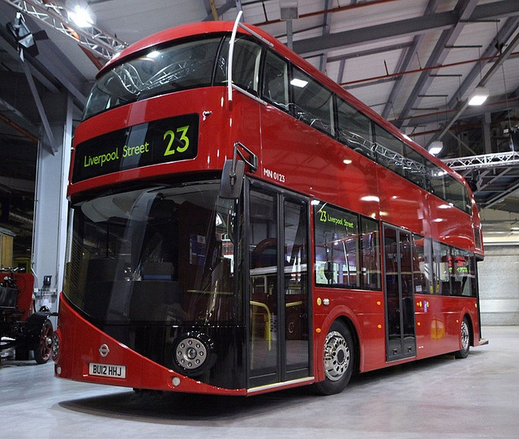
London double-deckers always are changed: leave old models, come new modern, more comfortable and ecological ones. But no one of them compare in popularity with old Routemaster.

Slide 19
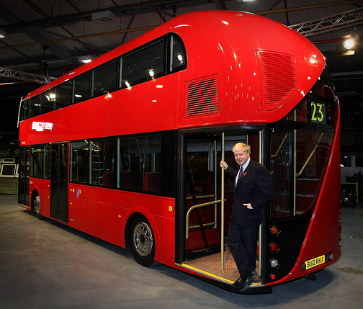
From 2012 in London streets you can see modern version of double-deckers Routemaster.

Slide 20
In modern London you can see modern buses. Londoners are very proud of them.

Slide 21
Welcome and go by Routemasters!

Slide 22
What is a double - decker?

Slide 23
What do you know about London bus?

Slide 24
What do you know about the history of London bus?

Slide 25
What colour is the traditional London bus?

Slide 26
Does the traditional bus have big doors for passengers?

Slide 27
Источники: Учебно-методический комплект «Английский с удовольствием» («Enjoy English») под редакцией М.З. Биболетовой. Изображения взяты на сайте http://yandex.ru Условия использования сайта https://yandex.ru/legal/fotki_termsofuse/
Used website: http://www.anglomania.org/2011/11/blog-post.html

