Slide 1
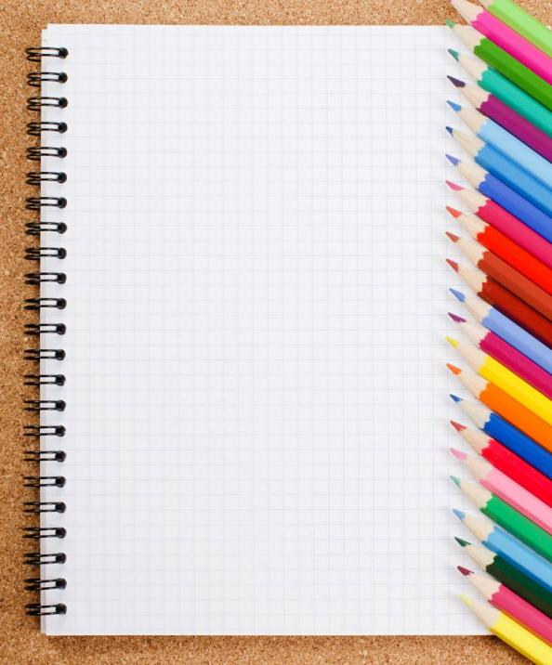
Short Answers Form 4-5
Хабарова Любовь Викторовна, учитель английского языка, высшая квалификационная категория,
МБОУ «Белослудская школа» Красноборский район Архангельская область

Slide 2
Have you got a brother?
No, _________

Slide 3
Can she run very fast?
Yes, _________

Slide 4
Is she your teacher?
Yes, _________

Slide 5
Does he like sport?
Yes, _________

Slide 6
Can you swim?
No, _________

Slide 7
Are you tired?
Yes, _________

Slide 8
Are they friends?
Yes, _________

Slide 9
Are you busy?
No, _________

Slide 10
Do you like music?
Yes, _________

Slide 11
Do they know this man?
No, _________

Slide 12
Can they sing well?
No, _________

Slide 13
Is this your home?
Yes, _________

Slide 14
Has your friend got holiday?
Yes, _________

Slide 15
Can your father answer the telephone?
No, _________

Slide 16
Are you friends?
No, _________

Slide 17
Is he a mechanic?
No, _________

Slide 18
Does he like school?
No, _________

Slide 19
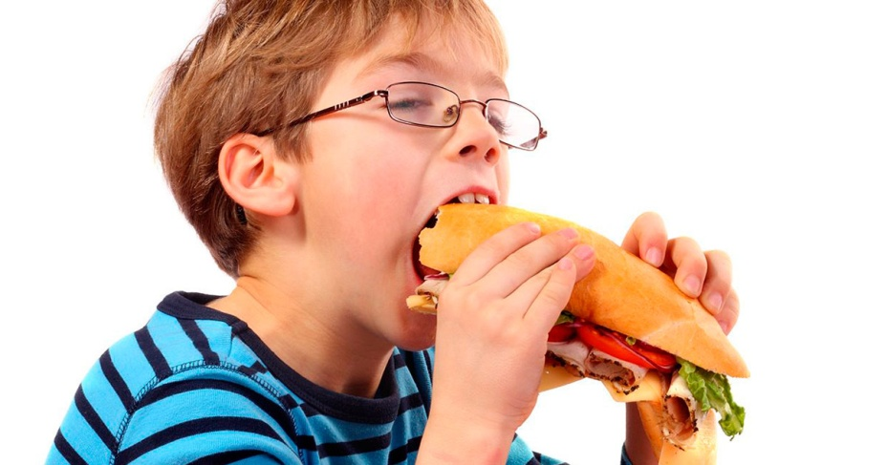
Is he hungry? Has he got a cake? Does he like sandwiches?

Slide 20
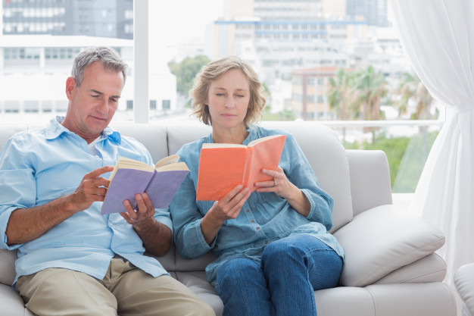
Are they your grandparents? Can you tell me their names? Has the man got a book in his hands?

Slide 21
Is he a mechanic? Has he got a red hat? Can he repair toilets well?

Slide 22
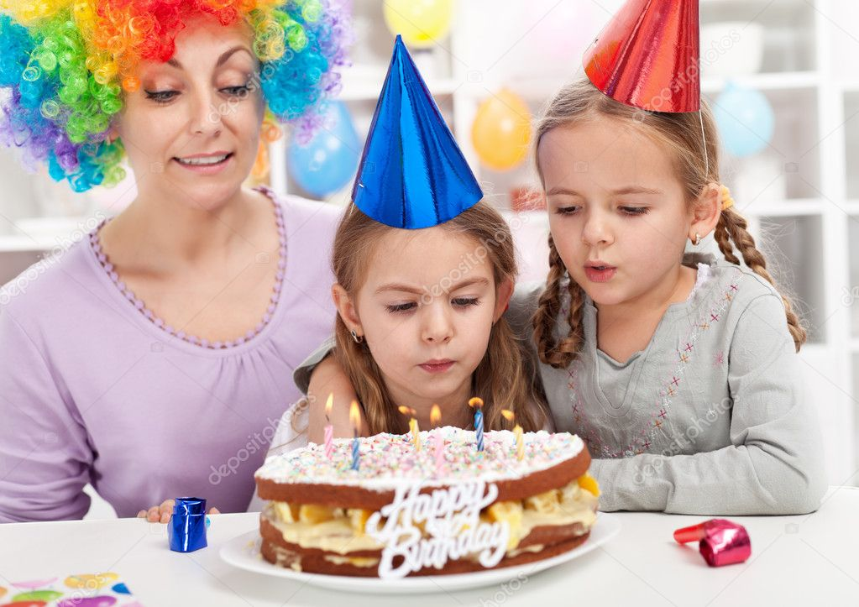
Is it your birthday today? Are you 10 years old? Do you like cake?

Slide 23
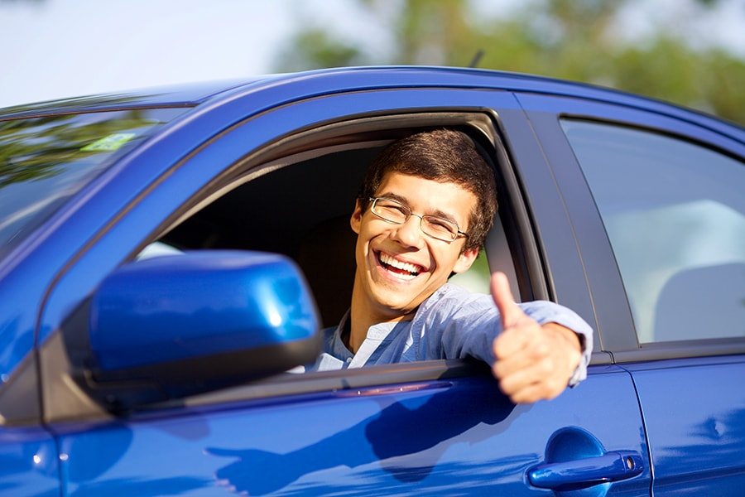
Is there a policeman in the car? Can he drive fast? Do you like red cars?

Slide 24
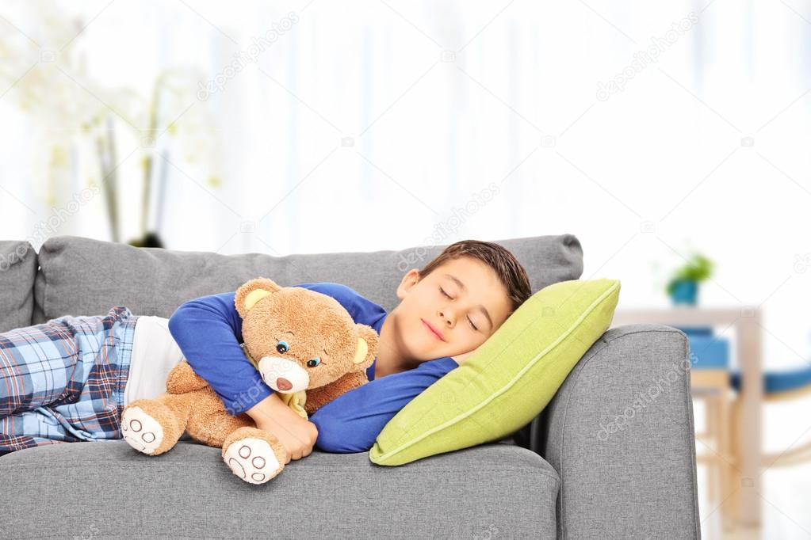
Is this your bedroom? Is there a teddy bear on the sofa? Do you know that boy there?

Slide 25
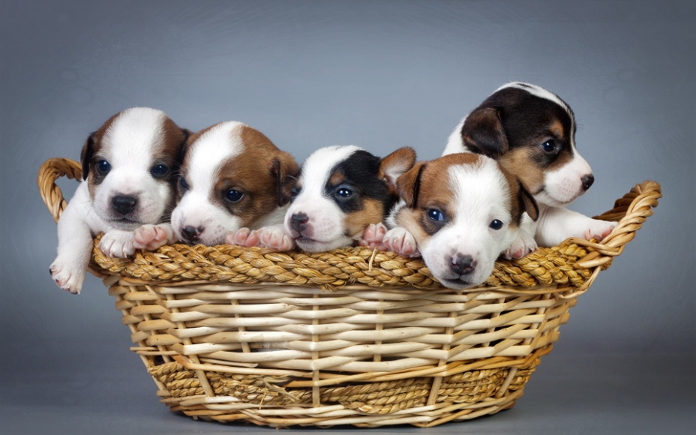
Are they your puppies? Has your friend got a pet? Do dogs like cats?

Slide 26
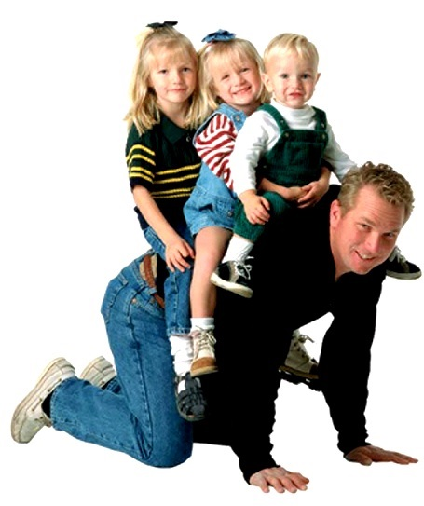
Are there four people? Does this man like children? Is he your father?

Slide 27
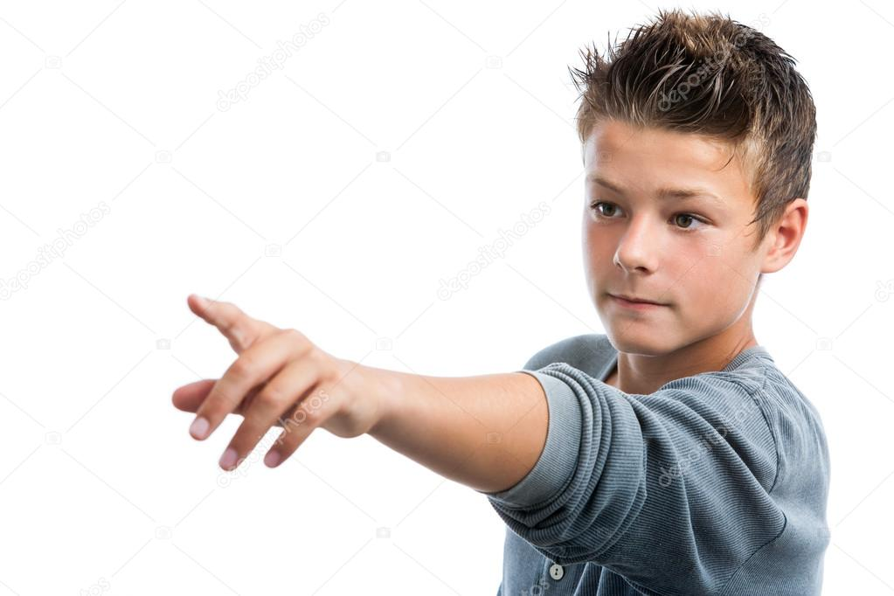
Are you a teacher? Can you speak English well? Do your lessons start at five o’clock?

Slide 28
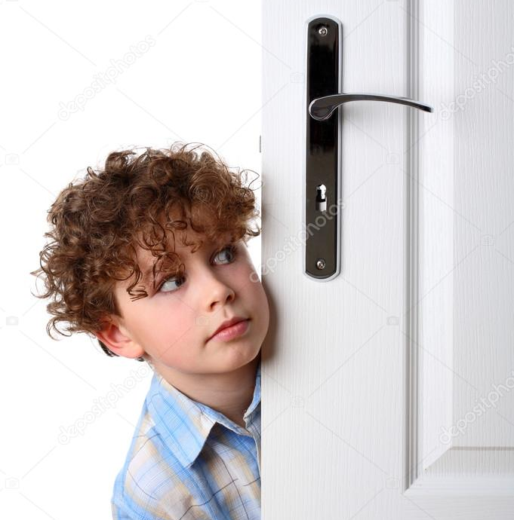
Is that boy watching TV? Do you know him? Has he got beautiful hair?

Slide 29
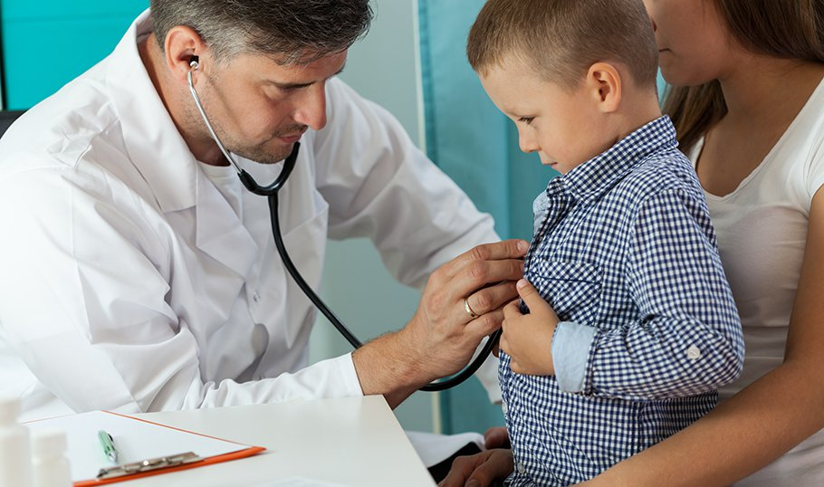
Is your father a doctor? Do your friends know this boy? Can you tell me his name?

Slide 30
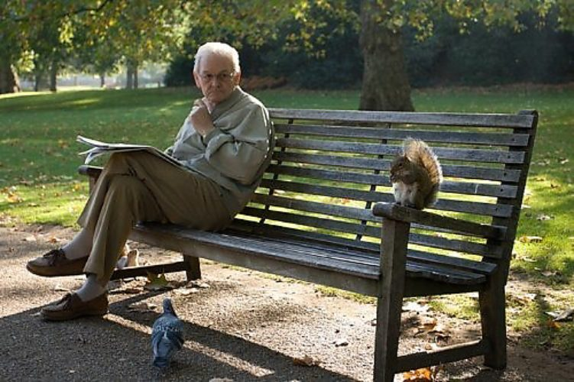
Is there a bird on the bench? Are there three men? Is he happy?

Slide 31
Short Answers
Источники: УМК Английский язык ФГОС Начальная инновационная школа Ю.А. Комарова, И.В. Ларионова, Ж. Перретт Учебник для общеобразовательных учреждений. Изображения взяты на сайте http://yandex.ru Условия использования сайта https://yandex.ru/legal/fotki_termsofuse/

