Slide 1
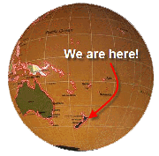
Welcome
to
New zealand!
Интерактивная викторина для учащихся 8 класса
Учебник английского языка для 8 класса под редакцией Ю.А. Комаровой.
Раздел Final Frontiers
Автор:
Ольга Михайловна Степанова, учитель английского языка
МБОУ «Цивильская СОШ №1
имени Героя Советского СоюзаМ.В. Силантьева»
города Цивильск Чувашской Республики
2019

Slide 2
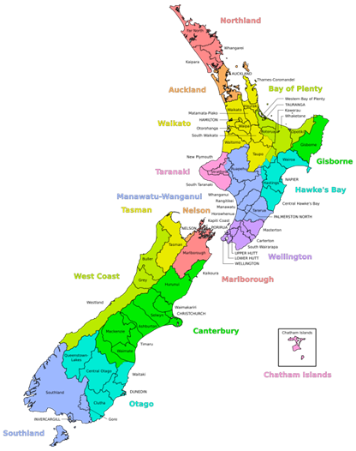
The original ________________ of New Zealand are called Maoris.
inhabitants
inhabitants
residents

Slide 3
Pacific
New Zealand is located in the south-western ____________ Ocean and features two main islands, the North Island and the South Island, as well as other smaller ones.
Pacific
Atlantic

Slide 4
The capital city of New Zealand is ______________ while the largest city is Auckland.
Wellington
Hamilton
Wellington

Slide 5
The official spoken languages of New Zealand are _____________ and te reo Maori, with English being the most widely used.
English
German
English

Slide 6
The Maori named the country, Aotearoa, which means “The Land of the Long White ____________.”
Cloud
Cloud
Mountain

Slide 7
n 1769, Captain James Cook came to the islands. He was British and they settled there. In 1840 they signed a treaty with the Maori people called The Treaty of Waitangi. This made New Zealand a colony of the British ____________ , so their ruler is actually the Queen of England!
Empire
Kingdom
Empire

Slide 8
remote
New Zealand is a really ____________ country, and a flight there from America would take about 13 hours and if you were flying from the UK you’d only get there about 24 hours later.
remote
nearest

Slide 9
In 1893 New Zealand became the first country in the world to give all women the right to ______________ .
vote
vote
play football

Slide 10
The bird species of New Zealand are particularly diverse, including alpine parrots and ground dwelling ___________.
Kiwis
Penguins
Kiwis

Slide 11
The term ‘Kiwi’ is also used as a _______________ for a New Zealander.
nickname
nickname surname

Slide 12
__________ products are New Zealand’s highest earning exports.
Dairy
Dairy
Meat

Slide 13
One cool thing, unless you like them of course, is that there are absolutely no ____________ in New Zealand at all.
snakes
snakes
spiders

Slide 14
sheep
There are nine __________ to every person in the country! That’s a whole heap of sheep.
cows
sheep

Slide 15
Did you know that Sir Edmund Hillary who was the first person to climb Mount ________ was a New Zealander?
Everest
Everest
Elbrus

Slide 16
New Zealand is in the Southern Hemisphere, which means January and February are the warmest months and _________ normally its coldest.
July
July
June

Slide 17
The End
The End
Thank You
for Being
with Us!

Slide 18
Источник:
Английский язык: учебник для 8 класса общеобразовательных организаций / Ю.А. Комарова, И.В. Ларионова, К. Макбет. – 6-е изд.- М.: ООО «Русское слово» - учебник, 2018. – 160 с.: ил.- (ФГОС. Инновационная школа). стр 86
New Zealand Facts for Kids http://www.sciencekids.co.nz/sciencefacts/countries/newzealand.html
New Zealand Facts https://www.coolkidfacts.com/new-zealand-facts-for-kids/
Изображения взяты на сайте http://yandex.ru
Условия использования сайта https://yandex.ru/legal/fotki_termsofuse/

