Slide 1
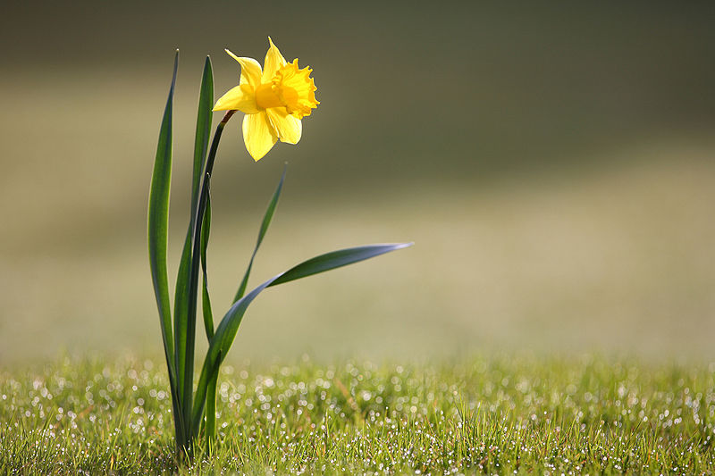
Daffodil,
the Wales'
flower
Facts Collection for the 7th 9th Grades
Автор:
Ольга Михайловна Степанова, учитель английского языка
МБОУ «Цивильская СОШ №1
имени Героя Советского СоюзаМ.В. Силантьева»
города Цивильск Чувашской Республики
2019

Slide 2
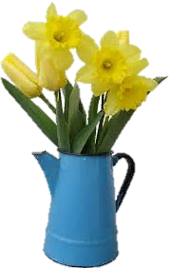
ON April 15, 1802, William Wordsworth and his sister Dorothy saw what he described as a "long belt" of daffodils, which inspired his famous "I wandered lonely as a cloud" poem.

Slide 3
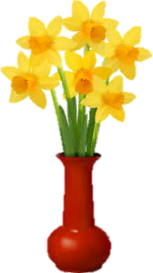
The name 'daffodil' was first recorded in 1538. Even earlier it was called 'affodil'. According to the Oxford English Dictionary, "The initial d has not been satisfactorily accounted for".

Slide 4
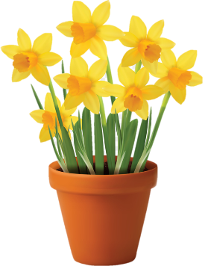
Daffodil flowers are often pointed slightly downwards on their stems, as though they are looking at something on the ground.

Slide 5
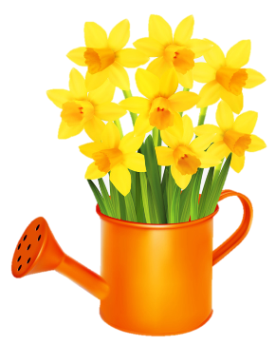
A popular idea is that their scientific name—Narcissus—is named after the beautiful youth in Greek mythology.

Slide 6
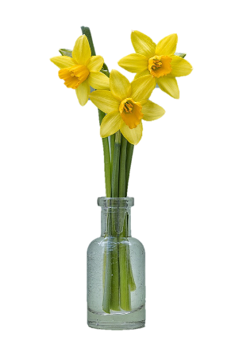
A popular idea is that their scientific name—Narcissus—is named after the beautiful youth in Greek mythology.

Slide 7
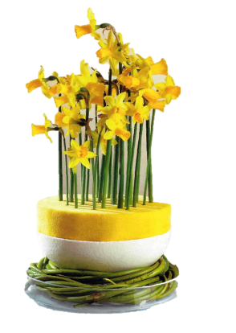
Among other names, it is also known as jonquil, narcissus or Paperwhite.

Slide 8
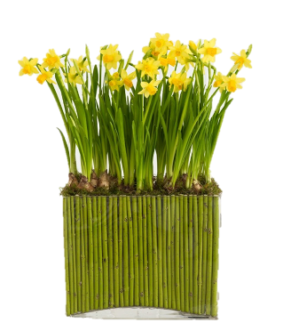
In Victorian times, daffodils represented chivalry. Today they symbolise hope.

Slide 9
There is a skin disease sometimes found in florists known as "daffodil itch"

Slide 10
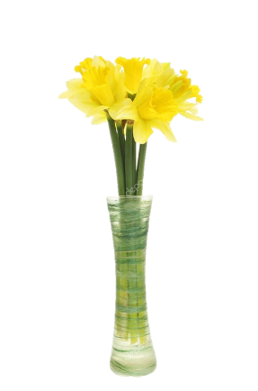
There are more than 50 species and 25,000 varieties of daffodil.
Daffodil bulbs are poisonous to squirrels.

Slide 11
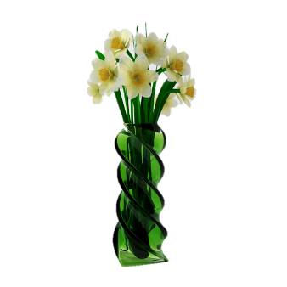
Daffodils were brought to Britain by the Romans who thought the sap from them had healing powers.

Slide 12
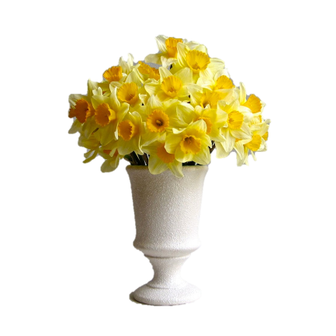
In China, the daffodil is seen as a symbol of wealth and good fortune.

Slide 13
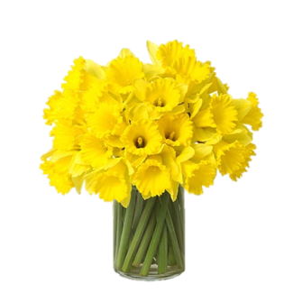
The only play by Shakespeare that mentions daffodils is The Winter's Tale, in which they appear twice in Act 4.

Slide 14
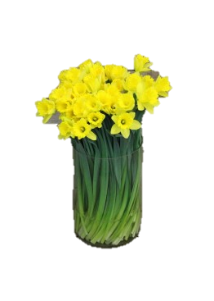
Bestowing someone with a bouquet of daffodils is thought to bring happiness into the home. In Wales, you'll be even happier if you spot the first of these cheerful blooms.

Slide 15
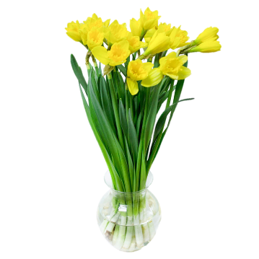
According to legend, if you see the first daffodil, your next 12 months will be filled with wealth.

Slide 16
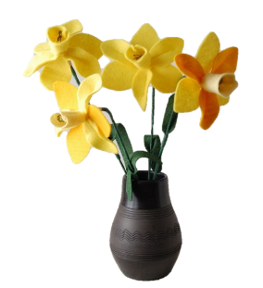
Scientists have identified a natural compound called narciclasine in daffodil bulbs. This name doesn't just sound fancy, it turns out it does fancy things, like being beneficial in treating brain cancer, for instance.

Slide 17
Don't ever present someone with a single daffodil.
Legend has it that offering a single bloom to someone foretells of their misfortune to come.

Slide 18
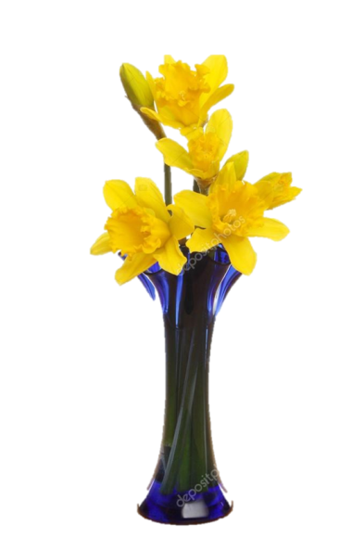
Try forcing a daffodil bulb to bloom for the Chinese New Year. Tradition has it this brings good luck to the household.

Slide 19
The End
Thank You!

Slide 20
Источник:
Devenyns J 10 Things You Didn't Know About Daffodils
https://www.wideopeneats.com/10-you-didnt-know-about-daffodils/
Top 10 facts about daffodils https://www.express.co.uk/life-style/top10facts/392032/Top-10-facts-about-daffodils
Изображения взяты на сайте http://yandex.ru
Условия использования сайта https://yandex.ru/legal/fotki_termsofuse/

