Slide 1
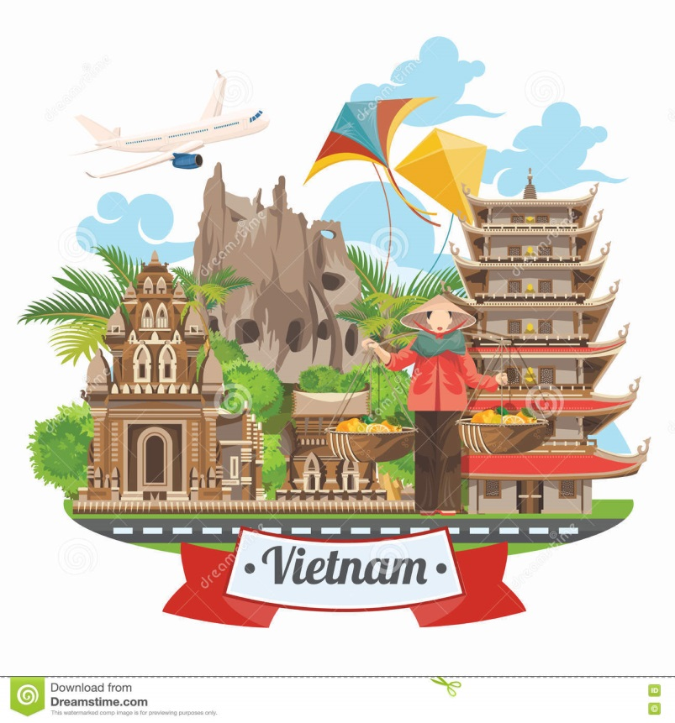
Vietnam:
its history and beauty
Virtual tour for the 5th-9th Grades
Автор:
Ольга Михайловна Степанова, учитель английского языка
МБОУ «Цивильская СОШ №1
имени Героя Советского Союза М.В. Силантьева»
города Цивильск Чувашской Республики
2019

Slide 2
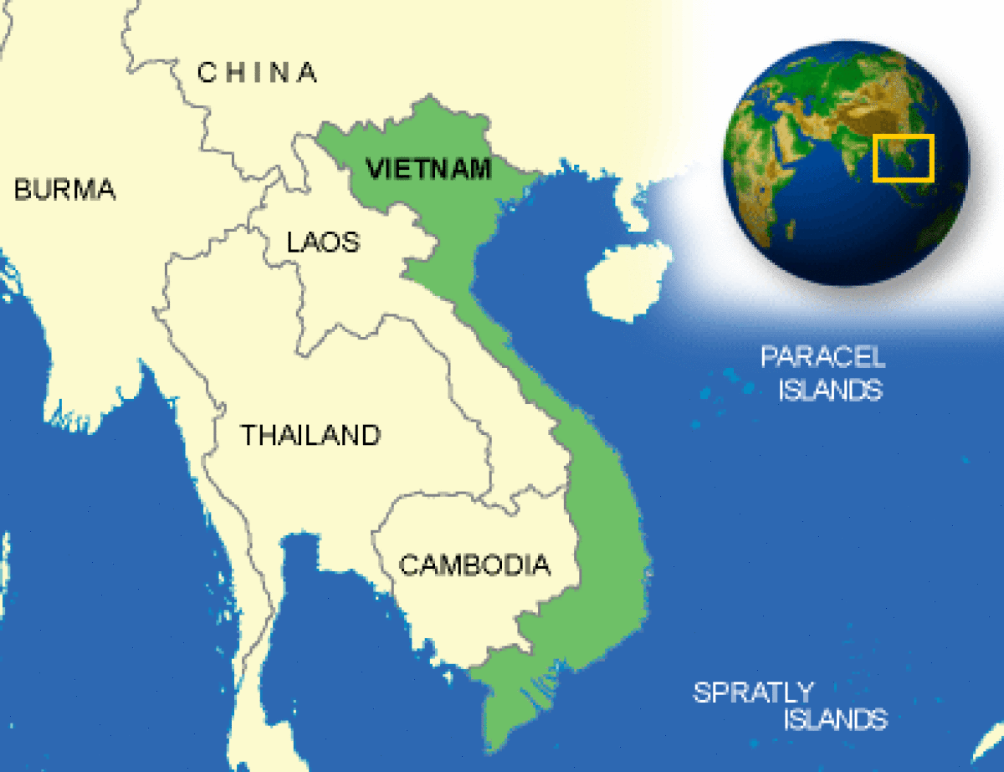
Most countries in the world have been conquered over and over again by different groups. Vietnam was different because it enjoyed freedom for over 1,000 years.

Slide 3
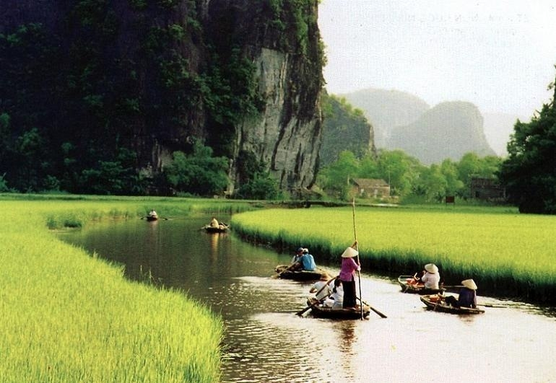
The country was settled over 5,000 years ago by native tribes. In 207 B.C., a Chinese lord invaded their country, naming it Nam Viet.

Slide 4
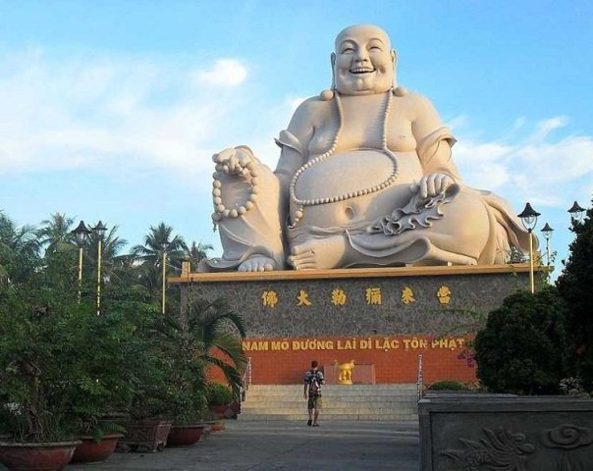
The Chinese ruled the country until 939 A.D., when a general and his army drove them out. It wasn’t until the 19th century that the country was conquered again – this time by France.

Slide 5
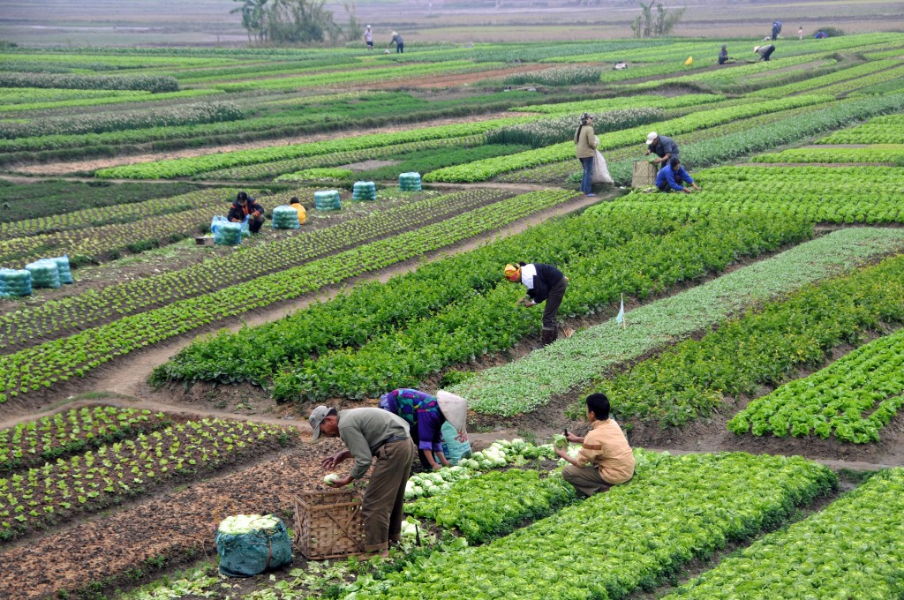
During World War II, Japan invaded Vietnam. After the war, the northern part of Vietnam became communist, while the south did not.

Slide 6
For almost 20 years, the north and the south fought. The United States, as well as Russia, China and other countries, was involved in the war.

Slide 7
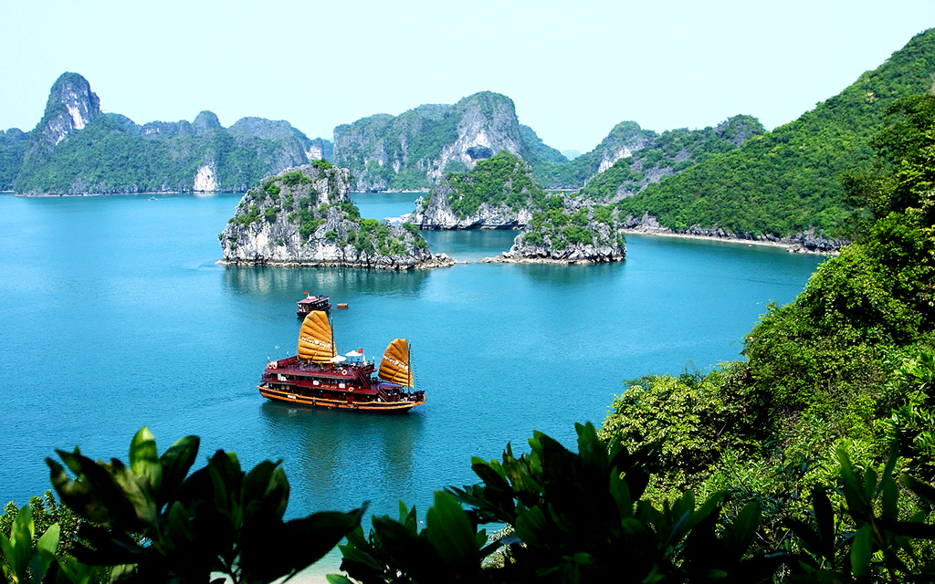
Finally, in 1975, the northern armies overtook the south. The country still has
a communist government.

Slide 8
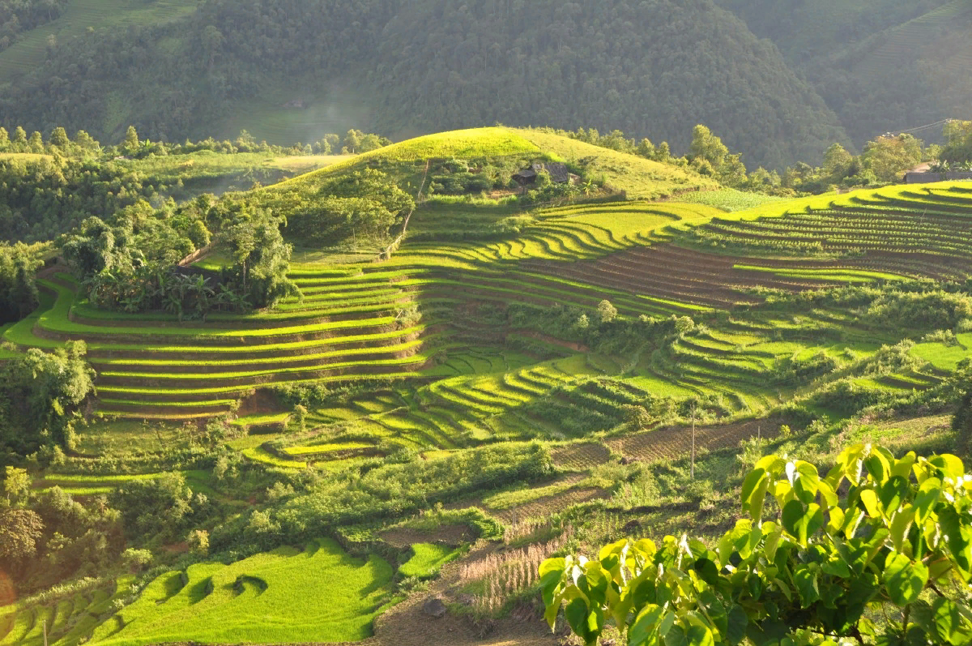
Vietnam sits in Southeast Asia, bordered by Cambodia, Laos and China. Its coastline stretches more than 1,000 miles along the South China Sea, but Vietnam is only 25 miles wide at its narrowest point.

Slide 9
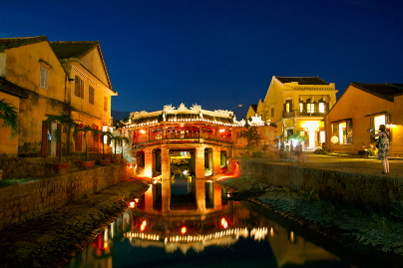
Vietnam is a hot, humid country with swampy lowlands that are ideal for growing rice, bananas and other vegetables.

Slide 10
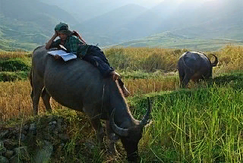
Vietnam is the second largest producer of rice in the world.
Many exotic animals live here, such as rhinos, tigers and elephants.

Slide 11
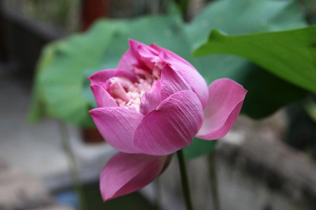
83,305,000 people live in Vietnam.
Vietnam has 127,844 square miles of land.

Slide 12
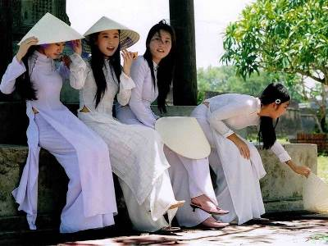
People in Vietnam speak Vietnamese, English, French, Chinese and Khmer.
People here belong to the Buddhist, Hoa Hao, Cao Dai, Christian and Muslim faiths.

Slide 13
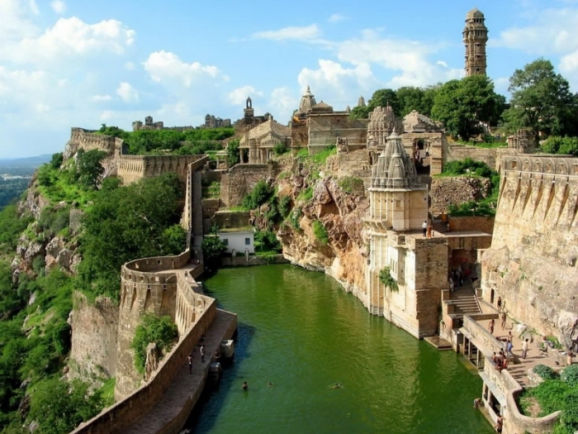
People in Vietnam can expect to live
72 years.
94 percent of adults can read.

Slide 14
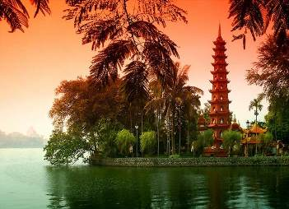
This video is about tourist spots
in Vietnam,
its culture and tradition:
https://youtu.be/hgXLa_8Aggc

Slide 15
Hope you liked
our virtual tour :)

Slide 16
Source:
Vietnam https://easyscienceforkids.com/all-about-vietnam/
Vietnam video https://youtu.be/hgXLa_8Aggc

