Slide 1
МБОУ «Цивильская СОШ №1
имени Героя Советского СоюзаМ.В. Силантьева»
города Цивильск Чувашской Республики
The Soaring Eagle,
the King of the 2019
тезисы исследовательского проекта
Автор:
Евгений Никитин
Ученик 5 В класса
Руководитель
Ольга Михайловна Степанова,
учитель английского языка
2019

Slide 2
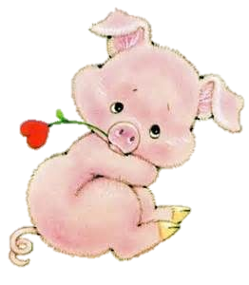
Проблема
Китайские символы встречи Нового года, гороскопы, атрибуты и прочее прочно вошли, а порой и полностью вытеснили из культур многих народов собственные новогодние традиции и обычаи. Но на арене современности культура славян стала набирать темпы в своём развитии и теперь славянский календарь ждёт помощи в пропаганде своих идей.

Slide 3
гипотеза
Славянский календарь смело может претендовать на трон вместо китайского
(на примере 2019 года – года Парящего Орла)

Slide 4
Цель проекта
Пропагандировать славянский календарь

Slide 5
задачи проекта:
Рассказать про 2019 год как про год Парящего Орла
Выявить интересные факты про год Парящего Орла
Составить рекламный проспект про год Парящего Орла на английском языке с целью пропаганды славянского календаря

Slide 6
Методы работы над проектом
Изучение литературы на данную тему
Интернет поиск материала на представленную тему
Социологический опрос по данной теме
Анализ полученных результатов по опросу
Предьявление материала на английском языке в формате презентации
Создание рекламного проспект а про Год Парящего Орла на английском языке

Slide 7
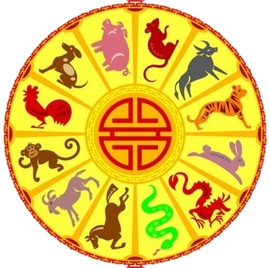
The original Slavic traditions today are rarely observed or honored by anyone. Oriental calendars and horoscopes have long supplanted them from the life of modern people.

Slide 8
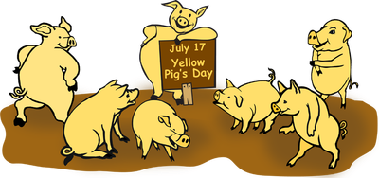
And so it happened that by generally accepted standards, 2019 belongs to the Yellow Earth Pig.

Slide 9
Аccording to Slavic customs, the symbol of the year 2019 is the soaring Eagle. A proud bird will replace the 2018th year of the curled hedgehog.

Slide 10
According to the Slavic calendar, the change of the symbol of the year will take place at the big spring celebration - Komoeditsa.

Slide 11
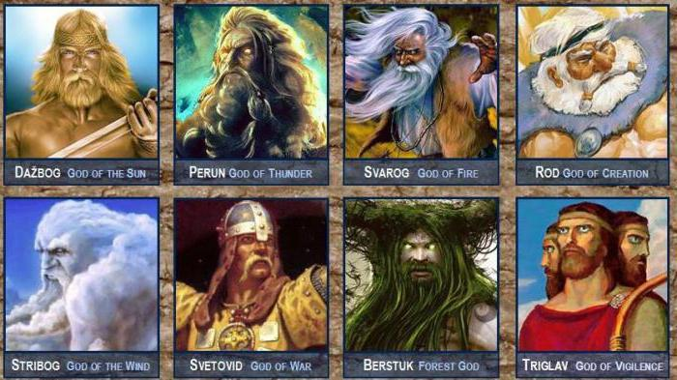
Slavic traditions and their Vedic beliefs, above all, suggest harmony with nature and all living things on this planet. Therefore, it is not surprising that every year it bears the name of a certain animal and is patronized by one of the all-powerful gods.

Slide 12
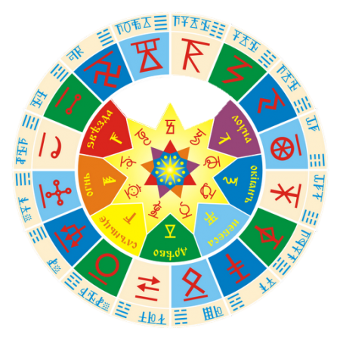
Each year in the Slavic calendar is divided into 12 months. Periods defined a clear time to rest, work, plant the land and prepare provisions for the winter. Every 16 years created a cycle. Unlike the Chinese calendar, in which there are 12 totemic animals.

Slide 13
Every year, under the sign of the animal, it predicted certain events for people, as in the Chinese calendar. However, the year change did not take place on January 1, but March 20.
This is the time
of the spring solstice.

Slide 14
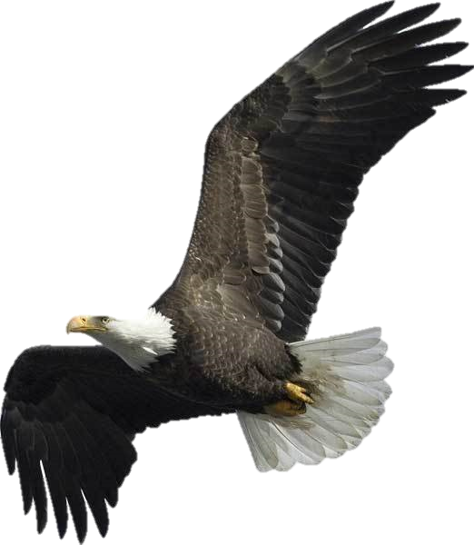
In 2019, the Soaring Eagle is the patron of the totem animal. This is the most proud, strong and wise bird.

Slide 15
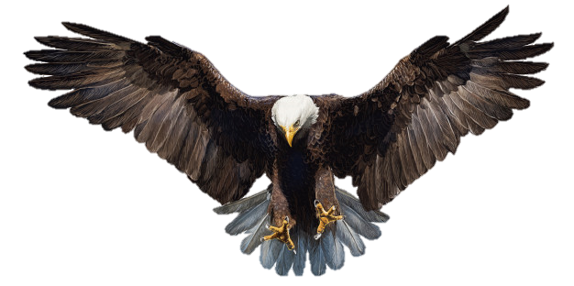
The eagle is a regal bird that flies very high. The Slavs respected and worshiped the eagle, because the bird achieves all its might with exhausted labor and perseverance.

Slide 16
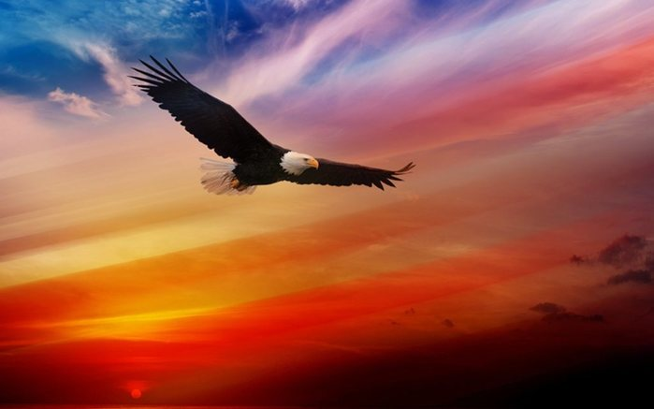
To rule in 2019, the Eagle will be with all its justice.
This year is expected to decline negative events. Especially beneficial and positive Eagle will affect business and political relations around the world. He promises to build relationships and establish peace.

Slide 17
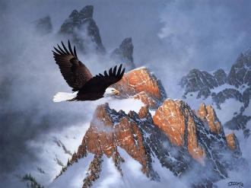
In 2019 , According to the Slavic calendar, many people will feel in themselves new strength and inspirations to go towards their achievements. This period will be successful for the change of activity and career.

Slide 18
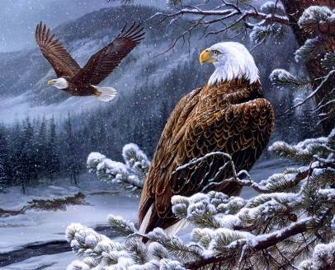
The most important skill in the year of the Eagle 2019 will be the distribution of its forces. Eagle appreciates hard work and dedication. Therefore, The eagle will not enjoy lazy people during his patronage.

Slide 19
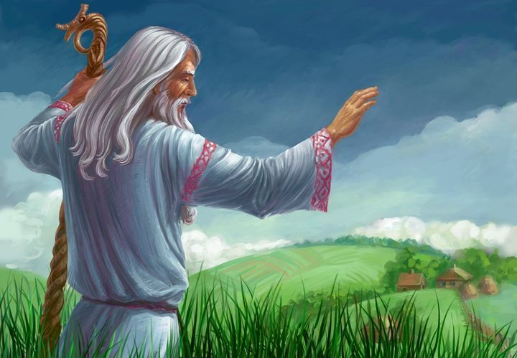
Those who were born in the year of the Soaring Eagle are very lucky.
If someone was born in 1939, 1955, 1971, 1987, 2003,2019, they are … lucky!

Slide 20
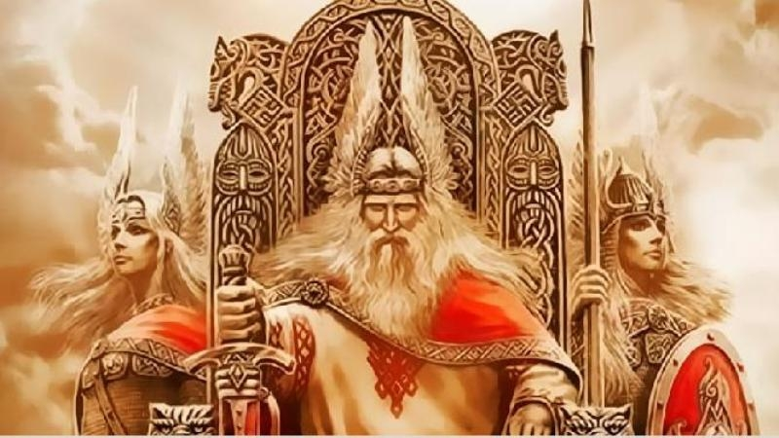
Conclusion The Year of the Soaring Eagle is even much more interesting than the Year of the Pig

Slide 21
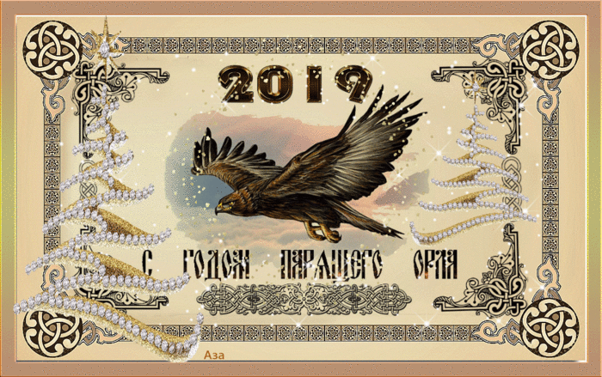
Happy Soaring Eagle Year!

Slide 22
Thank You for Your Attention
Sources:
Slavic traditions of the New Year 2019 https://girlday.ru/en/articles/842/
Изображения взяты на сайте http://yandex.ru Условия использования сайта http://yandex.ru/legal/fotki_termsofuse/ Фотографии взяты из личного архива ученика и публикуются с согласия автора.

