Slide 1
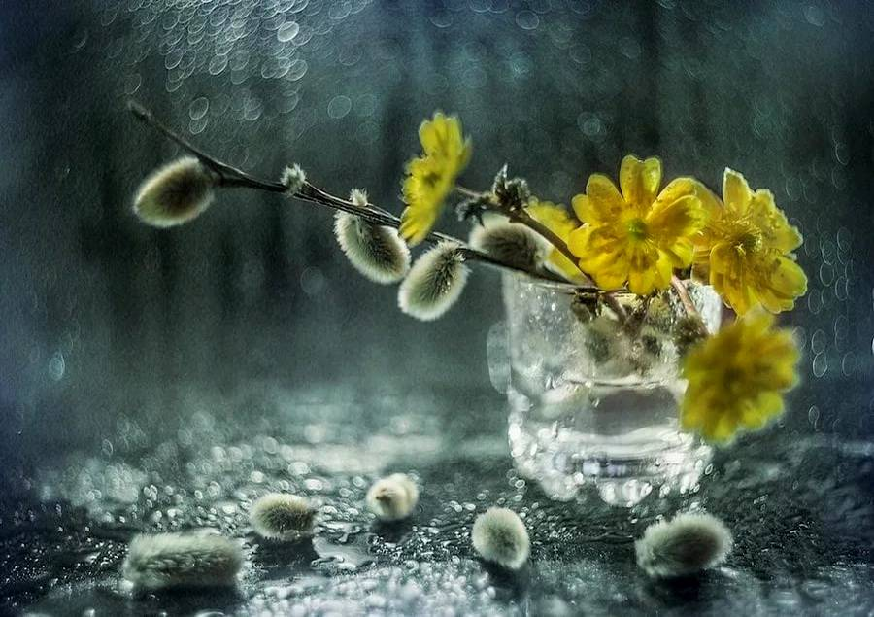
Hello Spring
Spring Flowers
Still Nature Gallery
for the 5th – 9th Grades
Автор:
Ольга Михайловна Степанова, учитель английского языка
МБОУ «Цивильская СОШ №1
имени Героя Советского СоюзаМ.В. Силантьева»
города Цивильск Чувашской Республики
2019

Slide 2
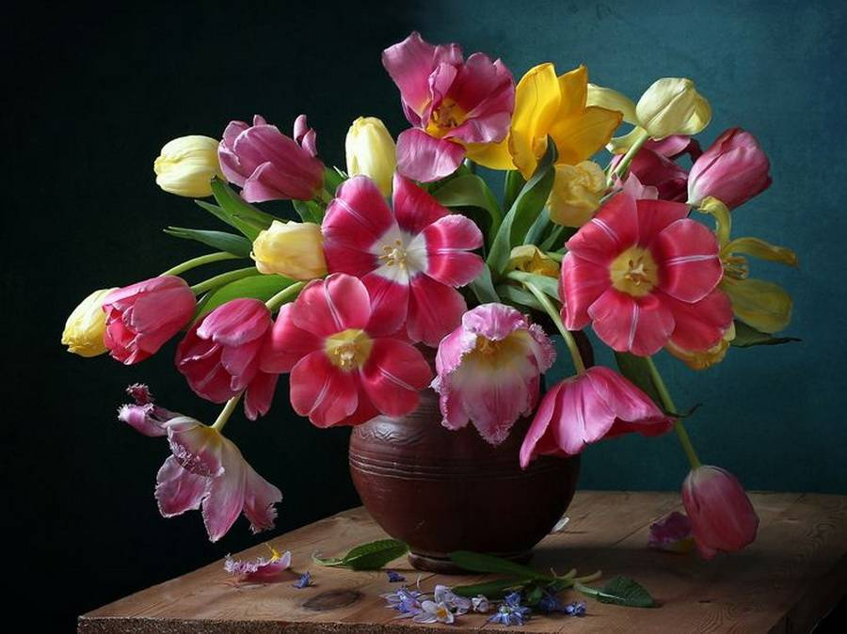
No winter lasts forever. No spring skips its turn.

Slide 3
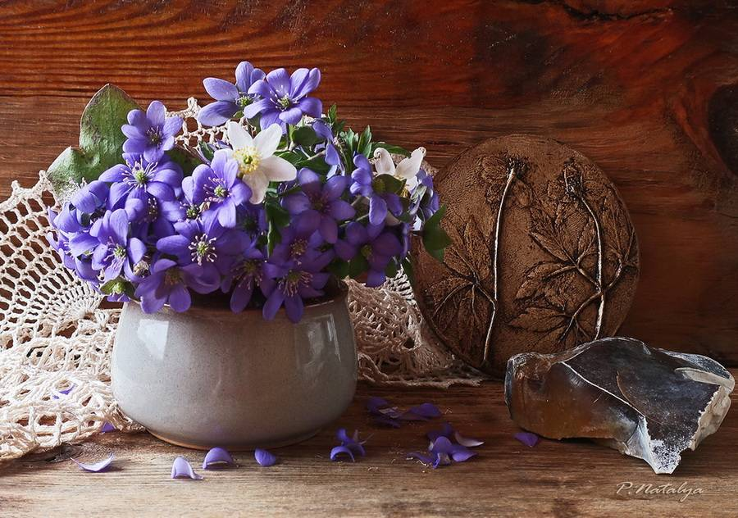
Spring is nature's way of saying let's party

Slide 4
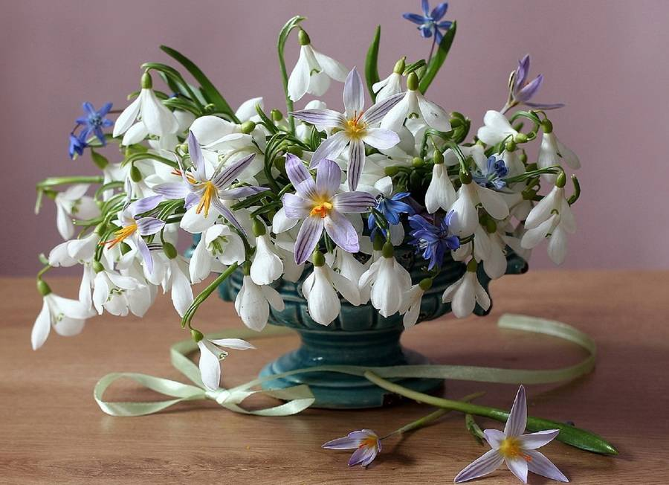
Spring breathes new life into the world around us

Slide 5
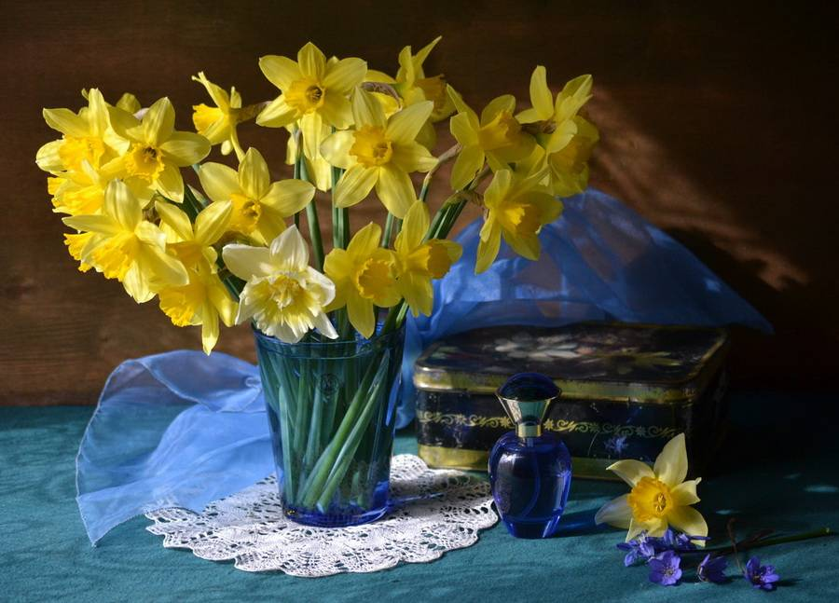
Springtime is the land awakening. The March winds are the morning yawn

Slide 6
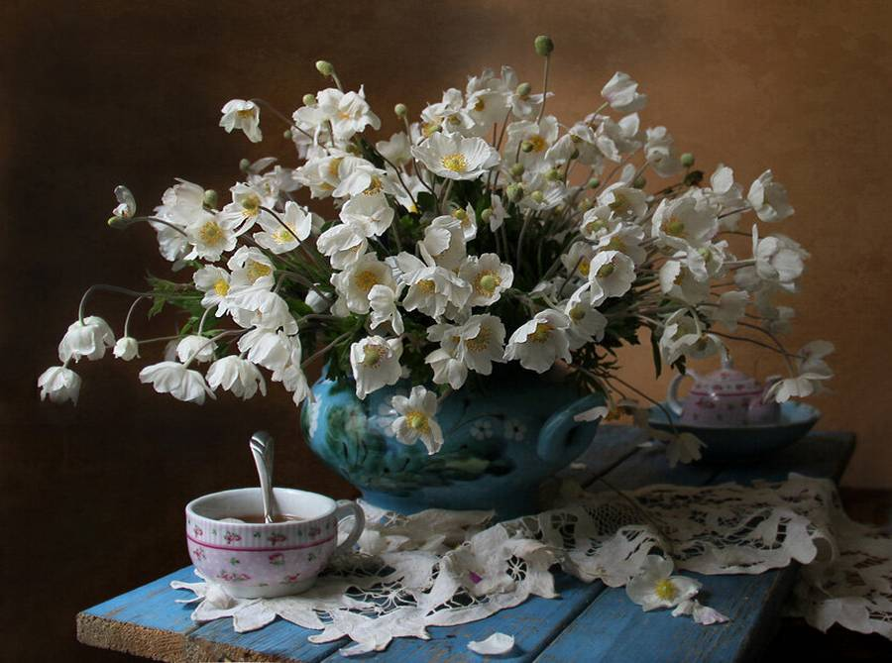
Spring is when you feel like whistling even with a shoe full of slush

Slide 7
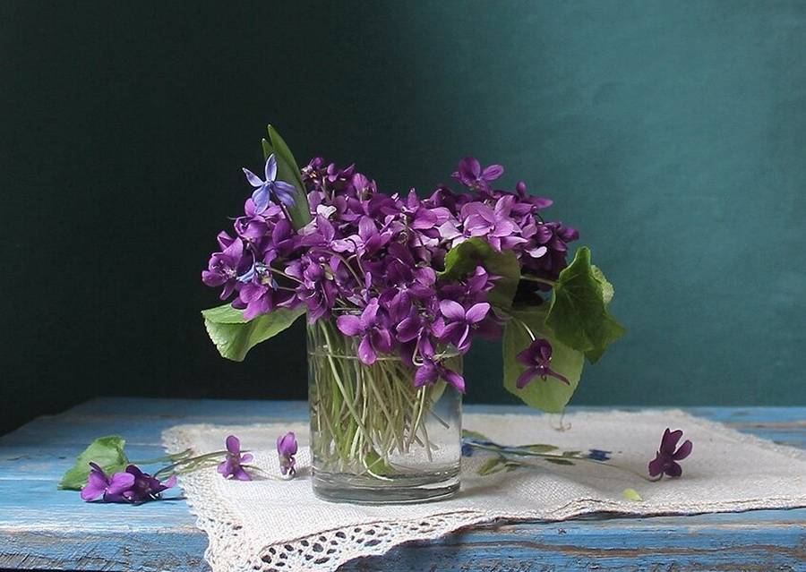
Live in the sunshine.
Swim the sea.
Drink the wild air

Slide 8
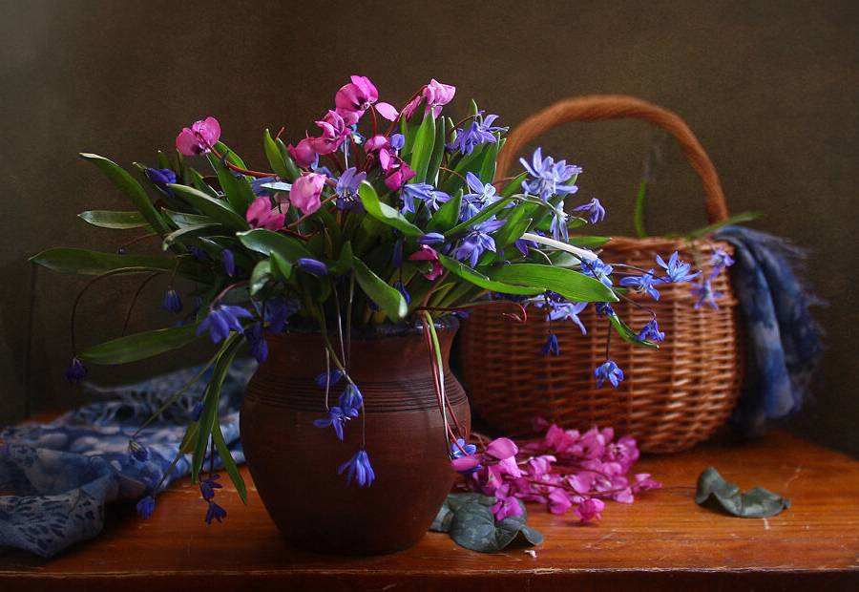
Spring is the time of plans and projects

Slide 9
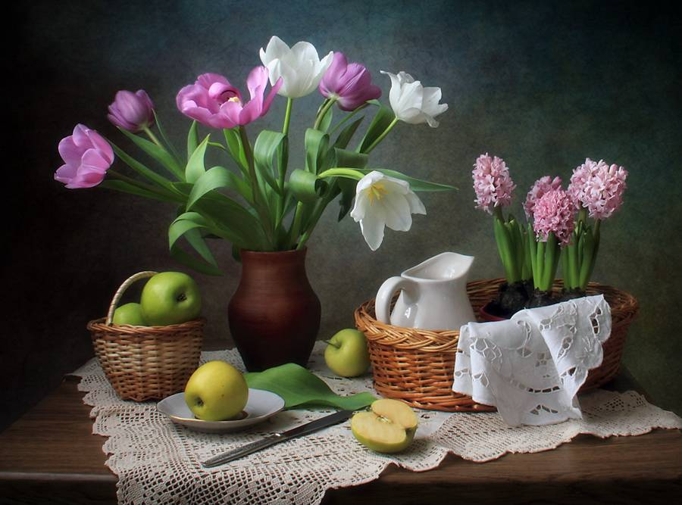
Spring work is going on with joyful enthusiasm

Slide 10
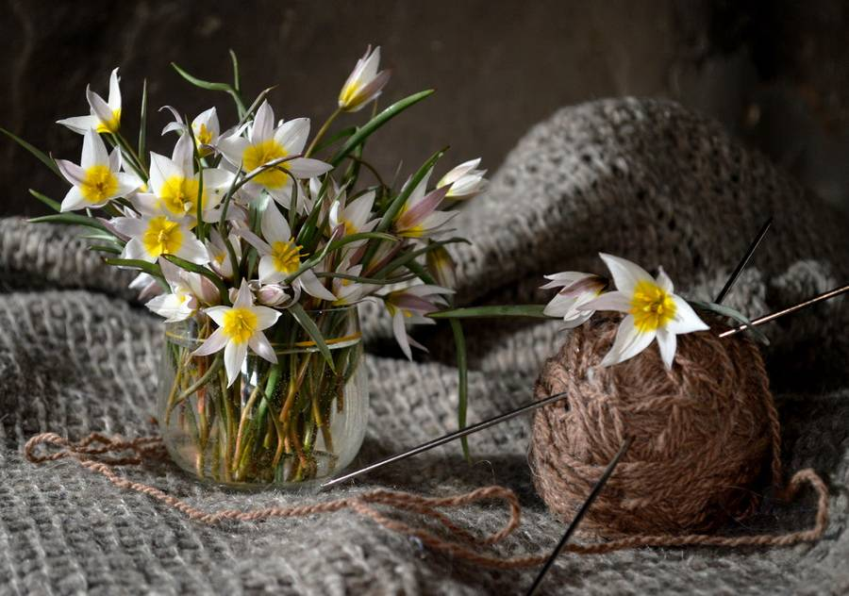
Daffodils are yellow trumpets of spring

Slide 11
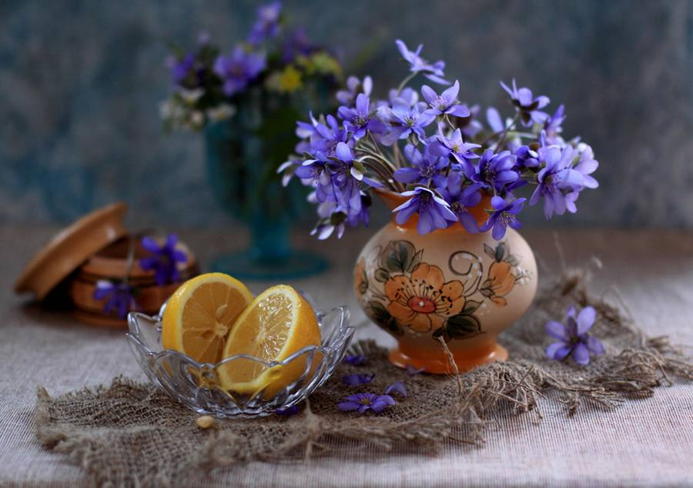
Despite the forecast, live like it's spring

Slide 12
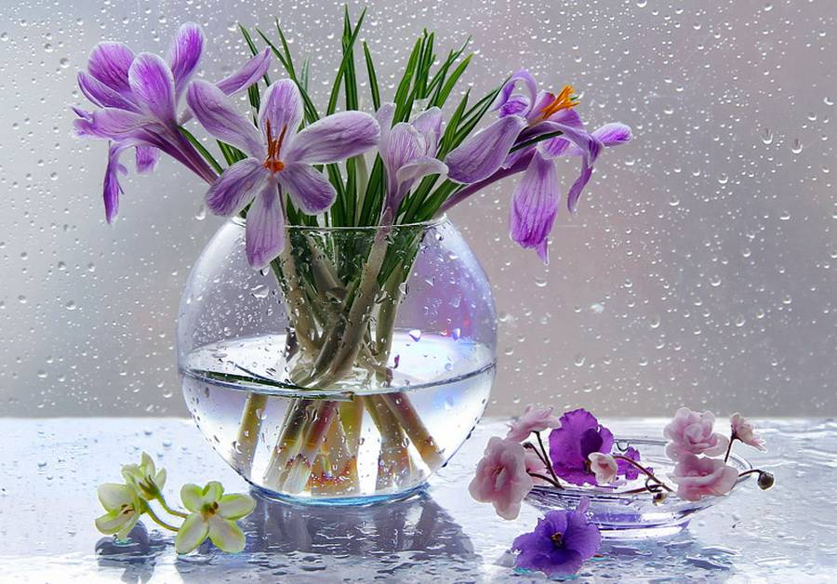
When you paint Spring, do not paint willows, plums, peaches, or apricots, but just paint Spring.

Slide 13
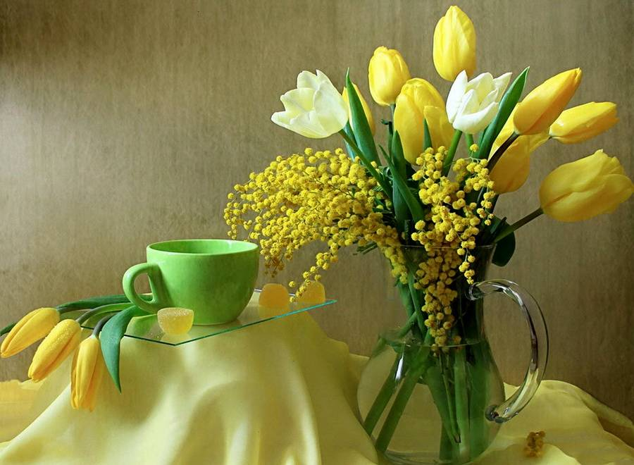
It is spring again. The earth is like a child that knows poems by heart.

Slide 14
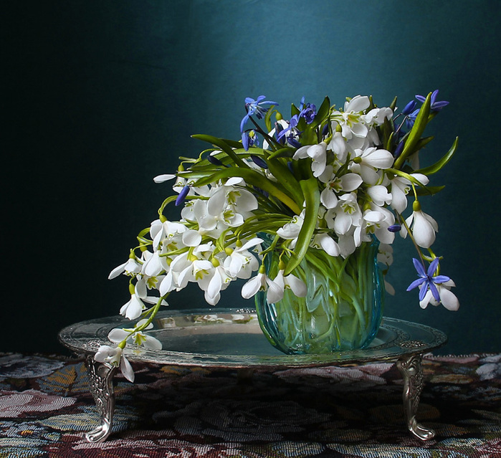
Keep Calm.
Spring is Coming.

Slide 15
The End
Thank You!

Slide 16
Источник:
Spring Quotes https://www.goodreads.com/quotes/tag/spring?page=1
Spring Quotes https://www.happier.com/blog/10-quotes-that-will-have-you-feeling-spring-regardless-of-temperature/
Изображения взяты на сайте http://yandex.ru
Условия использования сайта https://yandex.ru/legal/fotki_termsofuse/

