Slide 1
Malta
ОГЭ. Задание 34.
Read aloud. Form 9
You will not have more than 2 minutes for reading aloud.
Хабарова Любовь Викторовна,
учитель английского языка,
высшая квалификационная категория,
МБОУ «Белослудская школа» Красноборский район
Архангельская область

Slide 2
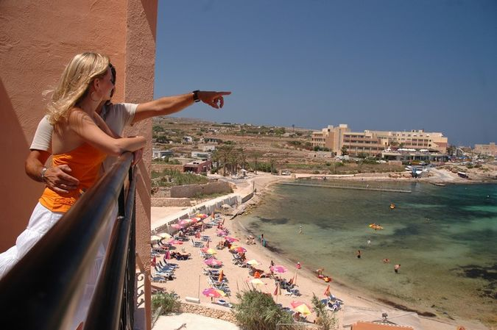
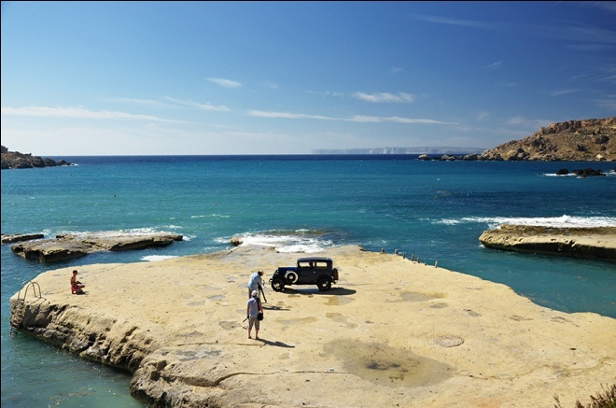
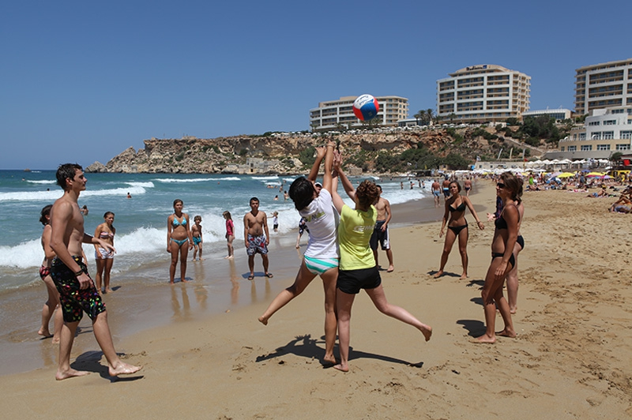
Malta is not one island, as most people think, but five. The country has no rivers or lakes. People rely on rain, which does not come every summer, but may cause flood in winter. If you are in Malta during the summer month, there is no need for an umbrella.

Slide 3
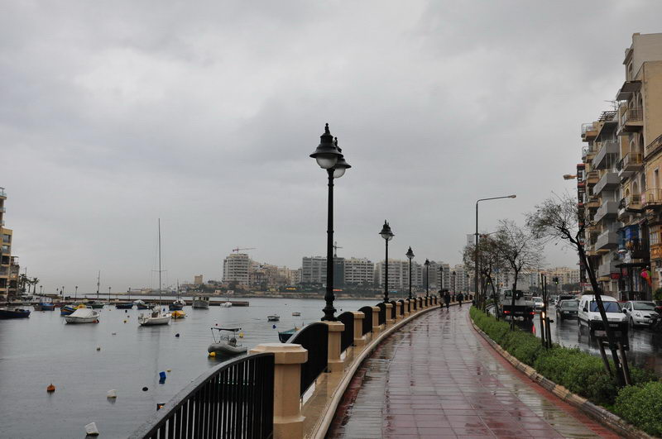
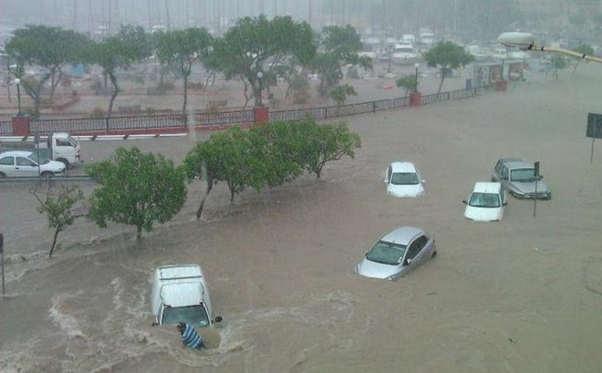
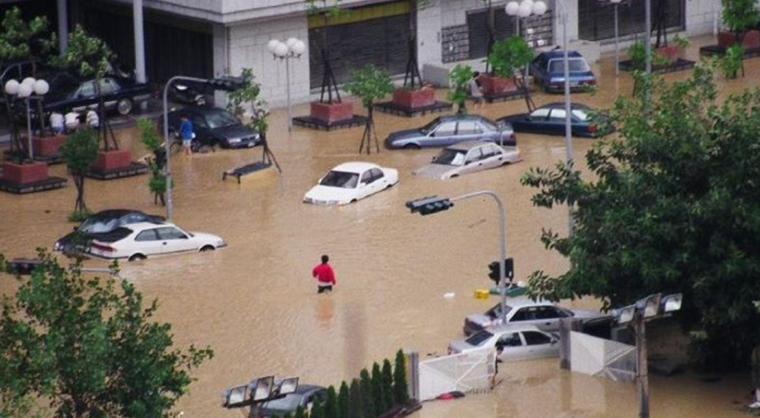
But come in October and the islands are flooded with rain. Shortage of water has stimulated the building of special factories that remove salt from the sea water. Nowadays they provide more than half of the country’s freshwater needs. Officially, the tap water is safe to drink in Malta, but it doesn’t taste good.

Slide 4
Источники: ОГЭ. Английский язык. Типовые экзаменационные варианты
Под редакцией Н.Н. Трубаневой. 2018г.
Изображения взяты на сайте http://yandex.ru Условия использования сайта https://yandex.ru/legal/fotki_termsofuse/

