Slide 1
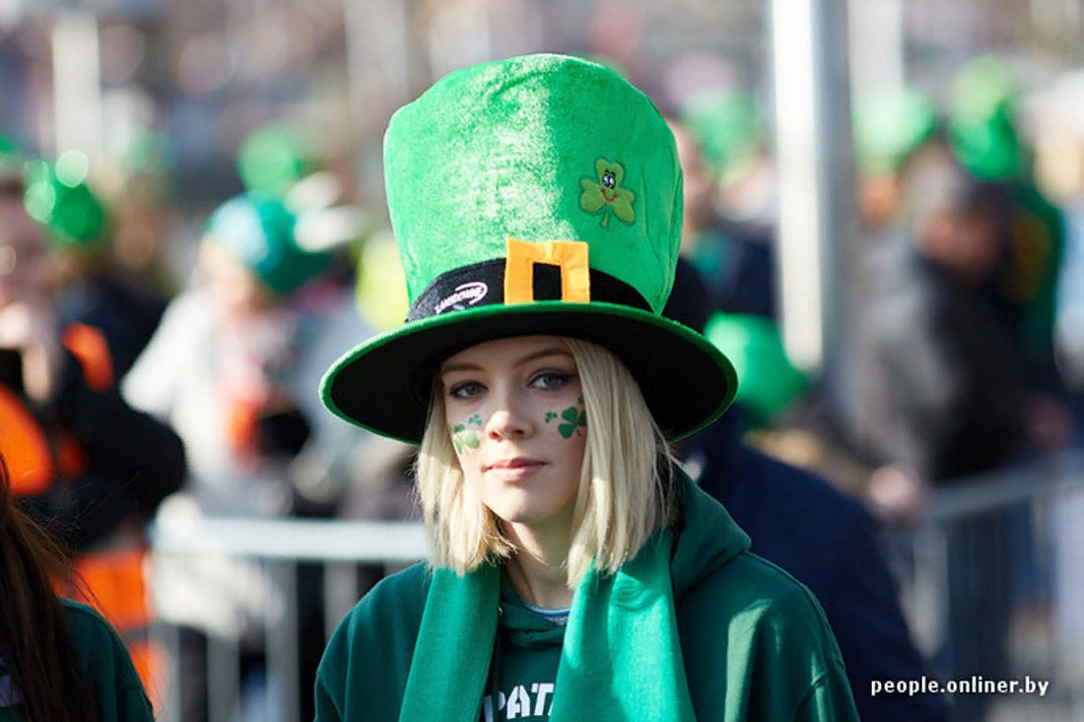
Green
fashion
Викторина-галерея моды
для учащихся
7-11 классов
Автор:
Ольга Михайловна Степанова, учитель английского языка
МБОУ «Цивильская СОШ №1
имени Героя Советского Союза М.В. Силантьева»
города Цивильск Чувашской Республики
2019

Slide 2
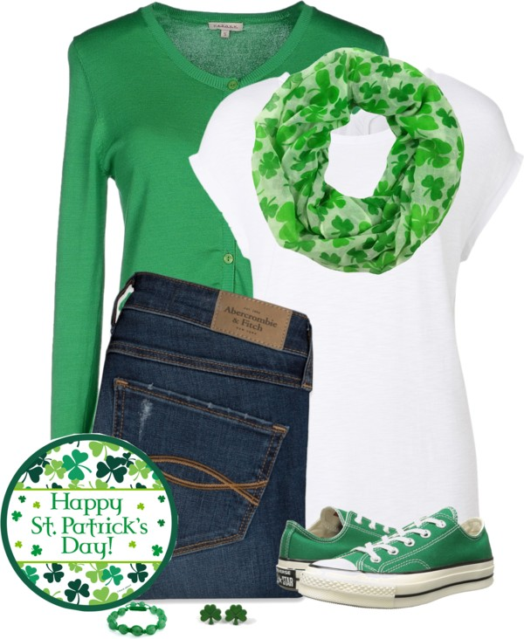
Make some fun with a white T-shirt, buttoned green ___________ and cool slim-fit jeans. Love the trainers.
cardigan
jacket
cardigan

Slide 3
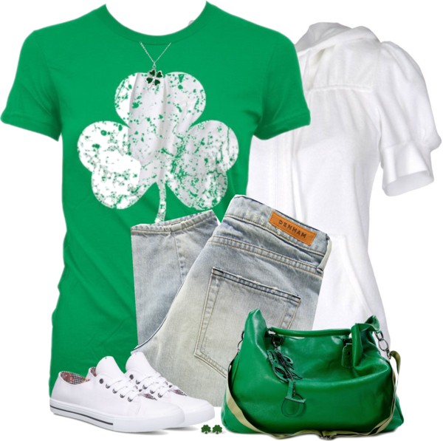
The green T-shirt can be updated with white short-sleeve hoodie, faded grey jeans, white trainers and green _________.
handbag
handbag
suitcase

Slide 4
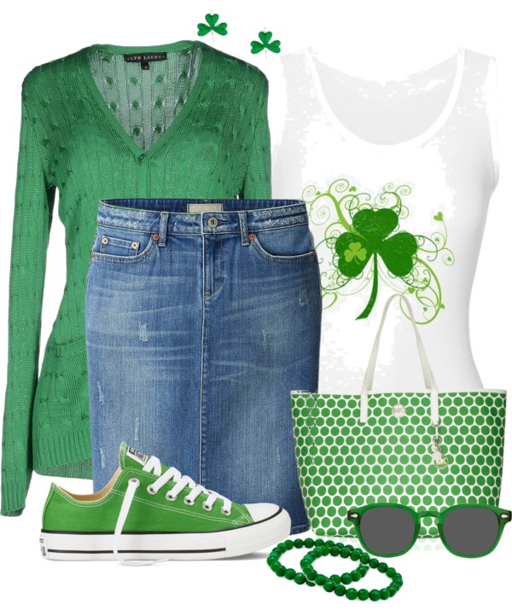
Go for a denim _______ , white tank and green cardigan. Love the green trainers and green frame wayfarers.
skirt
skirt
shirt

Slide 5
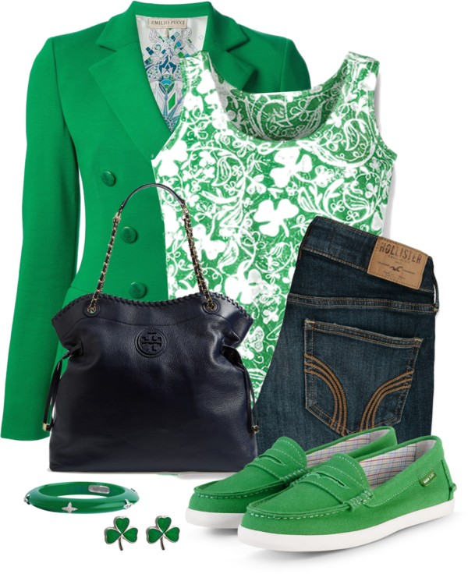
How about wearing a light green blazer with white-green printed tank, denim pants and green __________.
loafers
loafers
sandals

Slide 6
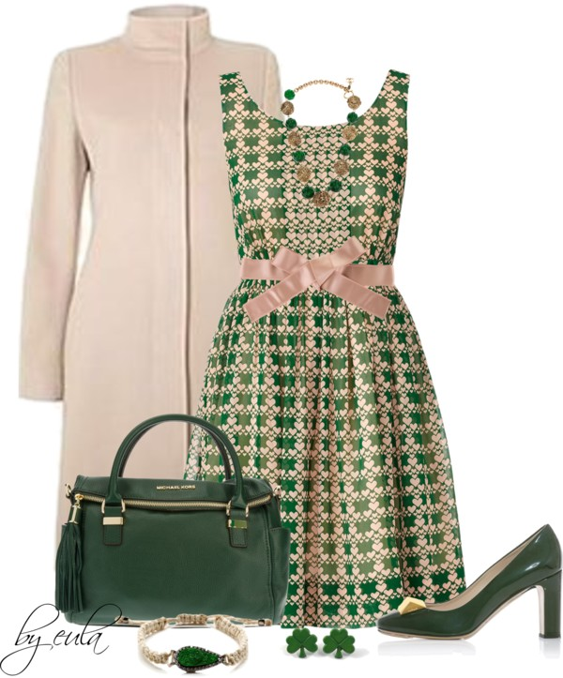
Make it more ladylike and try on a summer dress with a high-neck cream beige ________ and emerald accessories.
coat
sweater
coat

Slide 7
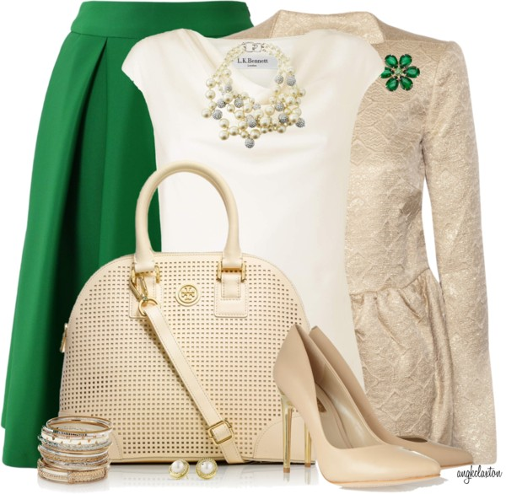
Have some fun with a tea-length green skirt, white _______ and brocade shiny cream blazer.
tee
tee
lee

Slide 8
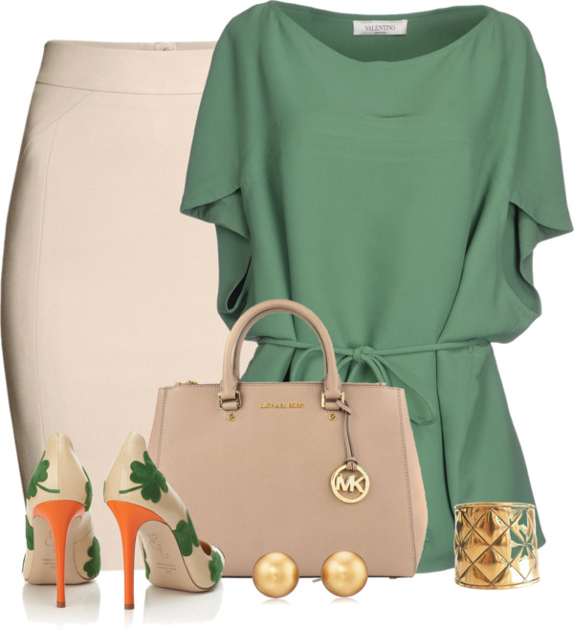
The choices of St. Patrick’s Day outfits are simple. Just begin with green outfits, such as green blouse or green top and nice … high heeled __________!
shoes
shoes
boots

Slide 9
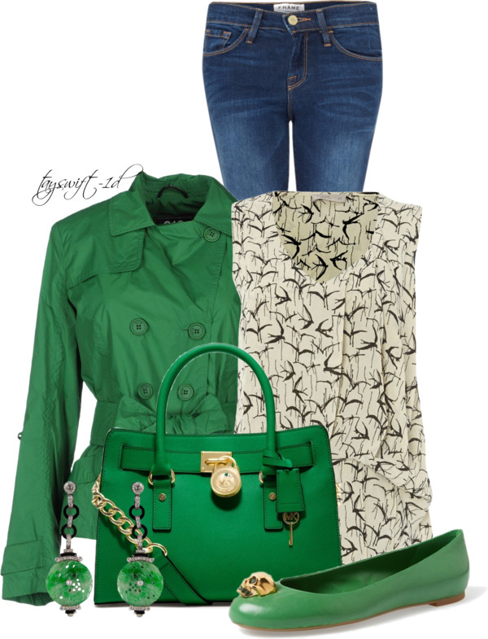
If it's windy outside, then you better go for a bright green trench-coat, bird print sleeveless top, faded blue skinnies, bright green handbag and flat ________.
pumps
pumps
plums

Slide 10
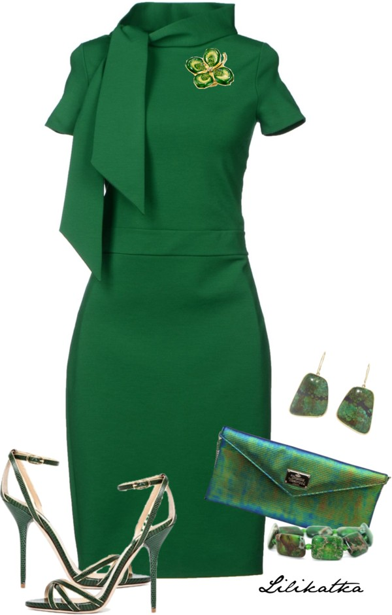
Be bold and go totally green! Love this pencil ________.
frock
apron
frock

Slide 11
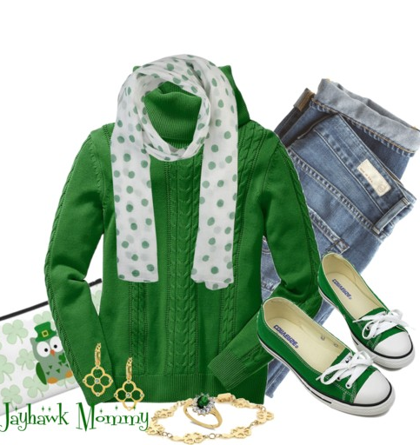
How about wearing wool cable knit green __________ for this very special day.
sweater
sweater
cardigan

Slide 12
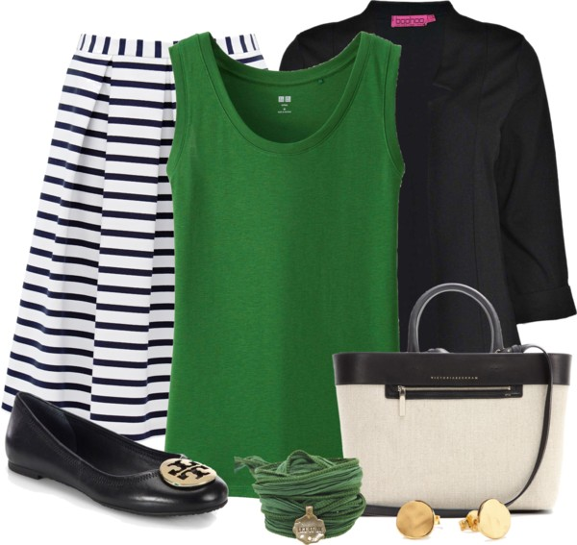
Make some fun with striped black and white midi _________ and green and black top.
skirt
dress
skirt

Slide 13
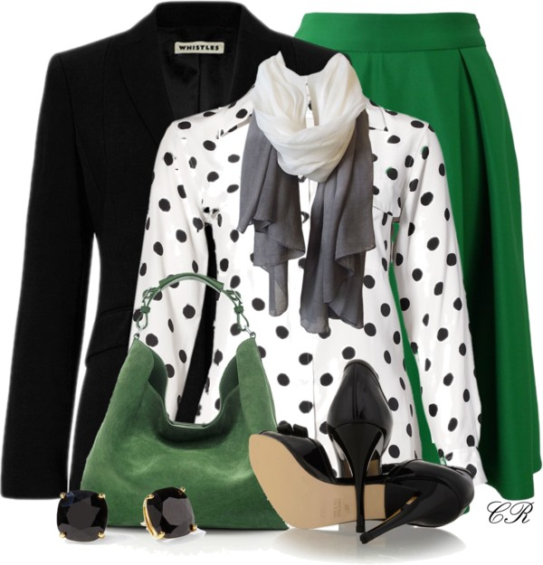
Update your sweet midi skirt with white blouse in black dots and cool black __________.
blazer
blazer
pullover

Slide 14
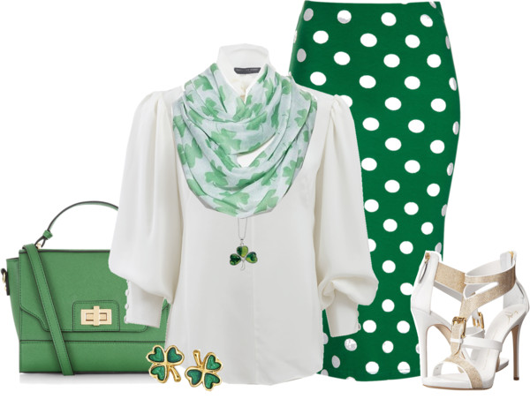
square
polka
Love this green pencil skirt with white ________ dots! Everything looks feminine and lightweight.
polka

Slide 15
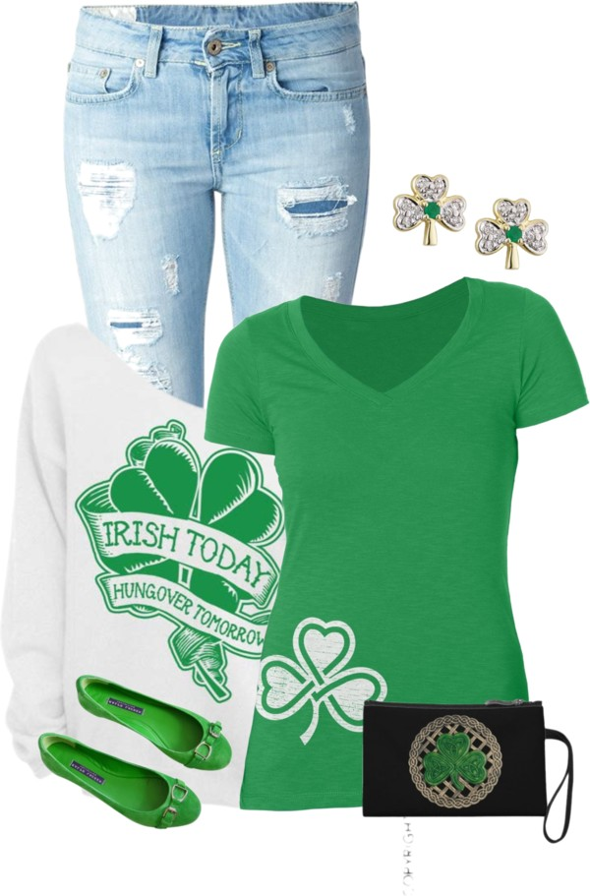
The casual look will always look amazing!
Go for some chic _____________ that for sure will update your outfit.
accessories
accessories
attractions

Slide 16
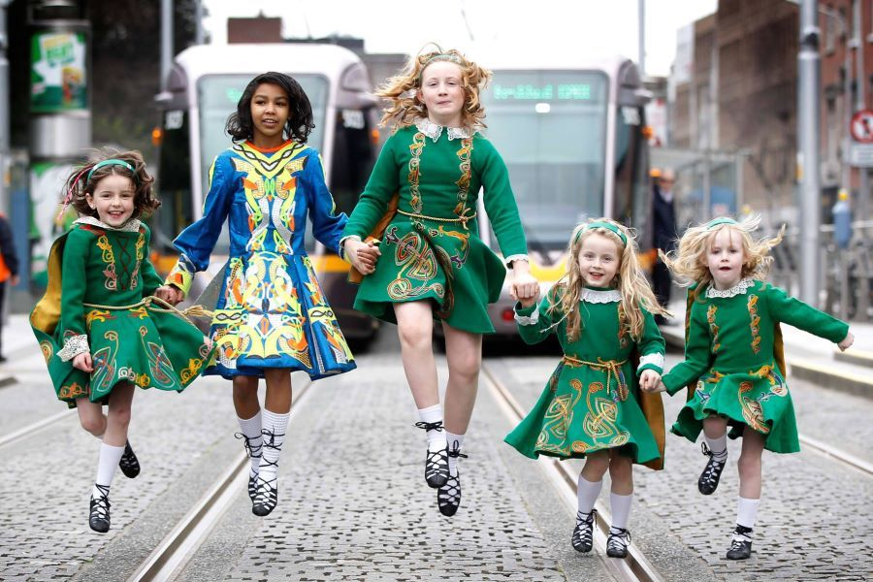
Happy St. Patrick’s Day!

Slide 17
Источник:
26 AWESOME OUTFIT IDEAS WHAT TO WEAR FOR ST. PATRICK’S DAY http://fashiongum.com/womens-fashion/26-awesome-outfit-ideas-what-to-wear-for-st-patricks-day/
Изображения взяты на сайте http://yandex.ru
Условия использования сайта https://yandex.ru/legal/fotki_termsofuse/

