Slide 1
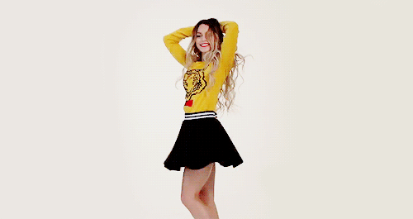
Skirt
empire
Интерактивная викторина в галерее империи юбок
для учащихся 7- 11 классов
Автор:
Ольга Михайловна Степанова, учитель английского языка
МБОУ «Цивильская СОШ №1
имени Героя Советского СоюзаМ.В. Силантьева»
города Цивильск Чувашской Республики
2019

Slide 2
A skirt is a tube- or cone-shaped garment that hangs from the _________ or hips and covers all or part of the legs.
waist
neck
waist

Slide 3
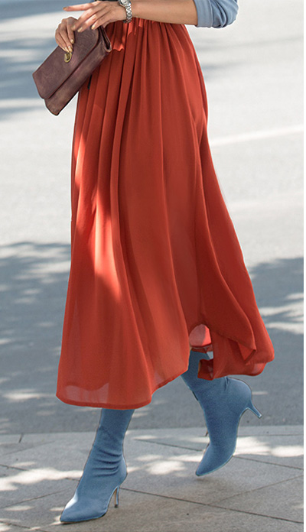
Different skirts have been ________ in many different cultures at different times.
worn
worn
wear

Slide 4
There are skirts that are ____________ for women, for men, or for both.
clothing
clothing
jewelry

Slide 5
are
Modern skirts ________ usually made of light to mid-weight fabrics, such as denim, jersey, worsted, or poplin.
are
is

Slide 6
In the western world, skirts are more commonly worn by women; with some exceptions such as the izaar which is worn by Muslim cultures and the kilt which is a traditional men’s garment in ____________ and Ireland.
Scotland
Scotland
Wales

Slide 7
Skirts are worn at semi-formal occasions, and sometimes at formal_________ , although a dress is more common.
events
lessons
events

Slide 8
It was in his 1954 Autumn Winter collection did the French designer Christian Dior introduce the classic modern __________ skirt.
pencil
pencil
pencilcase

Slide 9
The pencil skirt quickly became very popular, especially for _________ wear.
office
office
beach

Slide 10
feels
The pencil skirt __________ different from looser skirts, and impacts the wearer's movements and posture.
falls
feels

Slide 11
An A-line skirt is a skirt that is fitted at the hips and waist and gradually flares out towards the hem, giving the impression of the _______ of a capital letter A.
shape
shape
size

Slide 12
couture
The term A-line was first used by the same French _________ designer Christian Dior who fathered the pencil skirt, as the label for his collection of spring 1955.
couture
cuisine

Slide 13
The hemline of skirts can vary from micro to floor-length and can vary according to cultural conceptions of modesty and aesthetics as well as the wearer’s personal ________ .
taste
taste
color

Slide 14
Skirt is a part of uniform for girls in many schools across the world, with length of skirt varying as per local _________ .
culture
language
culture

Slide 15
The rah-rah (or ra-ra) skirt is a short flounced layered skirt that originated in cheerleading and became a popular fashion trend _________ teenage girls in the early 1980s.
among
among
between

Slide 16
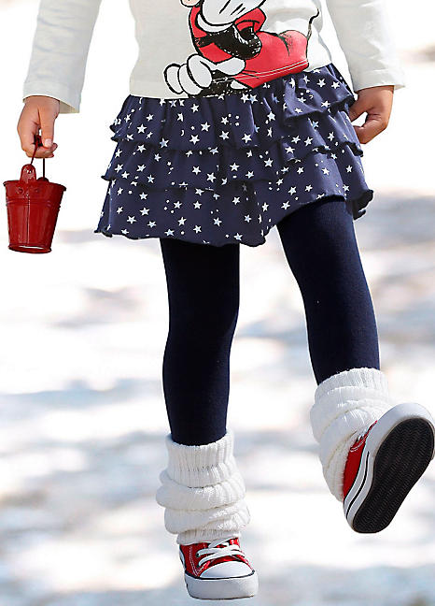
Rah-rah is a reduplication of an abbreviation for “_________", which is used as a synonym for "cheering".
hurrah
hurrah
hurry

Slide 17
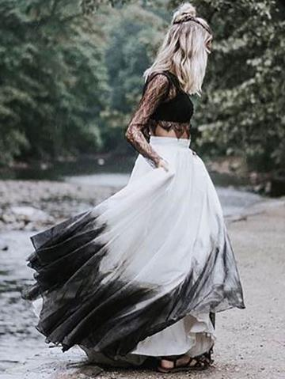
afraid
Don't be ________ to mix things up by pairing a military-style jacket with a velvet skirt, vintage with modern, off-the-rack with couture, formal with casual.
Nina Garcia
afraid
angry

Slide 18
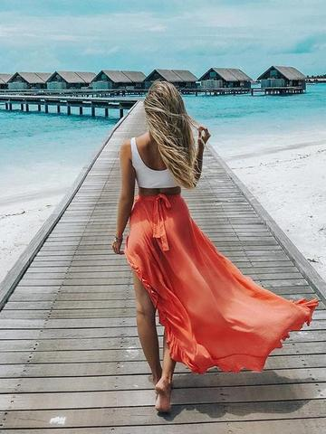
Do wear skirts! It's trendy!
It's trendier than the jeans!

Slide 19
Источник:
Skirt https://en.wikipedia.org/wiki/Skirt
Peter J Fashion Fact https://www.boldsky.com/fashion/facts/fashion-fact-the-birth-of-the-pencil-and-a-line-skirts-089081.html
Изображения взяты на сайте http://yandex.ru
Условия использования сайта https://yandex.ru/legal/fotki_termsofuse/

