Slide 1
Skirt
Style
history
Интерактивное чтение
для учащихся 7- 11 классов
Автор:
Ольга Михайловна Степанова, учитель английского языка
МБОУ «Цивильская СОШ №1
имени Героя Советского СоюзаМ.В. Силантьева»
города Цивильск Чувашской Республики
2019

Slide 2
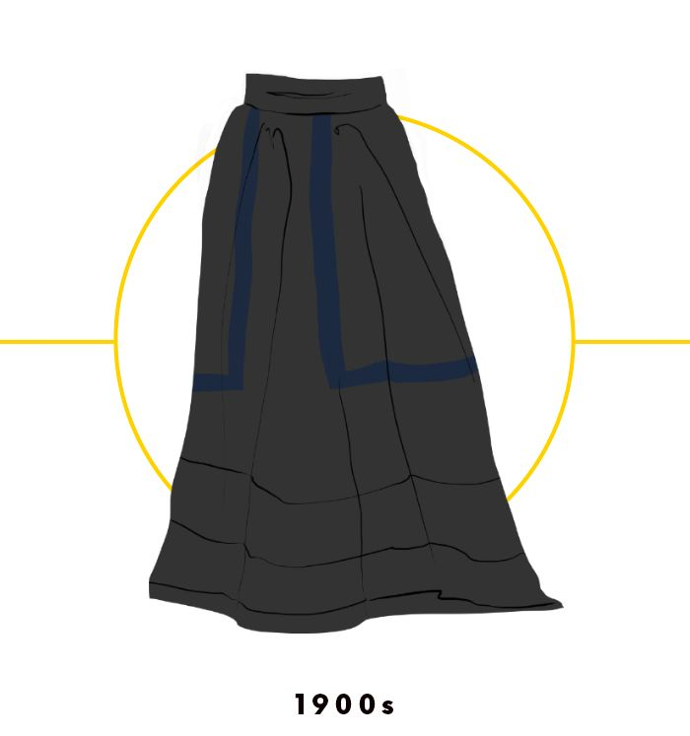
What hemlines did the early 1900s see?
Modest hemlines!
The early 1900s, much like the decades before it, saw modest hemlines that hit the floor. As opposed to donning full-length dresses that dominated the Victorian era, it became popular in the Edwardian era to wear skirts and blouses as separates.

Slide 3
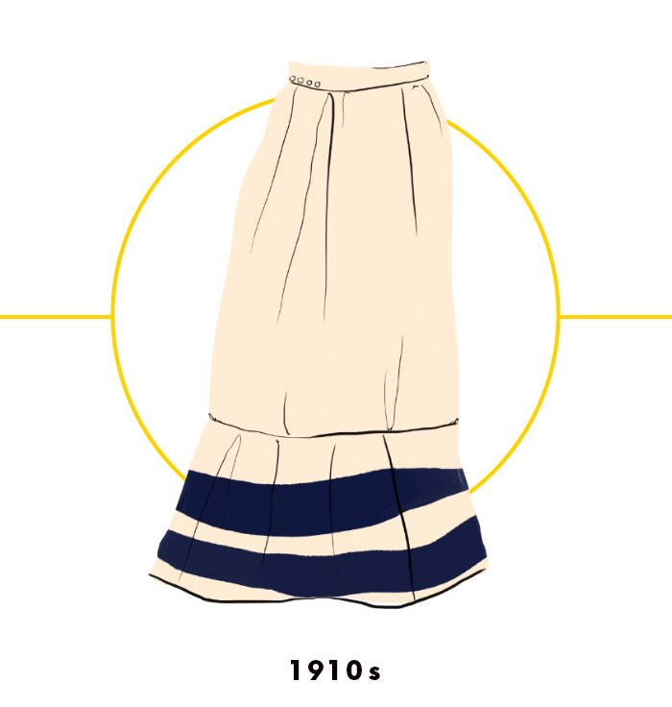
What silhouettes did adopt the 1910s?
Softer, more fluid silhouettes!
The 1910s bid adieu to some of the more somber styles before it, maintaining a floor-length hemline (that toward the latter half of the decade would be on the rise) but adopting softer, more fluid silhouettes.

Slide 4
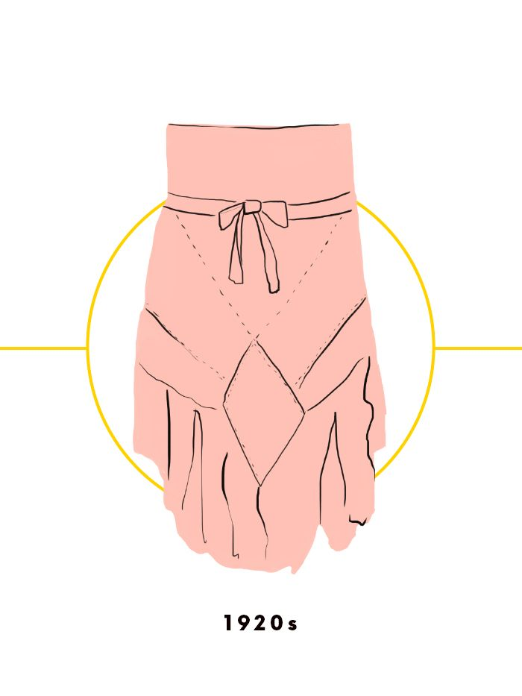
Did hemlines define the modern look for women of the Western or Eastern world?
For women of the Western world?
Hemlines began to rise during the Roaring Twenties with the emergence of the flapper, redefining the modern look for women of the Western world.

Slide 5
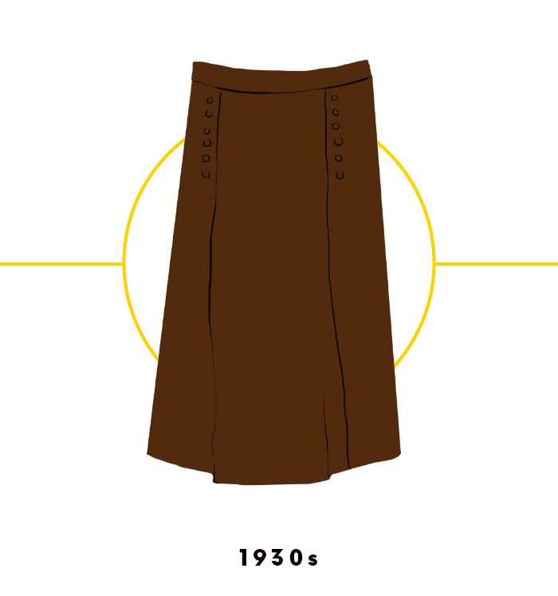
What kind of fabrics were used in fashion industry in 1930s?
Less expensive fabrics!
With the Great Depression came a return to more modest fashion sensibilities. Mid-calf to floor-lenth hemlines were revisited, as were less expensive fabrics during the difficult economic time.

Slide 6
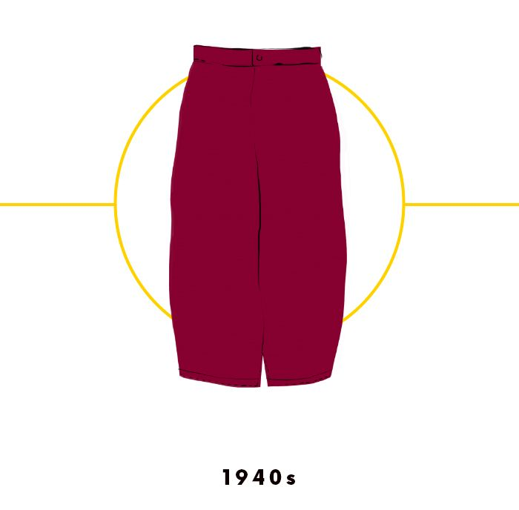
What kind of skirts were adopting in the 1940s?
Knee-length skirts or slightly A-line silhouette!
Utility fashion was the look du jour in the 1940s, with skirts adopting a straighter suiting or slightly A-line silhouette and hitting right at the knee.

Slide 7
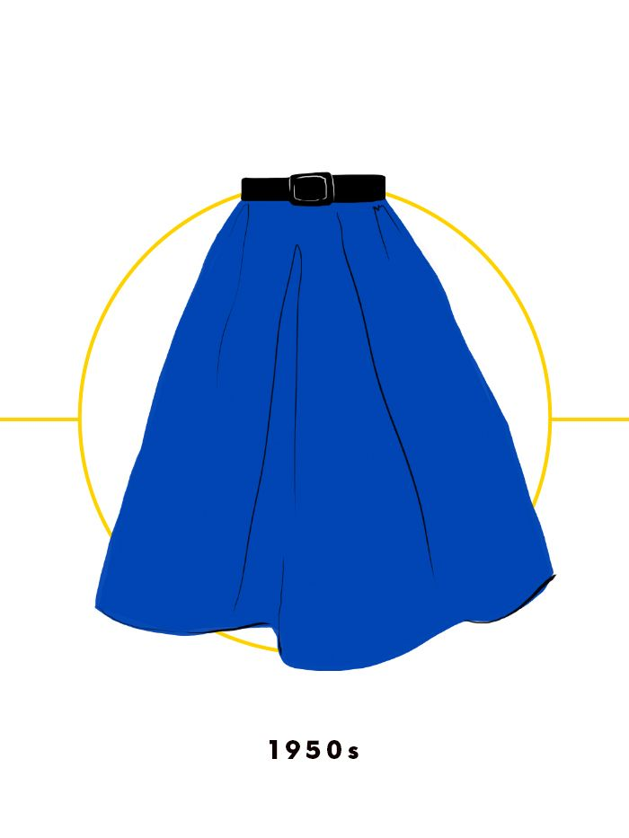
What kind of skirts came into fashion in the 1950s?
Billowy skirts with closely defined waistlines!
After World War II, fashion returned to its more indulgent roots with Dior's "New Look" that made a statement. By the 1950s, billowy skirts with closely defined waistlines were en vogue.

Slide 8
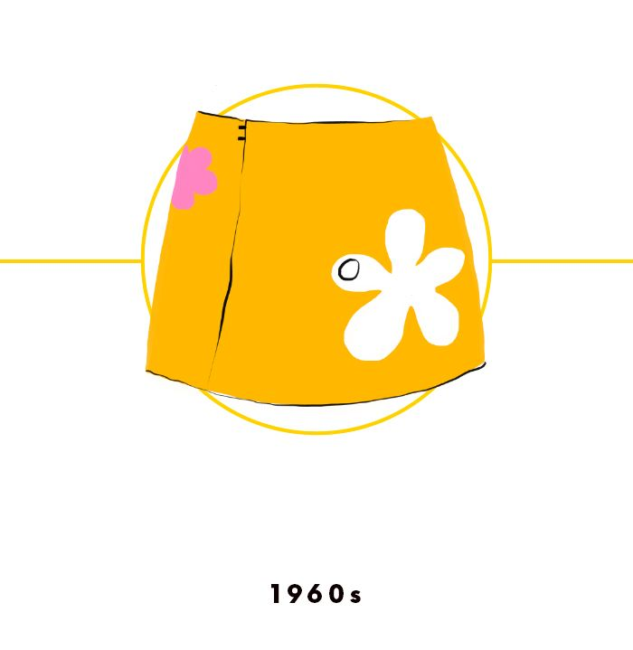
What skirts came into style in the 1900s?
Mod miniskirts!
The 1960s witnessed a dramatic shift in hemlines, with mod miniskirts and minidresses coming into style.

Slide 9
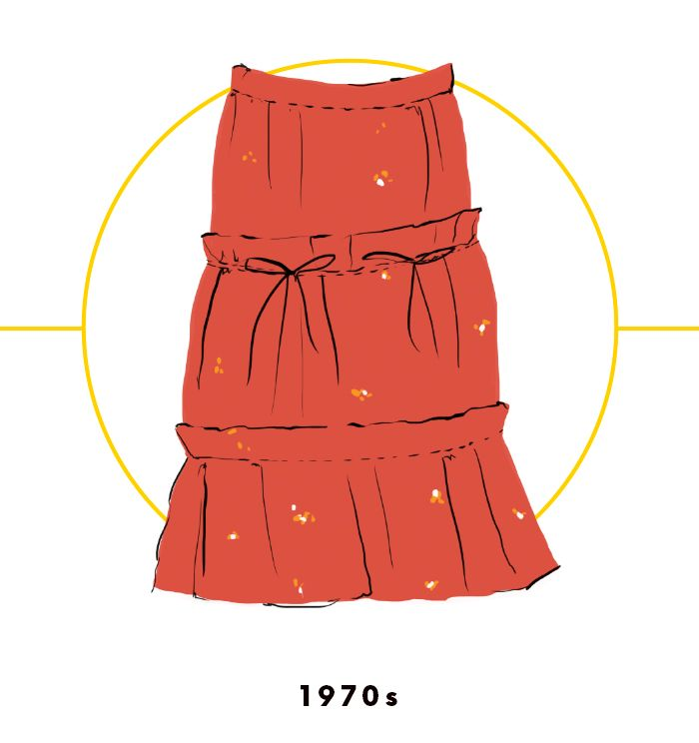
What skirts were popular in the 1970s?
Peasant skirts with longer hemlines!
The hippies of the 1970s popularized folk and bohemian styles, which called for peasant skirts with longer hemlines.

Slide 10
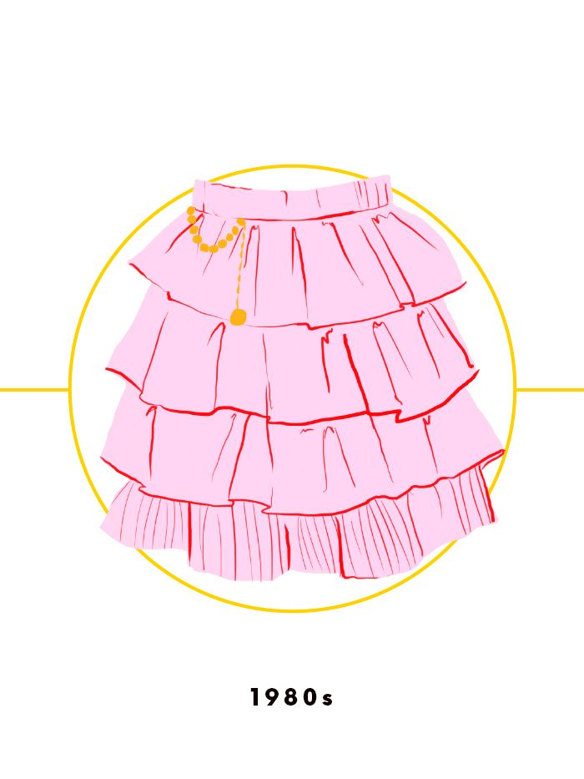
What details decorated the 1900s skirt style?
Ruffles, tulle, and bright colors!
The 1980s turned fashion on its head with bold new silhouettes, flashy materials, and an outrageous decadence unlike anything that preceded it. Ruffles, tulle, and bright colors were in favor, especially on skirts and dresses.

Slide 11
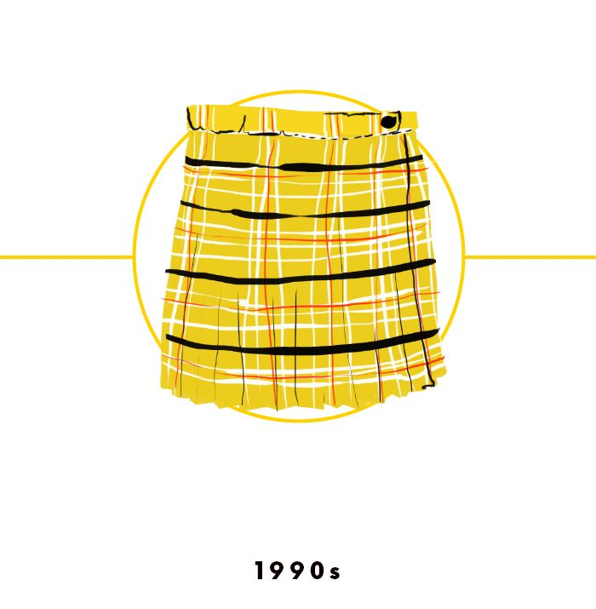
What hemlines were certainly favored in the 1990s?
Super-short hemlines!
Super-short hemlines were certainly favored in the 1990s, whether they were pleated plaid like the one Britney Spears wore in her "...Baby One More Time" video… the yellow plaid schoolgirl skirt has become something of a signifier of '90s sartorial sensibilities and an enduring pop culture icon of the era.

Slide 12
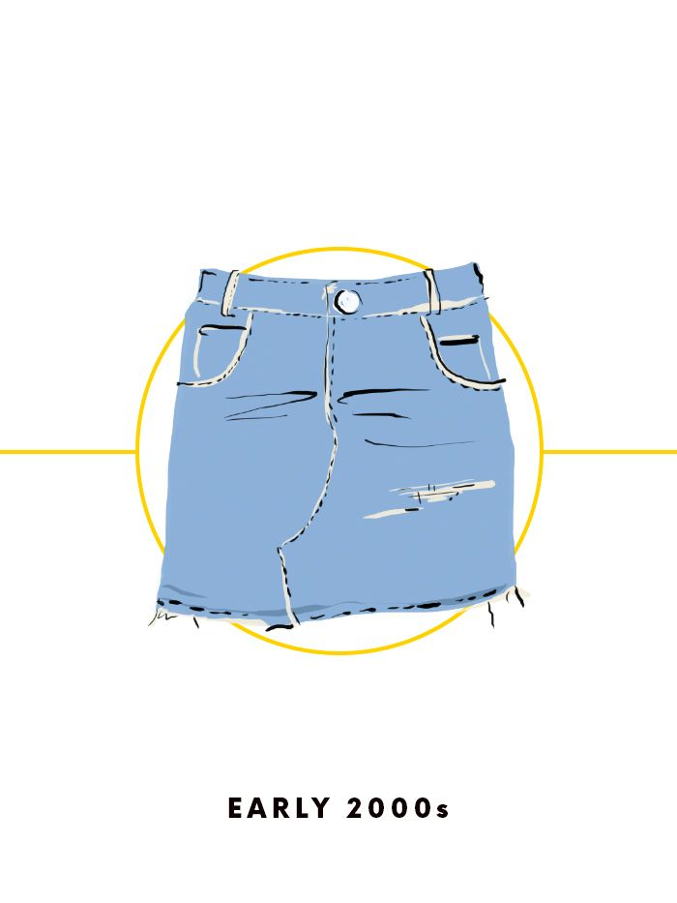
What skirts were the reigning style of the early 2000s.
The denim miniskirts!
The denim miniskirt was the reigning style of the early 2000s.

Slide 13
Skirts are especially welcomed
in summer!
Enjoy
your skirts!

Slide 14
Источник:
An Abridged History of the Skirt https://www.whowhatwear.co.uk/history-of-the-skirt
Изображения взяты на сайте http://yandex.ru
Условия использования сайта https://yandex.ru/legal/fotki_termsofuse/

