Slide 1
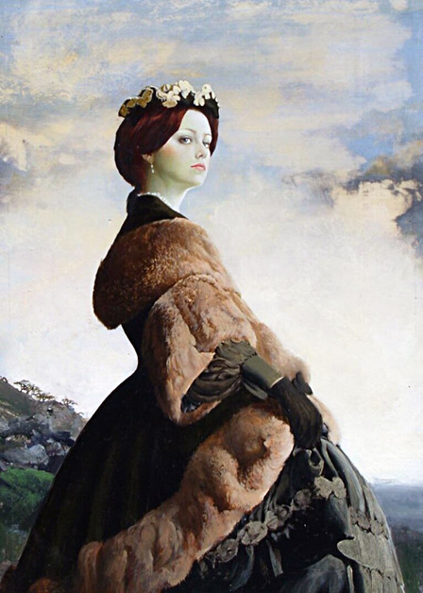
Walter Wyles and his ladies
Art Gallery
for the
8th 11th Grades
Автор:
Ольга Михайловна Степанова, учитель английского языка
МБОУ «Цивильская СОШ №1
имени Героя Советского СоюзаМ.В. Силантьева»
города Цивильск Чувашской Республики
2019

Slide 2
Portrait painting is a genre in painting, where the intent is to depict a human subject.
The term 'portrait painting' can also describe the actual painted portrait.
Portraitists may create their work by commission, for public and private persons, or they may be inspired by admiration or affection for the subject.
Portraits are often important state and family records, as well as remembrances.

Slide 3
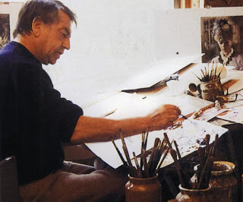
Welcome to the portrait gallery by Walter Wyles!
Walter Wyles (1925-2017), whose illustrations graced women's magazines from the fifties to the seventies when they were selling up to three and a half million copies every week, was the first British illustrator to be commissioned to draw romantic illustrations
by an American magazine .

Slide 4
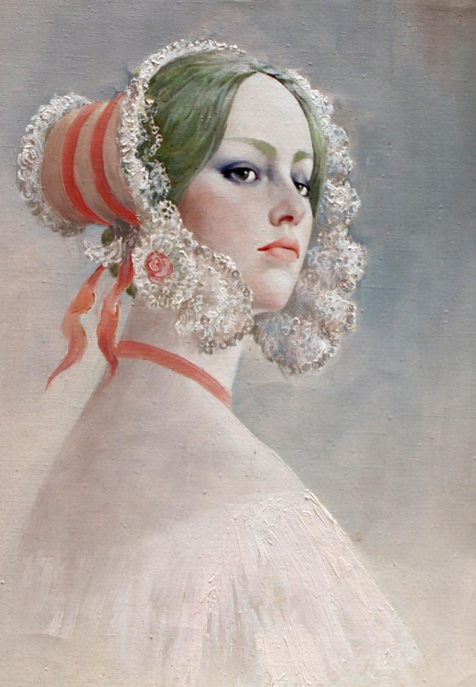
Every portrait that is painted with feeling is a portrait of the artist, not of the sitter.
Oscar Wilde

Slide 5
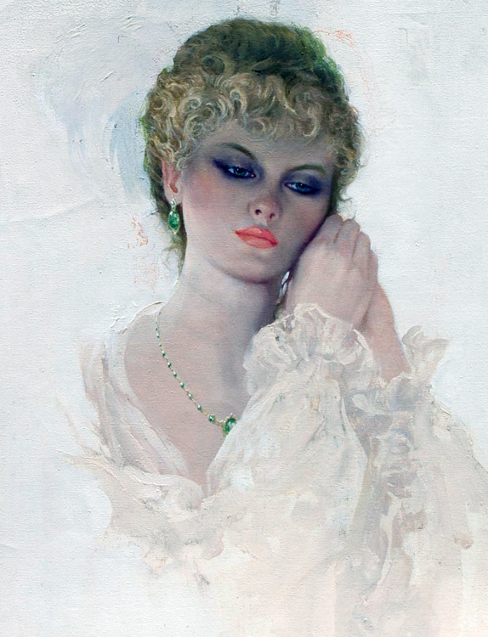
In art, there is no need for color; I see only light and shade. Give me a crayon, and I will paint your portrait. Francisco Goya

Slide 6
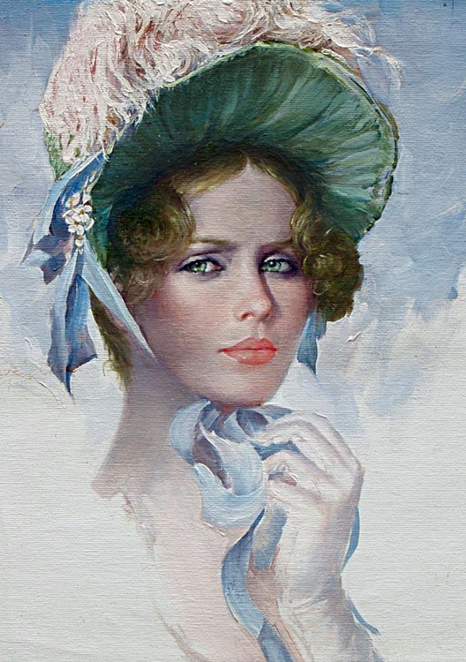
Get yourself a mirror and paint your own portrait, over and over. It's a great chance to experiment, you'll discover things about yourself, and you don't have to pay the model!
Susan Avishai

Slide 7
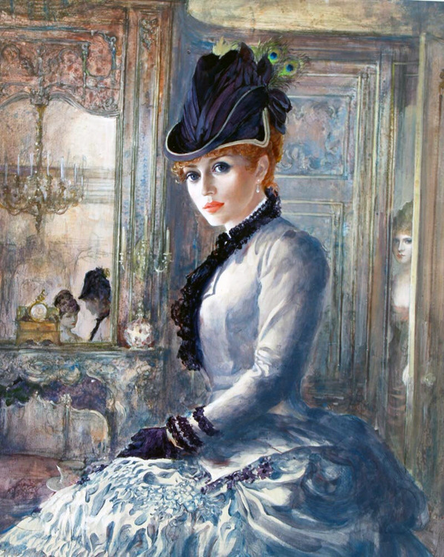
Nothing in a portrait is a matter of indifference. Gesture, grimace, clothing, decor even – all must combine to realize a character. Charles Baudelaire

Slide 8
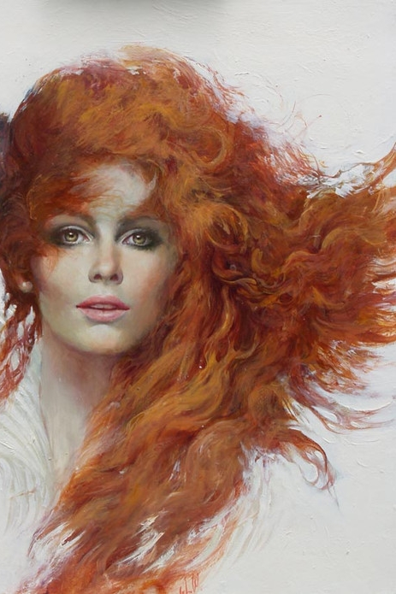
The general purpose of the portrait is to create some kind of monument to the sitter and transmit some kind of sympathy or understanding. Paul Brandford

Slide 9
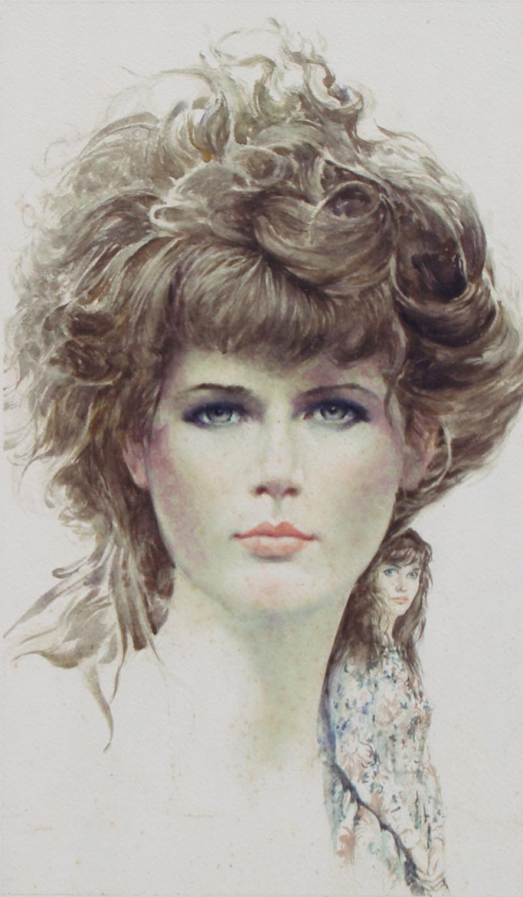
A good portrait ought to tell something of the subject's past and suggest something of his future.
Bill Brandt

Slide 10
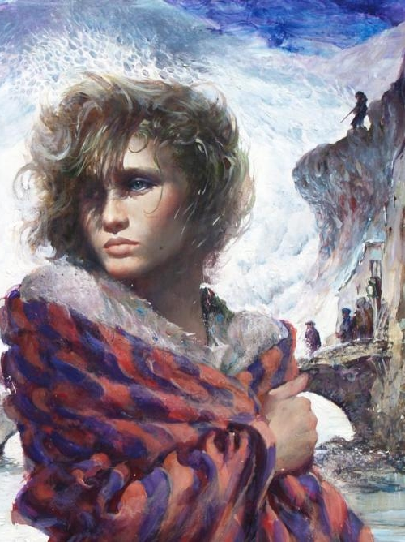
Clothes should not be allowed to take over the portrait. Simone Bingemer

Slide 11
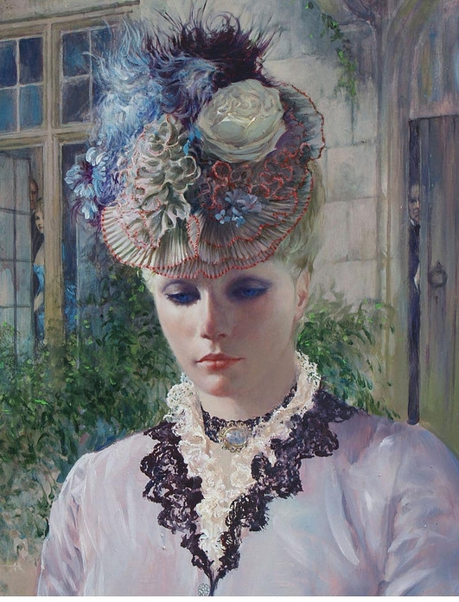
I never paint a portrait from a photograph, because a photograph doesn't give enough information about what the person feels. Francesco Clemente

Slide 12
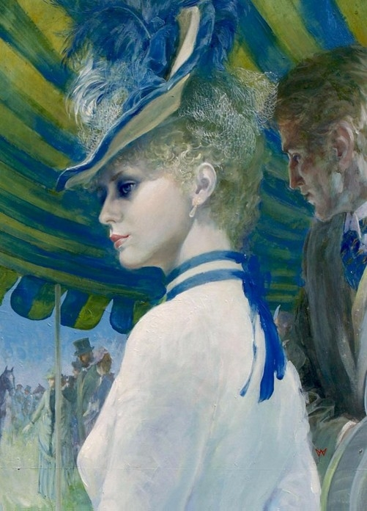
I have painted many portraits of people and I have painted many portraits of trees. Trees are more tranquil to work with, never demanding, never complaining their portrait doesn't look right.
Cosbie

Slide 13
The End
Thank You!

Slide 14
Источник:
Quotes about Portraiture http://www.art-quotes.com/getquotes.php?catid=234
Walter Wyles https://bearalley.blogspot.com/2017/06/walter-wyles-1925-2017.html
Изображения взяты на сайте http://yandex.ru
Условия использования сайта https://yandex.ru/legal/fotki_termsofuse/

