Slide 1
Virtual postcard to women’s day

Slide 2
In Russia: March 8 or Women’s day
On March 8,
men give women flowers

Slide 3
Оn this day husbands and children
help with the meals
and washing up

Slide 4
Men
do all the domestic work around the house and in the kitchen.

Slide 5
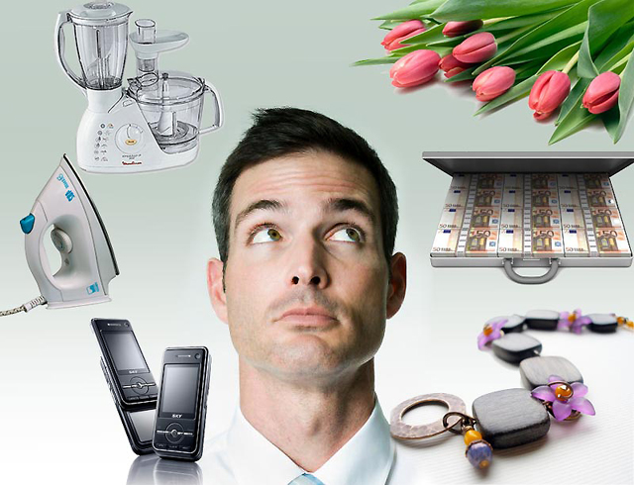
The men…
buy presents for women

Slide 6
Speak English, please: “men and children…..”

Slide 7
Mother’s day in England
Mother’s day is usually in March. People visit their mothers and give them flowers and small presents. If they can not visit their mothers they
send
a “Mother’s Day card”

Slide 8
Congratulations and wishes
Best wishes for Women’s Day!
Congratulations on Women’s Day!
My dear, dear Mommy,
I love you so much.
I want you to be happy
On the 8th of March.
I wish joys, happiness, health, love!
I wish compliments, smiles, presents!

Slide 9
We can send a musical virtual postcard for teachers and mothers
Help us playcast.ru
Редактор плэйкастов
http://www.playcast.ru/?module=playcast_editor
Обучающее видео
http://www.youtube.com/watch?v=Ef3raDV5HZU

