Slide 1
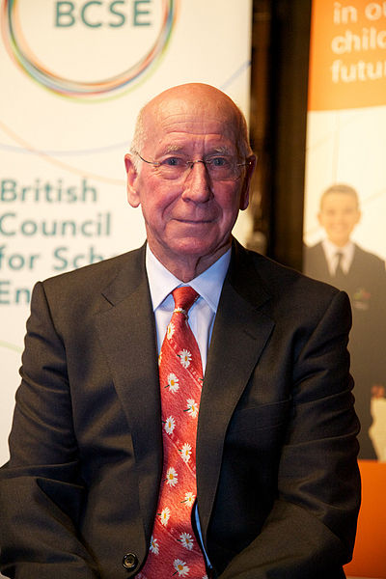
Famous people
Sir Robert "Bobby" Charlton

Slide 2
Background
Sir Robert "Bobby" Charlton (born 11 October 1937 in Ashington, Northumberland) is an English former professional football player, widely regarded as one of the greatest players of all time. Charlton was related to several professional footballers on his mother's side of the family: his uncles were Jack Milburn (Leeds United and Bradford City), George Milburn (Leeds United and Chesterfield), Jim Milburn (Leeds United and Bradford City) and Stan Milburn (Chesterfield, Leicester City and Rochdale), and legendary Newcastle United and England footballer Jackie Milburn was his mother's cousin. However, Charlton credits much of the early development of his career to his grandfather Tanner and his mother Cissie. His elder brother, Jack, initially went to work applying to the Police Service before also becoming a professional footballer with Leeds United.
On 9 February 1953, Bedlington Grammar School pupil Charlton was spotted playing for East Northumberland schools by Manchester United chief scout Joe Armstrong. Charlton went on to play for England schoolboys, and despite offers that followed from several other clubs, the 15-year-old signed with United on 1 January 1953, along with Wilf McGuinness, also aged 15. Initially his mother was reluctant to let him commit to an insecure football career, so he began to work as an electrical engineer; however he went on to turn professional in October 1954.

Slide 3
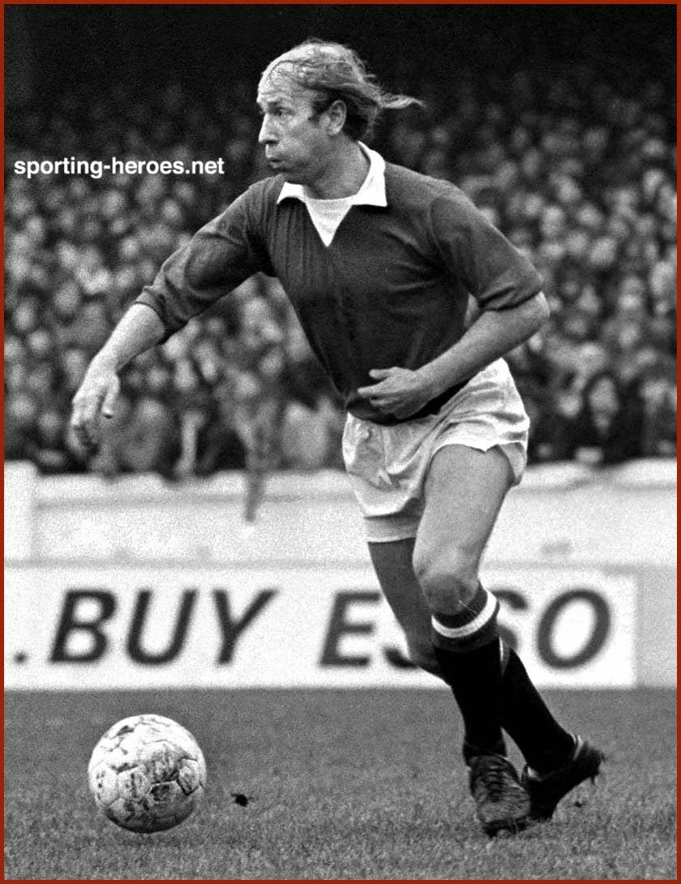
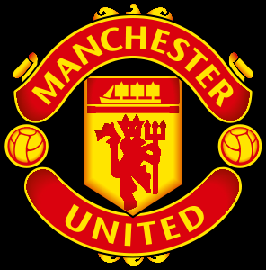
Early career
Charlton played 14 times for United in that first season, scoring twice on his debut and managing a total of 12 goals in all competitions, and including a hat-trick in an away win over Charlton Athletic in the February. United won the League championship but were denied the 20th century's first "double" when they controversially lost the 1957 FA Cup final to Aston Villa. Charlton, still only 19, was selected for the game.

Slide 4
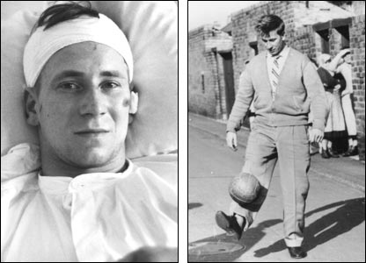
The Munich disaster
The plane, which flew with "Manchester United“ on a board made ​​a stop in Munich to refuel and then taxied to the runway. However, before takeoff suddenly one of the engines denied . After repairing the plane took off again, but stayed in the air only 4 seconds and fell to the ground. 28 passengers died in the accident , among them - 8 players of "Manchester“.
Fastened seat with Bobby Charlton has been pushed away on 50 meters from the wreckage. By some miracle, Bobby avoid damage. Coach Busby was seriously injured, he had to endure several difficult operations. All the surviving players experienced serious traumas. For a while they all were afraid to even think about flying on an airplane, although their life was made up of continuous traveling. Matt Busby finally recovered and decided to drink a lot of alcohol before next flying.

Slide 5
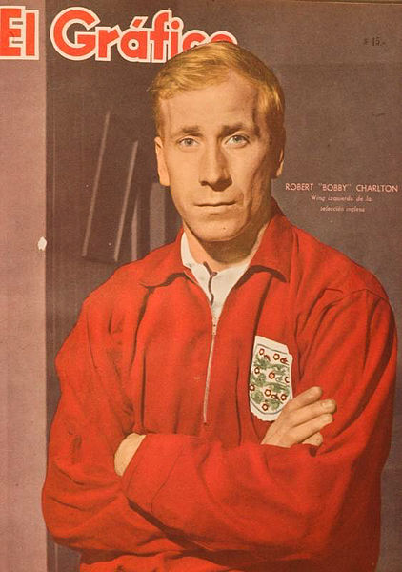
United and England
At the same time, Charlton's emergence as the country's leading young football talent was completed when he was called up to join the England squad for a British Home Championship game against Scotland at Hampden Park. It would be the start of a long, prolific, record-breaking and globally respected career for his country.
Charlton was handed his debut as England romped home 4–0, with the new player gaining even more admirers after scoring a magnificent thumping volley dispatched with authority after a cross by the left winger Tom Finney. He scored both goals in his second game as England beat Portugal 2–1 in a friendly at Wembley; and overcame obvious nerves on a return to Belgrade to play his third match against Yugoslavia. England lost that game 5–0 and Charlton played poorly. He was selected for the squad which competed at the 1958 World Cup in Sweden, but didn't kick a ball.

Slide 6
World Cup winner
England drew the opening game of the tournament 0–0 with Uruguay, and Charlton scored the first goal in the 2–0 win over Mexico. This was followed by an identical scoreline against France, allowing England to qualify for the quarter finals.
England defeated Argentina 1–0 – the game was the only one in which Charlton received a caution – and faced Portugal in the semi finals. This turned out to be one of Charlton's most important games for England.
Charlton opened the scoring with a crisp side-footed finish after a run by Roger Hunt had forced the Portuguese goalkeeper out of his net; his second was a sweetly struck shot after a run and pull-back from Geoff Hurst. Charlton and Hunt were now England's joint-highest scorers in the tournament with three each, and a final against West Germany beckoned.
The final turned out to be one of Charlton's quieter days; he and a young Franz Beckenbauer effectively marked each other out of the game. England won 4–2 after extra time.

Slide 7
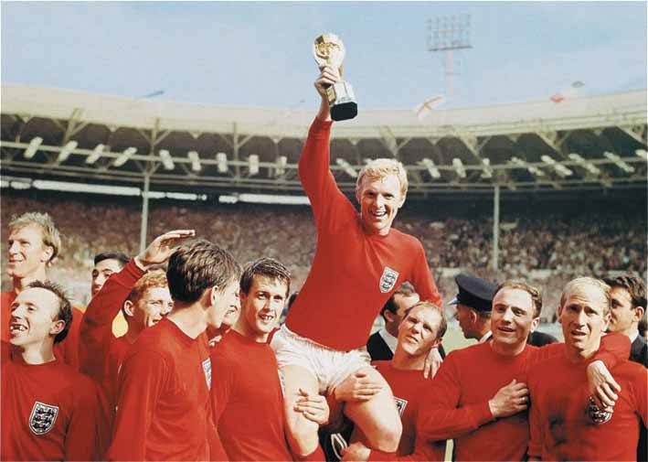

Slide 8
Honours
Club
Manchester United Football League First Division (3): 1956–57, 1964–65, 1966–67
FA Cup (1): 1962–63
Charity Shield (4): 1956, 1957, 1965, 1967
FA Youth Cup (3): 1953–54, 1954–55, 1955–56
European Cup (1): 1967–68
National
FIFA World Cup (1): 1966
British Home Championship (10): 1958, 1959, 1960, 1961, 1964, 1965, 1966, 1968, 1969, 1970
UEFA Euro 1968 (Bronze Medalist)
Individual
FIFA World Cup Golden Ball (1): 1966
FIFA World Cup All-Star Team (2): 1966, 1970
FIFA World Cup All-Time Team (1): 1994
FIFA 100: 2004
FWA Footballer of the Year (1): 1965-66
World Soccer's 100 Greatest Players of the 20th Century: 1999
England National Football Team All-Time Top Goal Scorer: 49 Goal (1st)
Manchester United All-Time Top Goal Scorer: 249 Goal (1st)
BBC Sports Personality of the Year Lifetime Achievement Award: 2008

Slide 9
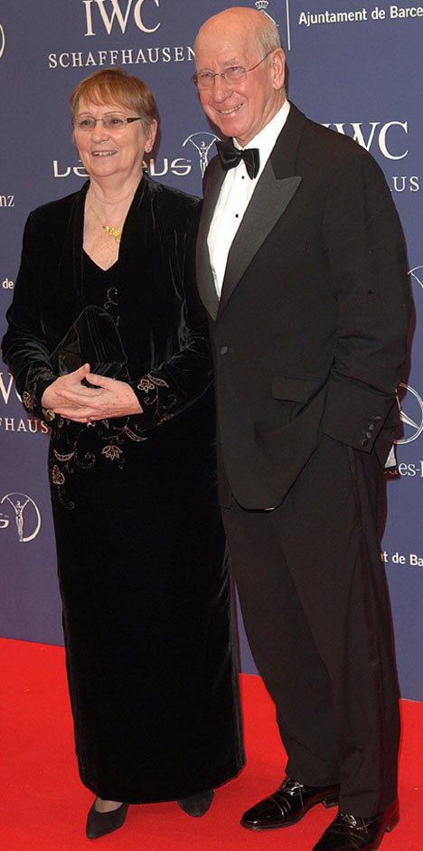
Personal life
He met his wife, Norma Ball, at an ice rink in Manchester in 1959 and they married in 1961. They have two daughters – Suzanne and Andrea. Suzanne was a weather forecaster for the BBC during the 1990s. They now have grandchildren, including Suzanne's son Robert, who is named in honour of his grandfather.
In 2007, while publishing his forthcoming autobiography, Charlton revealed that he has a long-running quarrel with his brother Jack.
It would appear that the two brothers are again on speaking terms, as Jack presented him with his BBC Sports Personality of the Year Lifetime Achievement Award on 14 December 2008.
Charlton began to lose his hair in the early 1960s and for a while refused to go bald gracefully, sporting a style of stranded, isolated hairs which would often flop around when he was running before he would tug them back over his head. This style is today still known as "the Bobby Charlton Comb-Over
On 6 February 2012 Sir Bobby Charlton was taken to hospital after falling ill, and subsequently had a gallstone removed. This prevented him from collecting a Lifetime Achievement award at the Laureus World Sports Awards.

Slide 10
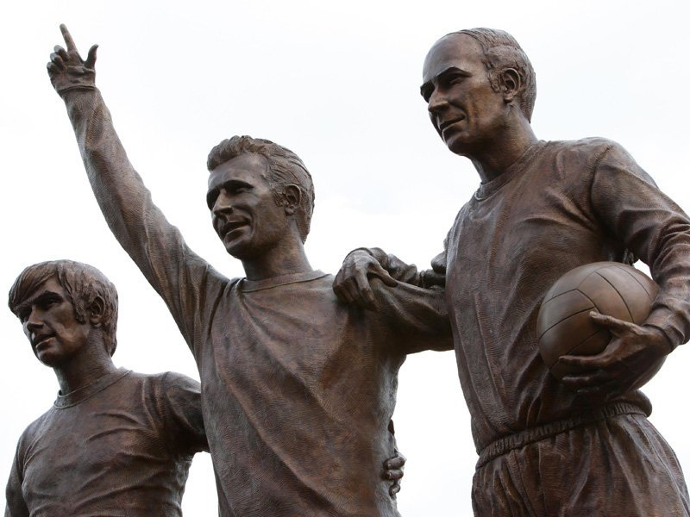
The End

