Slide 1
My hometown visitors’ guide
Sergach
Pupil: Tsatsin Egor, 8b

Slide 2
City history of Sergach
My hometown is Sergach. Sergach is situated in Russia. The city is located on the river Pyana, in 125 km to the southeast from Nizhni Novgorod.The population is 22,4 thousand inhabitants. Sergach was founded in 1172. In the vicinities of Sergach in the confluence of a small river Parathere is a place where Pjansky slaughter occurred in summer of 1377. In 1779 on Catherine’s II command the village became a district city, and in 1781 the city of Sergach had an arm with the image of a black bear, meaning that, «that sort of animals is enough in its woods».

Slide 3
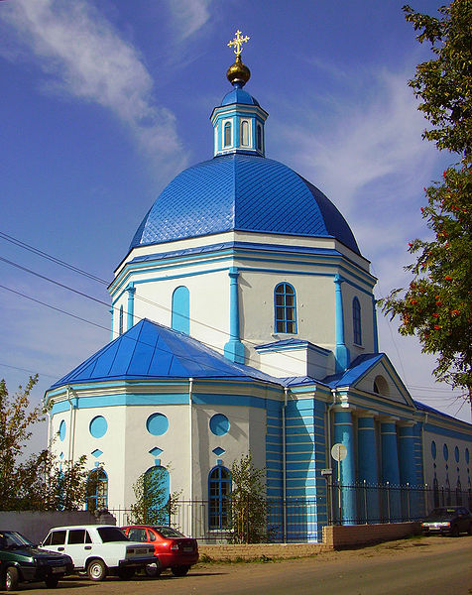
Cathedral of the Vladimir icon of Bozhiej of Mother
The looks of people are exited by the cathedral church of Vladimir Divine Mother ,the skill of builders, an ability to choose a place. It has been constructed one and a half centuries ago in the honour of the victory of Russia in Patriotic war of 1812, as a tribute of memory to victims sergachanam. The building of this church was begun in 1817 years.

Slide 4
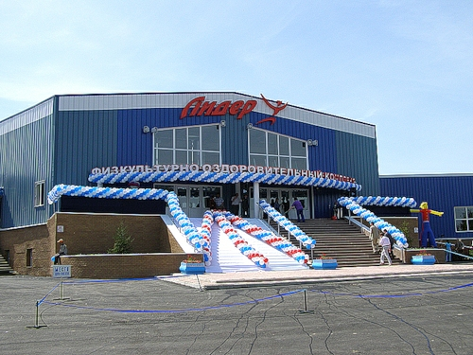
FOK

Slide 5
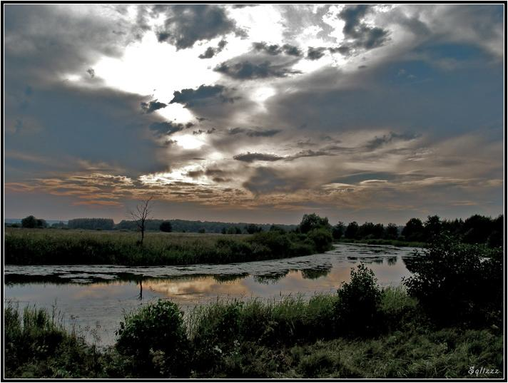
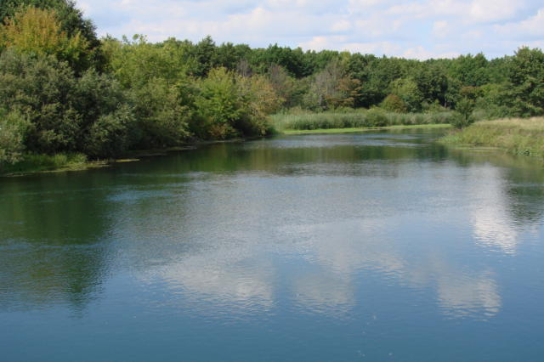
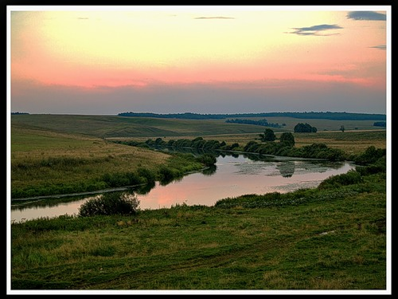
The river of Sergach

Slide 6
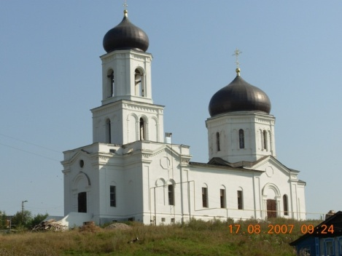
Ilinsky church

Slide 7
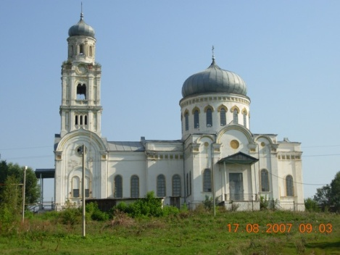
Michael Arhangela's church

Slide 8
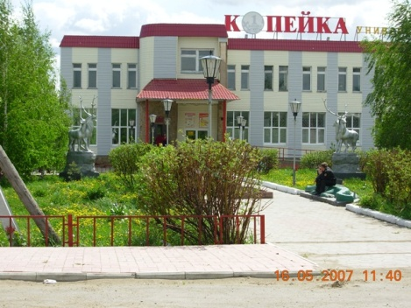

Slide 9
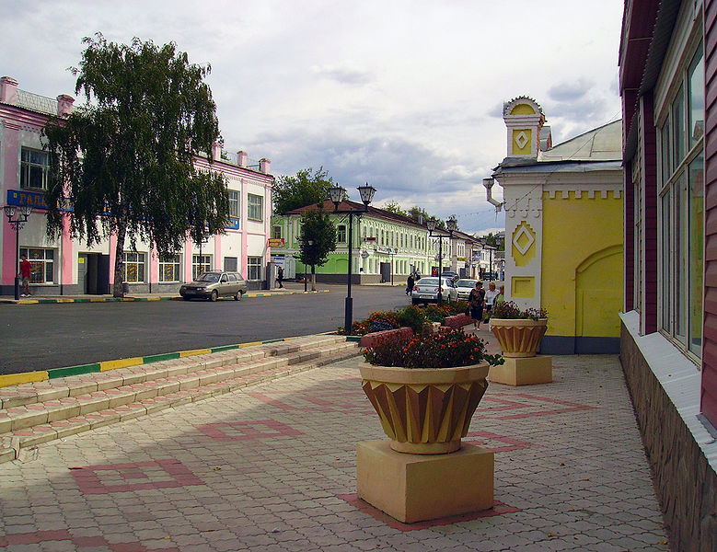
Welcome to Sergach!

Slide 10
Project
My hometown visitors` guide

